Slide 1
Welcome to Northern Ireland

Slide 2
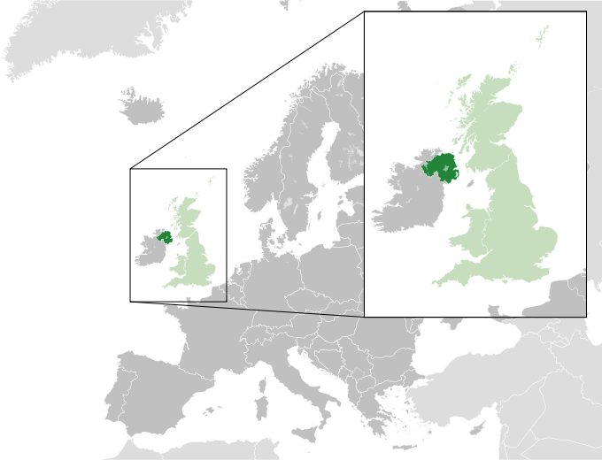
Northern Ireland is a part of the United Kingdom. Northern Ireland shares a border with the Republic of Ireland to the south and west. The area is 13,843km². The population is 1,810,900.

Slide 3
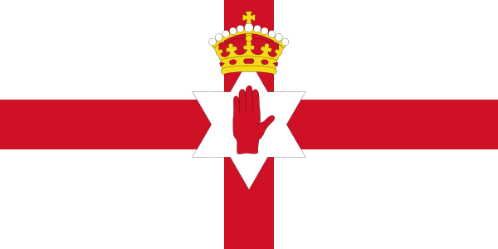
The flag of Northern Ireland

Slide 4
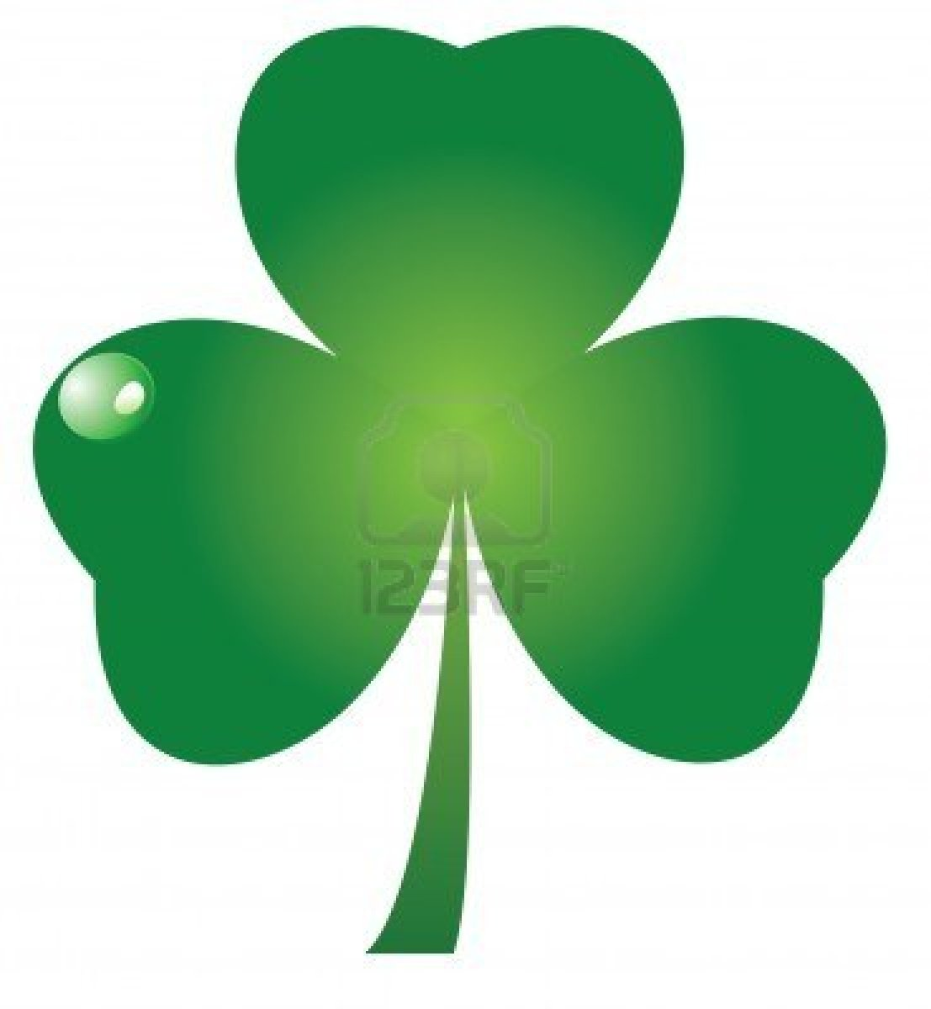
A shamrock is a symbol of Northern Ireland

Slide 5
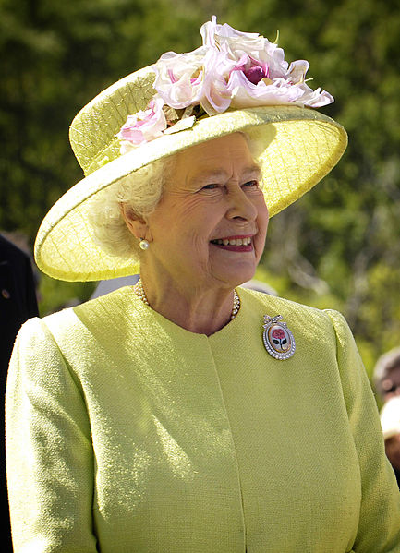
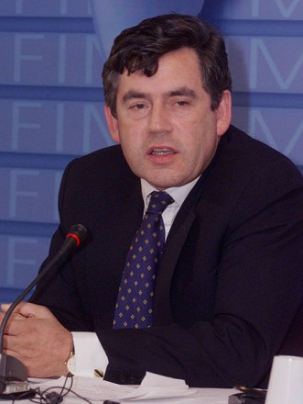
Since 1998, Northern Ireland has devolved government within the United Kingdom. The head of state is Elizabeth II. Prime Minister of Northern Ireland is Gordon Brown.

Slide 6
The capital of Northern Ireland is Belfast

Slide 7
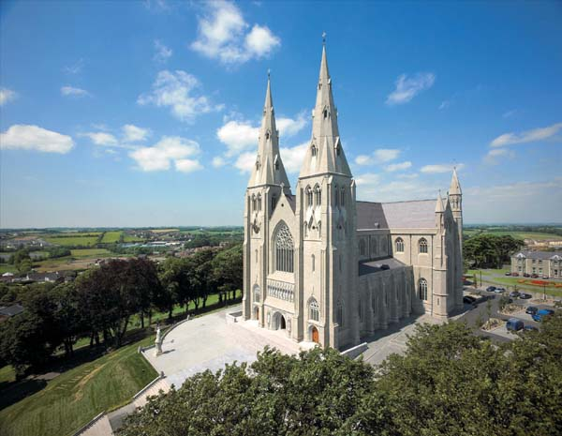
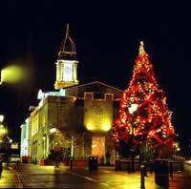
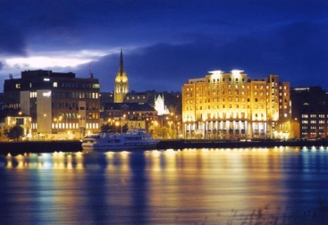
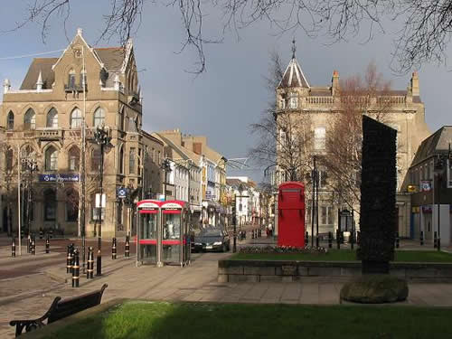
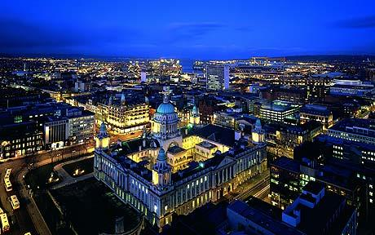
Armagh
Lisburn‎
Derry‎
The cities of Northern Ireland
Newry
Belfast

Slide 8
Places of interest in Northern Ireland

Slide 9
Belfast Castle

Slide 10
Giants Causeway

Slide 11
Tollymore Forest Park

Slide 12
Transport Museum

Slide 13
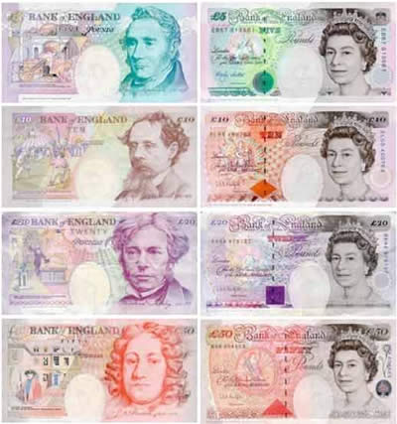
Northern Ireland's currency is the pound sterling.

Slide 14
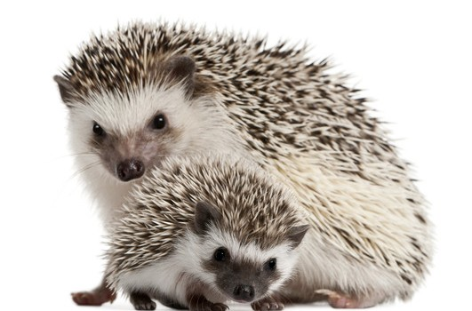
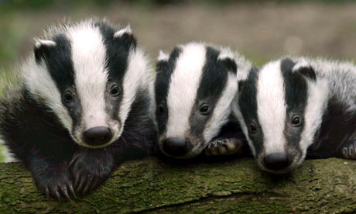
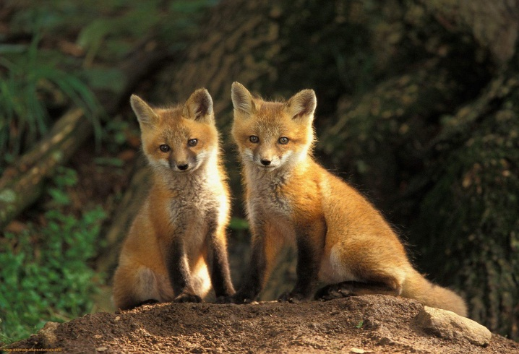
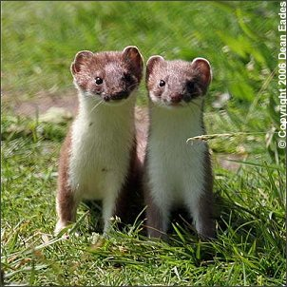
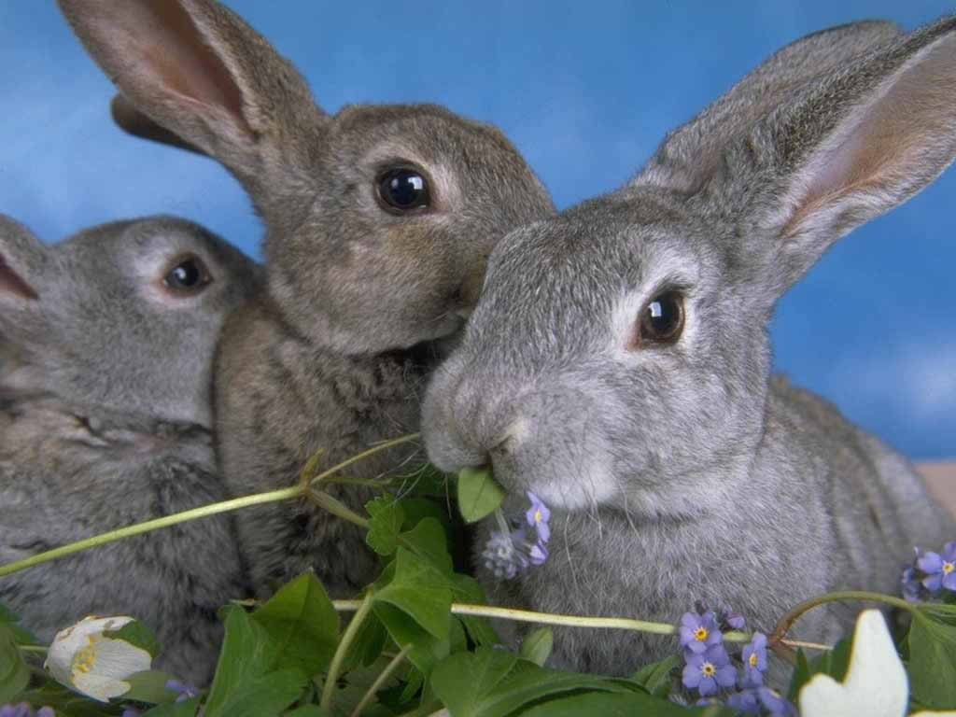
Badgers
Hedgehogs
Foxes
TYPICAL ANIMALS
Stoats
Rabbits

Slide 15
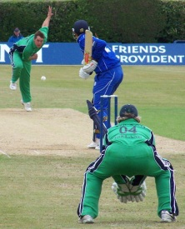
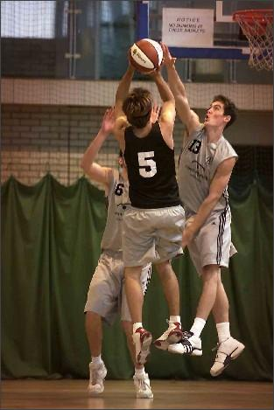
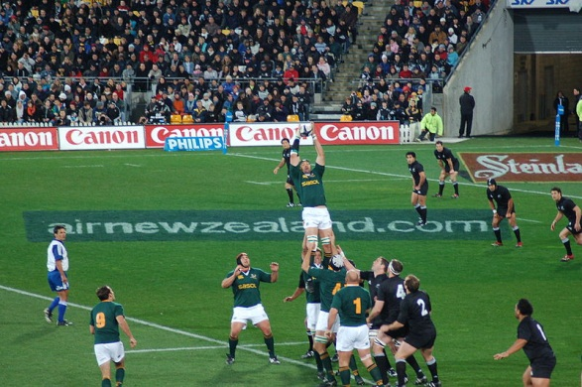
Sport in Northern Ireland
Cricket
Basketball
Rugby

Slide 16
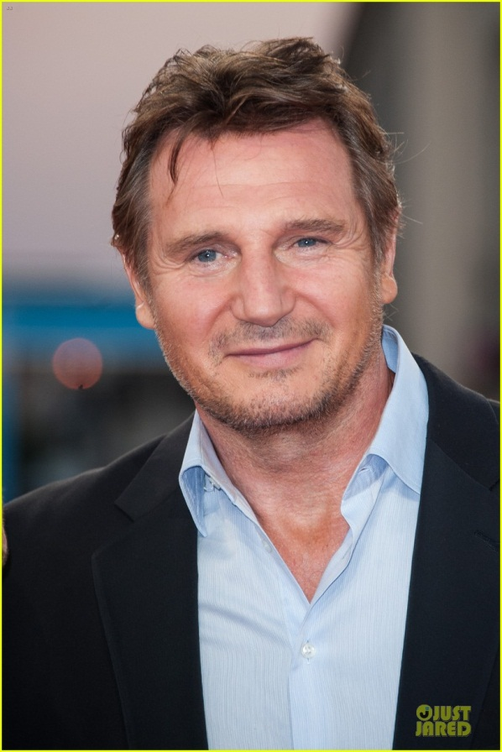
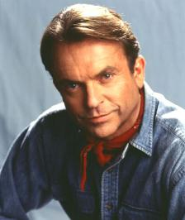
Famous People
Liam Neeson
Sam Neill

