Slide 1
Welcome to Scotland

Slide 2
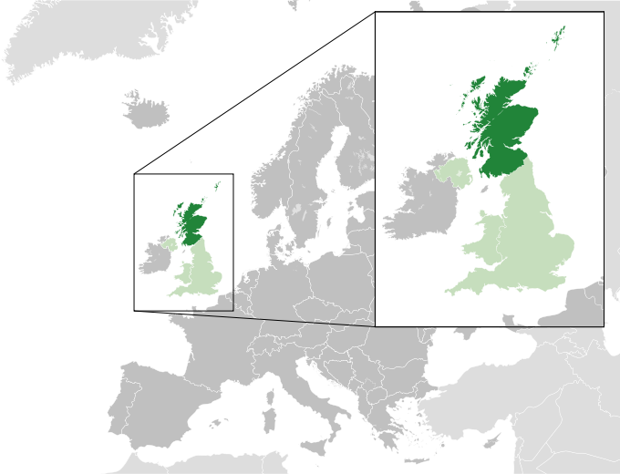

Slide 3
The flag of Scotland

Slide 4
A thistle is a symbol of Scotland.

Slide 5
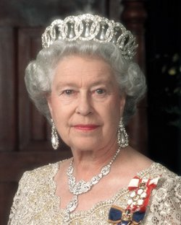
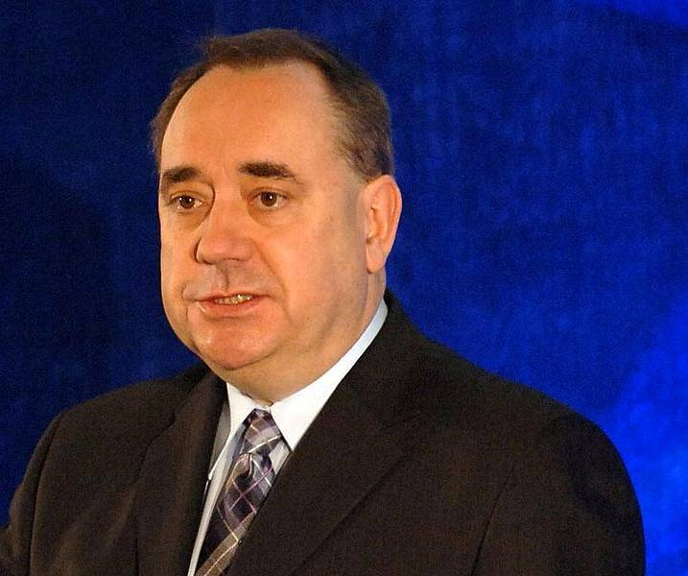
On 1 May 1707 the government of Scotland came to the signing of a political union with England to create the United Kingdom. The head of state is Elizabeth II. First Minister Alex Salmond .

Slide 6
The capital of Scotland is Edinburgh

Slide 7
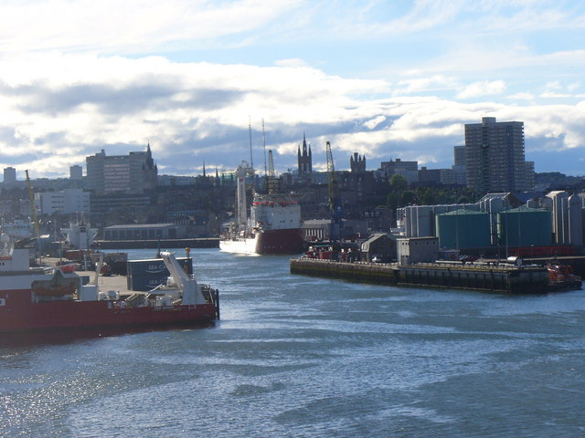
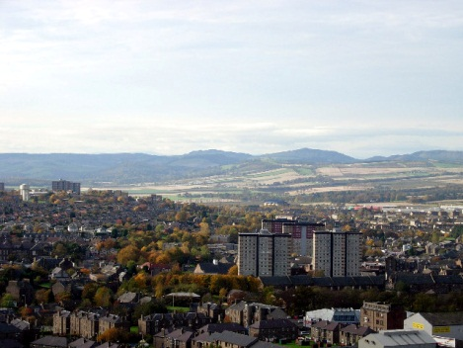
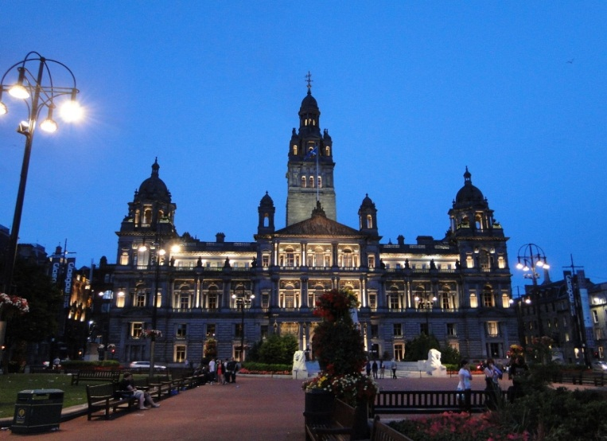
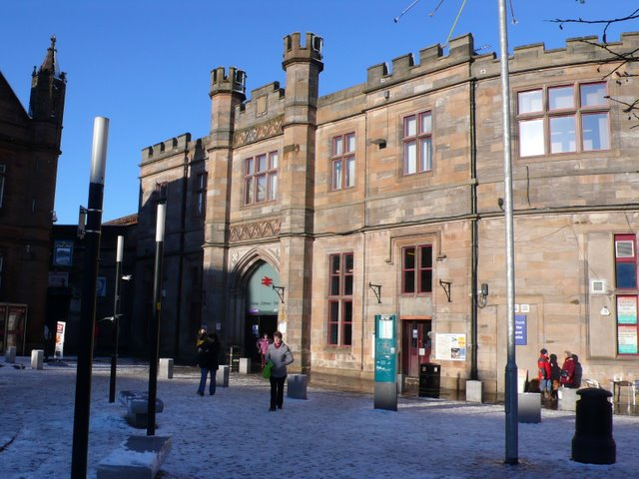
Aberdeen
Dundee
The cities of Scotland
Glasgow
Paisley

Slide 8
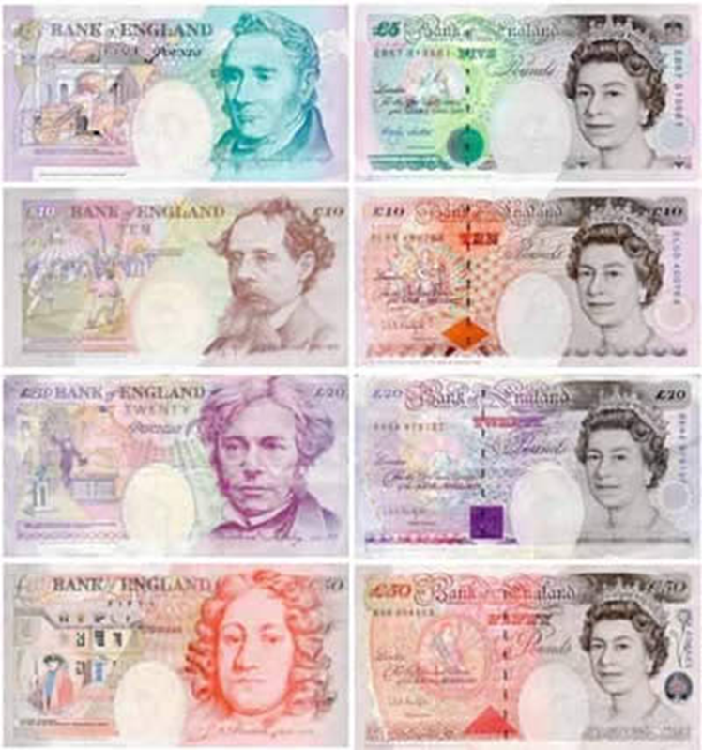
Scotland's currency is the pound sterling.

Slide 9
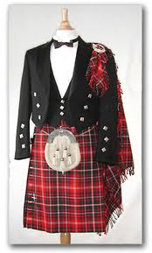
Kilts are the national clothes of Scotland.

Slide 10
Places of interest in Scotland

Slide 11
Edinburgh Castle

Slide 12
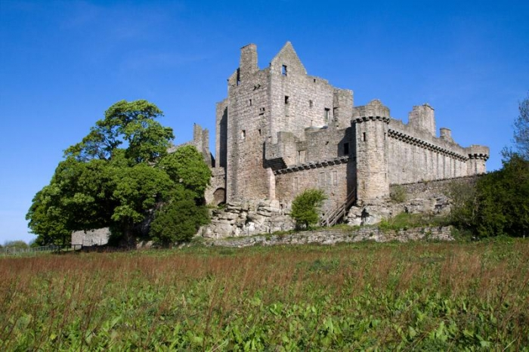
Craigmillar Castle

Slide 13
Loch Ness

Slide 14
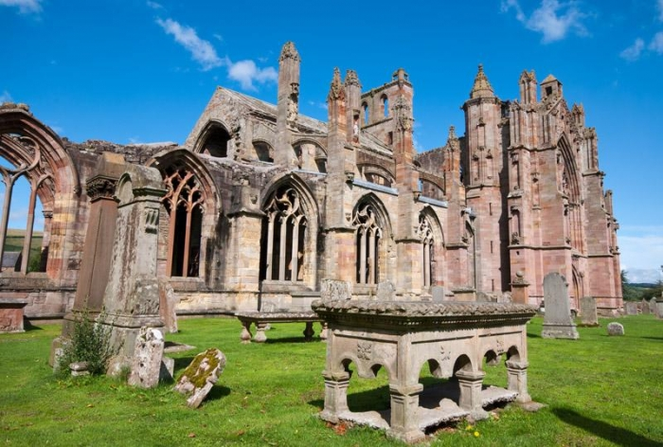
Melrose Abbey

Slide 15
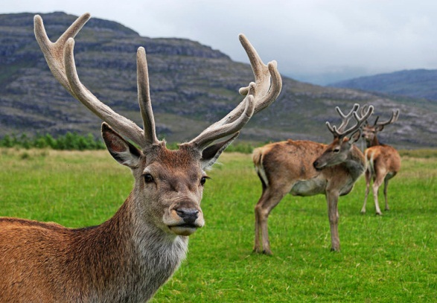
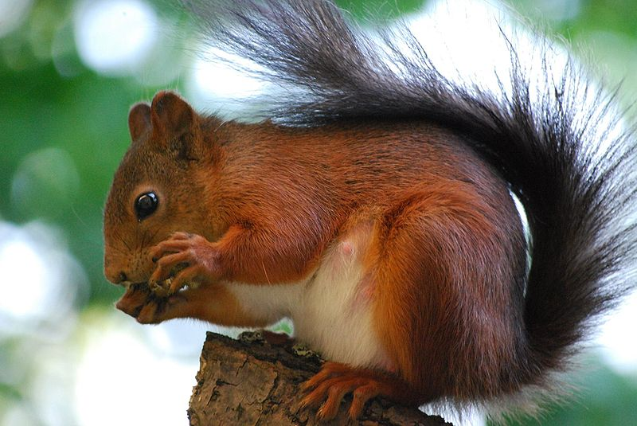
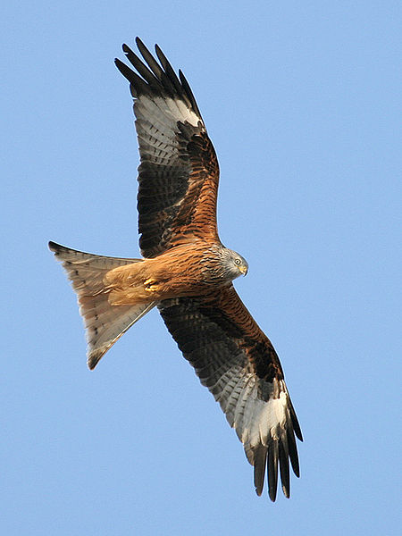
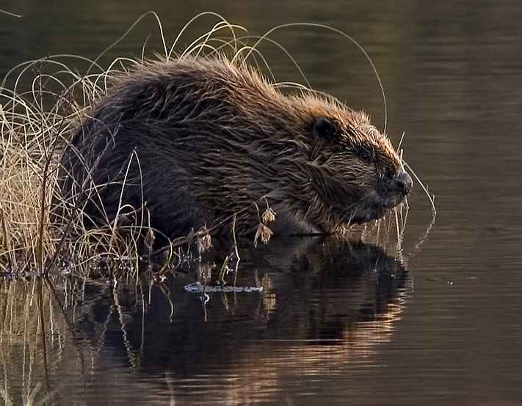
Red Deer
Red Squirrel
TYPICAL ANIMALS
The European Beaver
Red Kite

Slide 16
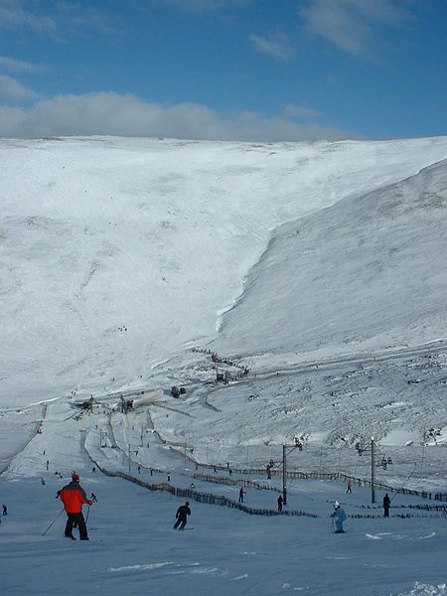
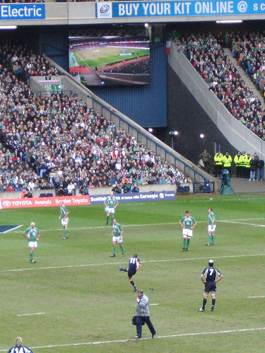
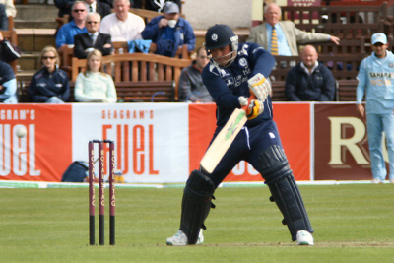
Sport in Scotland
Skiing
Rugby
Cricket

Slide 17
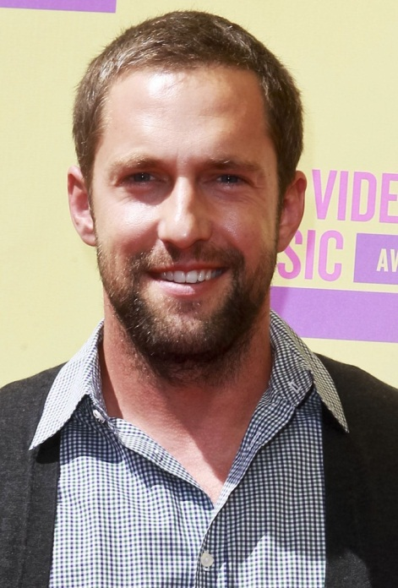
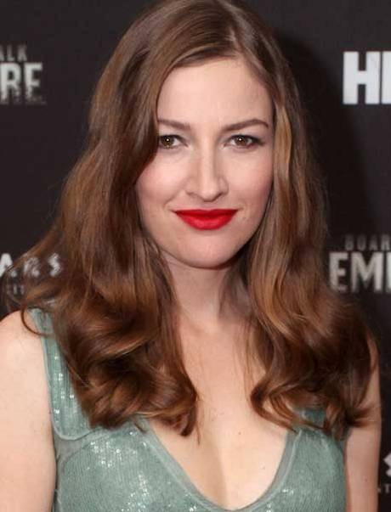
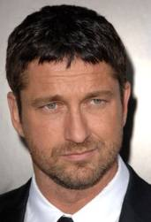
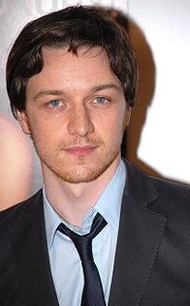
Famous People
Calvin Harris
Kelly MacDonald
Gerard Butler
James McAvoy

