Slide 1
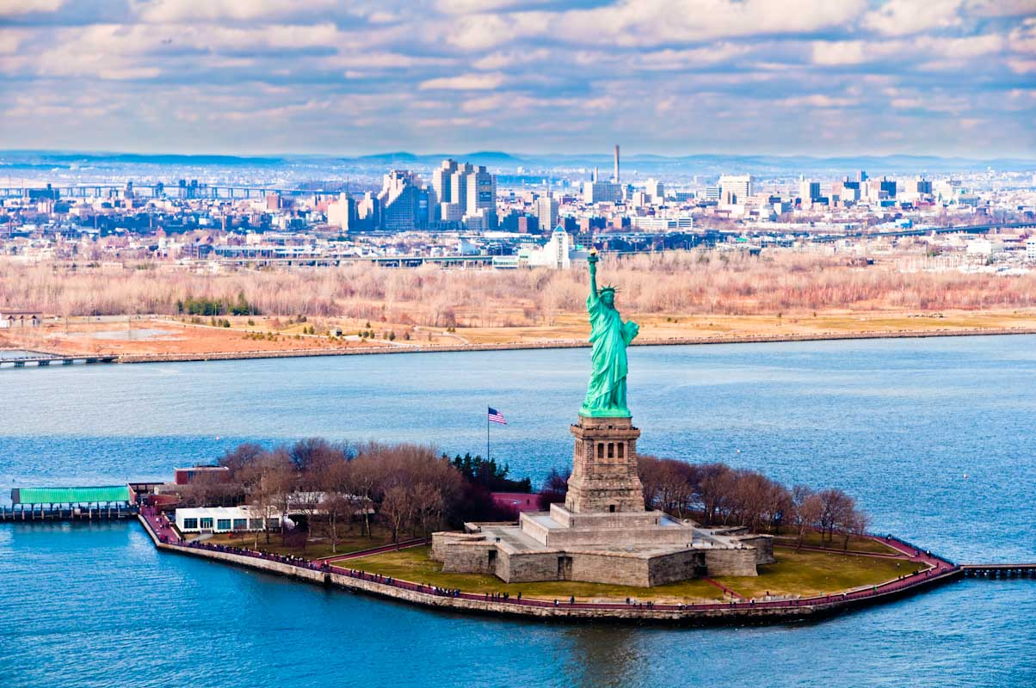
Welcome to the USA

Slide 2
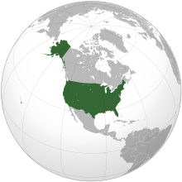
The United States of America lie in the middle of the North American continent. The area of the USA is over nine million square kilometres. It’s population is more than 260 million people. In the north the USA is bordered by Canada, and in the south it borders on Mexico.It is washed by the Atlantic Ocean in the East and by the Pacific Ocean in the West.

Slide 3
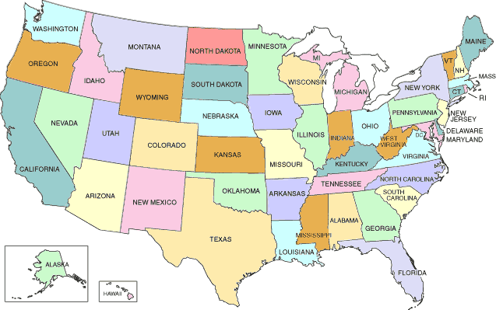
The country is composed of 50 states today. The country is rich in coal, oil, iron, and minerals. The United States economy is highly developed. The United States is one of the leading countries in the world economy. The people of the United States are a mixture of many different nationalities.

Slide 4
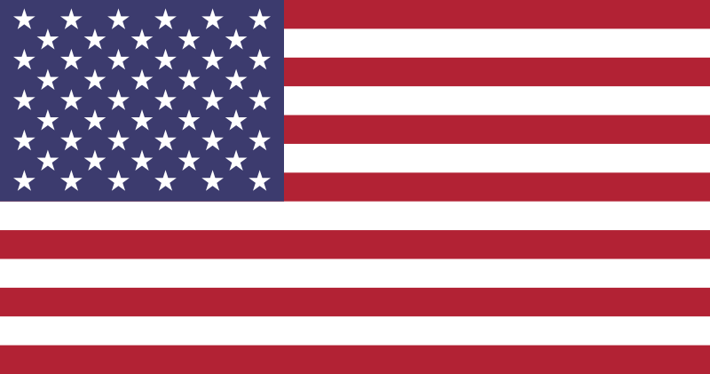
The flag of the USA
Red colour is for courage,
White is for purity,
And blue is for justice

Slide 5
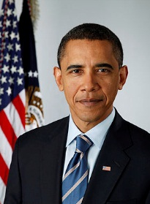
The president of the USA is Barack Obama.

Slide 6
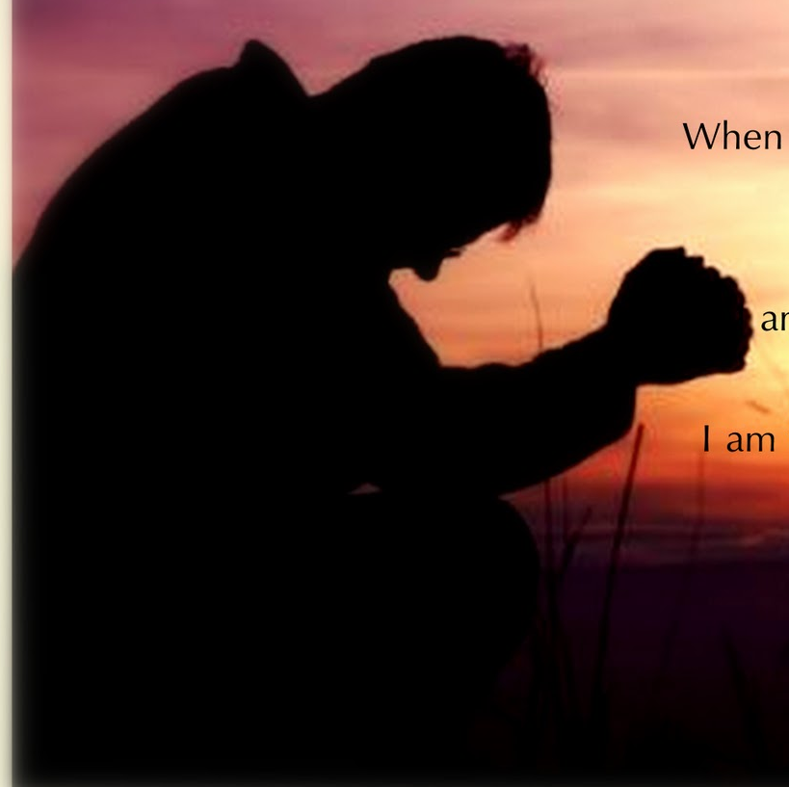
The national motto is ’’In God we trust ’’-expressing the country’s ideals.

Slide 7
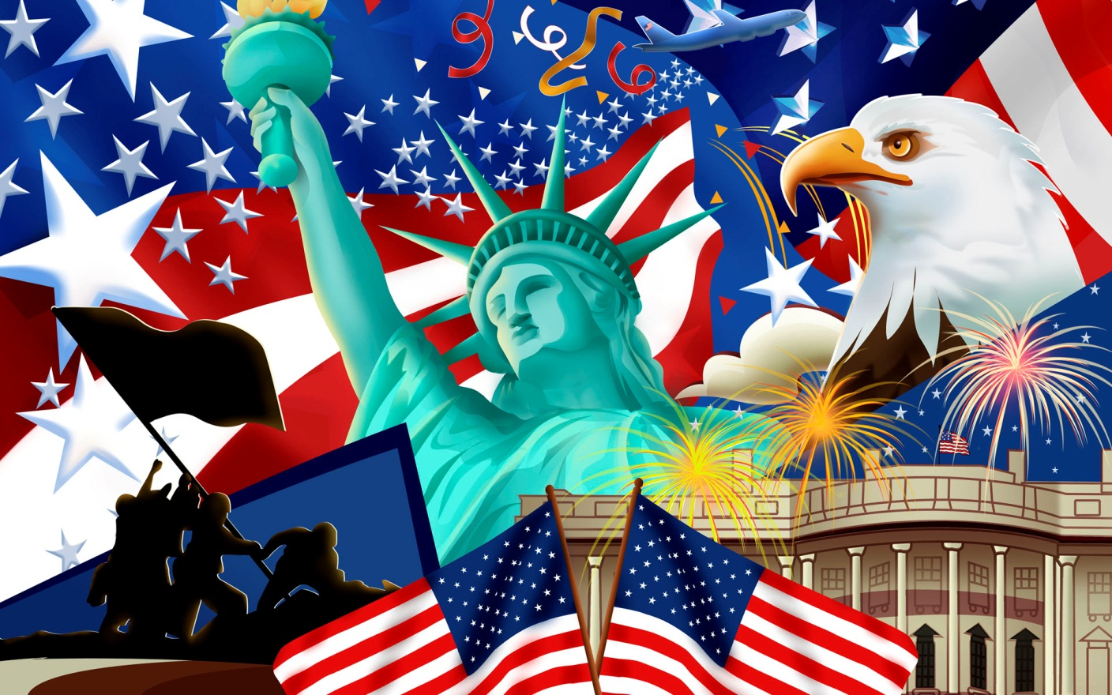
The symbols of the USA

Slide 8
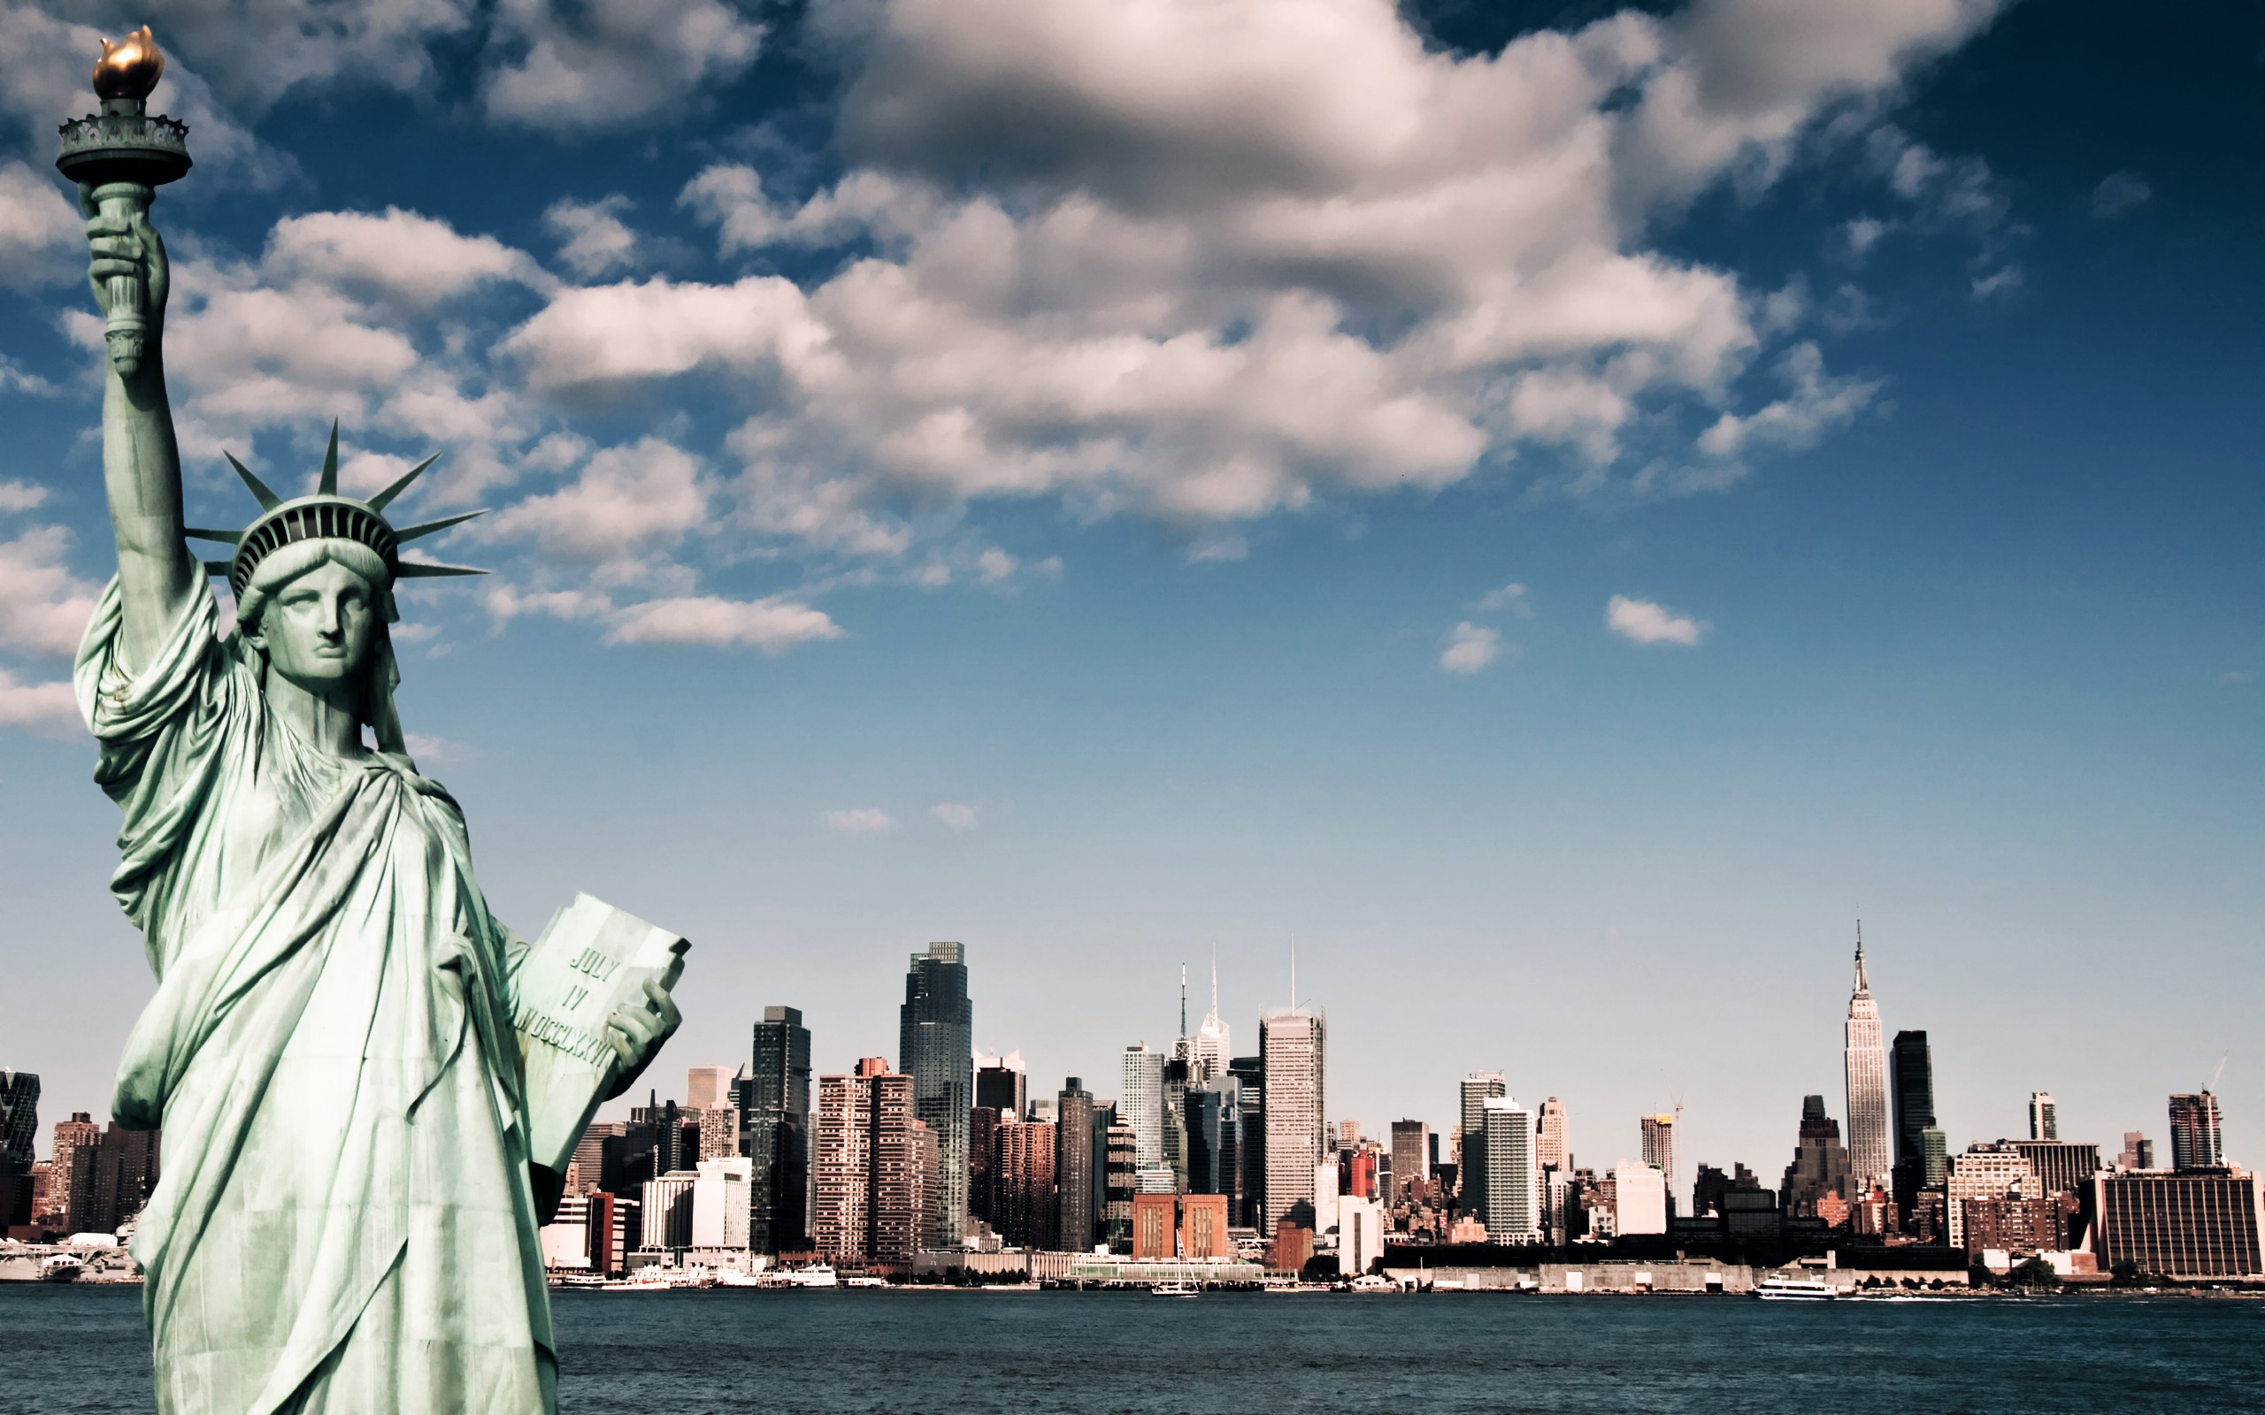
The statue symbolizes a welcome to a land of freedom.

Slide 9

Bald eagle

Slide 10
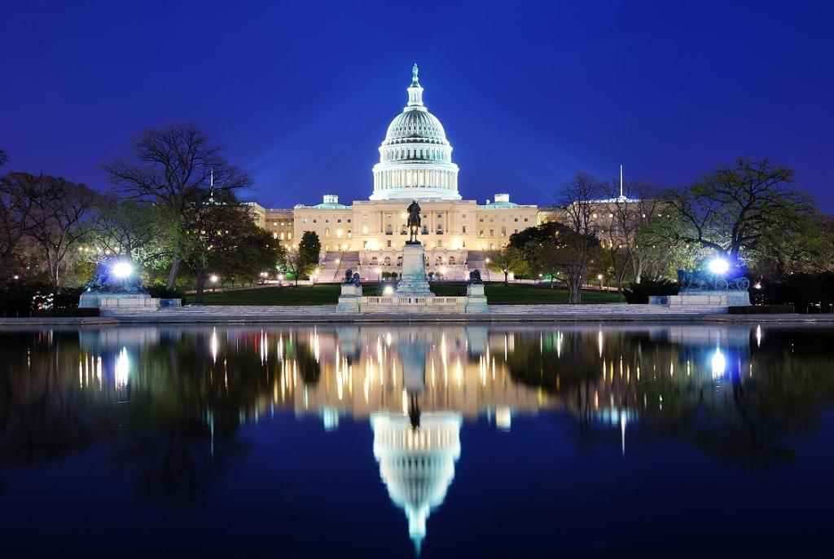
The capital of the USA is Washington

Slide 11
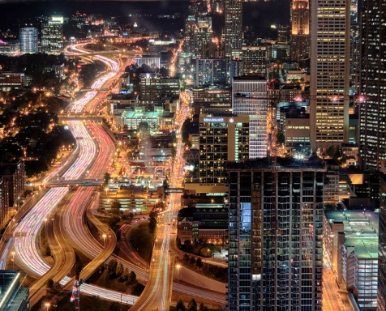
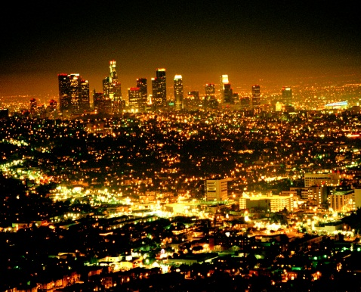
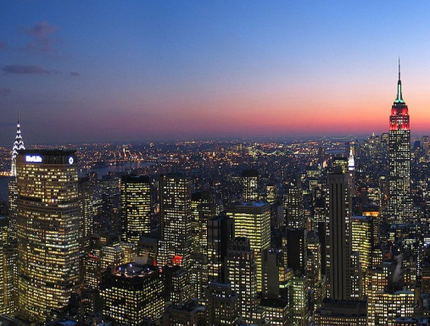
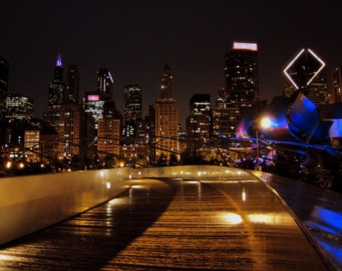
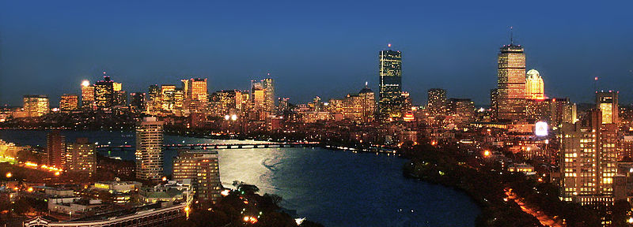
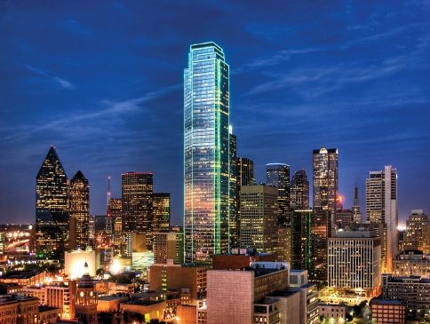
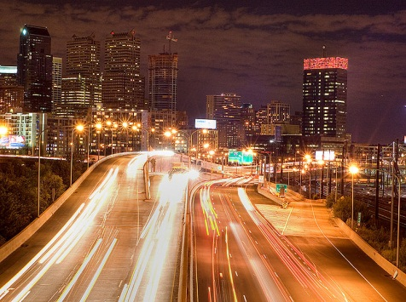
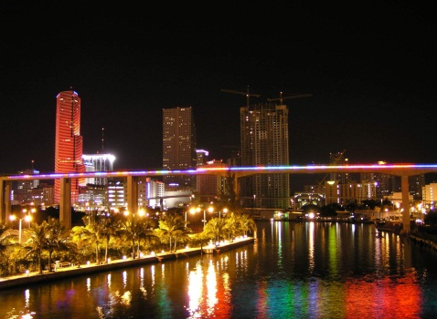
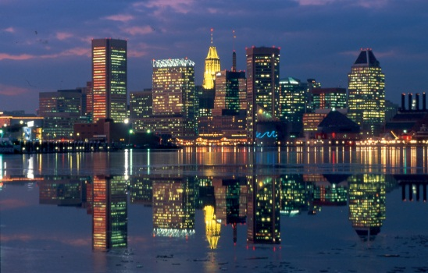
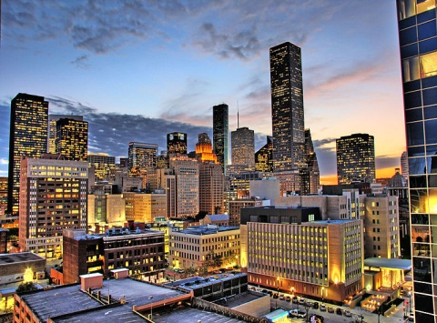
Atlanta
Los Angeles
New York
Chicago
The cities of the USA
Boston
Dallas
Philadelphia
Miami
Washington
Houston

Slide 12
Places of interest in the USA

Slide 13
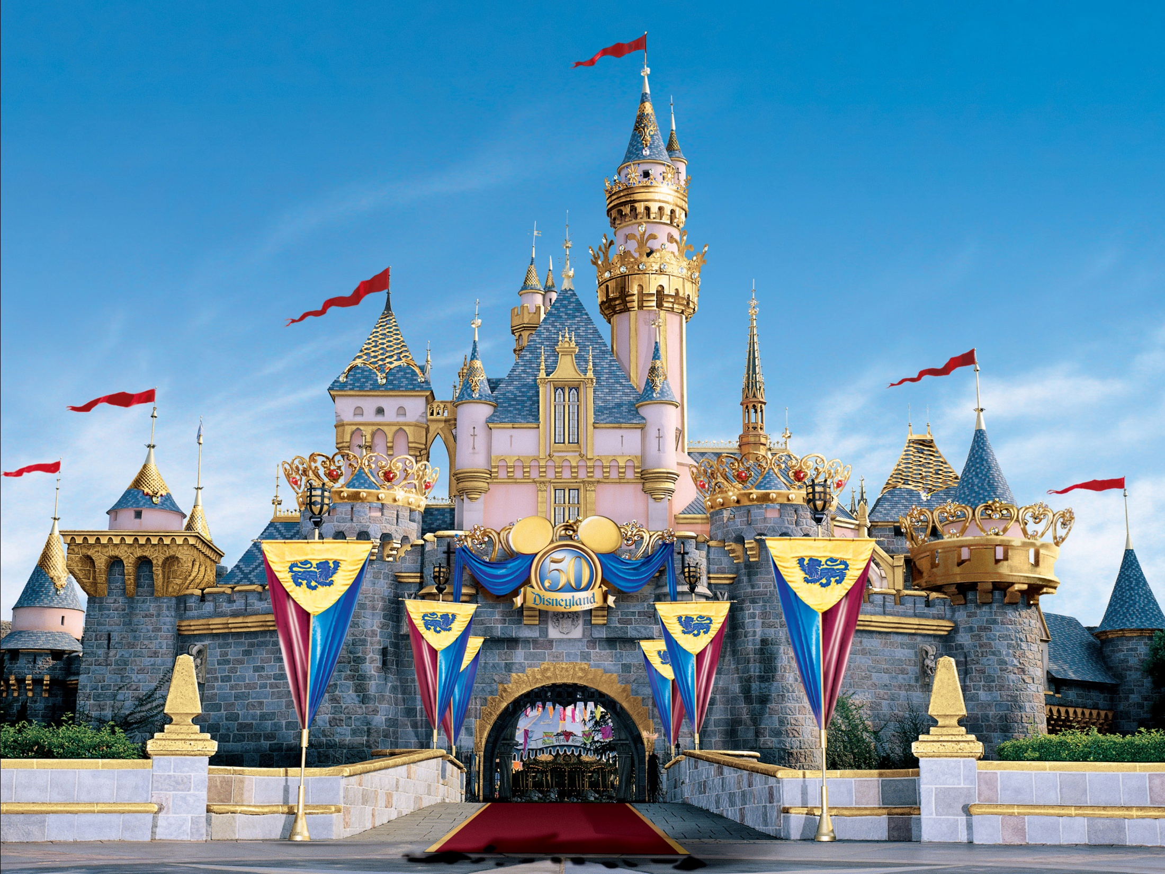
Disneyland

Slide 14
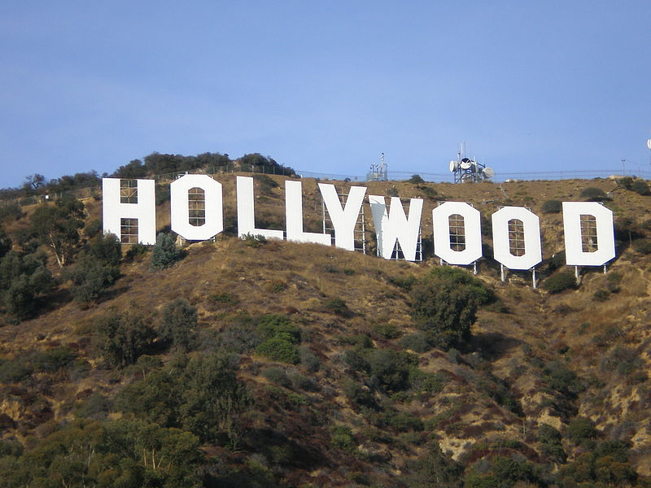

Slide 15
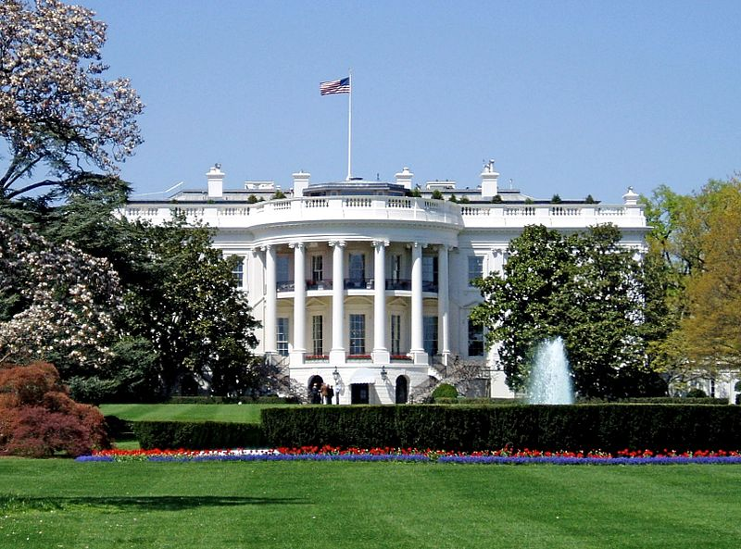
White House

Slide 16
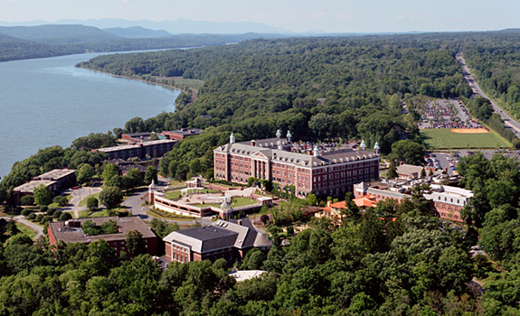
Hyde Park

Slide 17
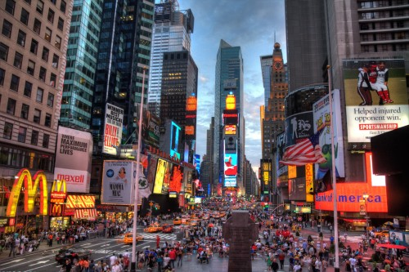
Manhattan

Slide 18
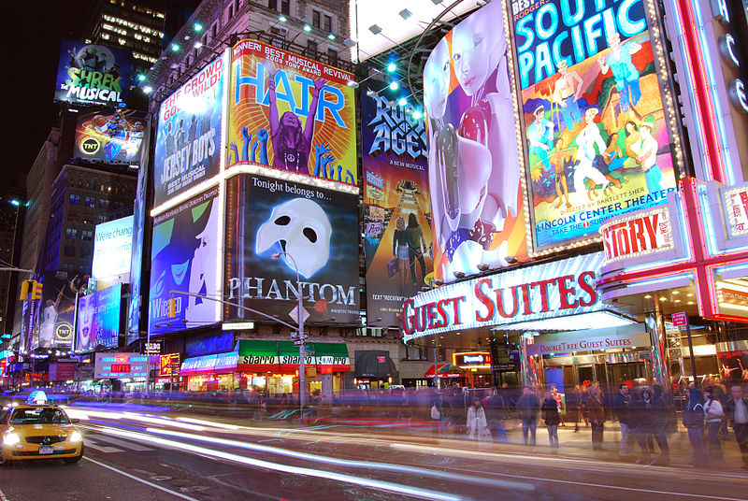
Times Square

Slide 19
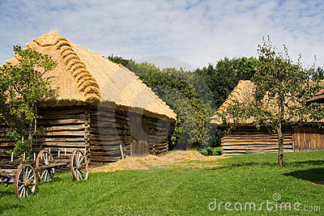
Moravian village

Slide 20
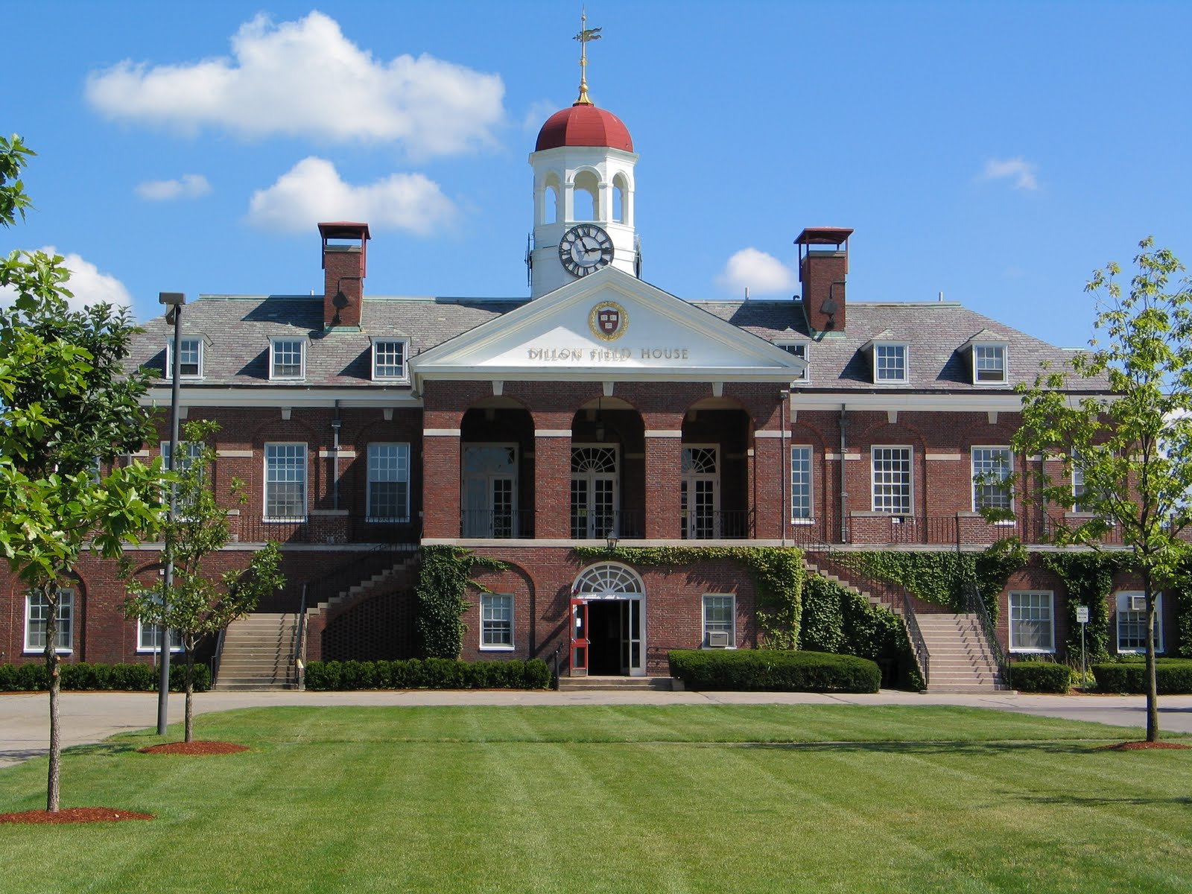

Slide 21
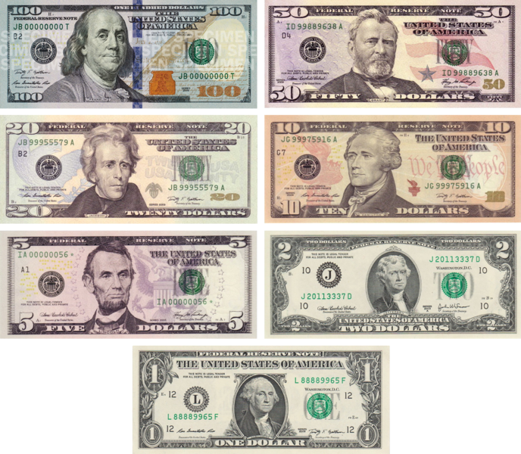
The United States dollar is the official currency of the United States of America and its overseas territories.

Slide 22
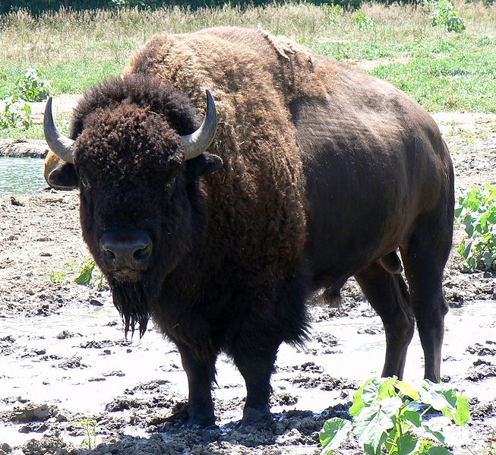
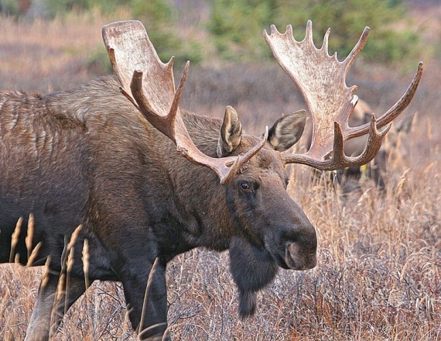
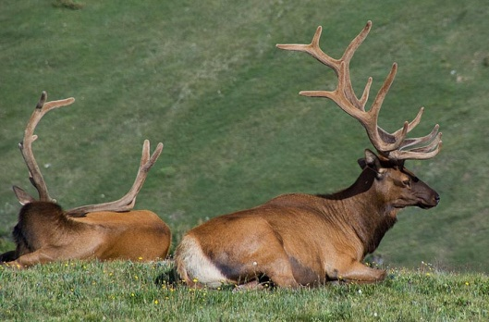
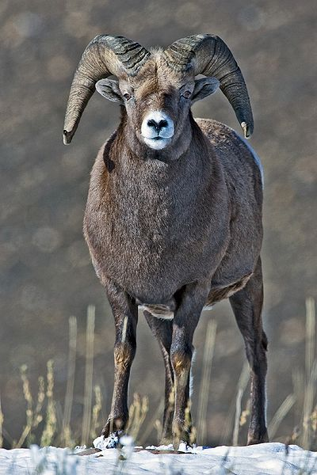
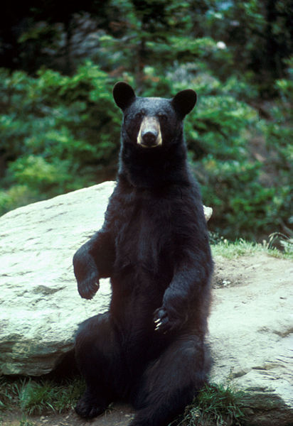
American bison
Moose
Deer
TYPICAL ANIMALS
Bighorn sheep
American black bear

Slide 23
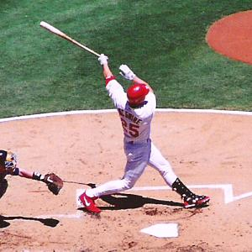
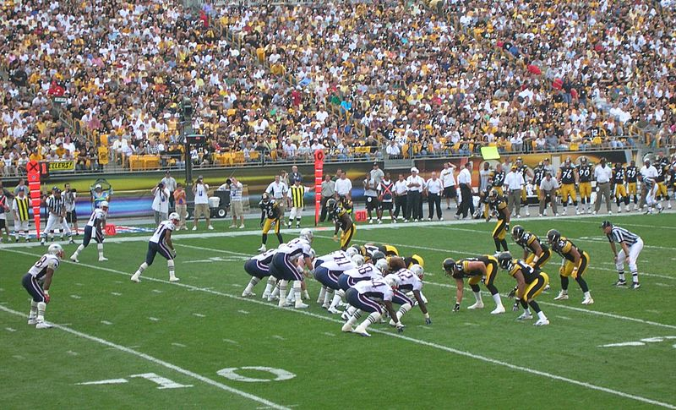
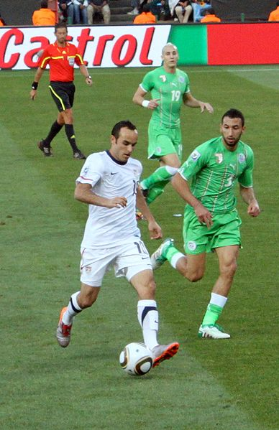
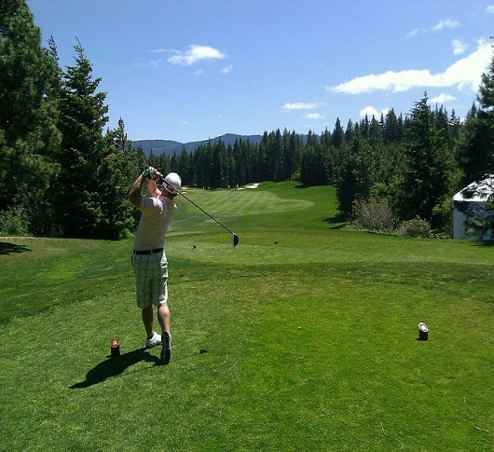
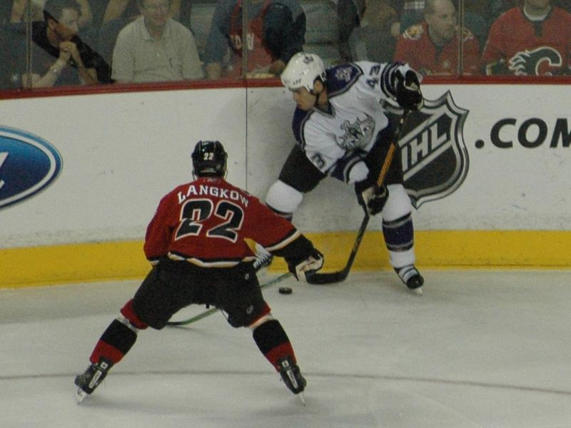
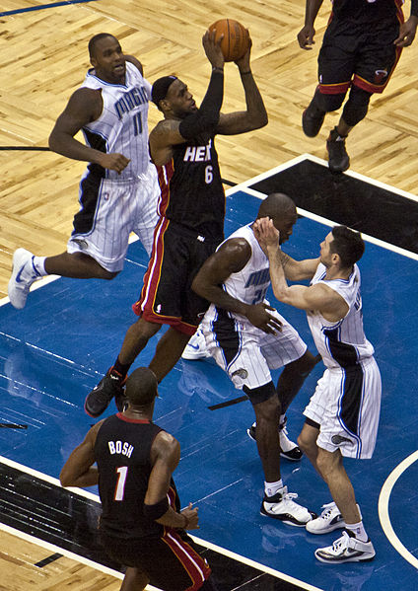
Baseball
American football
Soccer
Sport in the USA
Golf
Ice hockey
Basketball

Slide 24
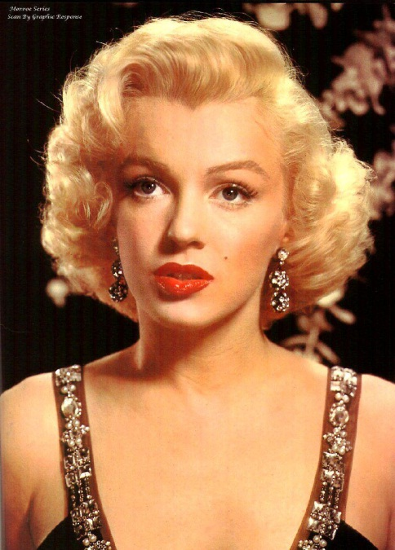
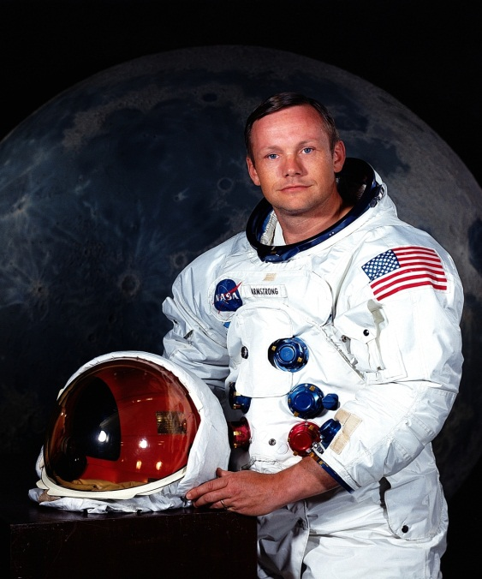
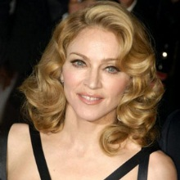
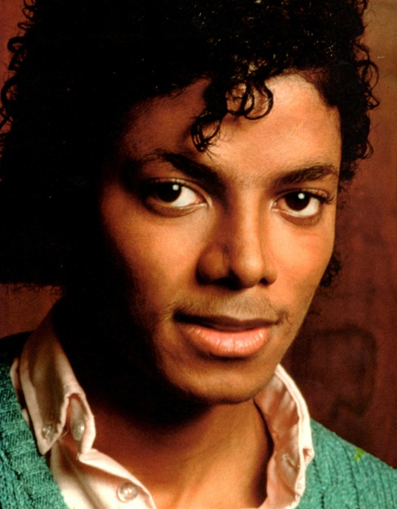
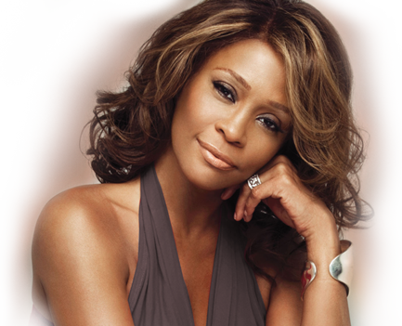
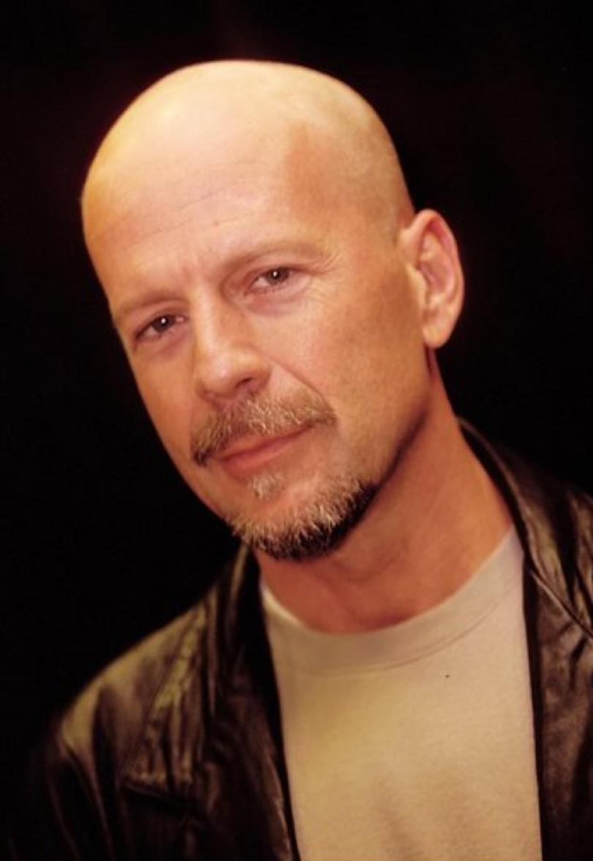
Marilyn Monroe , actress
Neil Armstrong , astronaut
Madonna , singer
Famous People
Michael Jackson , singer
Whitney Houston , singer
Bruce Willis , actor

