Slide 1
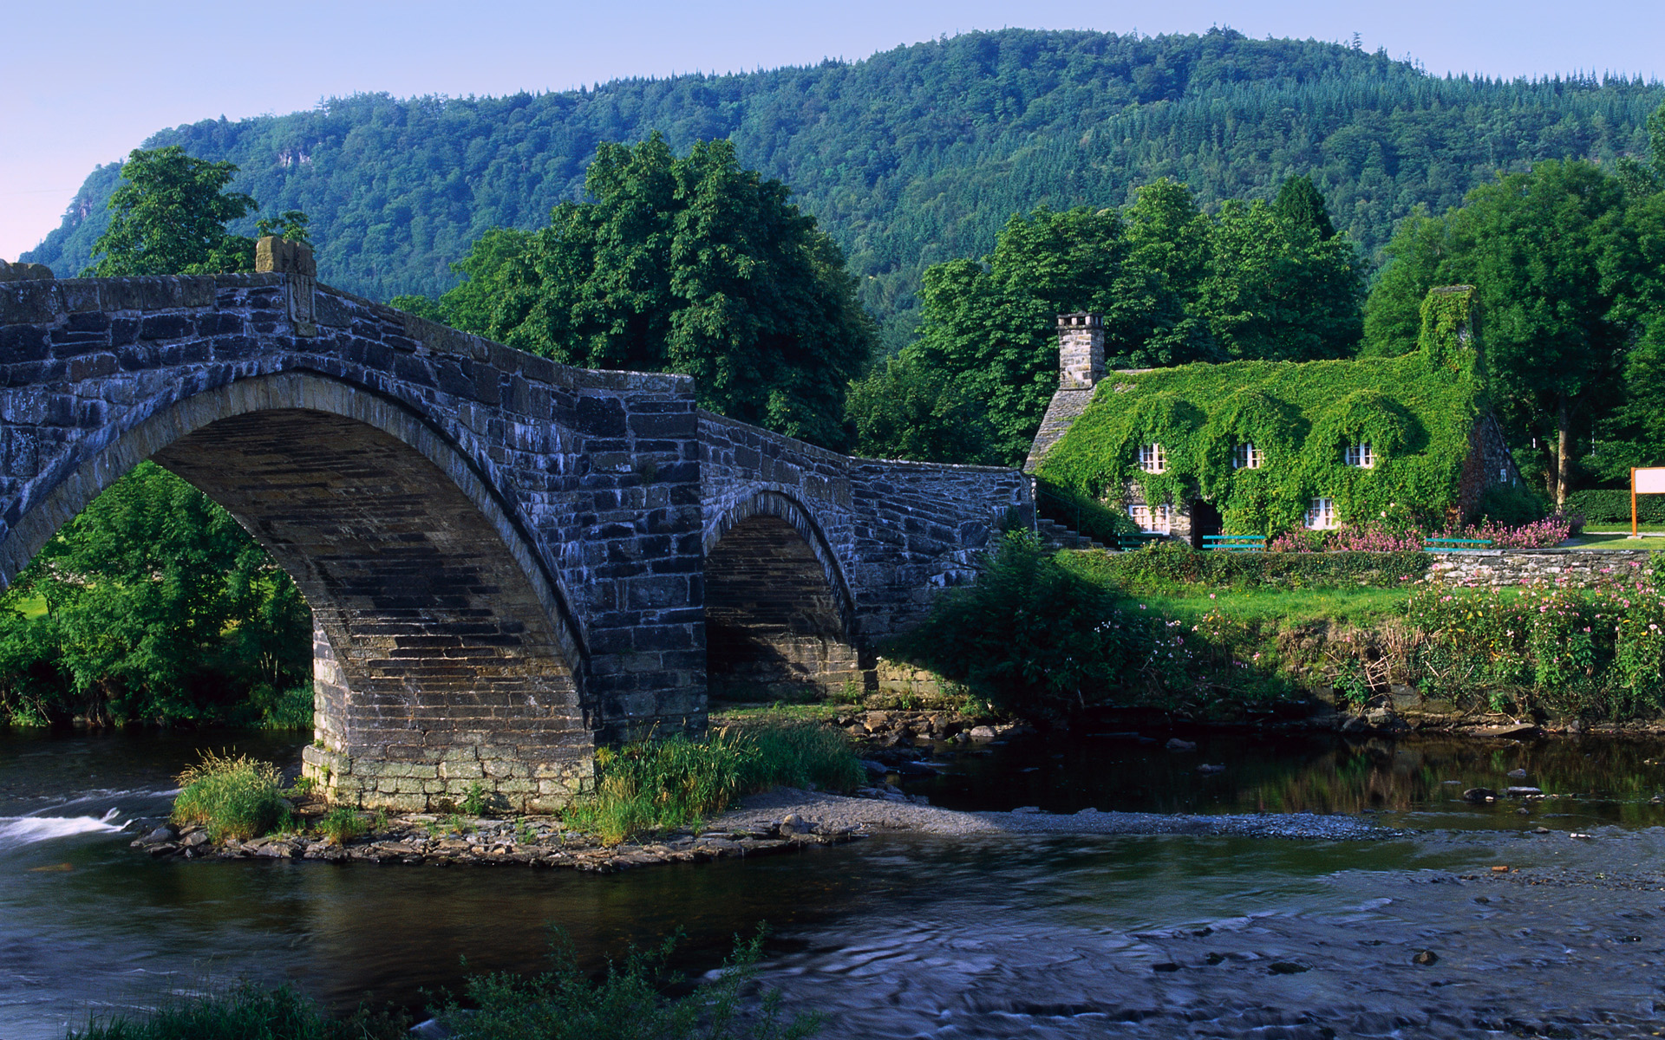
Welcome to Wales

Slide 2
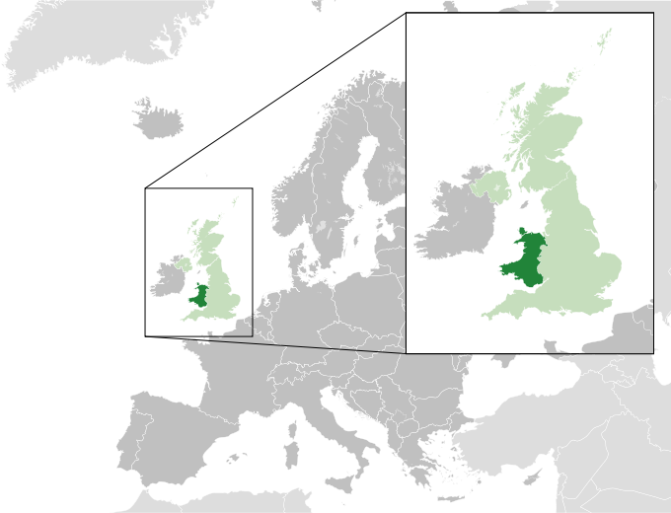
Wales is one of the most beautiful parts in Great Britain. It is a country that is a part of the United Kingdom and the island of Great Britain, bordered by England to its east and the Atlantic Ocean and the Irish Sea to its west. It has a population of 3,064,000 and a total area of 20,779km². The country lies within the north temperate zone and has a changeable maritime climate. Wales is a generable mountainous country.

Slide 3
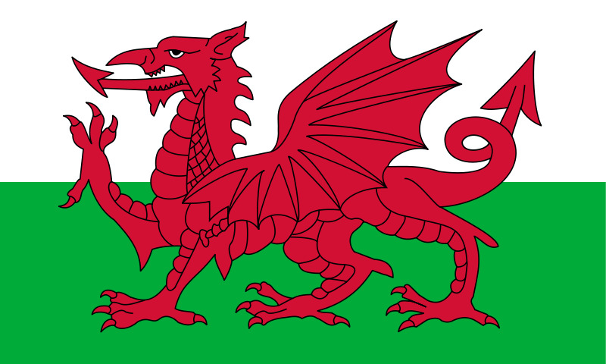
The flag of Wales

Slide 4

A leek and a daffodil are the symbols of Wales.

Slide 5
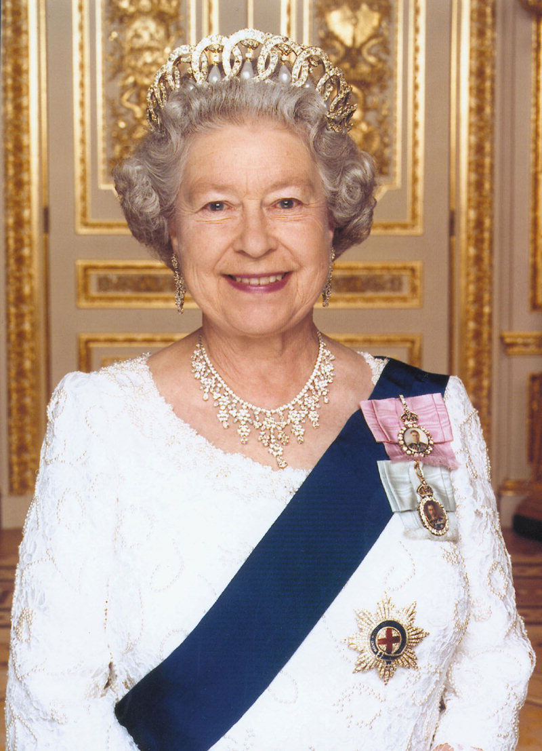

Wales is a country that is a part of the United Kingdom of Great Britain and the islands. The monarch is Elizabeth II. First Minister is Carwyn Jones.

Slide 6
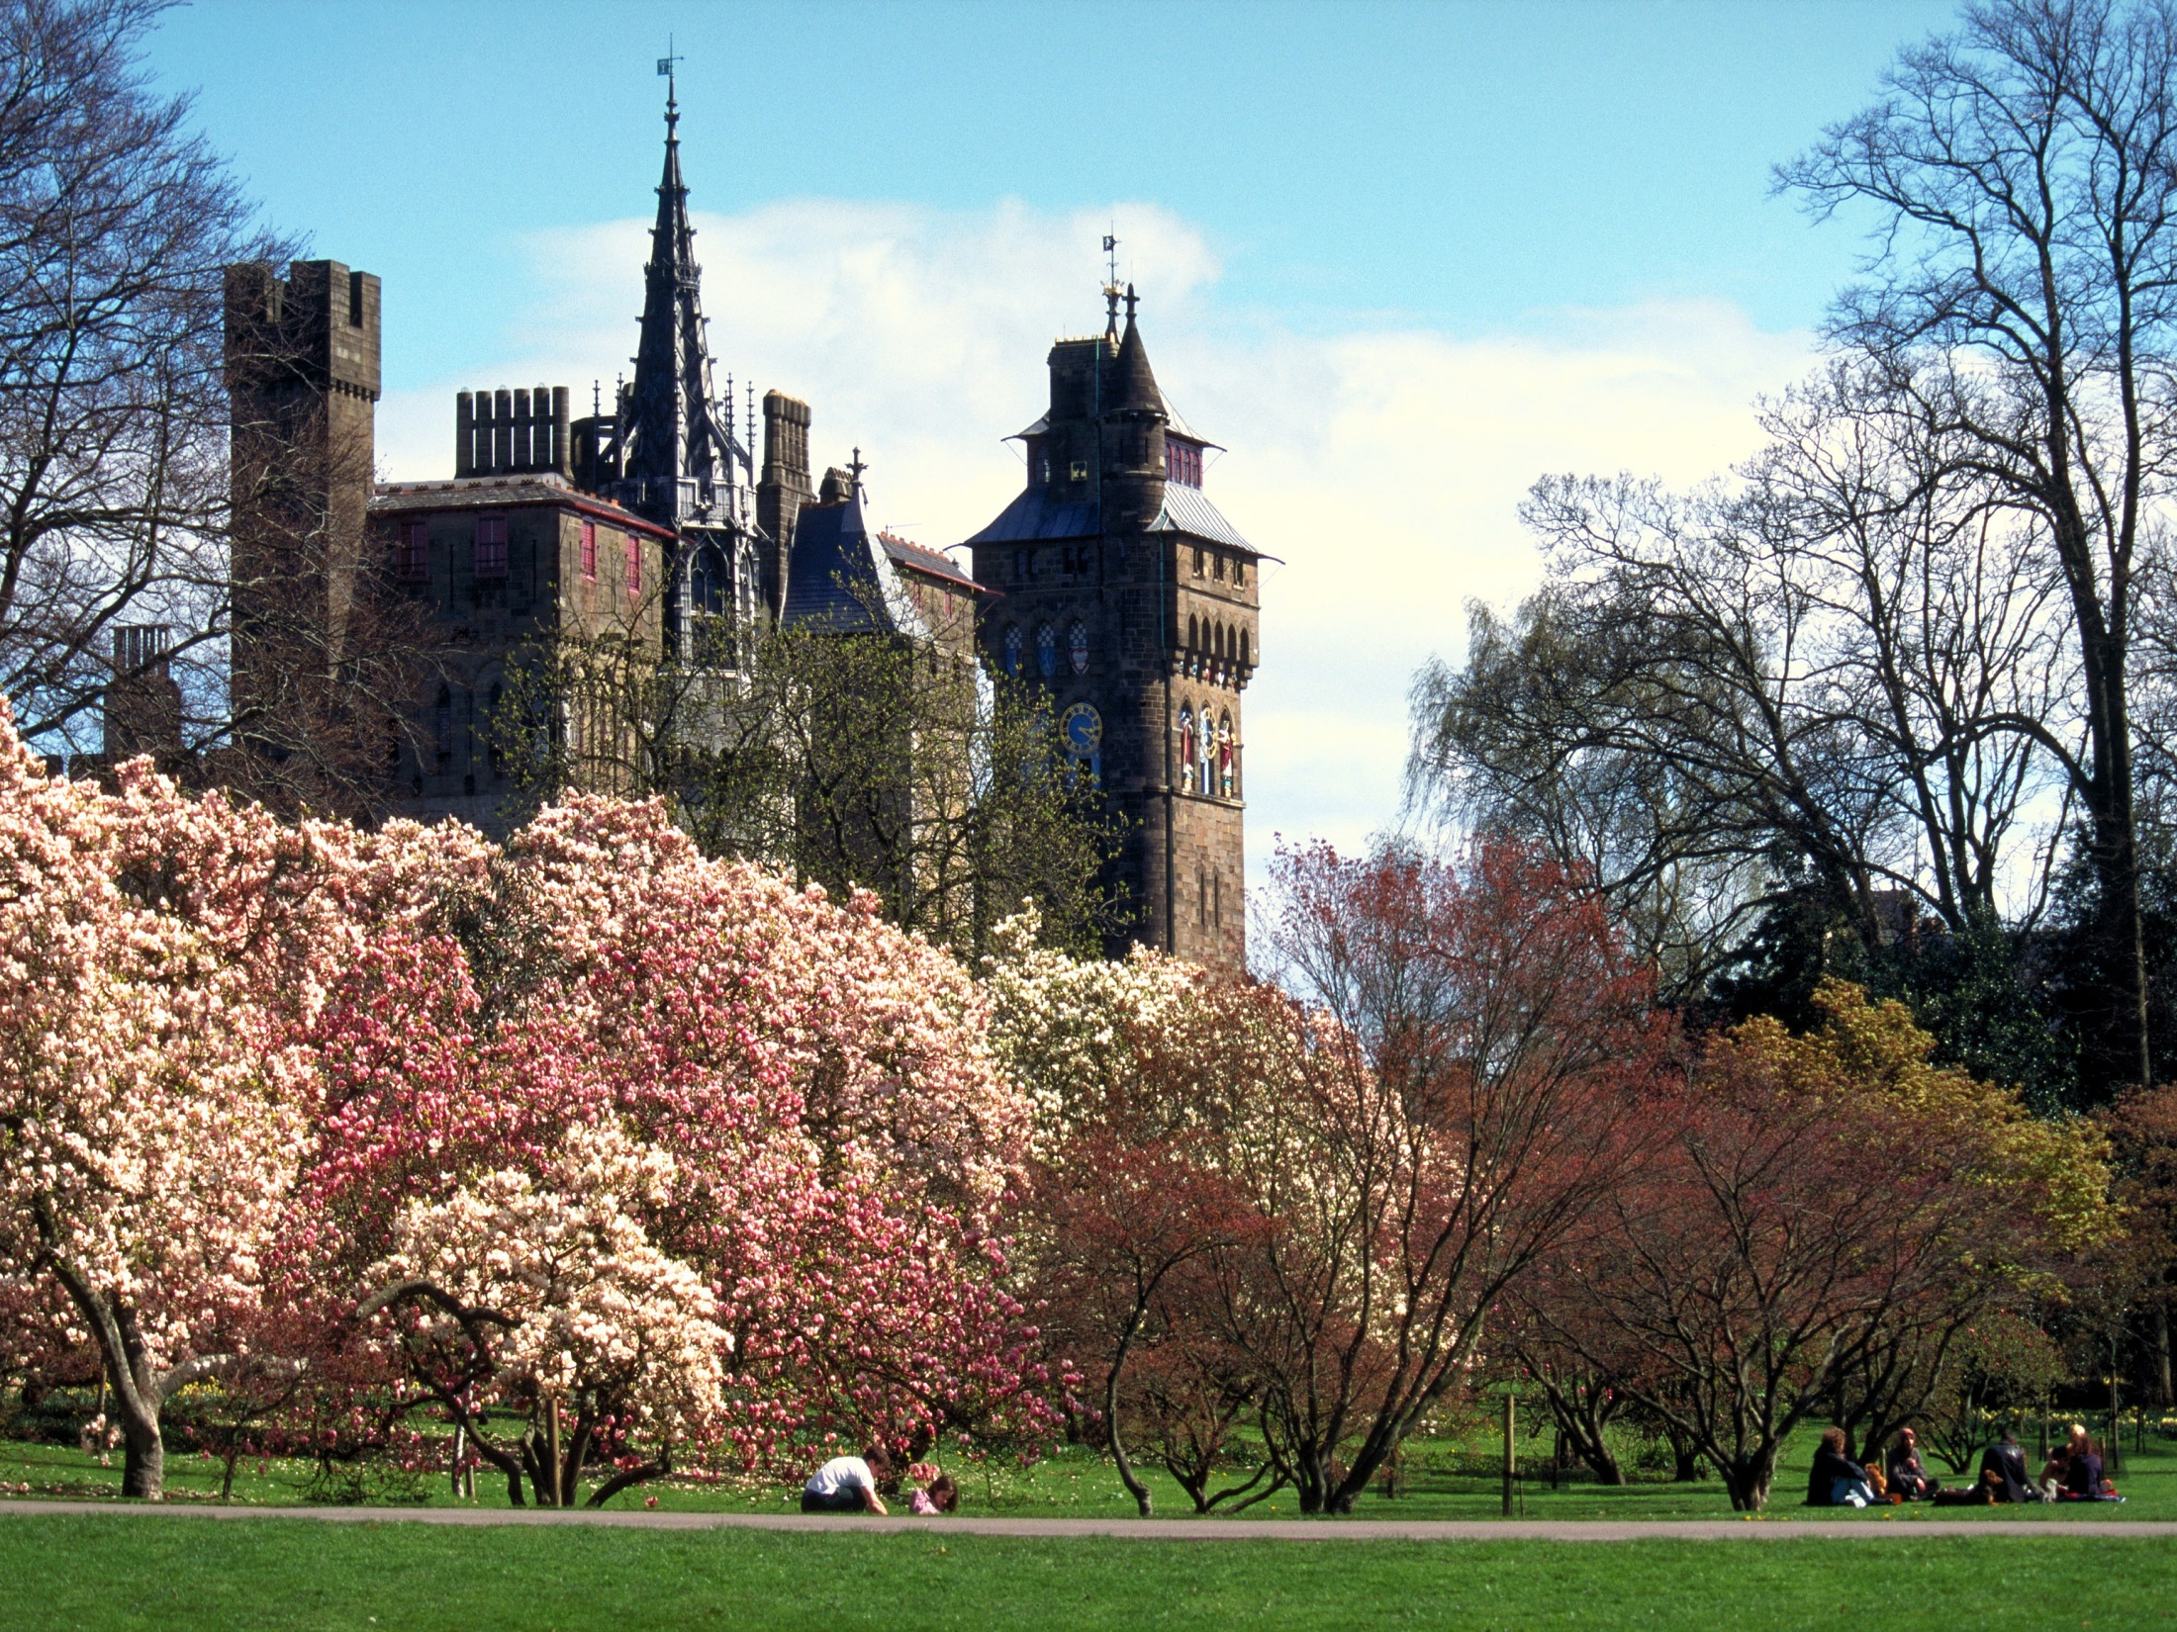
The capital of Wales is Cardiff

Slide 7
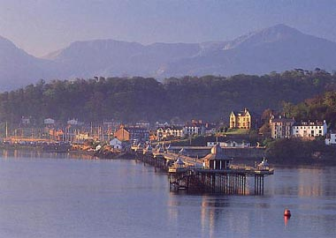
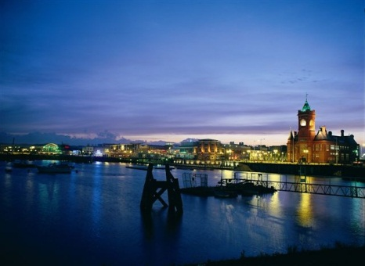
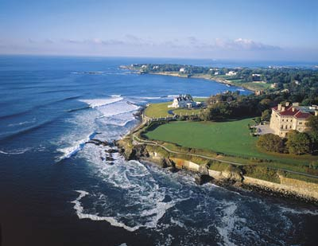
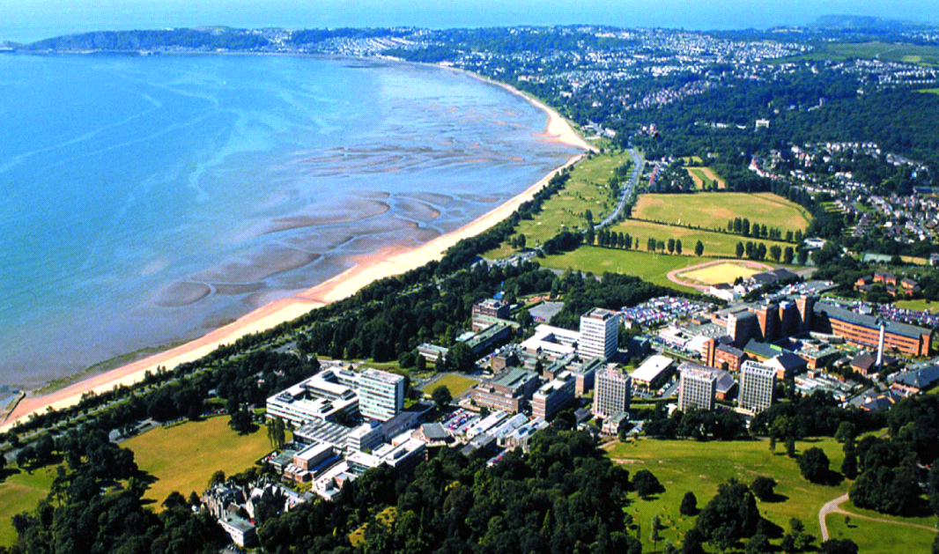
Bangor
Cardiff
The cities of Wales
Newport
Swansea

Slide 8
Places of interest in Wales

Slide 9
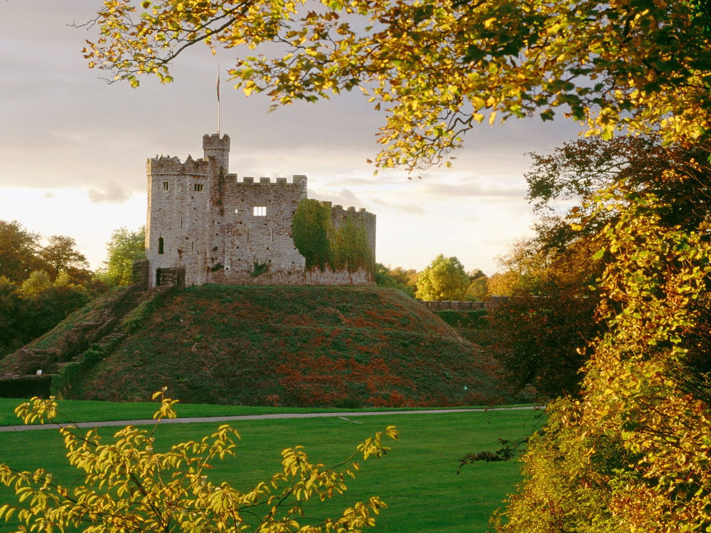
Cardiff Castle

Slide 10
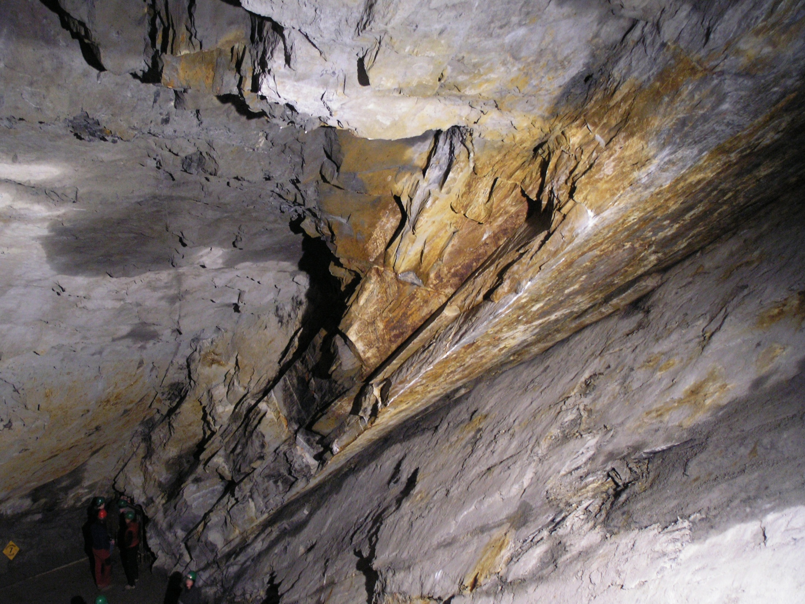
Llechwedd Slate Caverns

Slide 11
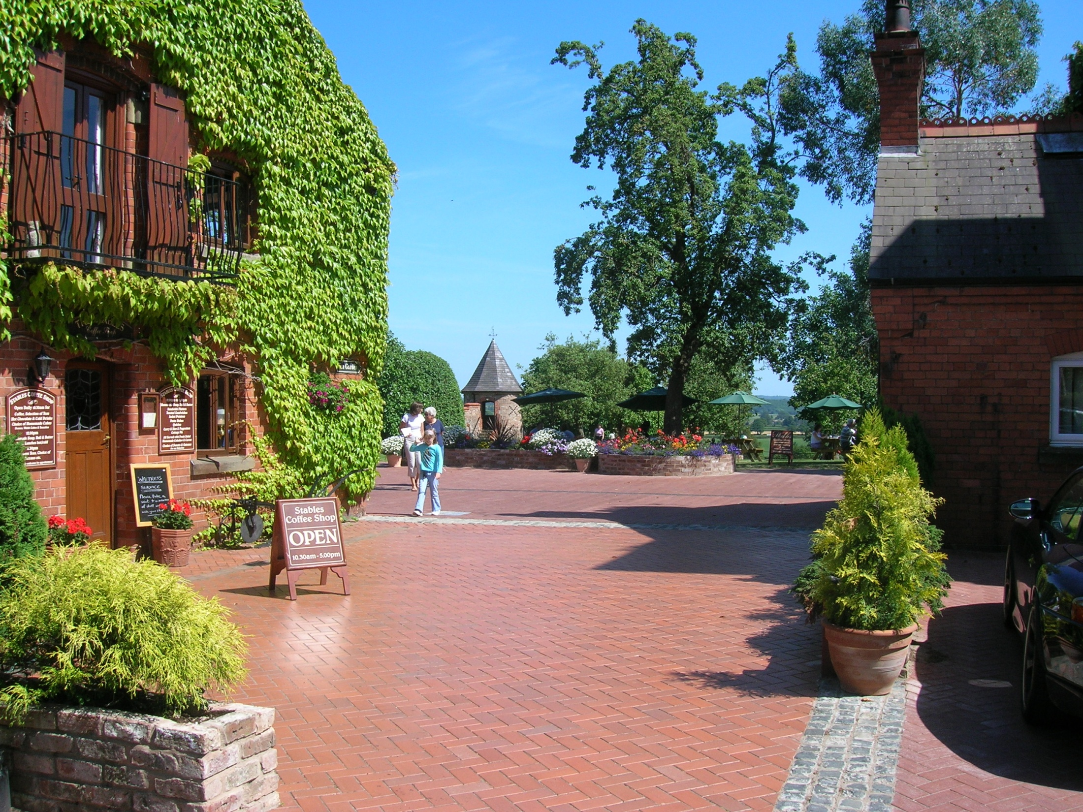
Plassey Craft and Retail Centre

Slide 12
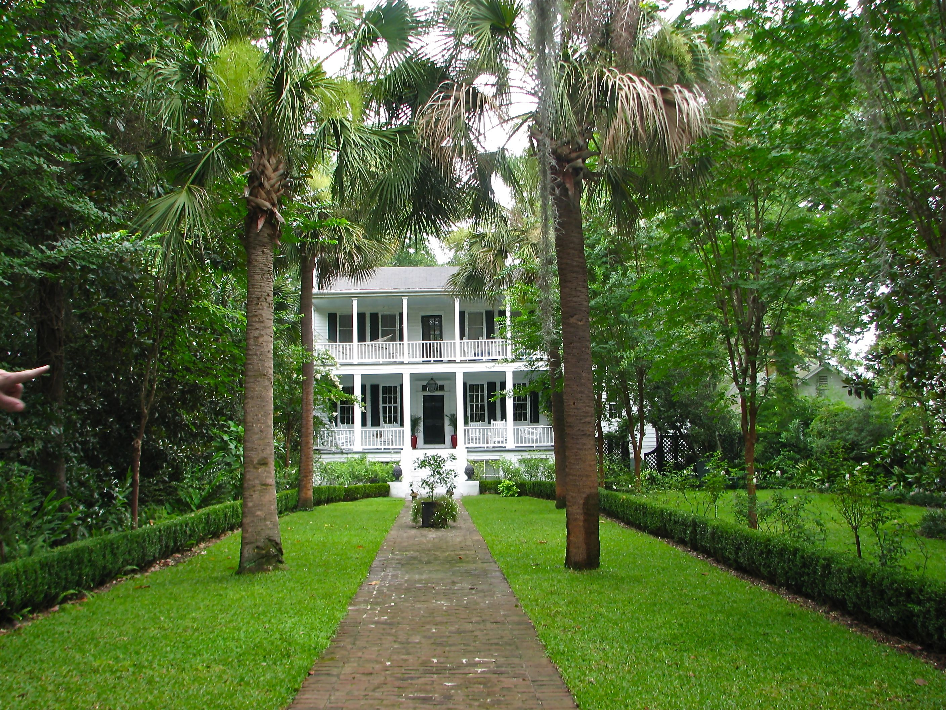
Plantasia

Slide 13
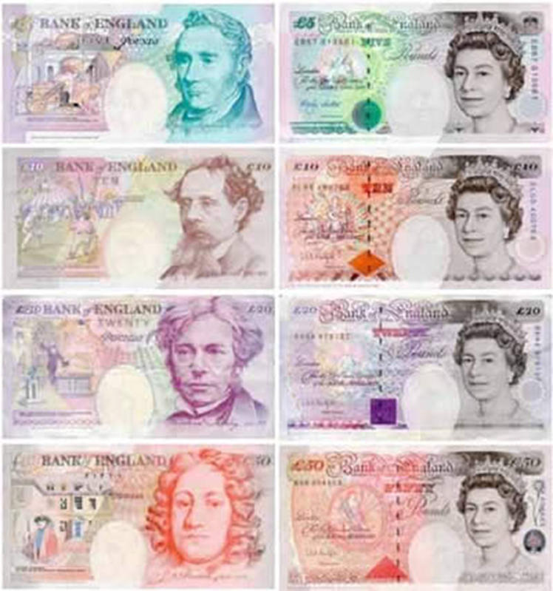
The currency is the pound sterling.

Slide 14
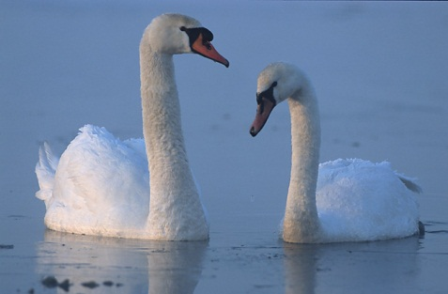
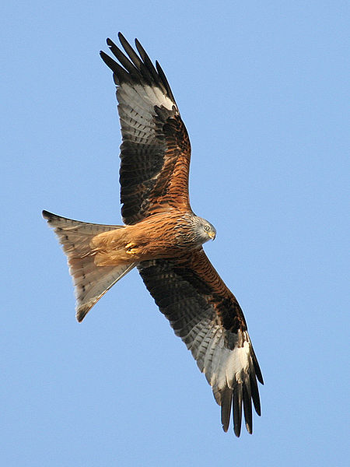
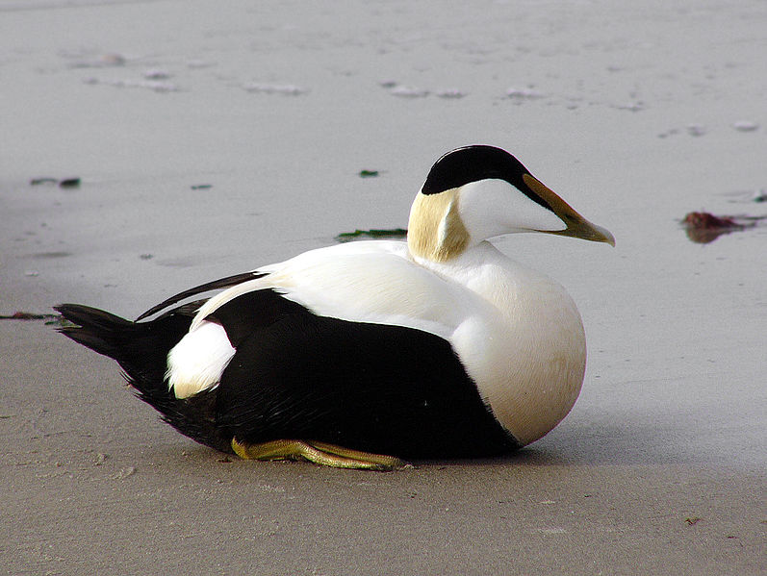
Mute Swans
Red Kite
TYPICAL ANIMALS
Duck

Slide 15
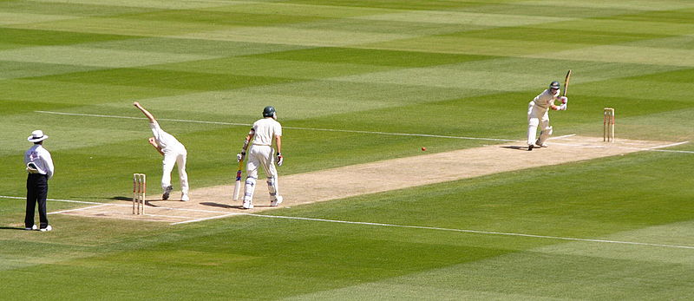

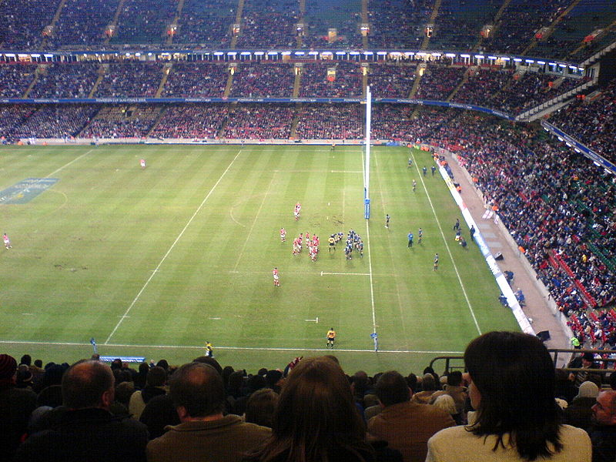

Cricket
Football
Sport in Wales
Rugby
Boxing

Slide 16
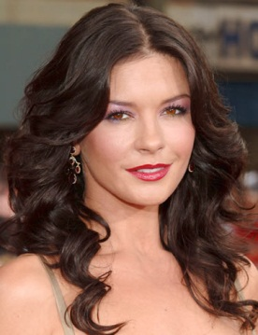

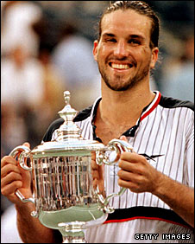
Famous People
Catherine Zeta-Jones
Duffy
Patrick Rafter

