Slide 1

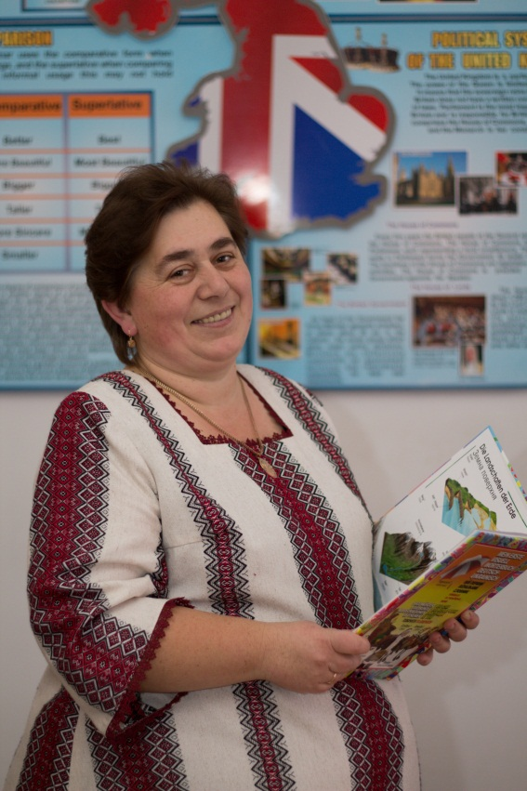
Lyudmyla Hryhorivna Marchyshak, an English teacher at Vasylkivtsi Specialized School in Information Technologies and Technological Disciplines
Pedagogical period – 26 years, a teacher of higher qualification category, pedagogical title «senior teacher»

Slide 2
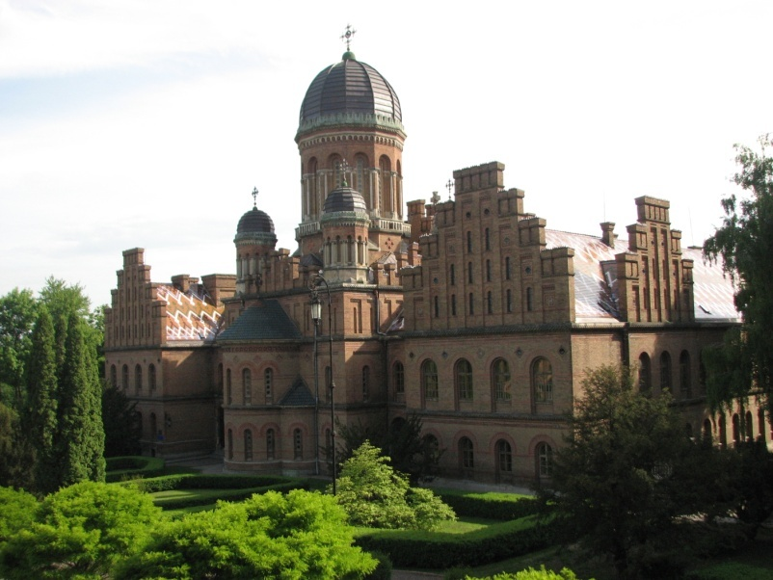
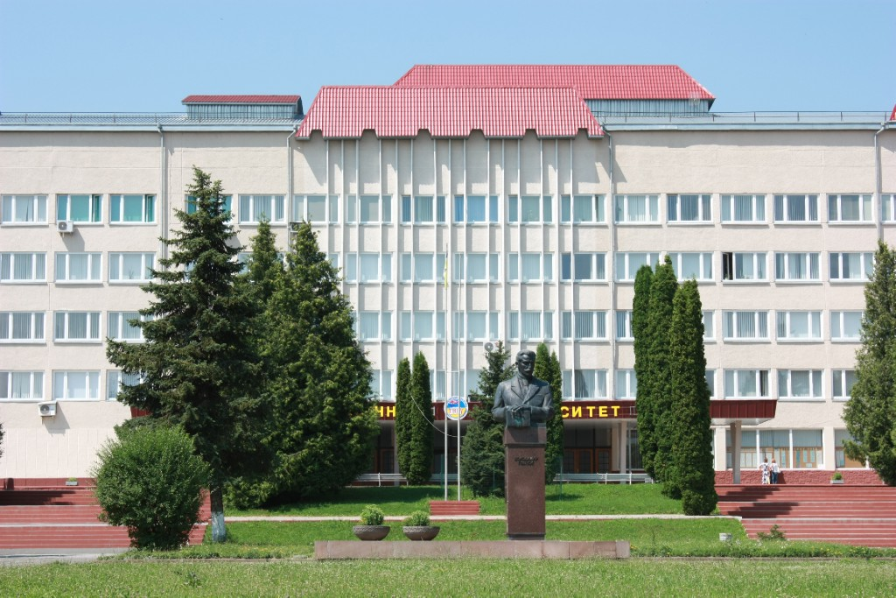
Yuriy Fedkovych Chernivtsi State University, Philology Faculty
1990-1995
Volodymyr Hnatiuk Ternopil National Pedagogical University, Post-Graduate Faculty, 2000-2002
The Place of Studying:

Slide 3
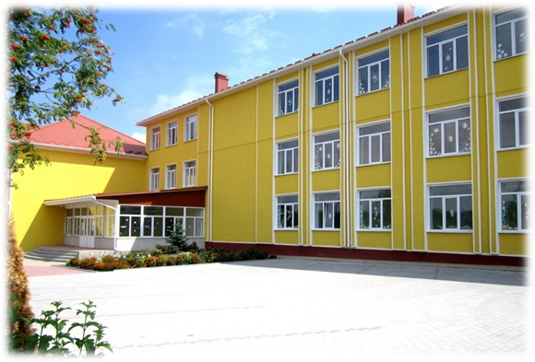


The Place of Work:
Vasylkivtsi Specialized School in Information Technologies and Technological Disciplines

Slide 4
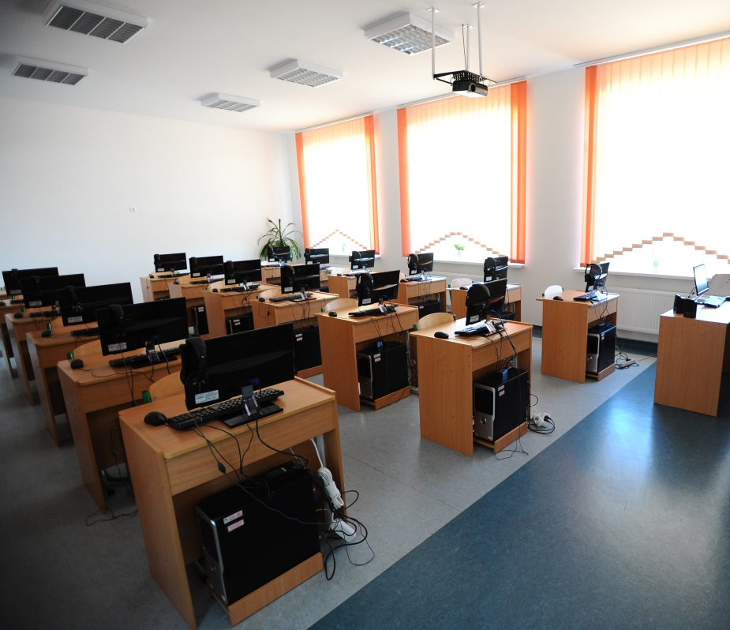
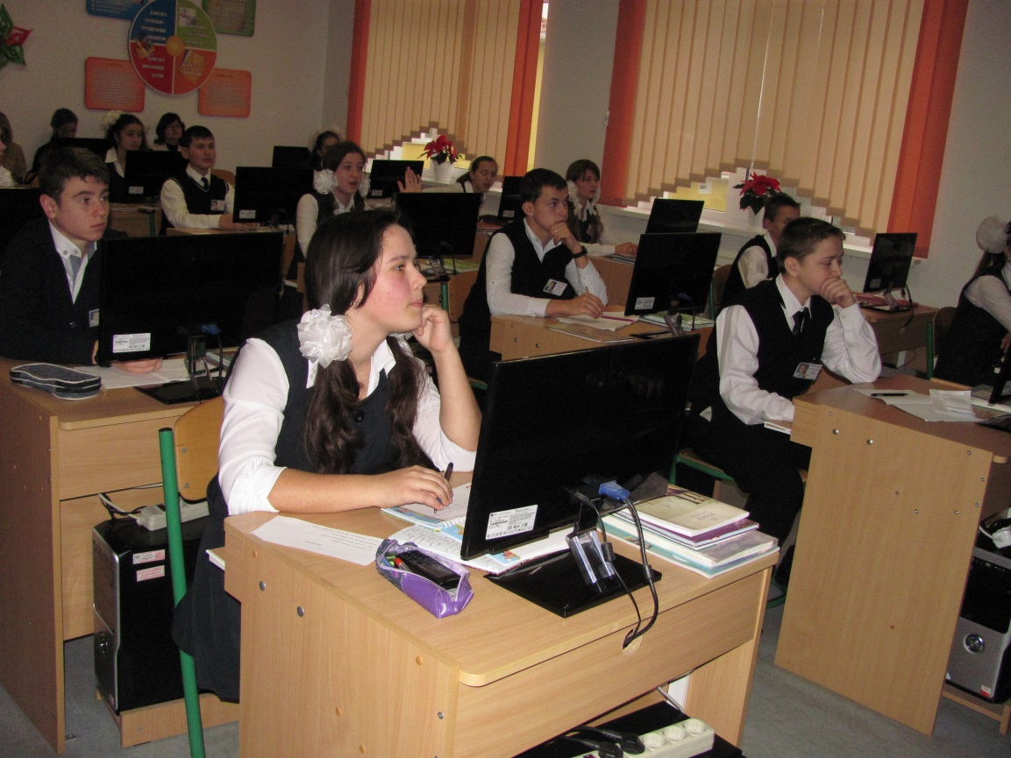
The Laboratory of Interactive Studying is the Creative Workshop

Slide 5
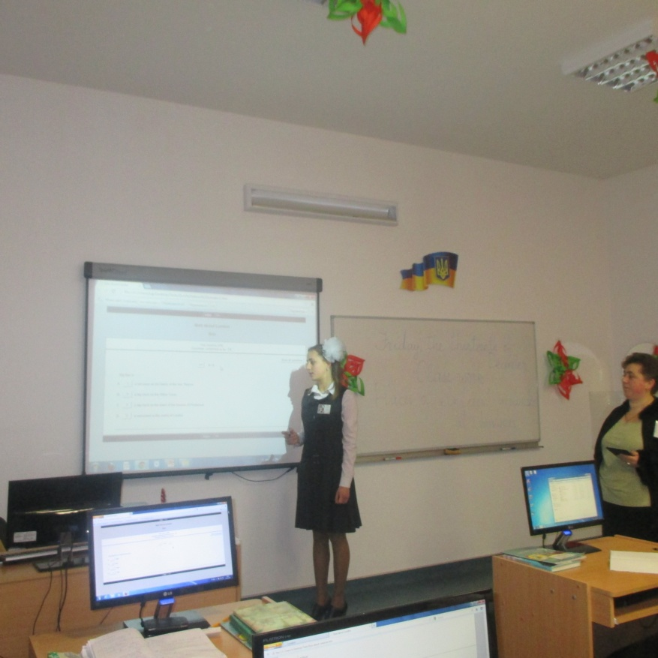
I work on the pedagogical
problem:
“Using Information and Communication
Technologies at English
Lessons”

Slide 6
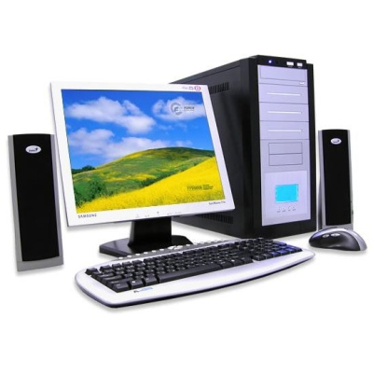
How I can use computers:
doing tests using programme “Hot
Potatoes”;
2) doing exercises on the sites:
http://Learning Apps.org http://learningapps.org/1192905 http://learnenglishteens.britishcouncil.org http://elt.oup.com/students/englishfile/
3) modern digital photo and video equipment;
4) for organization research work at the lessons;
5) to improve listening, speaking, reading and
writing in English

Slide 7
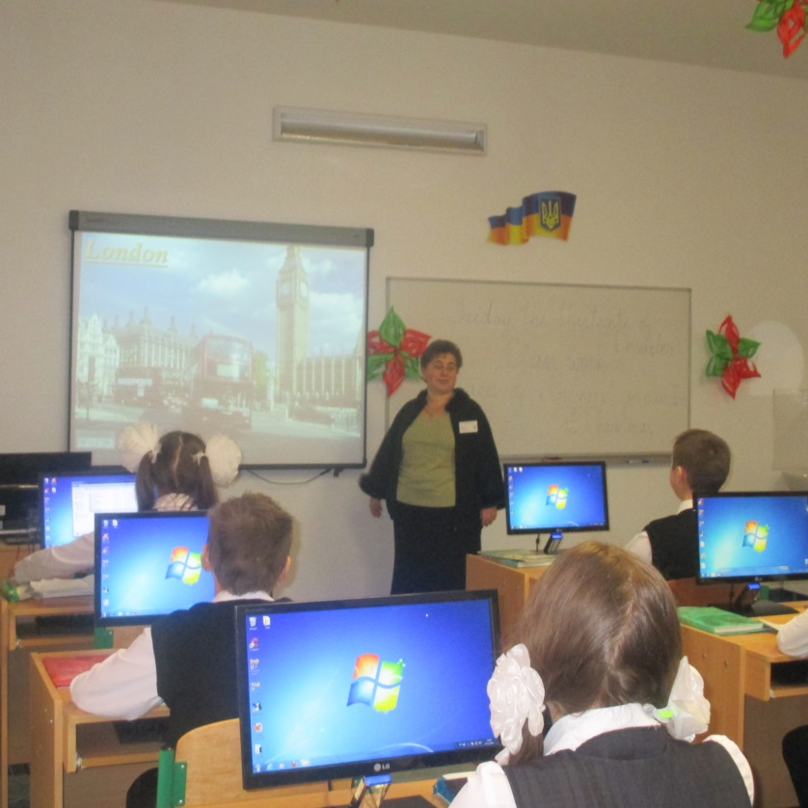
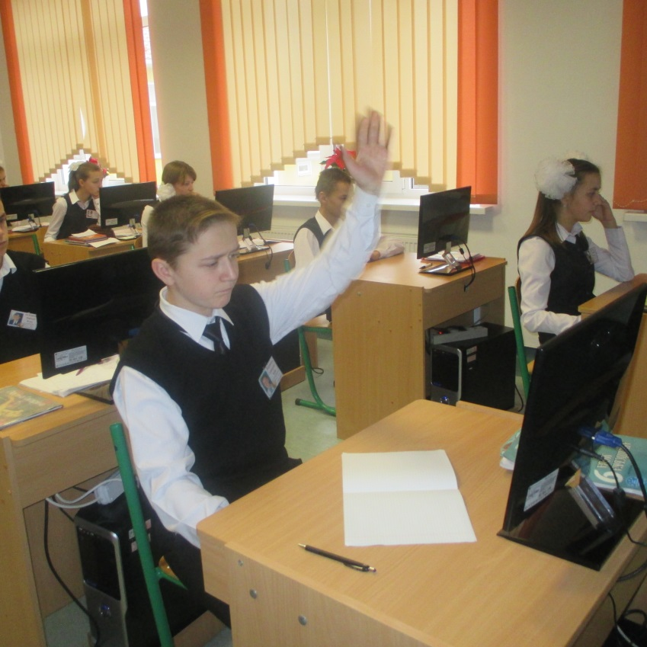
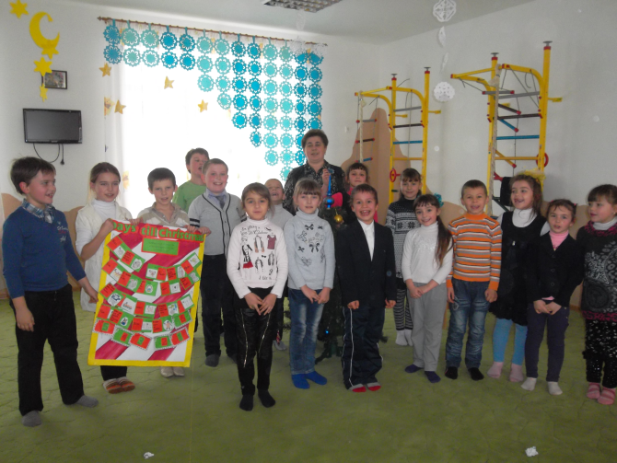
“A teacher prepares for a good lesson during all his or her life,” said famous Ukrainian pedagogue
V. Sukhomlynsky

Slide 8
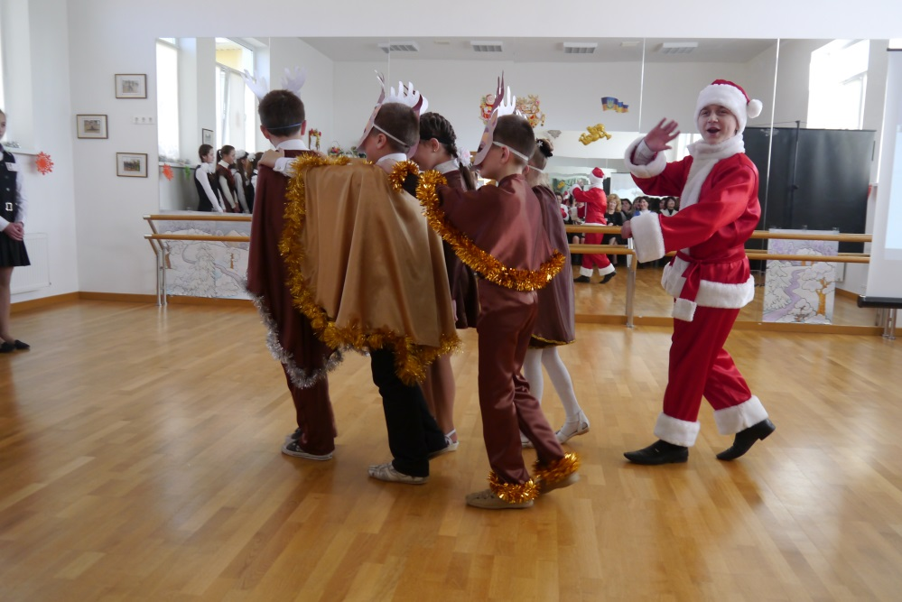
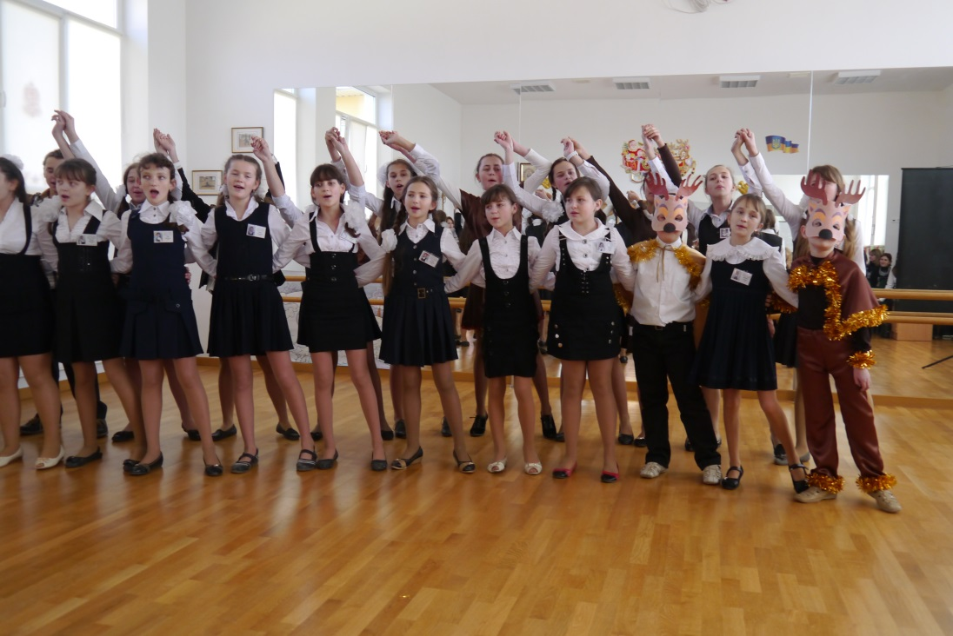
Out-of-class
activities

Slide 9
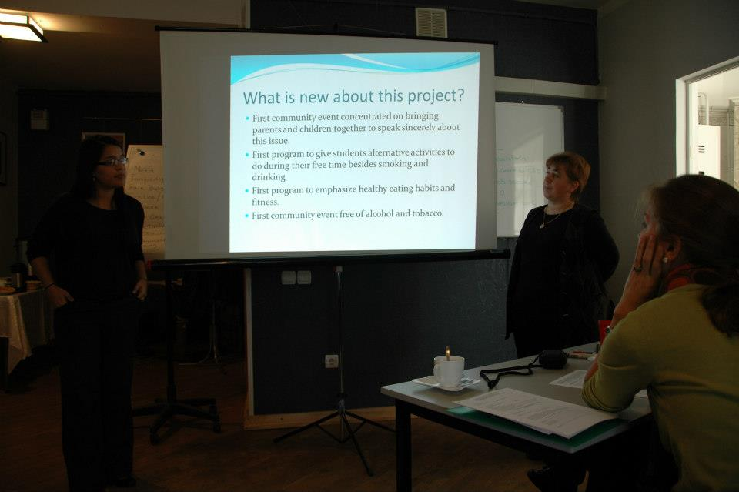
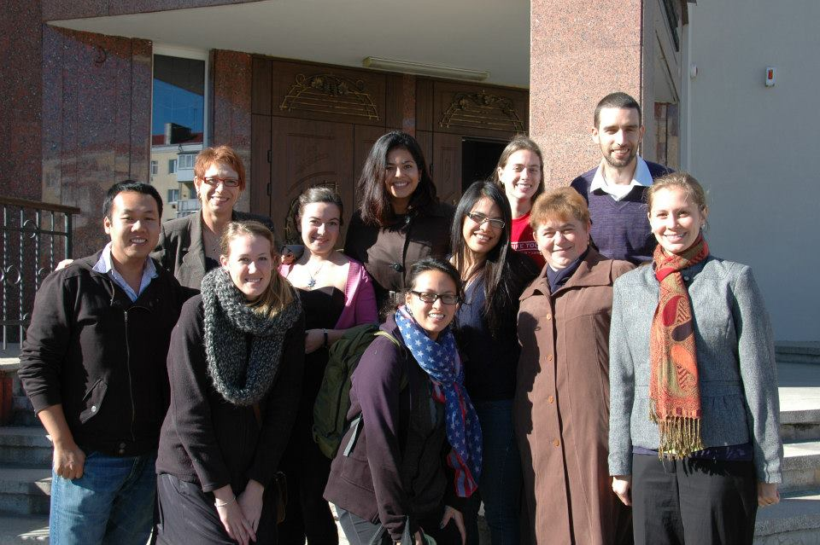
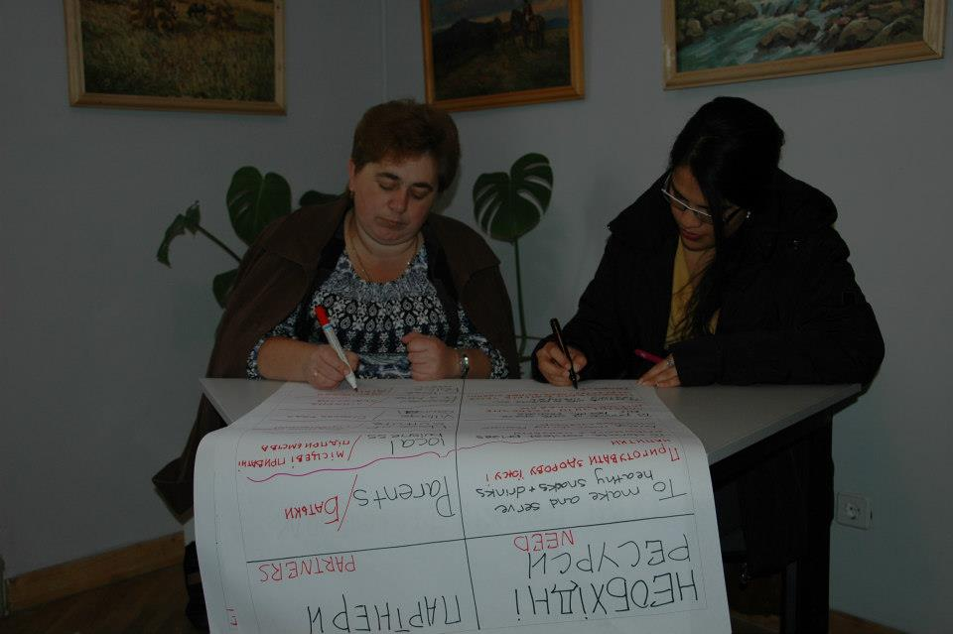
Work on a project with Vanessa Morales, Peace Corps volunteer in Dolyna, Ivano-Frankivsk region

Slide 10

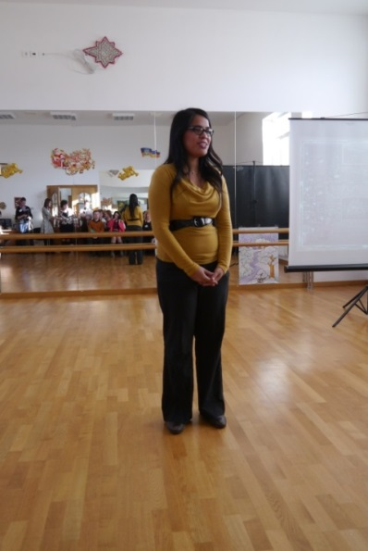
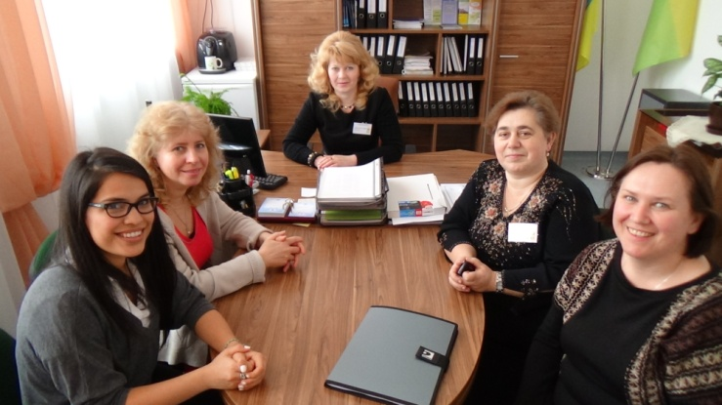
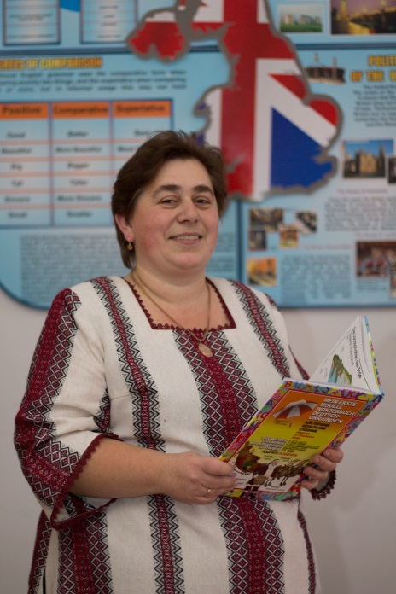
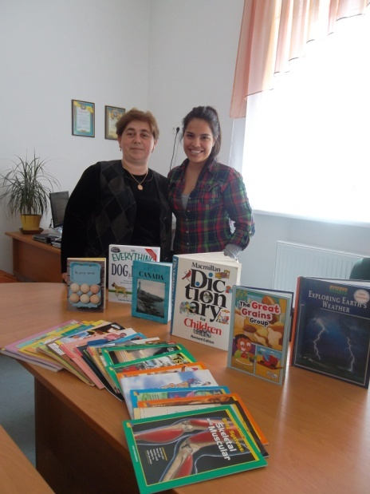
Work on a spa-grand “Leaders in Art” which we won in 2014

Slide 11
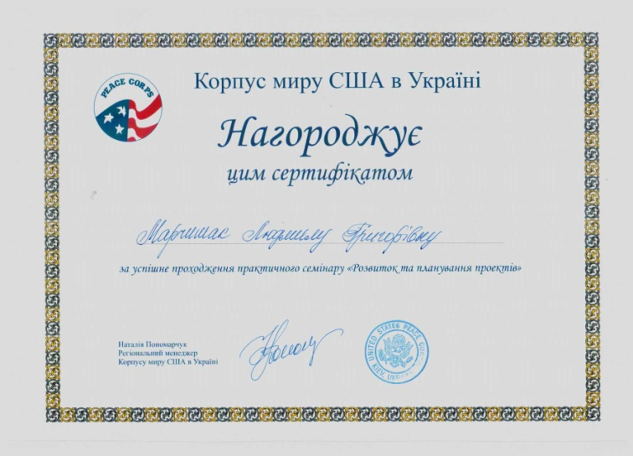
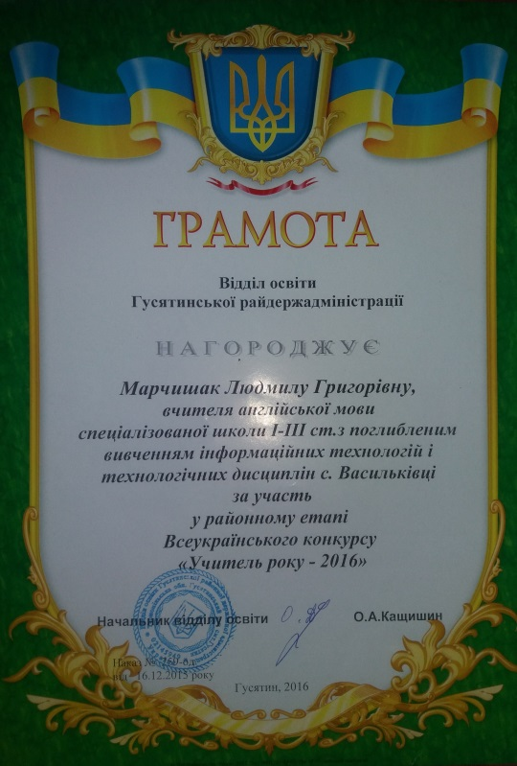
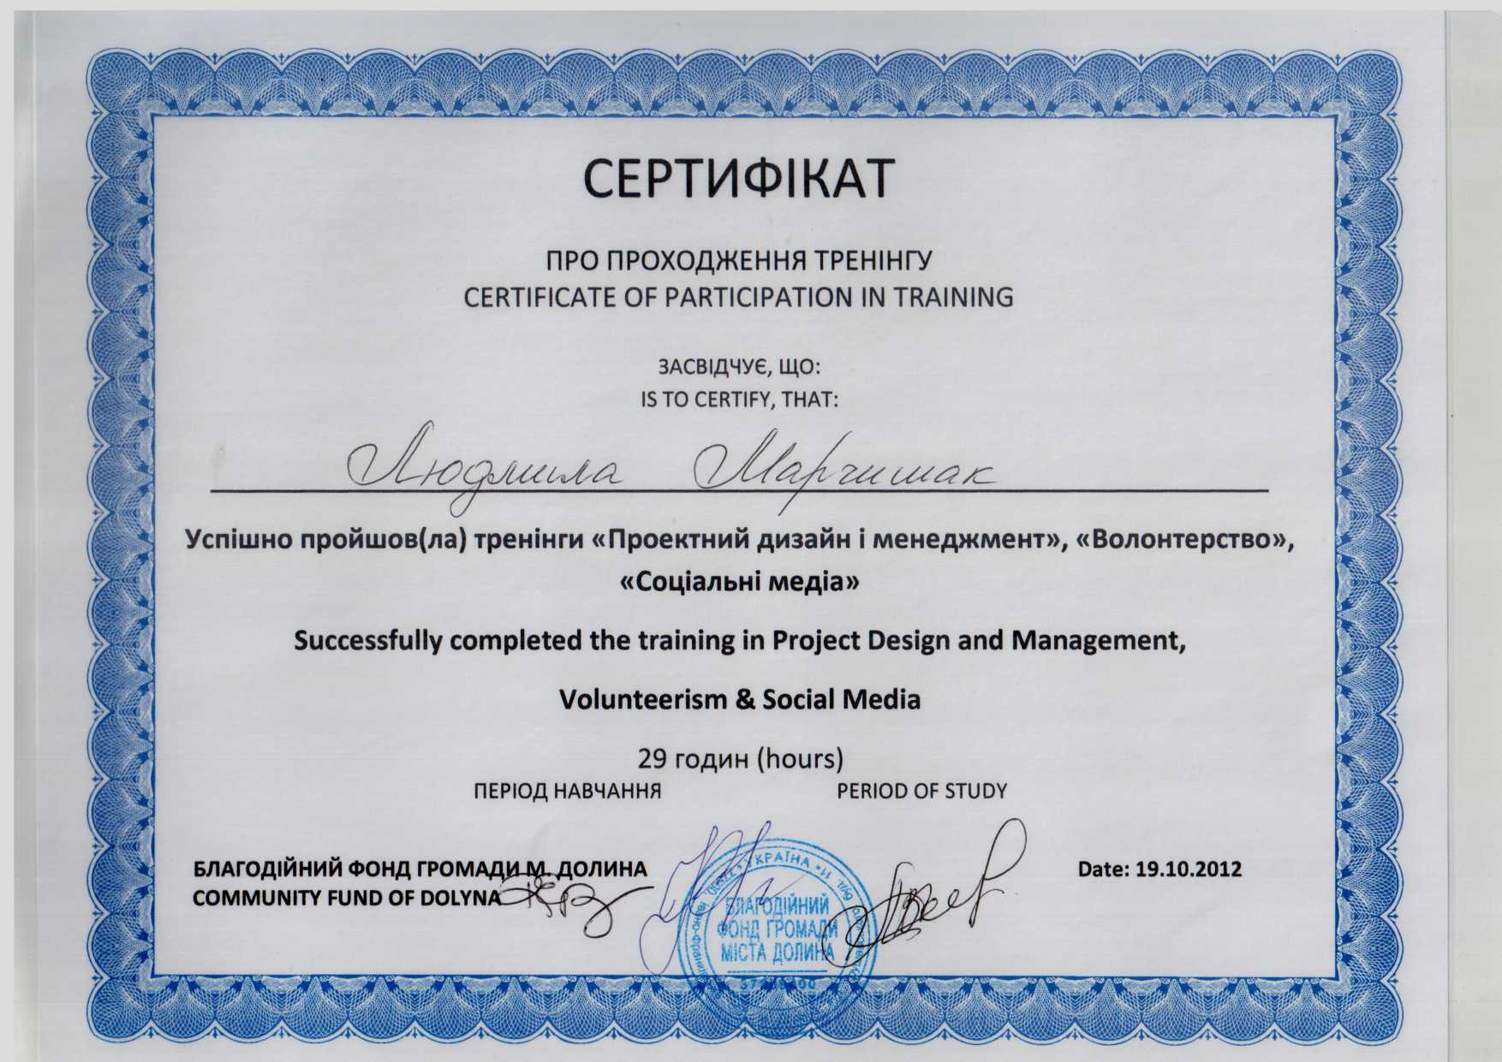
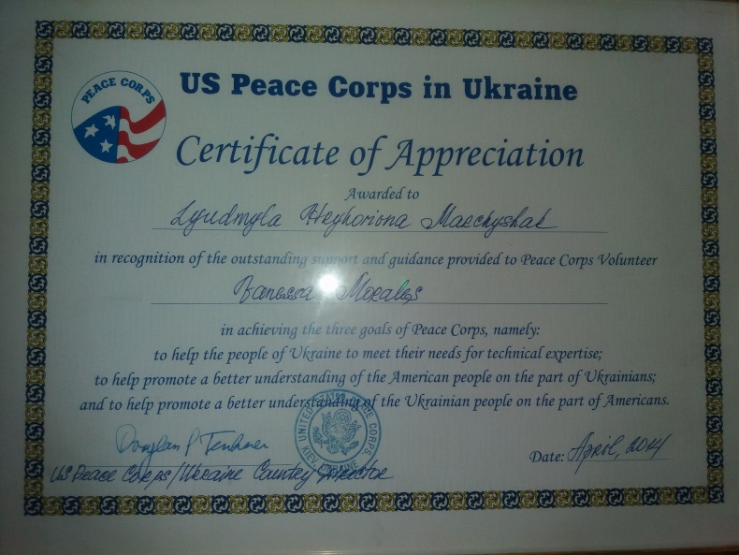
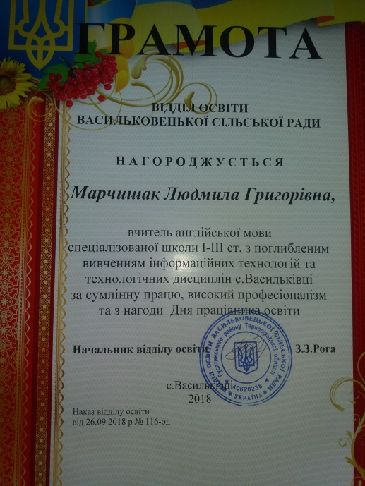
My awards and
certificates:

Slide 12
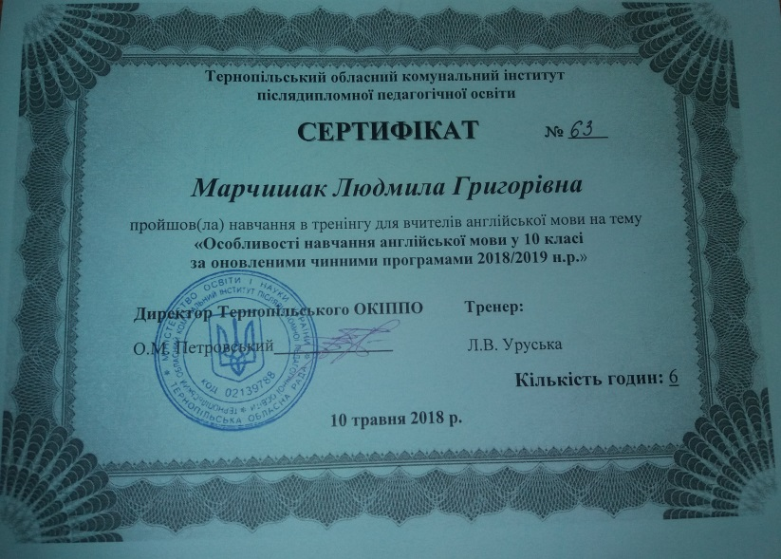
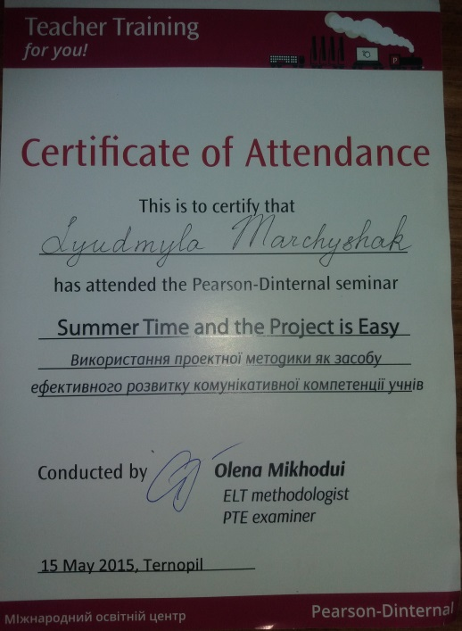
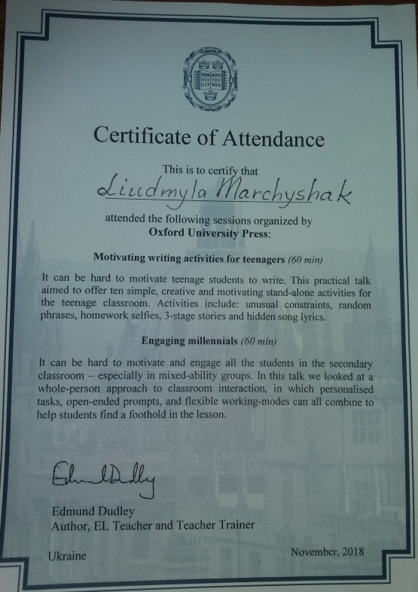
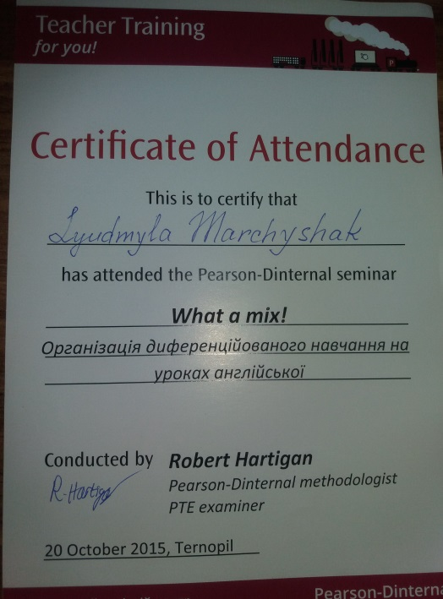
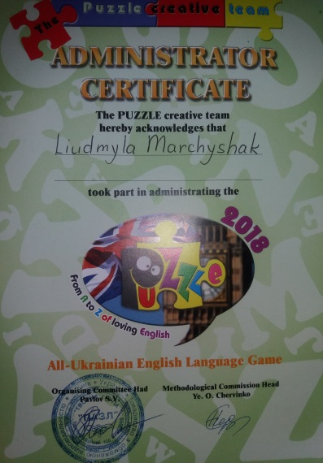
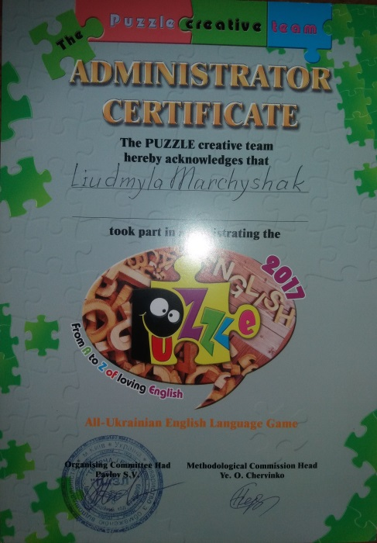
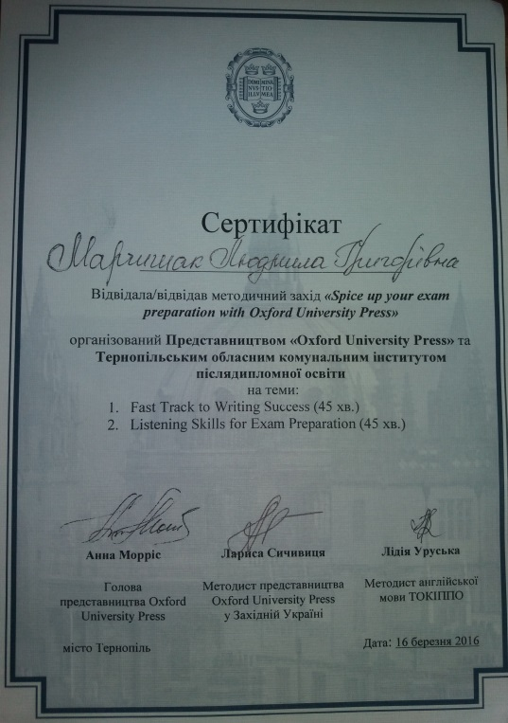
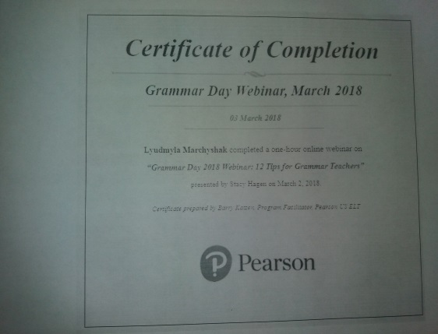
My awards and
certificates:

Slide 13
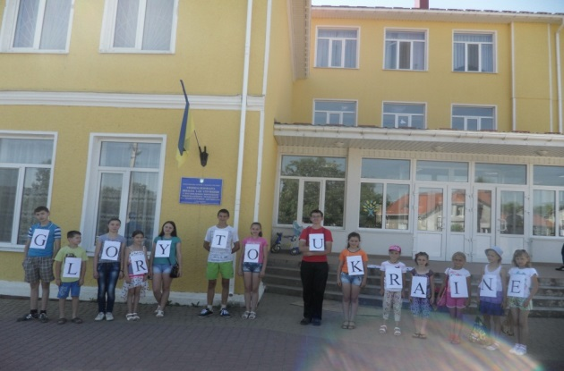
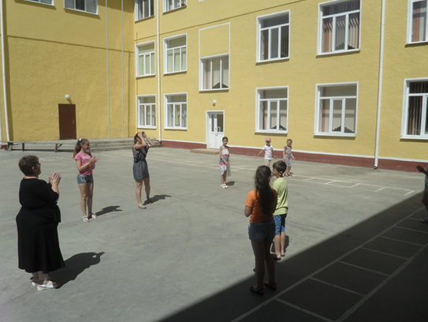
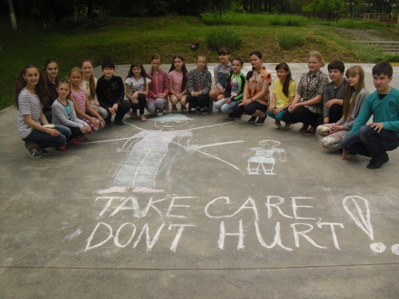
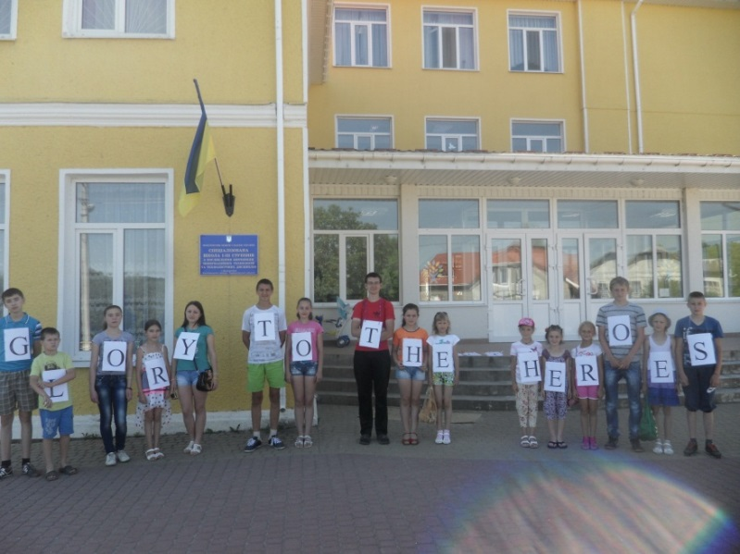
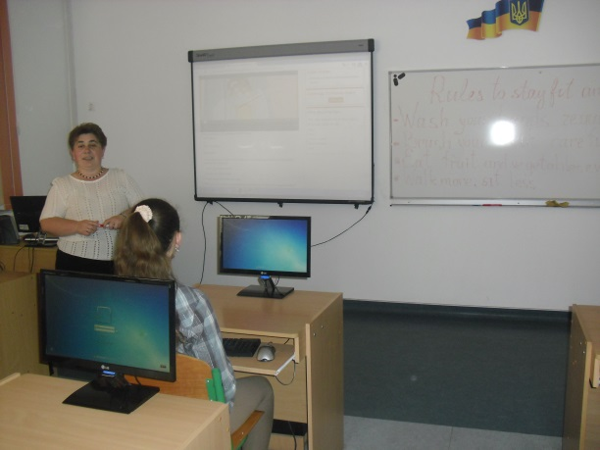
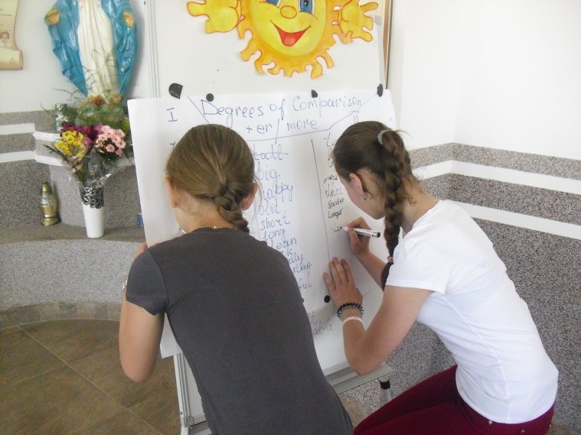
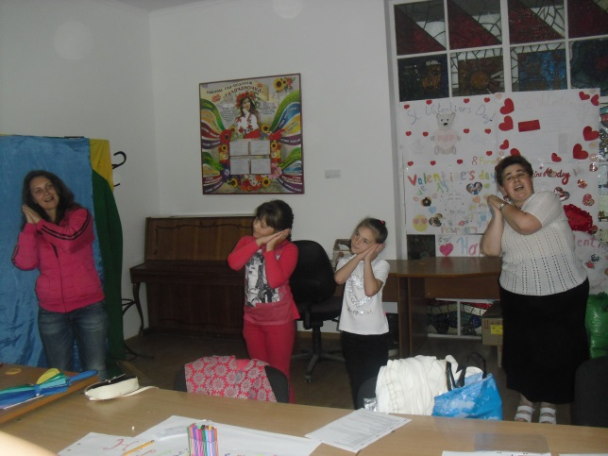
Summer camp “Mriia”

