Slide 1
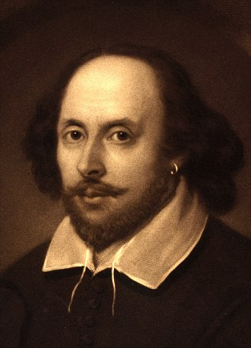
William Wordsworth
(7 April 1770 – 23 April 1850)

Slide 2
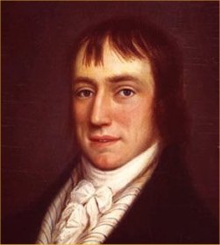
William Wordsworth was born April 7, 1770 in Kokermaute Cumberland County. William Wordsworth was the second of five children D.Vordsvorta

Slide 3
In 1779, young William Wordsworth defined in the classical school in Houkshede (North Lancashire), where he made an excellent knowledge of classical philology and mathematics and well-read in English poetry. In Houkshede future poet devoted much time favorite pastime - pedestrian walks.

Slide 4
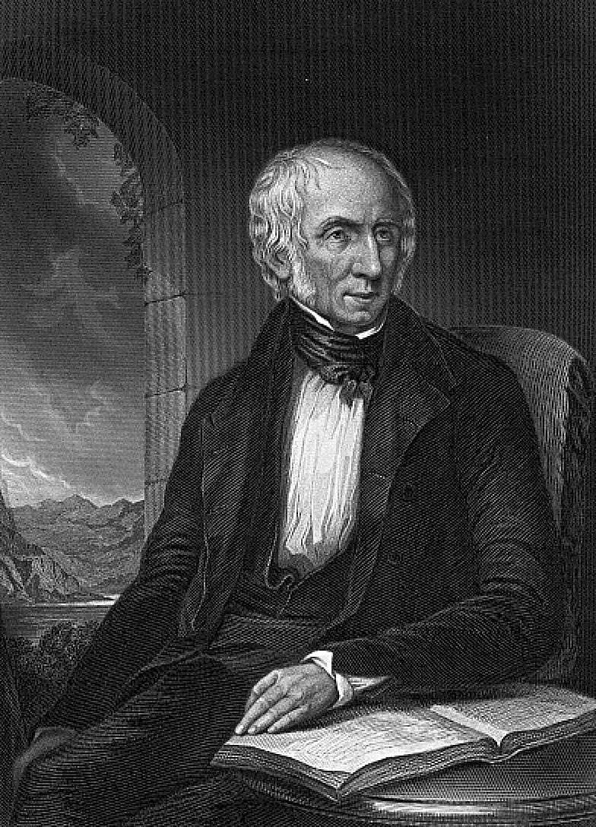

Slide 5
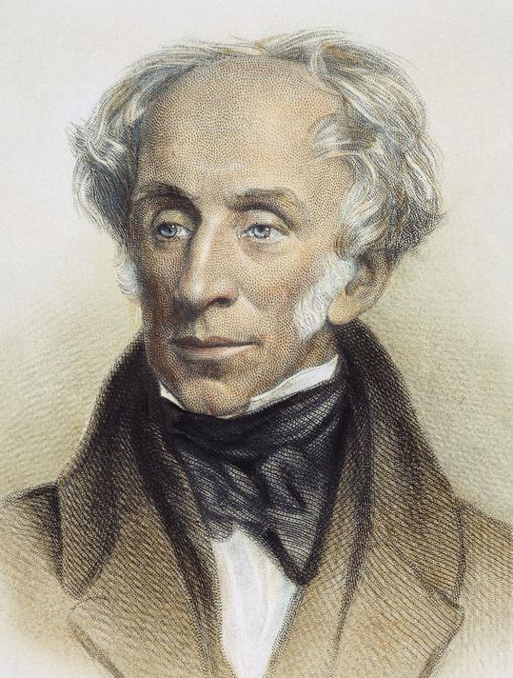

Slide 6
Already in 1787, William Wordsworth entered St. John's College, Cambridge, where he worked primarily in English literature and Italian. During the holidays, he walked around the Lake District and Yorkshire and wrote distihom heroic poem "Evening Walk," in which many insightful paintings of nature.
William Wordsworth

Slide 7
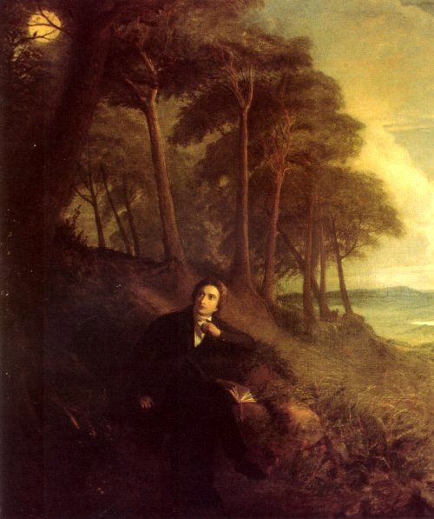

Slide 8
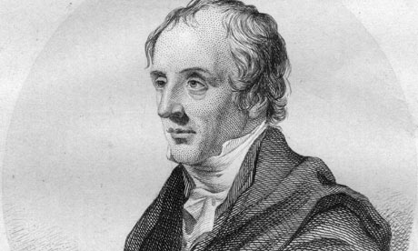
Wordsworth's father, although rarely present, taught him poetry, including that of Milton, Shakespeare and Spenser, in addition to allowing his son to rely on his own father's library. Along with spending time reading in Cockermouth, Wordsworth would also stay at his mother's parents' house in Penrith, Cumberland. At Penrith, Wordsworth was exposed to the moors. Wordsworth could not get along with his grandparents and his uncle, and his hostile interactions with them distressed him to the point of contemplating suicide.

Slide 9
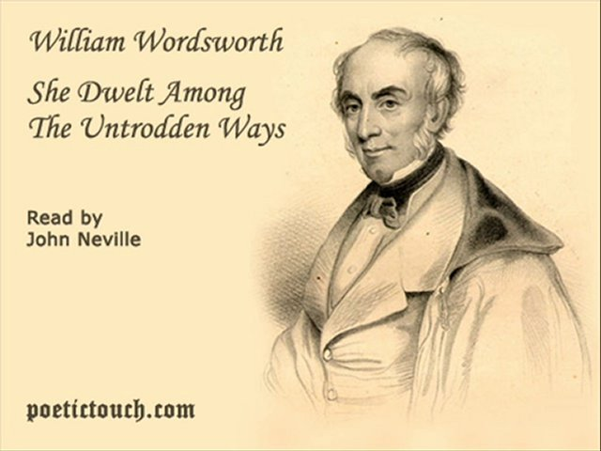

Slide 10
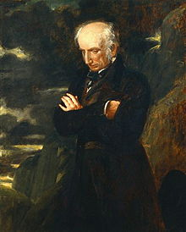
Wordsworth made his debut as a writer in 1787 when he published a sonnet in The European Magazine. That same year he began attending St John's College, Cambridge, and received his B.A. degree in 1791.He returned to Hawkshead for his first two summer holidays, and often spent later holidays on walking tours, visiting places famous for the beauty of their landscape. In 1790, he took a walking tour of Europe, during which he toured the Alps extensively, and visited nearby areas of France, Switzerland, and Italy.

Slide 11
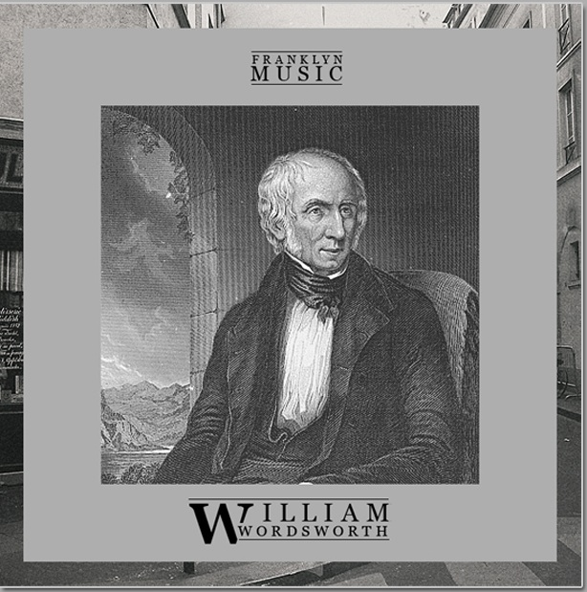

Slide 12
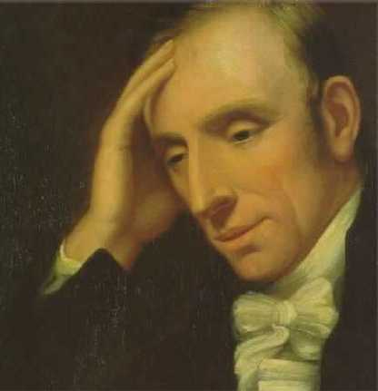
After the death of Robert Southey in 1843, 73-year-old Wordsworth was appointed by Queen Victoria poet laureate, but was not, unlike predecessors no special creative duties. In recent years, especially after the death of his daughter, Wordsworth virtually stopped writing poems.

Slide 13
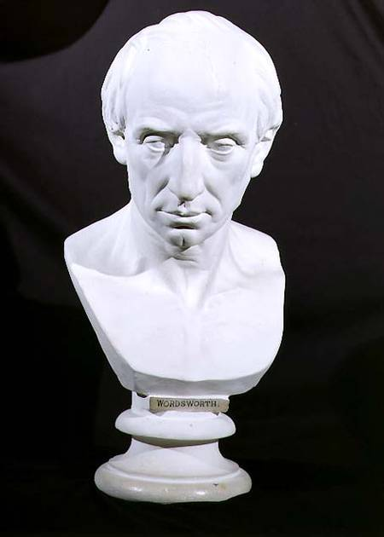
William Wordsworth died by re-aggravating a case of pleurisy on 23 April 1850, and was buried at St. Oswald's church in Grasmere.

