Slide 1
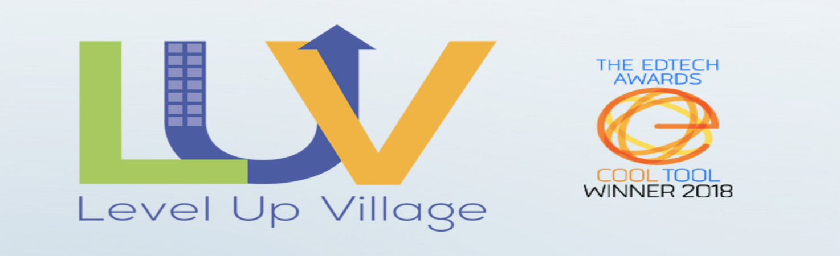
Participation in the international project “Level up village”
We are ready to break down
classroom walls

Slide 2

THEIR MISSION
Their mission at Level Up Village is to globalize the classroom and facilitate seamless collaboration between students from around the world via pioneering Global STEAM (STEM + Arts) enrichment courses.

Slide 3
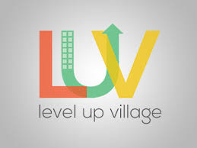
WHAT THEY DO
They offer STEAM courses for students. Schools run their courses to students in-school, after school and during the summer. In each course, they connect your students with peers in other countries – students exchange video letters with their global partner students and collaborate on projects. By partnering with them, schools also sponsor STEAM education in the developing world through their “Take a Class, Give a Class” model.
https://www.levelupvillage.com

Slide 4
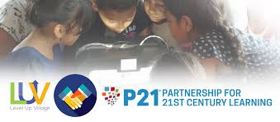
21ST CENTURY SKILLS
To be successful in the jobs of the future, students will need to apply learning across various disciplines and collaborate across national, social and economic divides. By participating in Level Up Village courses, students not only develop cutting-edge STEAM Skills, but also the softer skills of global collaboration and communication.

Slide 5
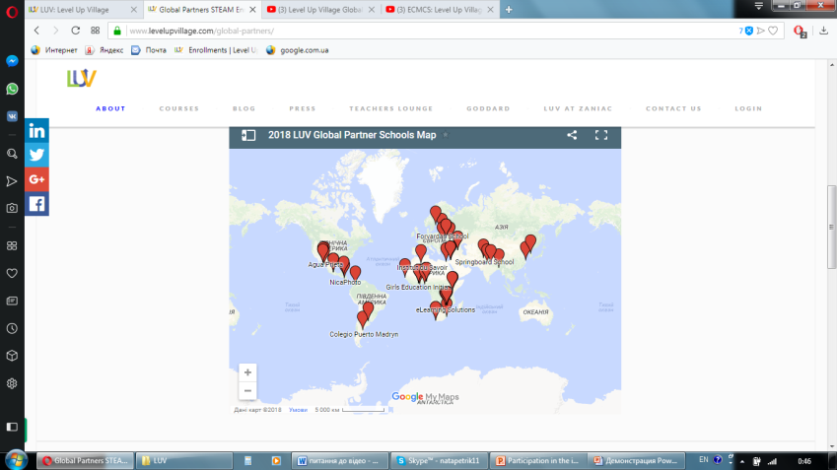

Their REACH
A social impact company based in Old Greenwich, Connecticut, Level Up Village runs courses at more than 400 public and private schools in the U.S., the U.K. and Australia with 40+ Global Partner organizations in more than 20 countries.

Slide 6
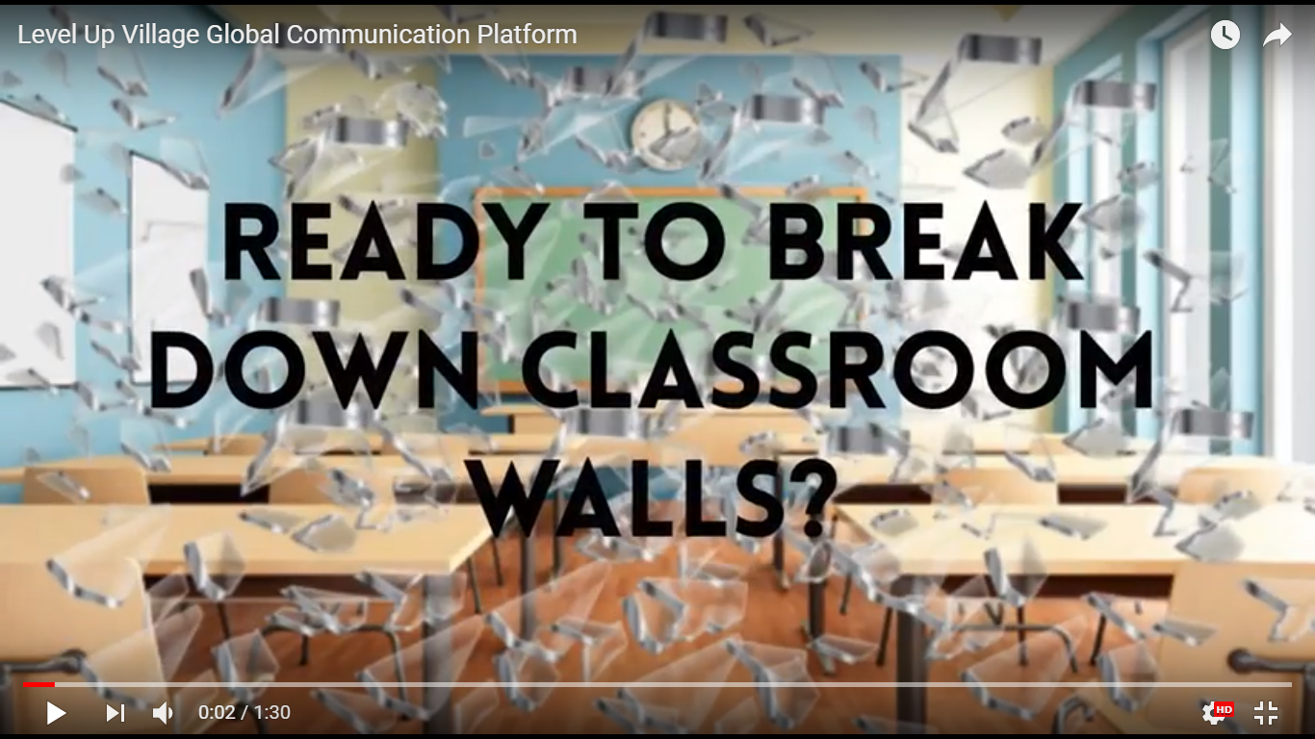
https://youtu.be/YH6ldMFRxDs
https://youtu.be/YH6ldMFRxDs

Slide 7
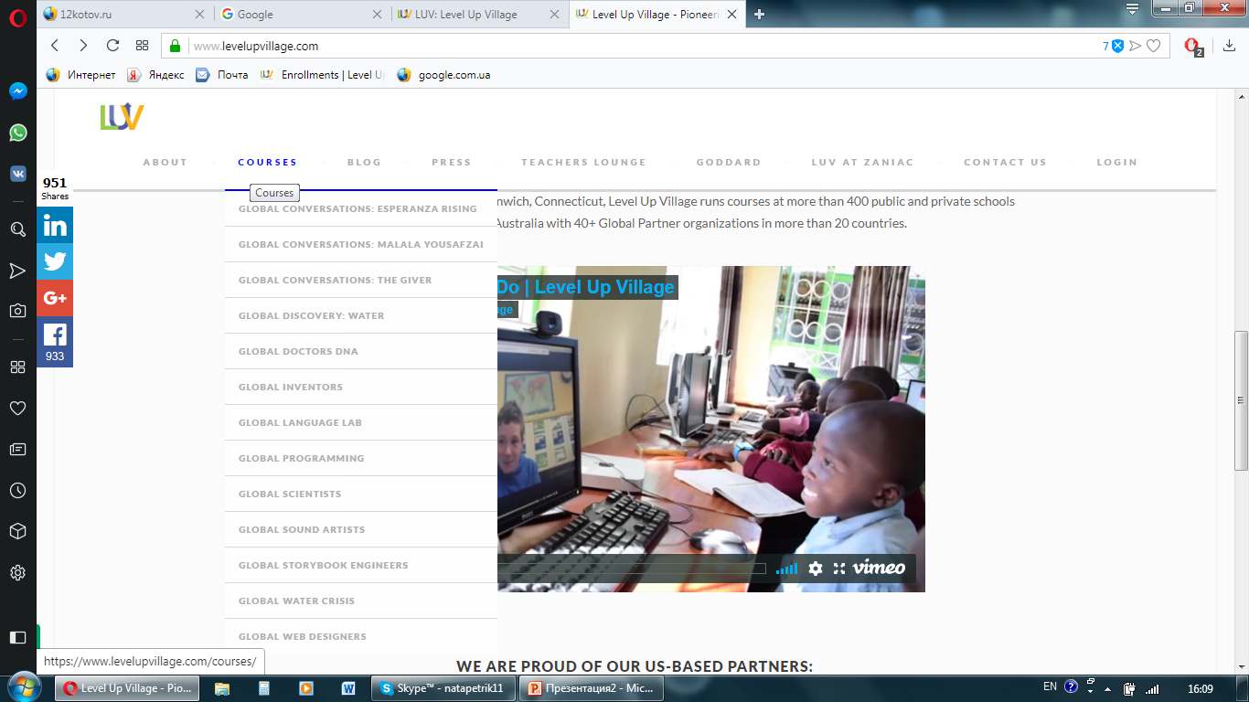

Slide 8
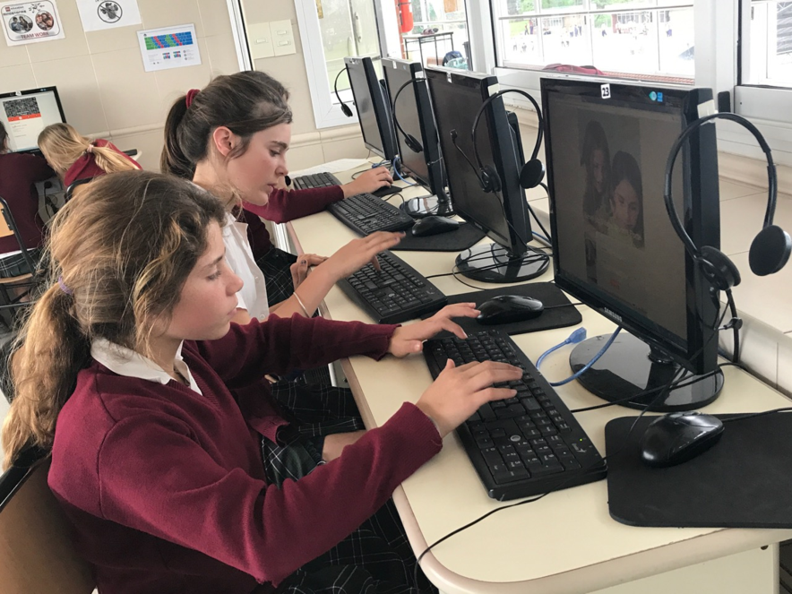
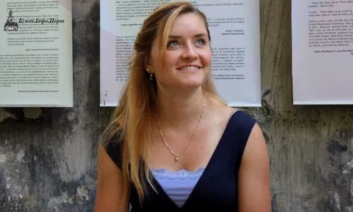
Level Up Village recently began working with Buchach lyceum. It’s due to American Peace Corps volunteer Caroline Kaufman, who teaches English at the lyceum.

Slide 9
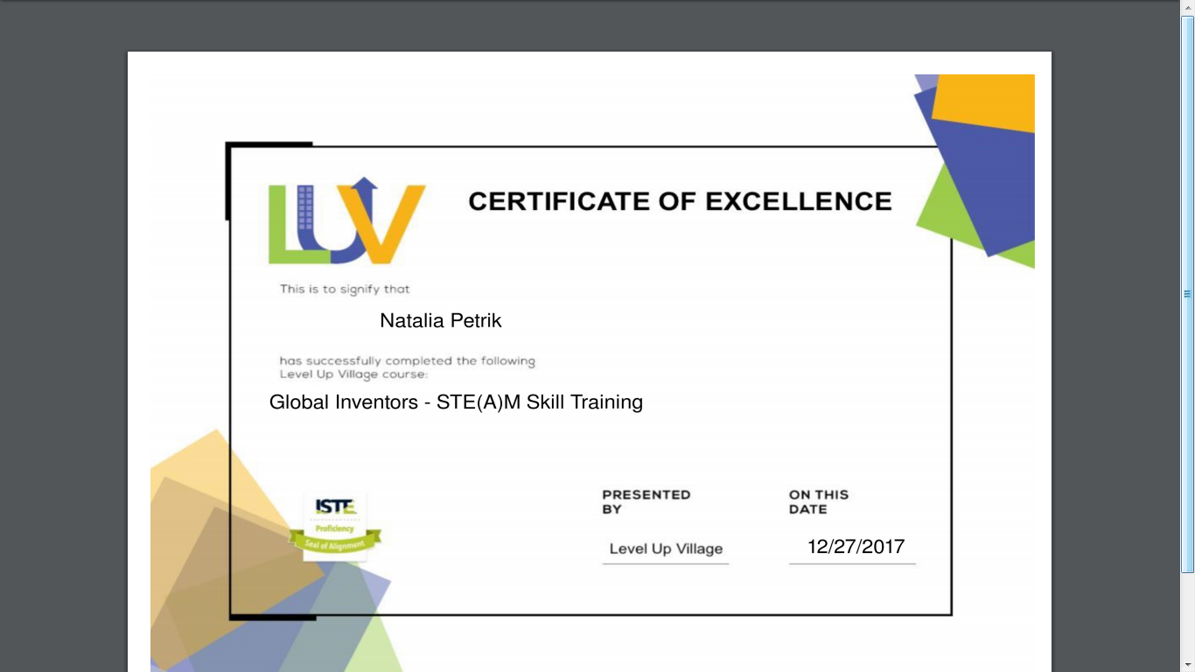
Before starting to work with children in Level Up village courses our teachers had to complete four modules and got a certificate

Slide 10
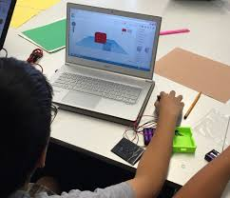
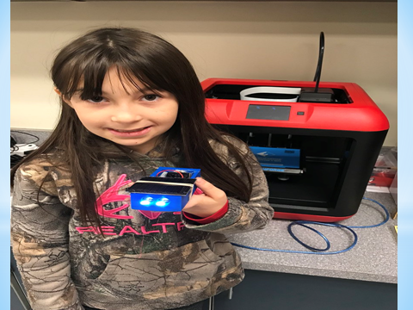
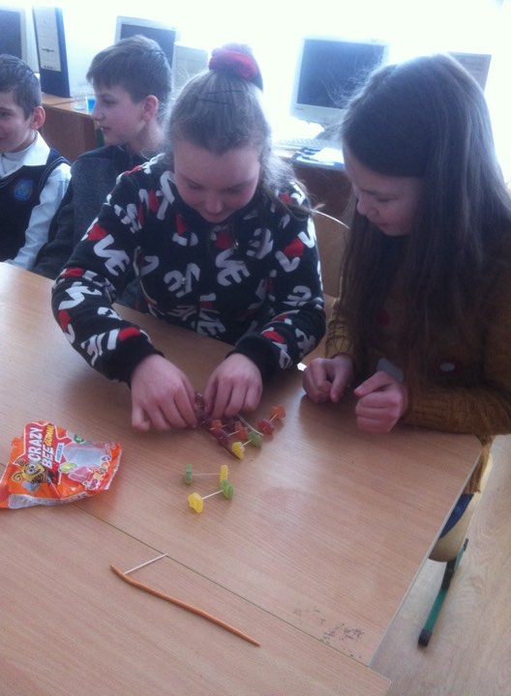
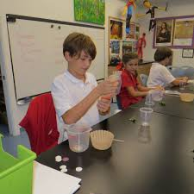
Students of Buchach lyceum took part in two courses:
Global Inventors
Global Doctors DNA

Slide 11
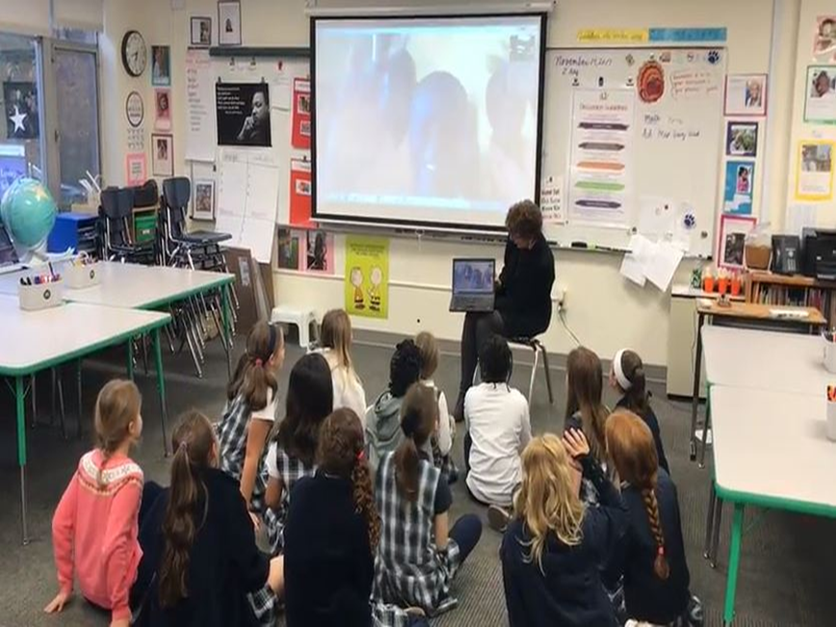
Global inventors
25 students from the 8th and the 10th forms of Buchach lyceum were eager to participate in Level Up Village’s Global Inventors 3D printing course with partner students in the United States. They used both computers and mobile phones to access LUV’s Global Communications Platform.

Slide 12
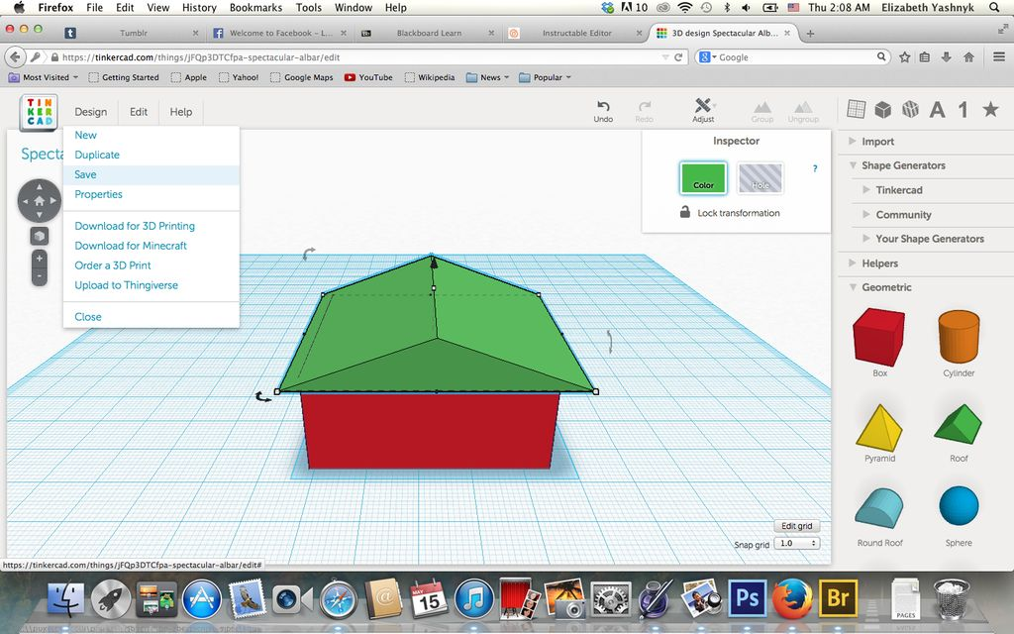
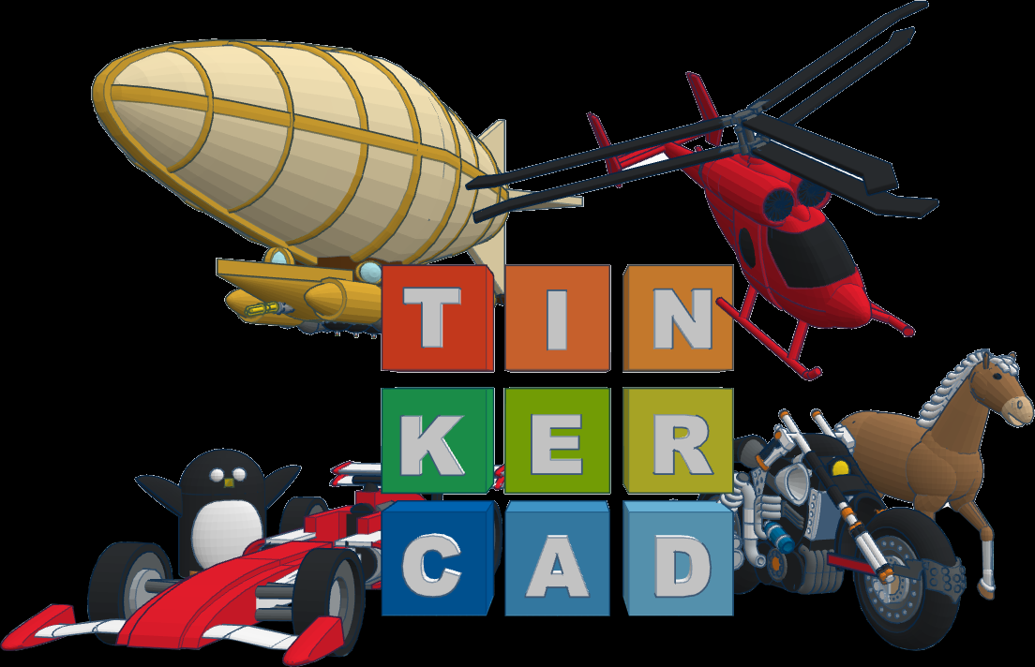
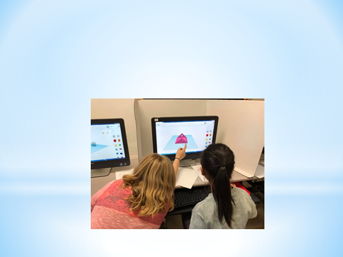
Participating in this course our students used 3D design program Tinkercad, in which they could create solar light design

Slide 13
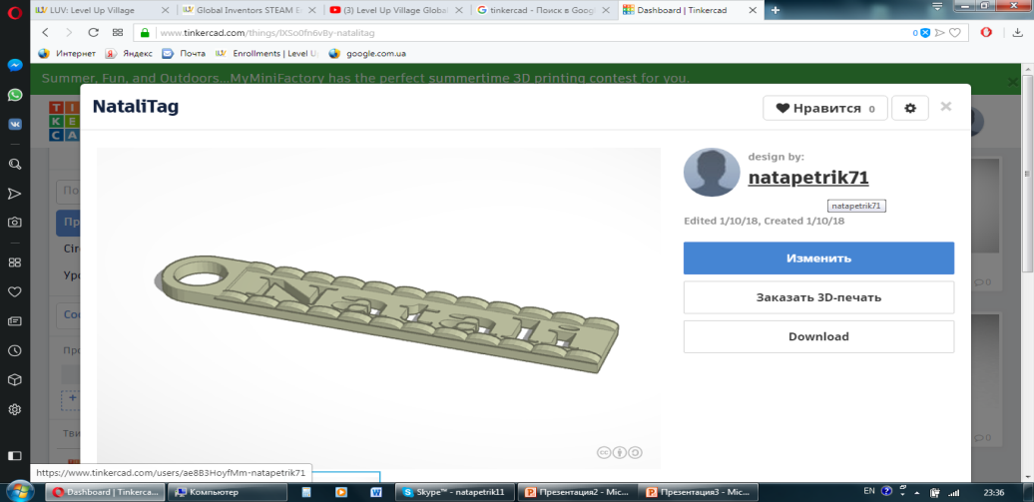
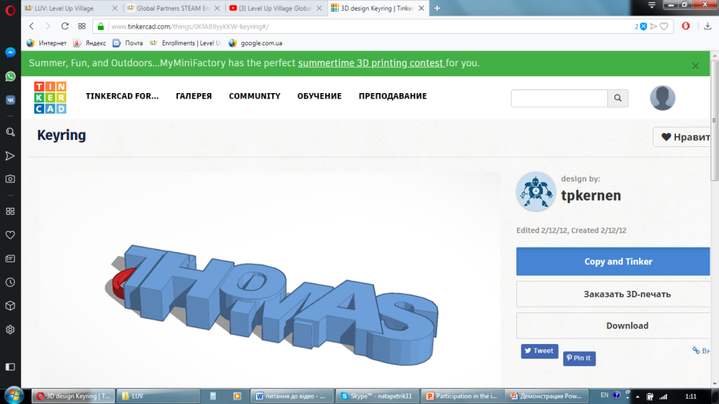
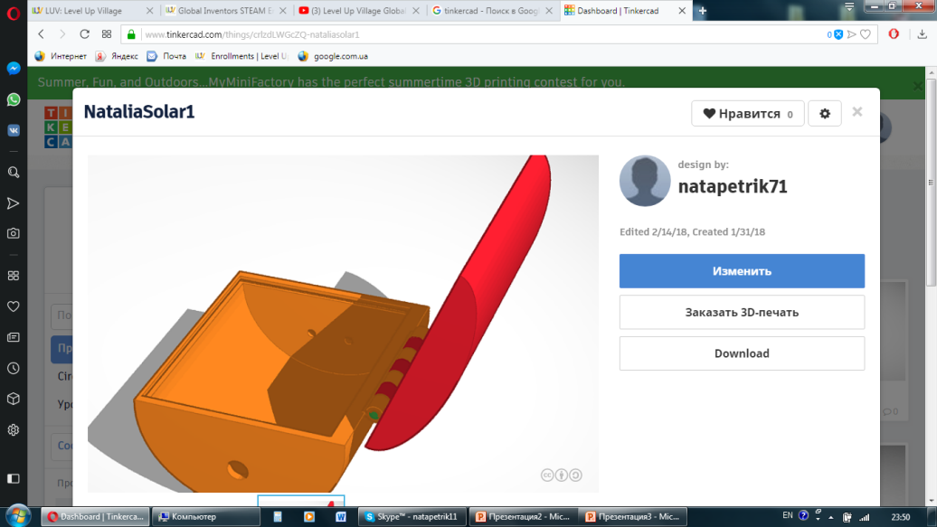
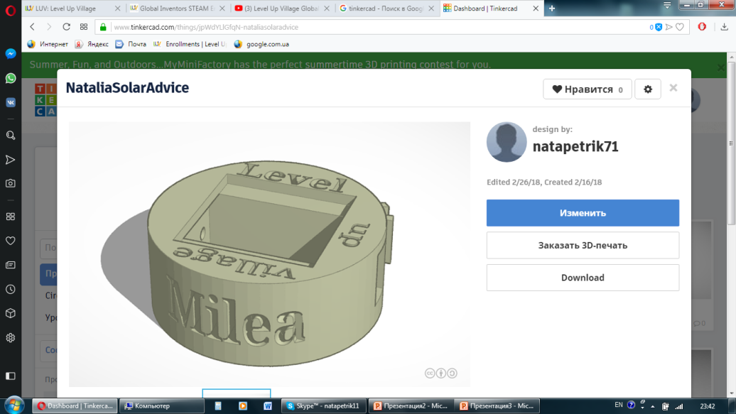
First they created key ring with their name on it
Then they created their own solar light box

Slide 14
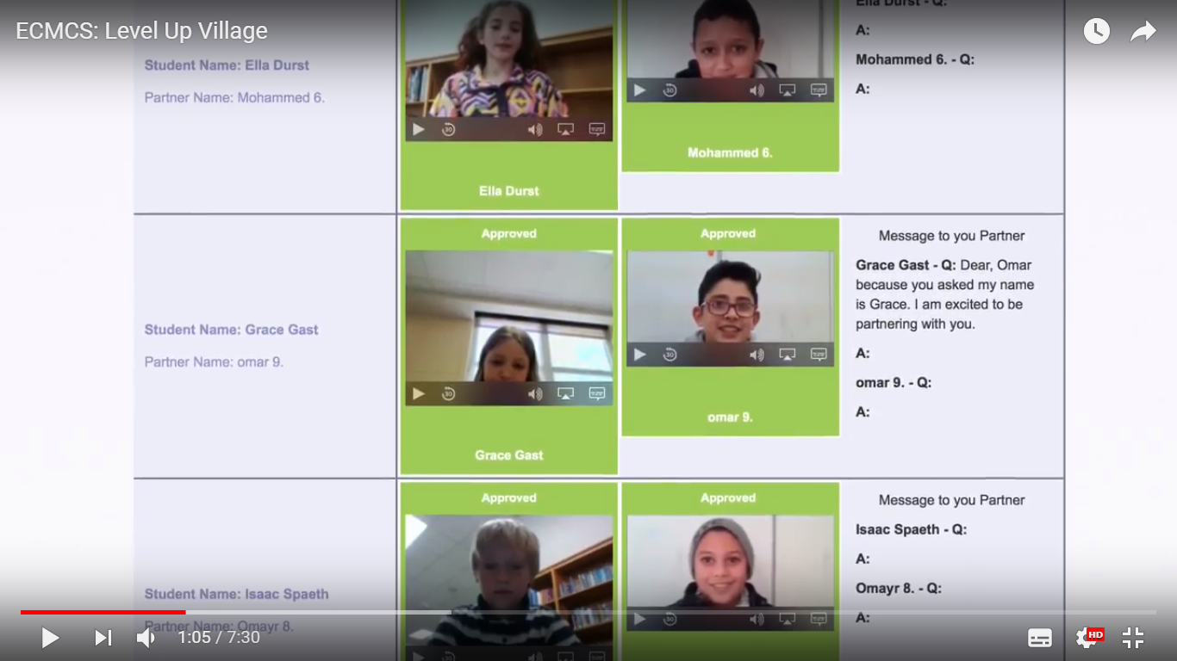
And also they communicated and collaborated

Slide 15
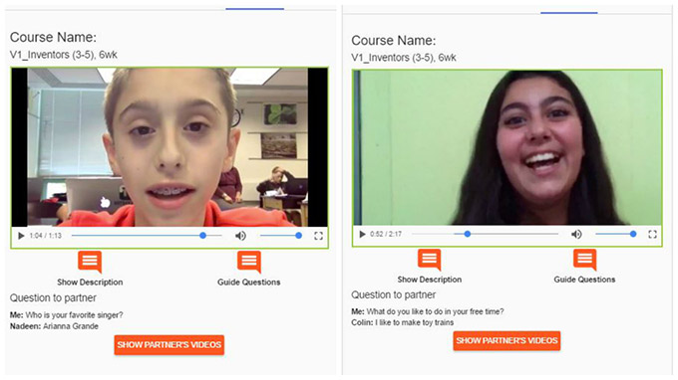
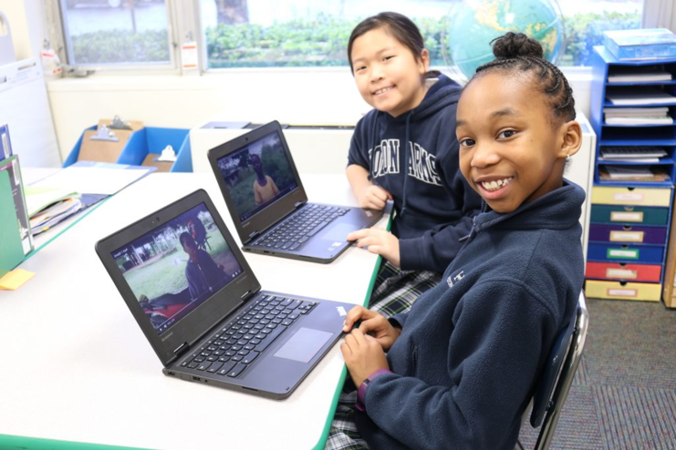
What did this course give to our students
Students in this class have learnt about the power of 3D printing, one of the most innovative technologies of our time. In this exciting course, they have also learnt how to use Computer Aided Design (CAD) software to create and modify a series of designs. The final project was to work together with their global partners to create and 3D print a solar-powered light source, all while exchanging video messages about their projects and daily life in each of their countries.

Slide 16
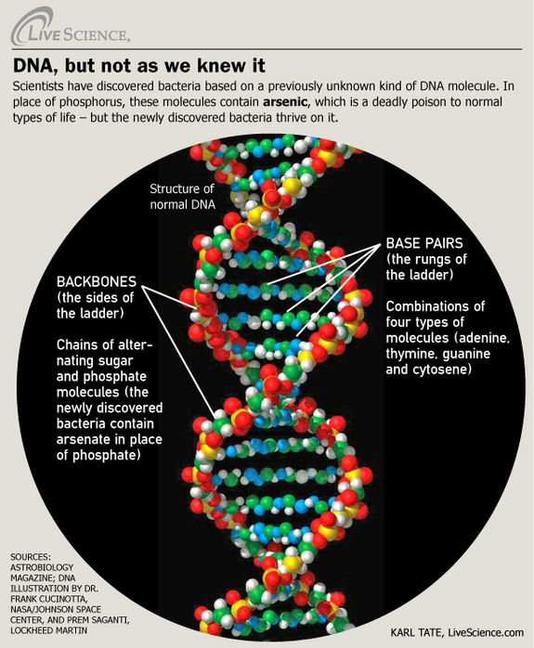
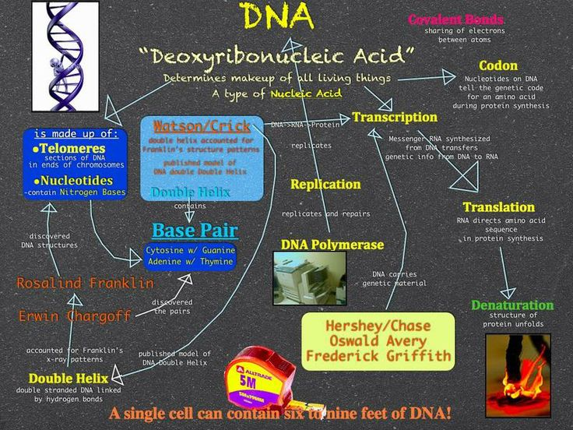
Global doctors DNA
20 students from the 7th and the 8th forms of Buchach lyceum have chosen the Level Up Village course Global Doctors DNA

Slide 17
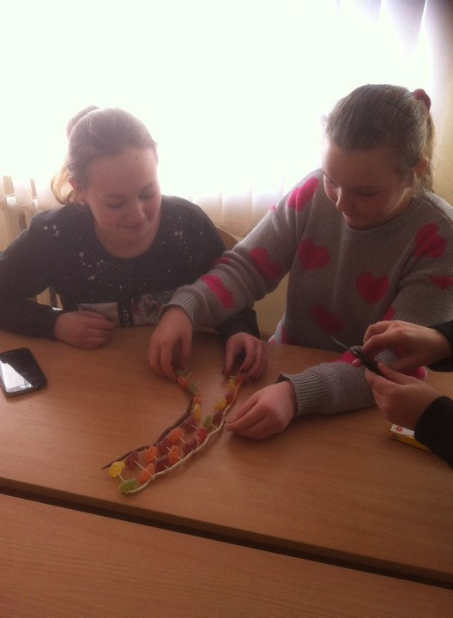
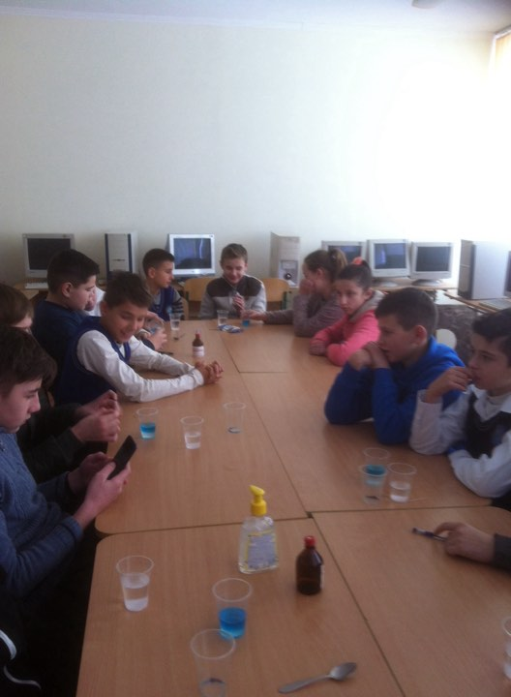
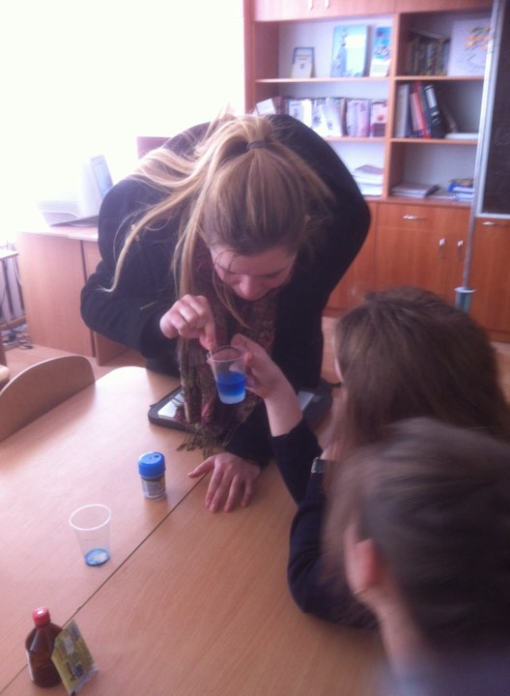
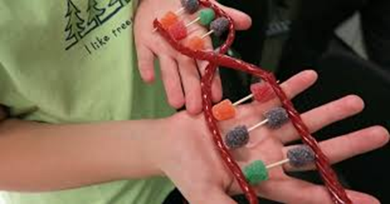
What did this course give to our students
In this course our students have explored whether the environment or DNA determines who we are as individuals and how we live our lives. Together with their Global Partner, students learnt about genetics and epigenetics while discovering how environmental and social conditions around the world can influence those things for better or worse. They also conducted a variety of experiments and participated in activities such as making Punnett squares, building molecular models and delving into case studies of genetic traits and mutations.

Slide 18

All in all, I believe LUV has given us a great opportunity to open our minds, share and learn from other cultures, and the most important thing is that it has provided real life context for children to work and communicate. It’s certainly not the same when kids ask for help to speak correctly because they’re completing a worksheet than when they ask for help because they need to tell something to their new US friend. We are very thankful for this opportunity, and looking forward to more LUV projects!
https://www.youtube.com/watch?v=N11m-vkRX3c

