Slide 1
Тема: Україна. Ми чекаємо на гостей.
Мета: розвивати комунікативні здібності, спостережливість, пам'ять і слух учнів
сприяти розвитку мовної здогадки, мовленнєвої реакції;
удосконалювати техніку читання;
виховувати активність, стимулювати інтерес до вивчення предмета;
виховувати почуття поваги до Батьківщини.

Slide 2
І. Організаційний етап
1) Привітання
Т: Good morning! How are you today? I’m very glad to see you healthy, active and ready for the lesson.
2) Повідомлення теми, мети уроку
T: Today we’ll start a new topic. Solve the crossword

Slide 3
Find antonyms:
1.
 |  | 2
3
4
 | 5
6
 | 7
1. The North 2. Angry 3. Warm 4. white 5. Tell 6. summer 7. Far

Slide 4
3) Введення в іншомовну атмосферу
Try to describe our country, using the letters
U
K
R
A
I
N
E
Unusual
Known
Rich
Arresting
Interesting
Native
Enjoyable

Slide 5
II. Основний етап
Speaking
Remember some words you have learned:
Europe, to be situated, an area, to border, to wash by, mild and soft climate, population, mountains, river, capital, country, language.
(Техніка «Зникло слово» - учні закривають очі, в цей час вчитель стирає одне-два слова. Завдання – згадати і відтворити слово)

Slide 6
Answer the questions using the map.
Where is Ukraine situated?
What is the area of Ukraine?
What can you say about its geographical position?
What countries does Ukraine border on?
What seas is Ukraine washed by?
What rivers and mountains are there on the territory of Ukraine?
What about the climate of Ukraine?
What is the population of our country?
What nationalities inhabit Ukraine?

Slide 7
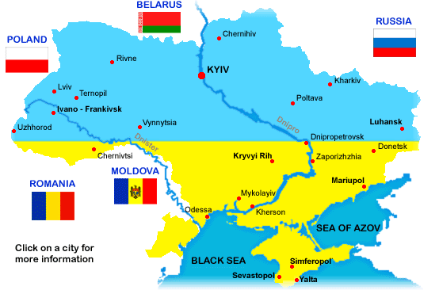

Slide 8
Reading
Read interesting facts about Ukraine:
After the European part of Russia, Ukraine is the largest country in Europe.
The Stone Grave, sixteen kilometers from the city of Melitopol in the region of Zaporizhzhya, is an important archaeological site. The monument, also known as the Stone Library, contains petroglyphs (stone drawings) from ancient times.

Slide 9
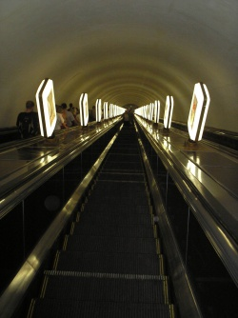
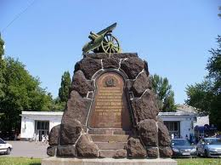
Arsenalnaya Metro Station located in Kiev is the deepest in the world (105 meters). The station was built in 1960, very close to the House of Parliament.

Slide 10
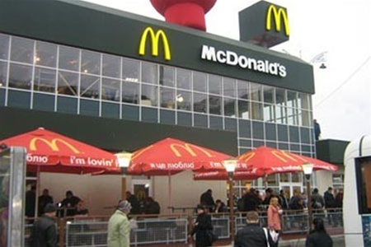
The third most visited McDonald’s in the world is located in Kiev, near the train station.

Slide 11
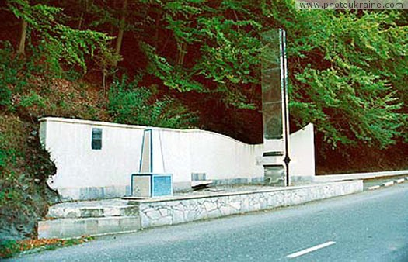
Geographical center of Europe is situated in Ukraine. It is in Dilove village near Rakhiv town in Carpathian Mountains of Western Ukraine.

Slide 12

Ukrainian is the second most melodic language in the world after Italian.

Slide 13
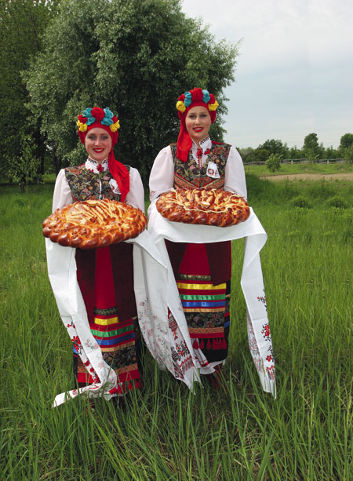
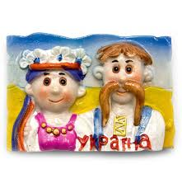
The greatest treasure of Ukraine is its people who are light-hearted, hospitable, and generous.

Slide 14
ІІІ. Заключний етап
Домашнє завдання
Підсумки уроку
What do you know about Ukraine? How do you understand the proverb:
“East or West, home is best”.
Оцінювання

