Slide 1
SEASONS AND WEATHER
By Oksana Solodka

Slide 2
IT IS SPRING

Slide 3
IT IS SUMMER

Slide 4
IT IS AUTUMN

Slide 5
IT IS WINTER

Slide 6
WHEN IS YOUR BIRTHDAY?
MY BIRTHDAY IS IN …. (WINTER)
(spring, summer, autumn, winter)

Slide 7
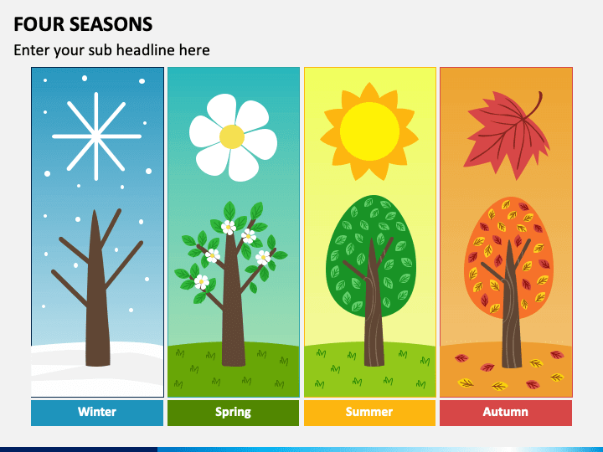
https://www.youtube.com/watch?v=RnqYRHW5IaY
SPRING IS GREEN,
SUMMER IS BRIGHT,
AUTUMN IS YELLOW,
WINTER IS WHITE

Slide 8
WHEN IS IT HOT?

Slide 9
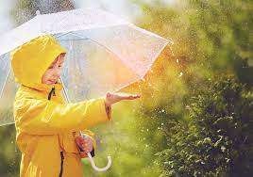
WHEN IS IT RAINING?

Slide 10
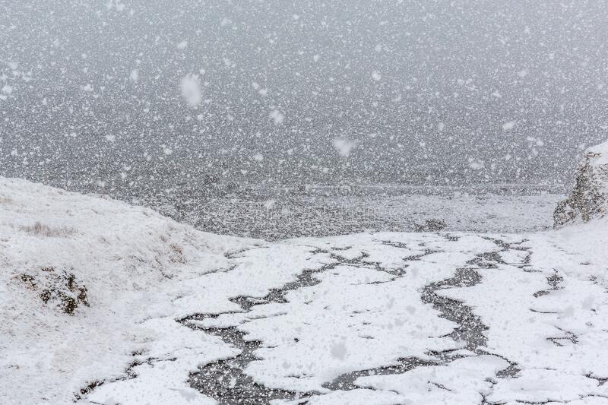
WHEN IS IT SNOWING?

Slide 11
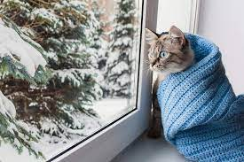
WHEN IS IT COLD?

Slide 12
https://www.liveworksheets.com/worksheets/en/English_as_a_Second_Language_(ESL)/Seasons/Seasons_in_English_dd12647dp
https://www.liveworksheets.com/worksheets/en/English_as_a_Second_Language_(ESL)/Weather/Seasons_and_clothes_pq3062nk
https://www.liveworksheets.com/worksheets/en/English_as_a_Second_Language_(ESL)/Seasons/Seasons_and_weather_jb181669me
https://www.youtube.com/watch?v=id1Ft22Ptmg&t=50s

