Slide 1
LETTERS
By Oksana Solodka

Slide 2
https://www.youtube.com/watch?v=75p-N9YKqNo

Slide 3
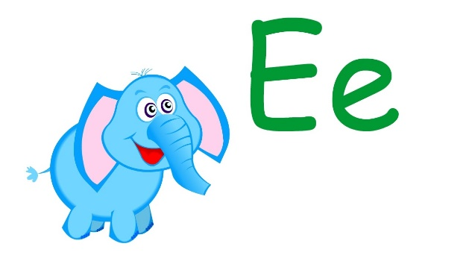
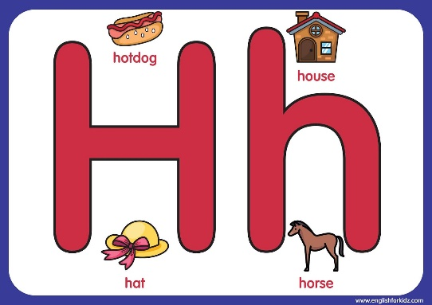

Slide 4
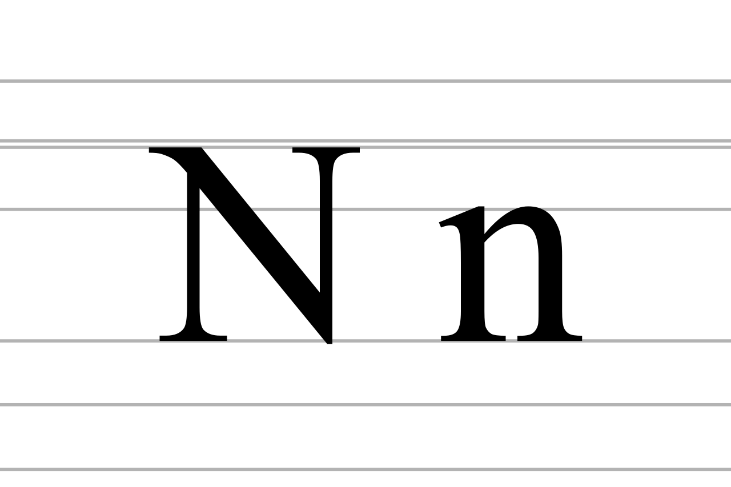
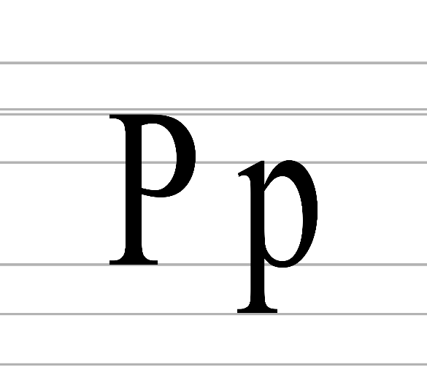
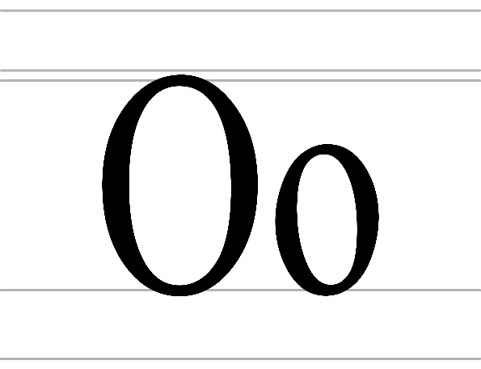
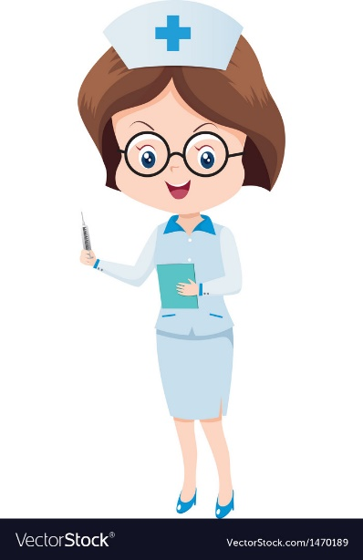
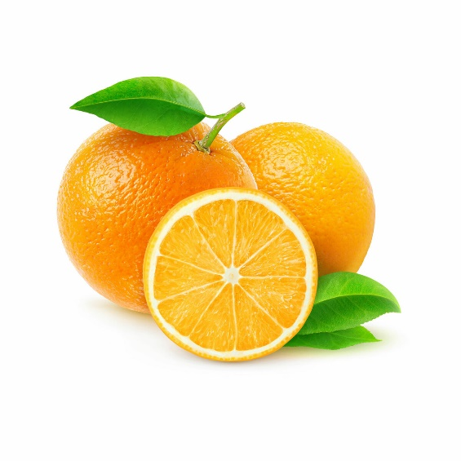
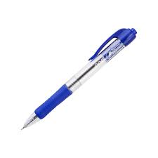
Mum
Nurse
Orange
Pen

Slide 5
Books, p.33
https://faf2e.ouponlinepractice.com/lms/index
(ex. 1, 2, 3, 4)
https://faf2e.ouponlinepractice.com/lms/workbook?bookid=ff1

Slide 6
