Slide 1
JOBS
By Oksana Solodka

Slide 2
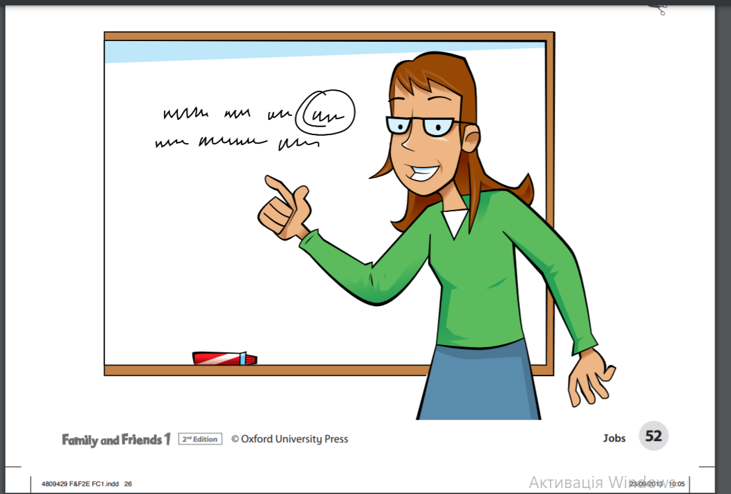
A teacher

Slide 3
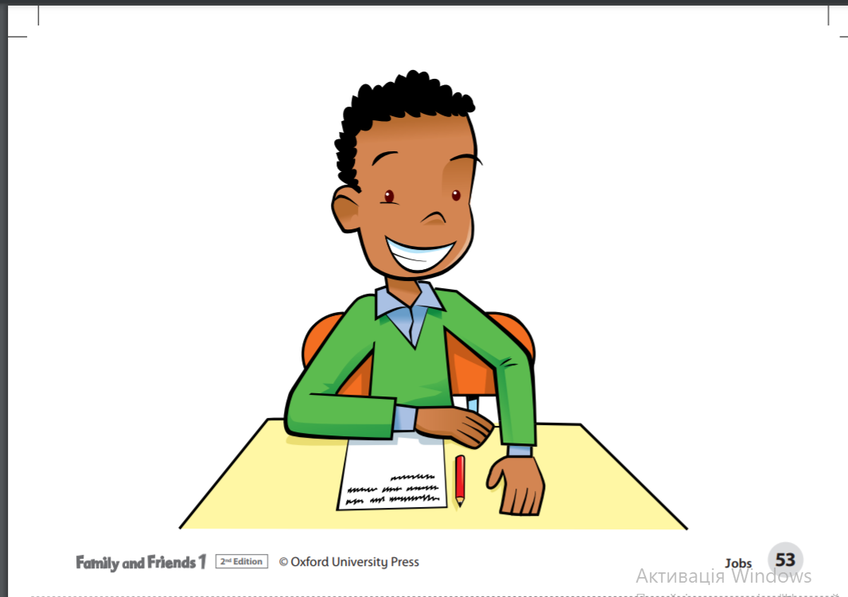
A pupil

Slide 4
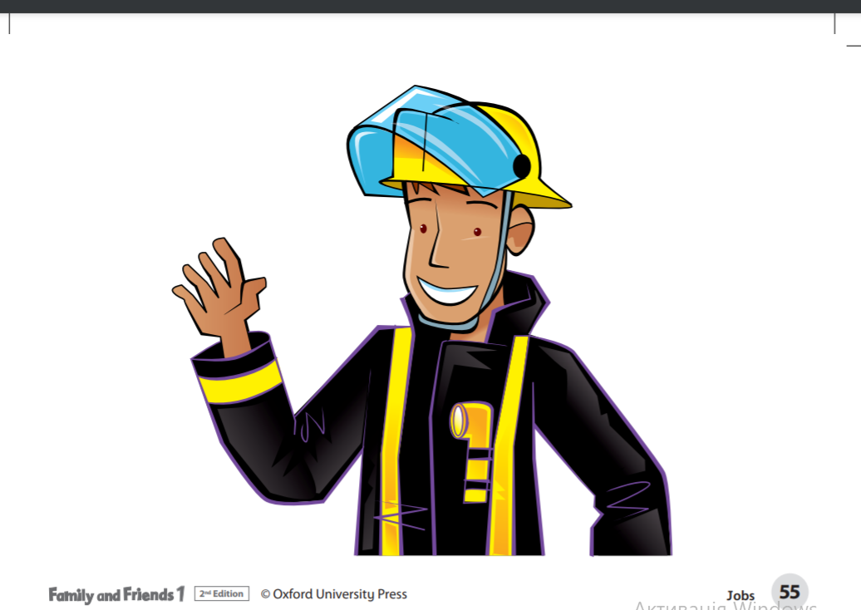
A fireman

Slide 5
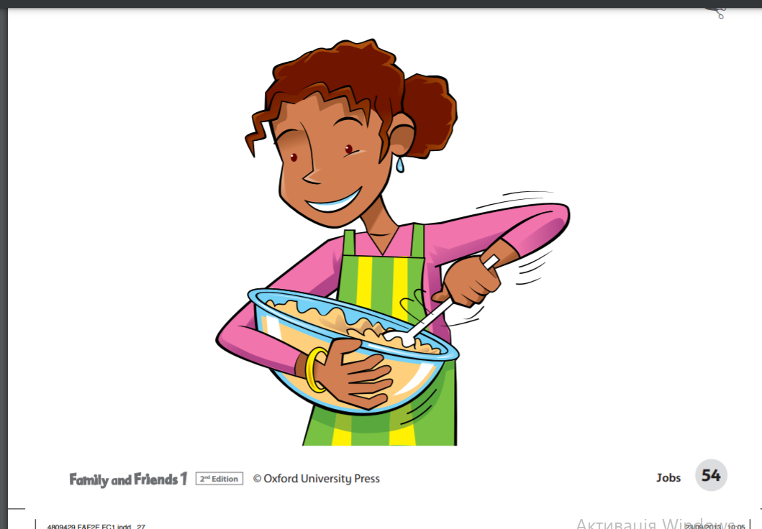
A housewife

Slide 6
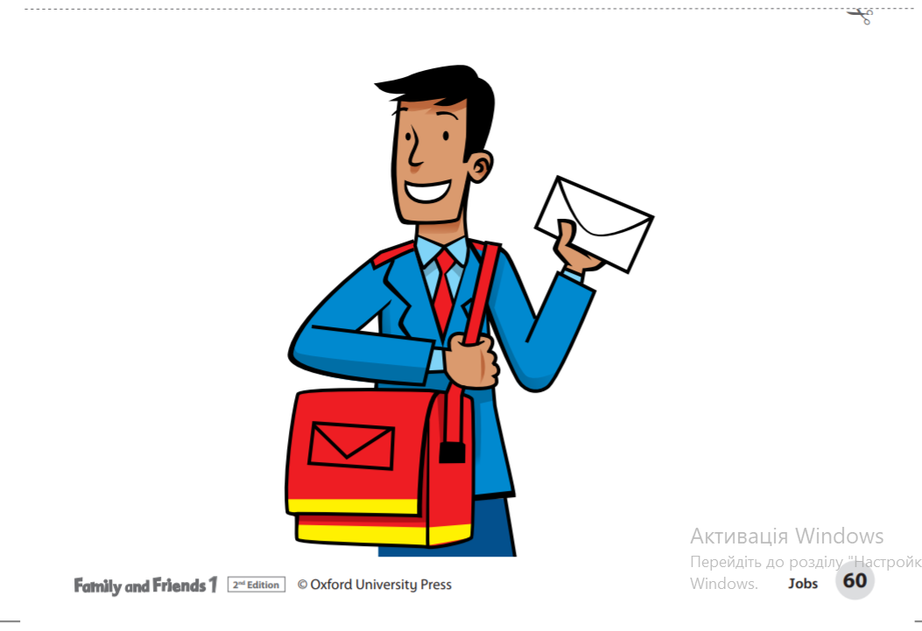
A postman

Slide 7
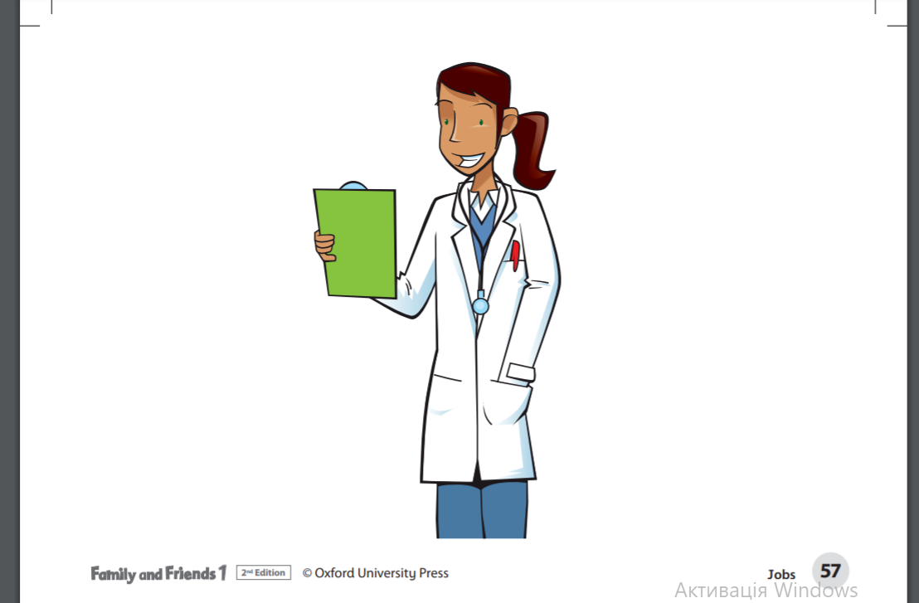
A doctor

Slide 8
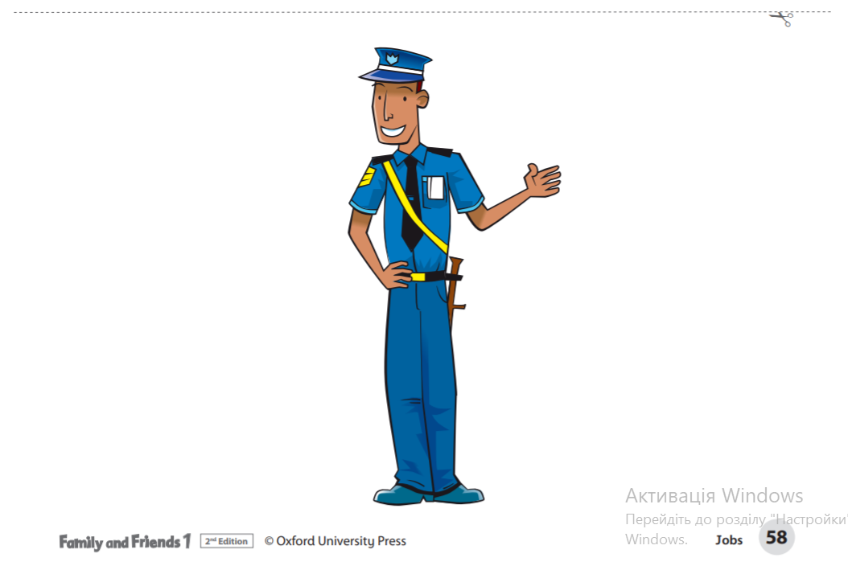
A policeman

Slide 9
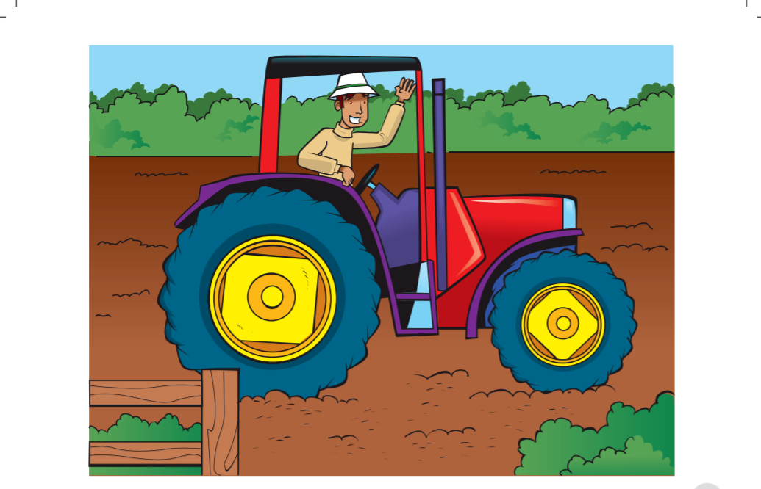
A farmer

Slide 10
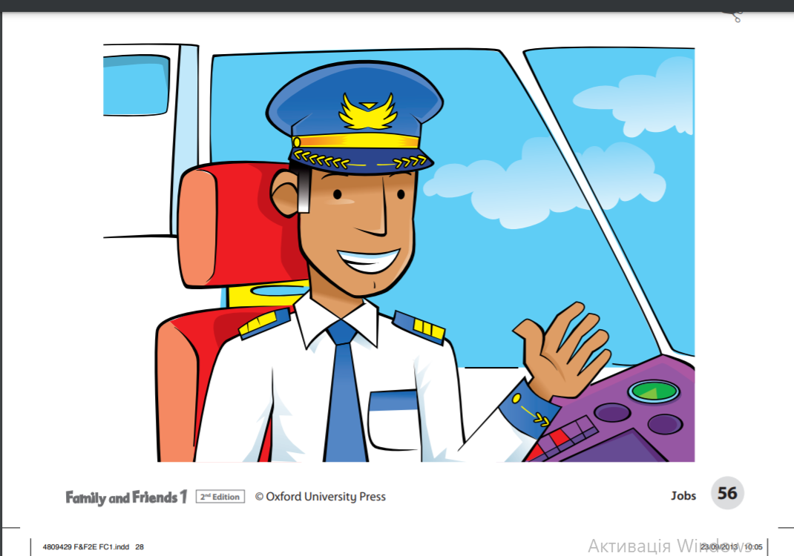
A pilot

Slide 11
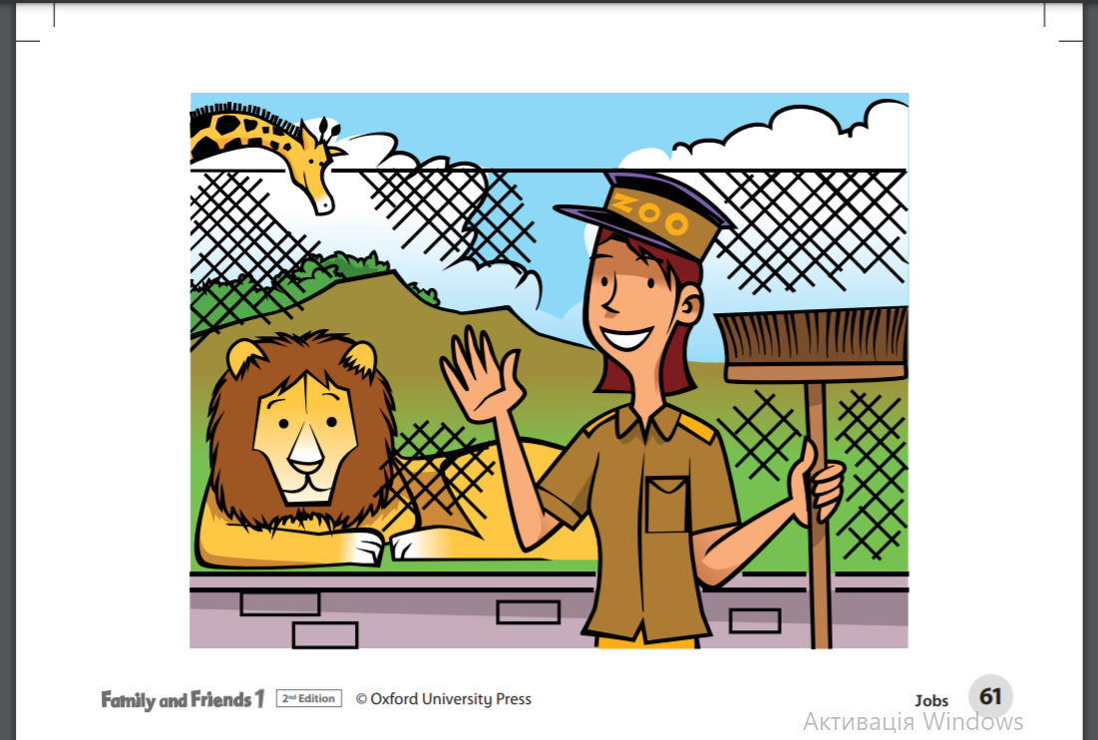
A zookeeper

Slide 12


Book, p. 34
https://faf2e.ouponlinepractice.com/lms/book?bookid=ff1 (describe the pictures, name the jobs, remember family words, listen and follow)
Ex. 2 (read and repeat, some pupils)
Ex. 3 (together, write yes/no)

Slide 13
Online
https://faf2e.ouponlinepractice.com/lms/workbook?bookid=ff1
HT: p. 34 (WB)

