Slide 1
Unit 4. Food
By Oksana solodka

Slide 2
ARE YOU HUNGRY?
Learn and revise Food Vocabulary
Talk about breakfast, lunch and dinner

Slide 3
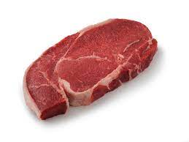
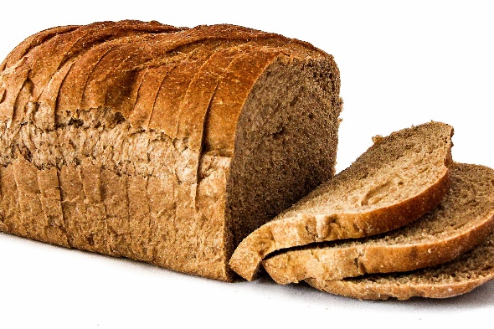
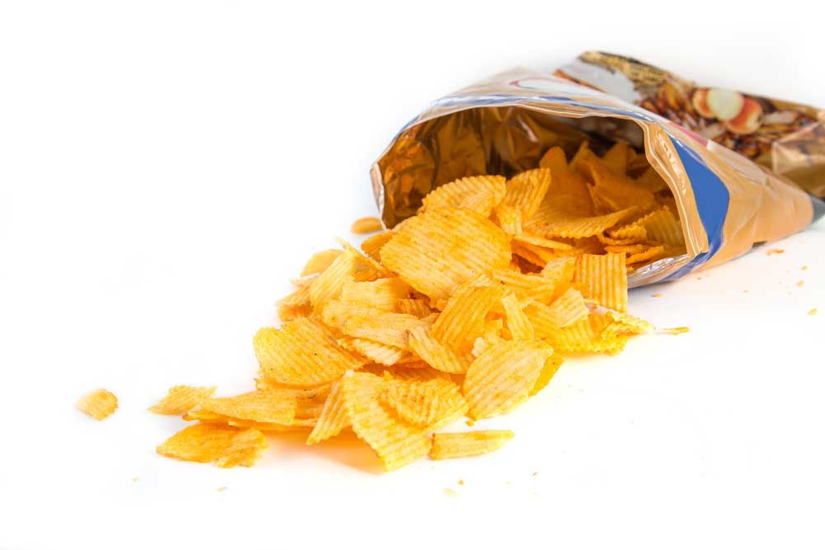
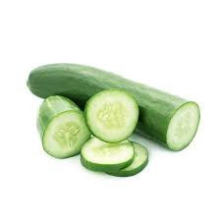
New Vocabulary
Ex. 1, 2, p. 40
beef
bread
crisps
cucumber

Slide 4
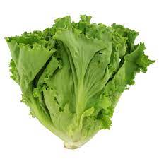
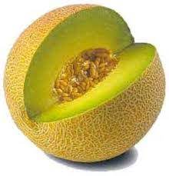
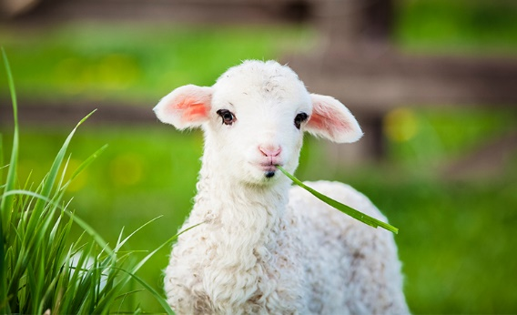
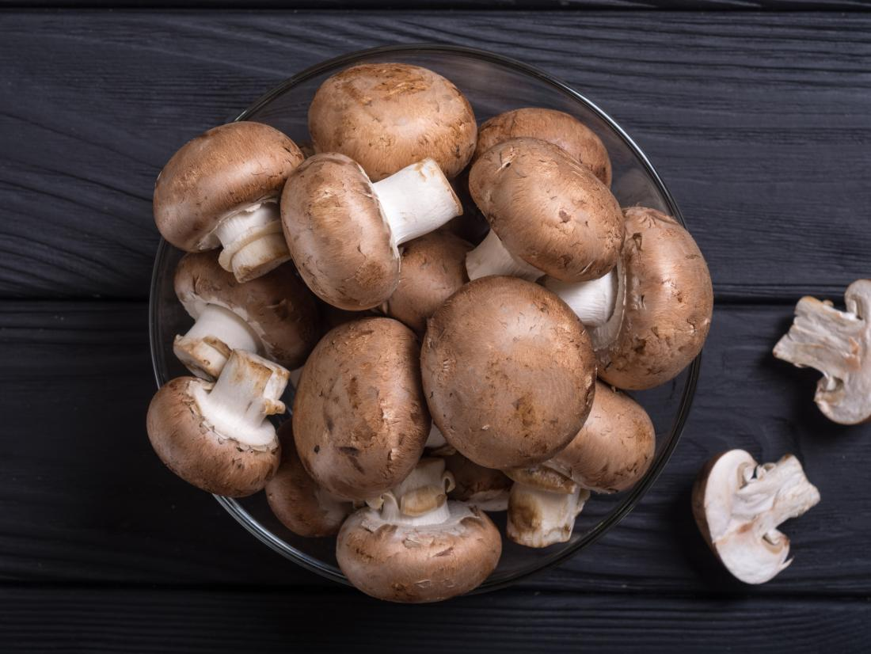
pepper
lettuce
lamb
melon
mushrooms

Slide 5
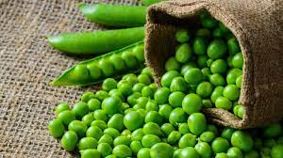
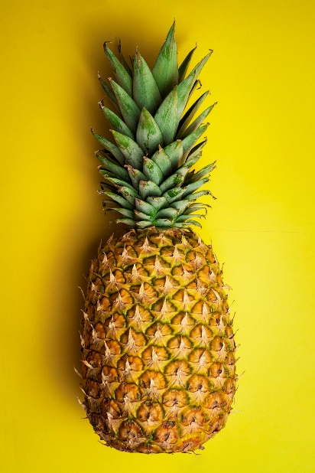
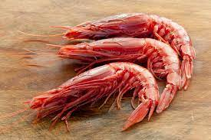
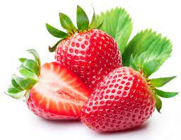
onion
peas
pineapple
prawns
strawberry

Slide 6
Pair Work
Work in Breakout rooms (4 minutes), get to know each other’s likes and dislikes
What food do you like?
I like mushrooms but I don’t like onion

Slide 7
Grammar: Countable/Uncountable nouns Ex.1, p.130, ex.4, 5, p. 42

Slide 8
Workbook
Ex. 1, 2, p. 42 (by themselves)
Ex. 3,4, p. 42 (together)
https://elt.oup.com/student/solutions/elementary3rdedition/audio?cc=ua&selLanguage=uk#tracktitle

Slide 9
Speaking: Meals of the day
What do you usually have for breakfast/lunch/dinner?
https://elt.oup.com/student/solutions/elementary3rdedition/audio?cc=ua&selLanguage=uk#tracktitle
dinner
breakfast
lunch

Slide 10
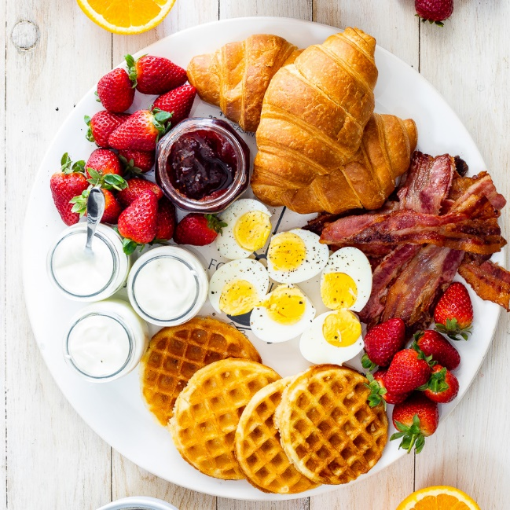
Writing
On school days I usually have ….
At weekends I usually have …
Ex. 6, p. 42 (Workbook)
Breakfast???

Slide 11
Hometask
Learn the words, p. 40-41
Revise “Articles”

Slide 12
There is/there are; some and any
Revise “Food” Vocabulary;
Revise grammar structure “there is/there are”, some and any

Slide 13
Hometask-check
Vocabulary Test
https://docs.google.com/forms/d/e/1FAIpQLSckSNGNNc5Q7YgdmBBV6grvq9U8b9RsL1B8XuCk7-JVb1iw2A/viewform

Slide 14
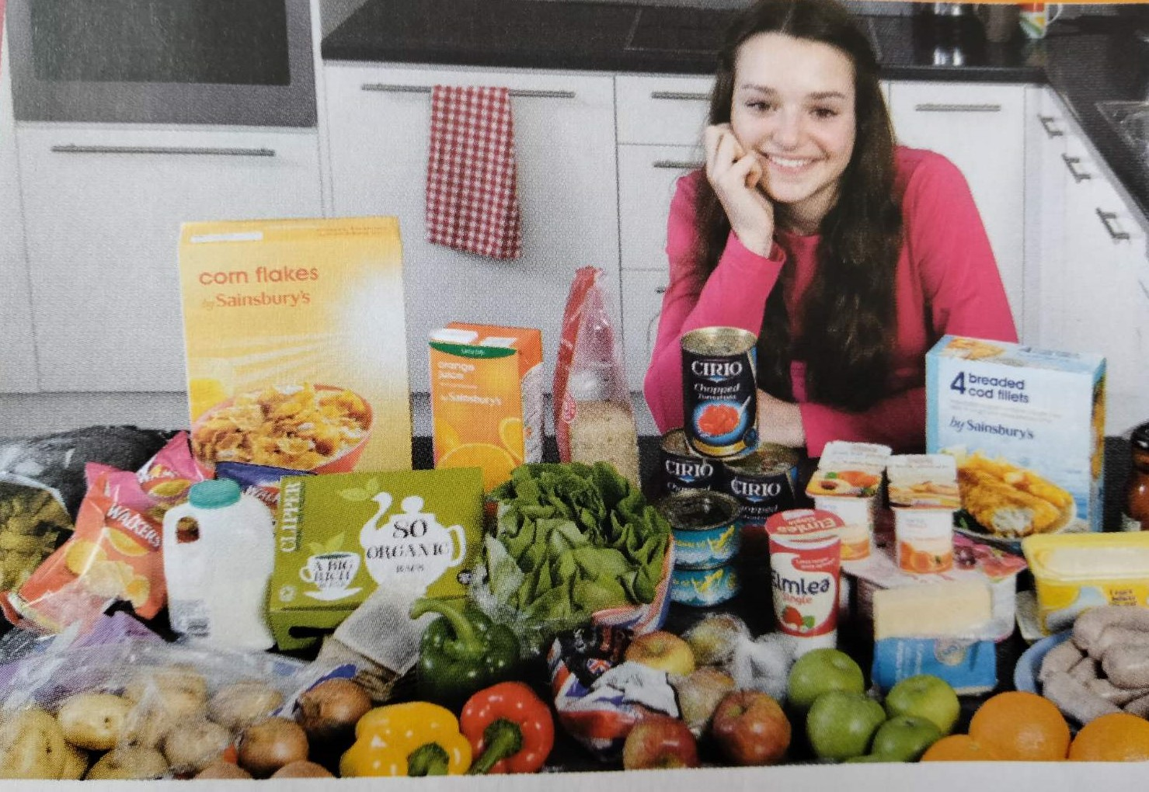
Speaking: picture description
Ex. 1, 2, p. 42 (Book)

Slide 15
Grammar Revision

Slide 16
Ex. 3,4, p. 42 (together, Book)
Ex. 1, p. 43 (WB, by themselves)
https://www.liveworksheets.com/worksheets/en/English_as_a_Second_Language_(ESL)/There_is_-_there_are/There_is-_there_are_ae842821ax

Slide 17
I have got some apples.
Have we got any bread left?
Ex.6, p. 42+p.130
+
SOME
?; -
ANY

Slide 18
Hometask
P. 43 (WB, finish to the very end!)

Slide 19
WHAT A WASTE!
Identify and understand unstressed words;
Practice listening skills.

Slide 20
Hometask-check
P.43, Workbook (check orally)

Slide 21
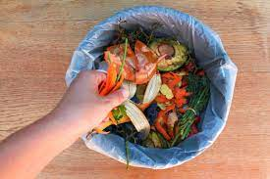
Picture description ex.1-3, p.43 (Book)
Throw away – викидати
Need – потребувати
Rubbish bin – смітник
Fresh – свіжий
Old – старий, несвіжий
Meal – їжа, прийом їжі
Shape – форма
Angry – сердитий
Hungry – голодний

Slide 22
Listening
Ex.1, 2, 3, 4, p. 44 (WB)
https://elt.oup.com/student/solutions/elementary3rdedition/?cc=ua&selLanguage=uk

Slide 23
Hometask
https://www.liveworksheets.com/worksheets/en/English_as_a_Second_Language_(ESL)/There_is_-_there_are/There_is-are_gm725626rt
https://www.liveworksheets.com/worksheets/en/English_as_a_Second_Language_(ESL)/Some_or_any/Some_or_any_ui4319uo

Slide 24
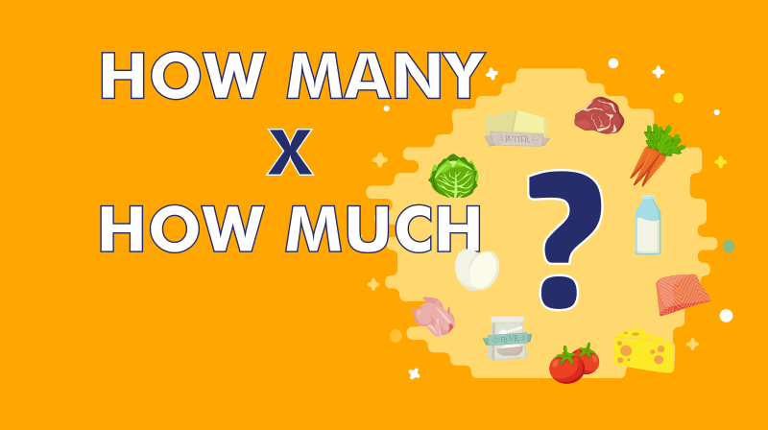
Grammar: how much, how many?
Talk and ask about quantity

Slide 25
How many ….?

Slide 26
How much … ?

Slide 27
Friends, apples, eggs
Milk, water, coffee

Slide 28
Ex.3, 5, 7, p. 44 (Book, together)
Ex. 7,8, p.130 (Book, by themselves)
Ex. 8, p. 44 (Book, Wednesday)
Ex. 1-3, p. 45 (WB, Wednesday)

Slide 29
Hometask
Ex.1, p.44 (Book, read and translate the dialogue) (on Wednesday)
Ex. 4,5, p.45 (WB, on Friday)

