Slide 1
CLOTHES
LESSON 1

Slide 2
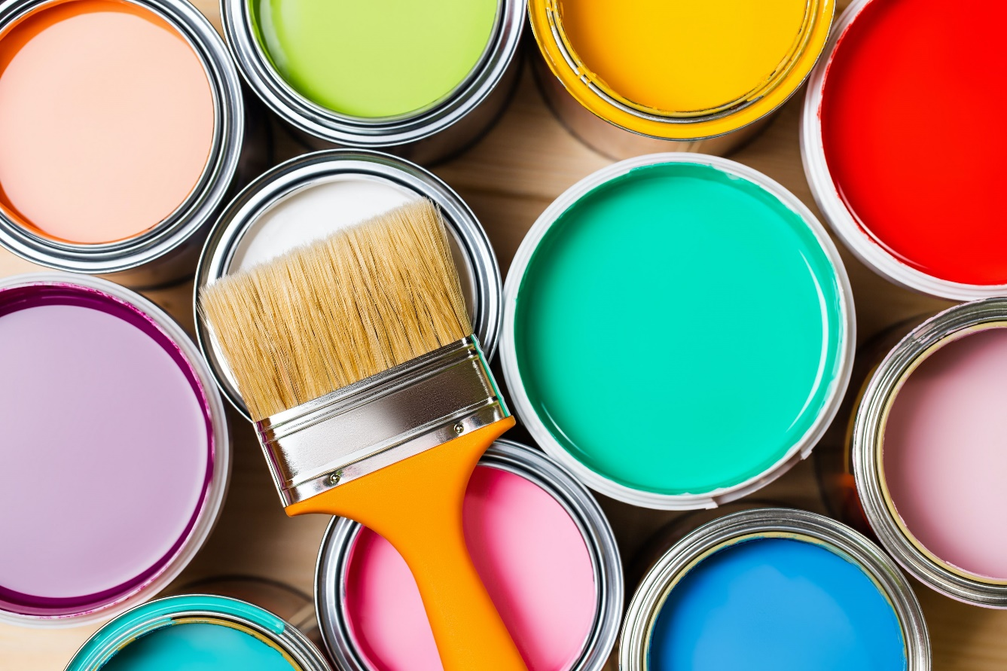
Colour revision
https://www.youtube.com/watch?v=qhOTU8_1Af4
Ask about their favourite colours

Slide 3
New Vocabulary
Name and learn the words
Say the colours of the pieces of clothes

Slide 4
This is a dress

Slide 5
These are socks

Slide 6
This is a T-shirt

Slide 7
These are trousers

Slide 8
These are shorts

Slide 9
Book, p. 52
https://faf2e.ouponlinepractice.com/lms/book?bookid=ff1
(ex. 1,2)
https://faf2e.ouponlinepractice.com/bookdata/ff1/media/video/FAF1_Unit07.mp4
(ex.3)

Slide 10
Workbook
Ex.1-3, p. 52

Slide 11
Lesson 2
Revise vocabulary on the topic “Clothes”
Practise grammar constructions “his/her”

Slide 12
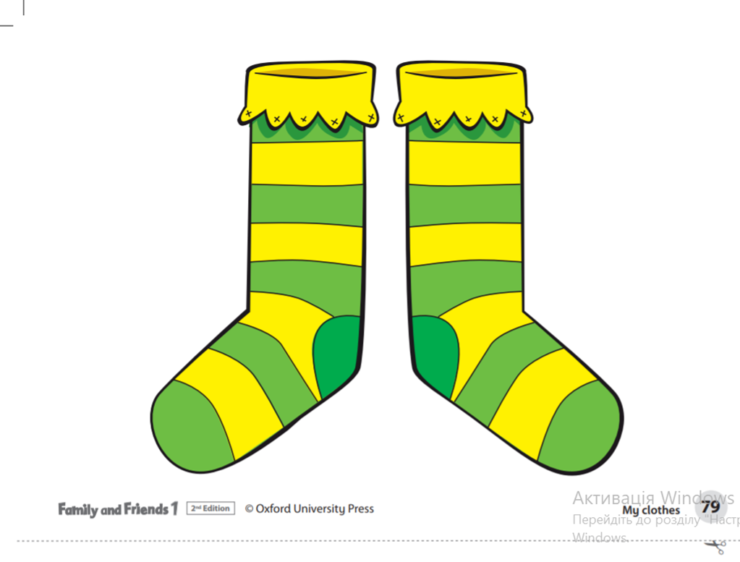
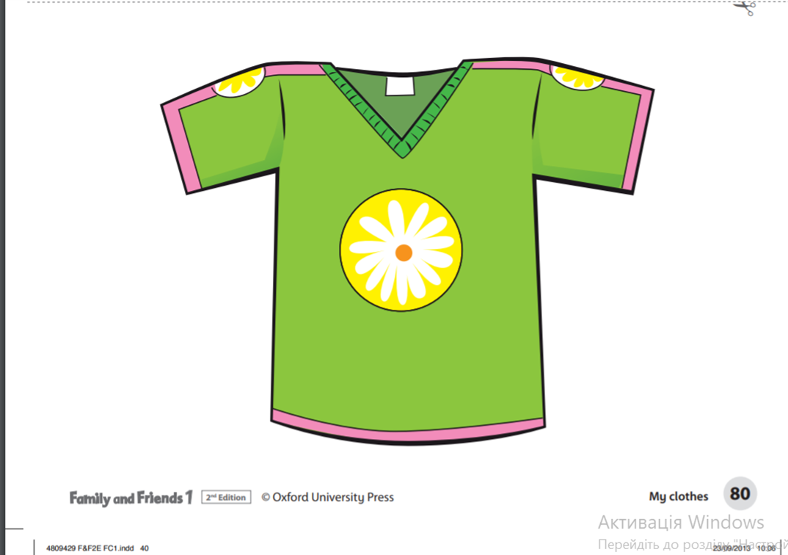
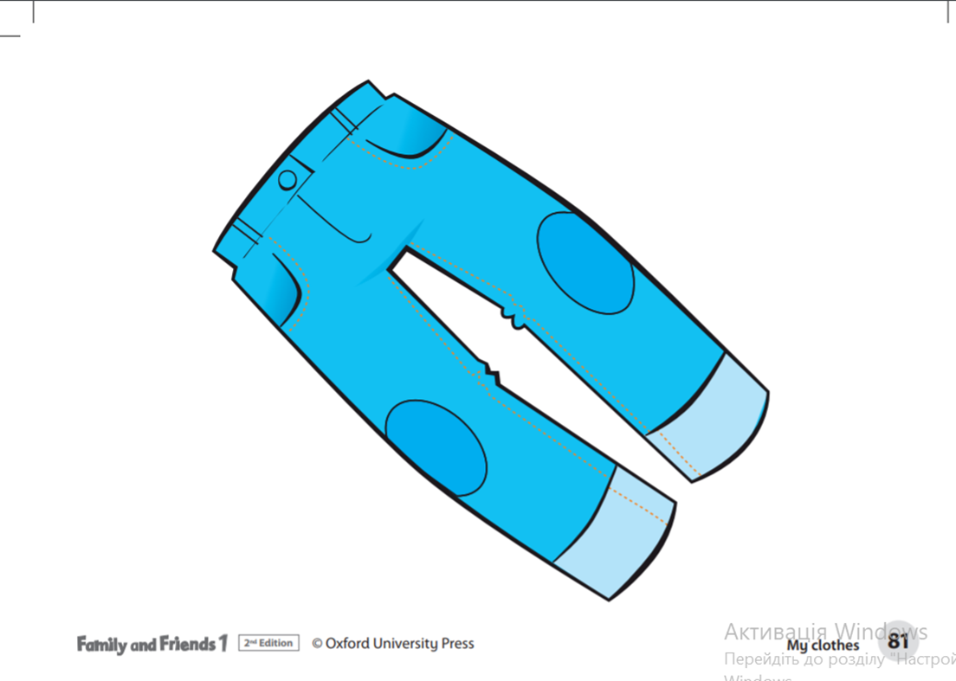
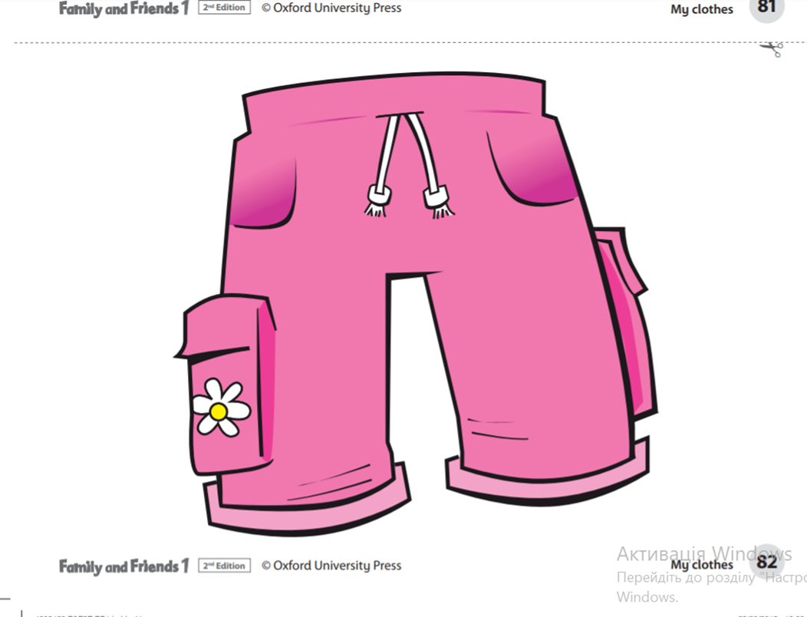
What’s this?

Slide 13
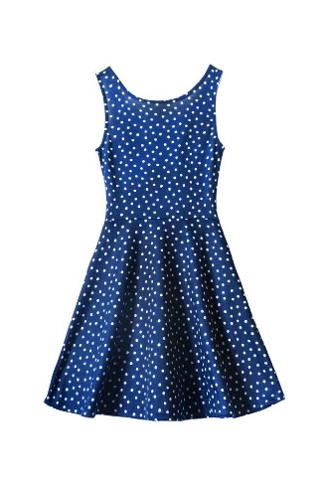
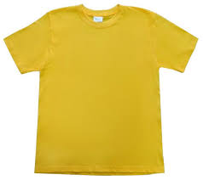
Unscramble sentences
This is a
This is a

Slide 14
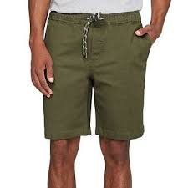
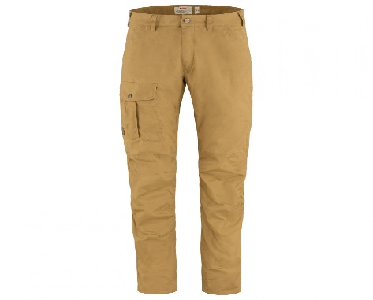
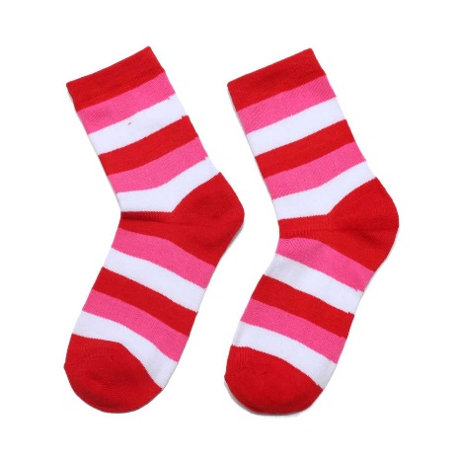
These are
These are
These are

Slide 15
Grammar point
HIS

Slide 16
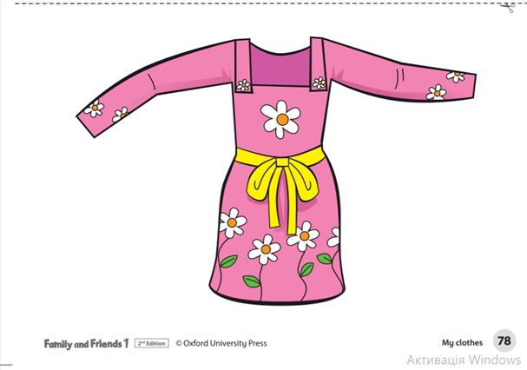
Grammar point
HER

Slide 17
https://www.liveworksheets.com/worksheets/en/English_as_a_Second_Language_(ESL)/Possessives/Choose_the_correct_option_tj1950276yn
https://www.liveworksheets.com/jf2380054lr

Slide 18
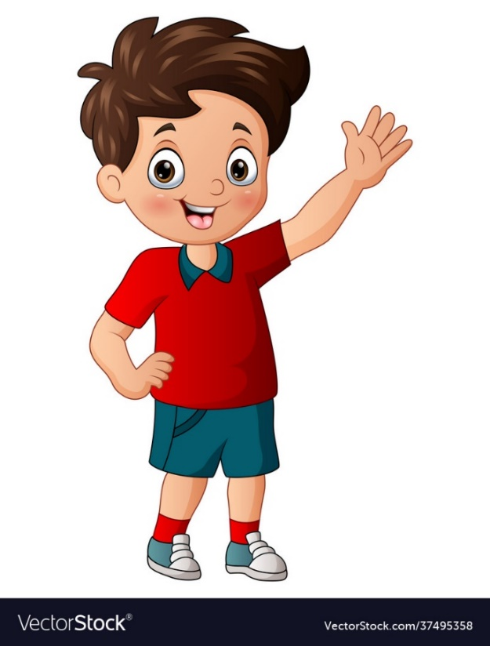
Rosy’s dress her dress
Rosy’s socks
Billy’s trousers
Dad’s shorts
Mum’s umbrella
Grandpa’s book

Slide 19
Choose the correct option
Hometask- check (p.53, book)
https://faf2e.ouponlinepractice.com/lms/workbook?bookid=ff1
(online)
HT: revise p. 52 (words+ write them!!!)

Slide 20
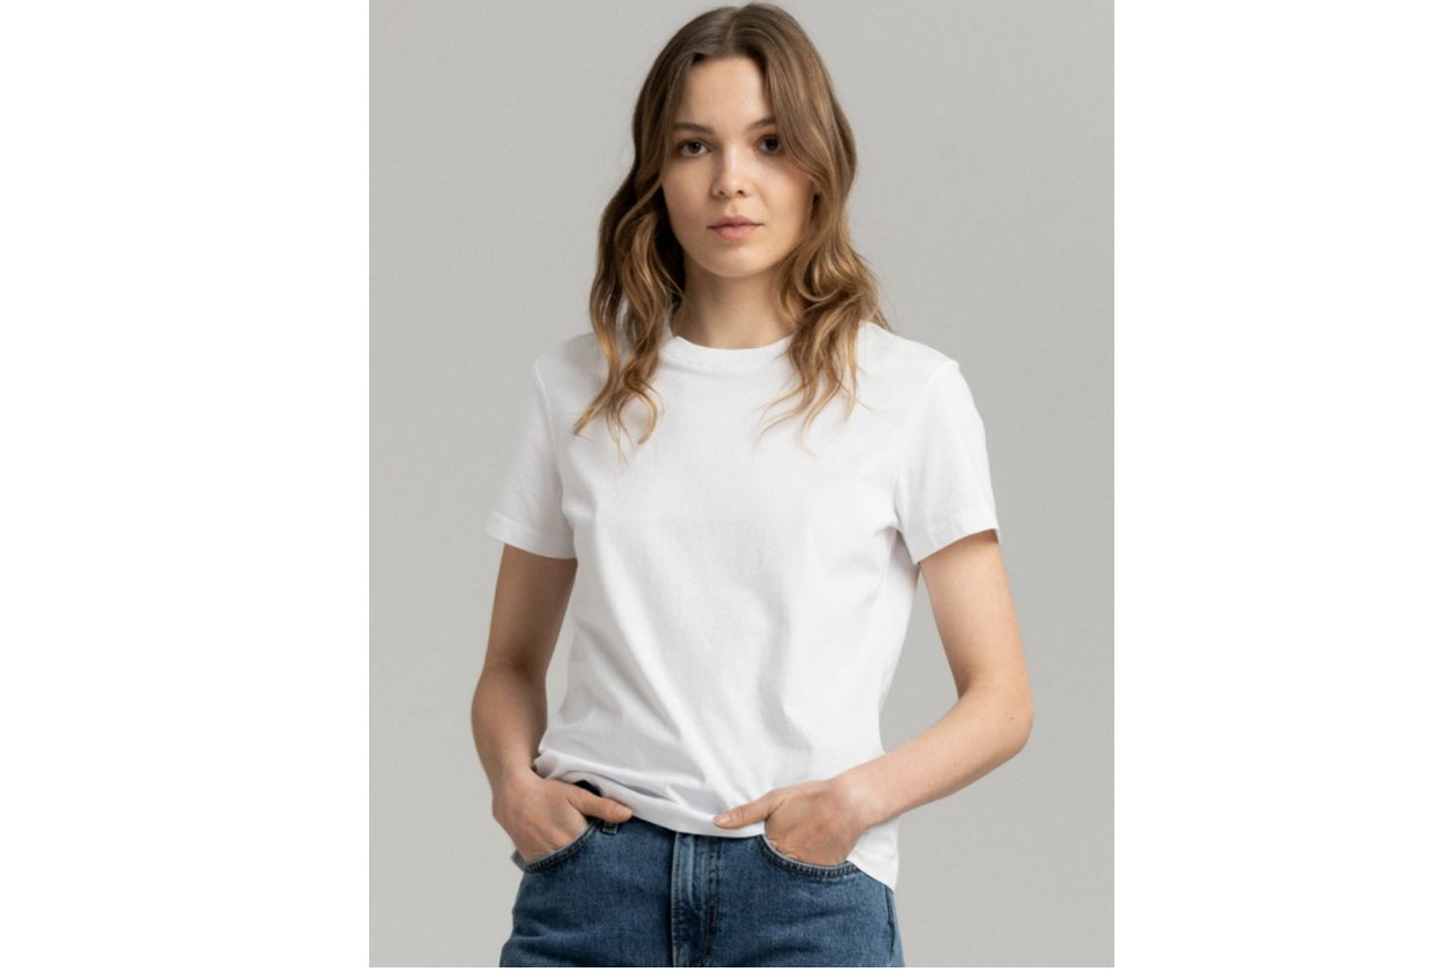
Skills Time!

Slide 21
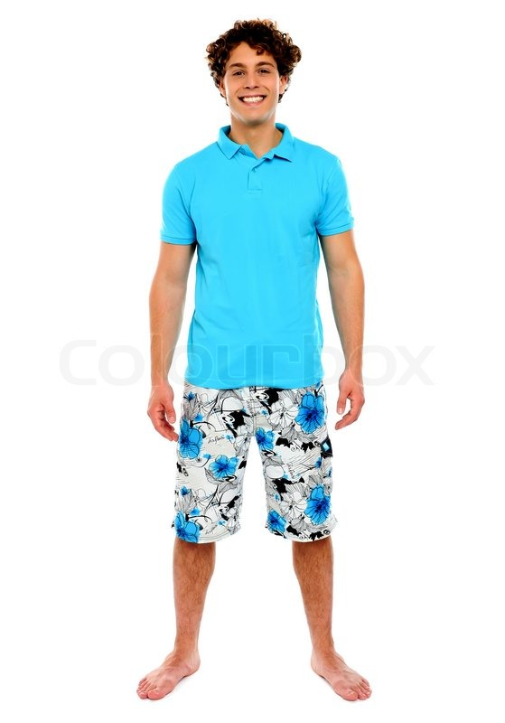

Slide 22
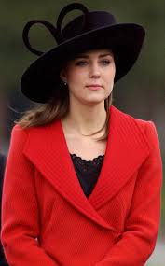

Slide 23
