Slide 1
WHERE’S GRANDMA?
Unit 8
By Oksana solodka

Slide 2

Lesson one: Words
To identify different places at home;
To understand a short story
Where do you live?
Who lives with you?

Slide 3
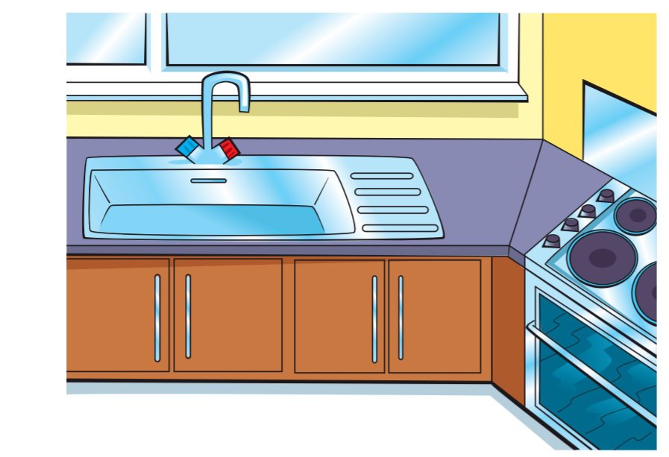
It’s a kitchen

Slide 4
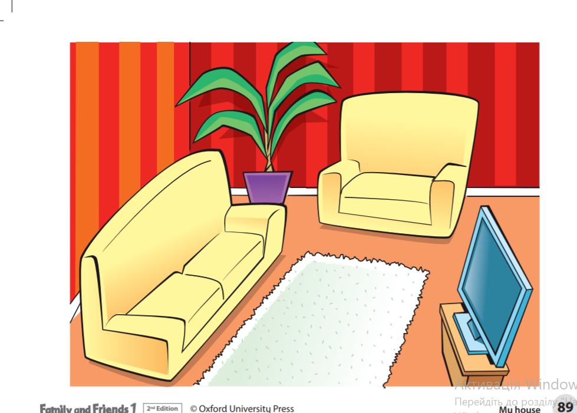
It’s a living room

Slide 5
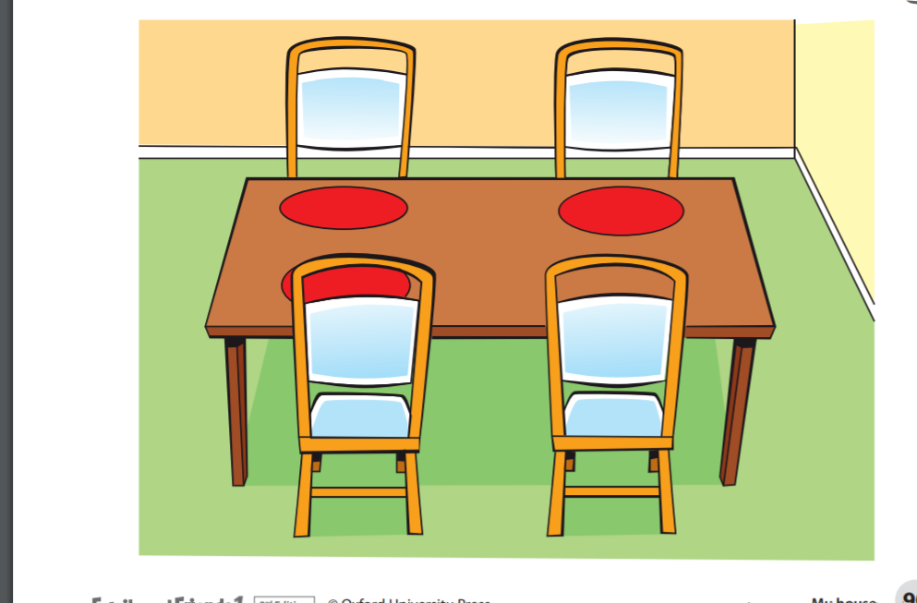
It’s a dining room

Slide 6
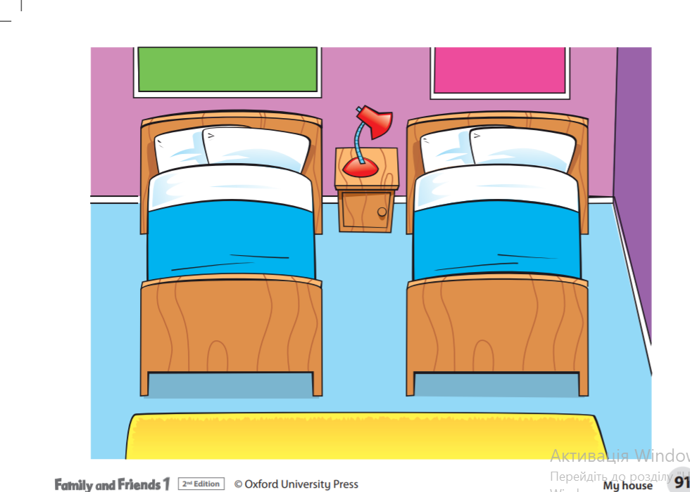
It’s a bedroom

Slide 7
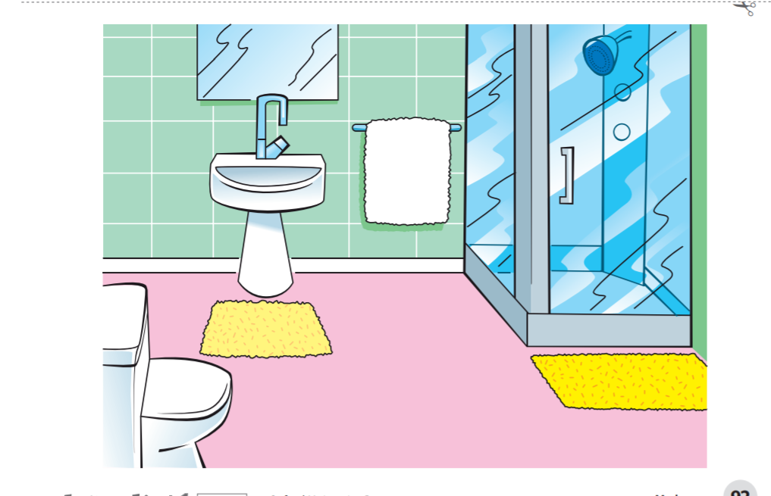
It’s a bathroom

Slide 8
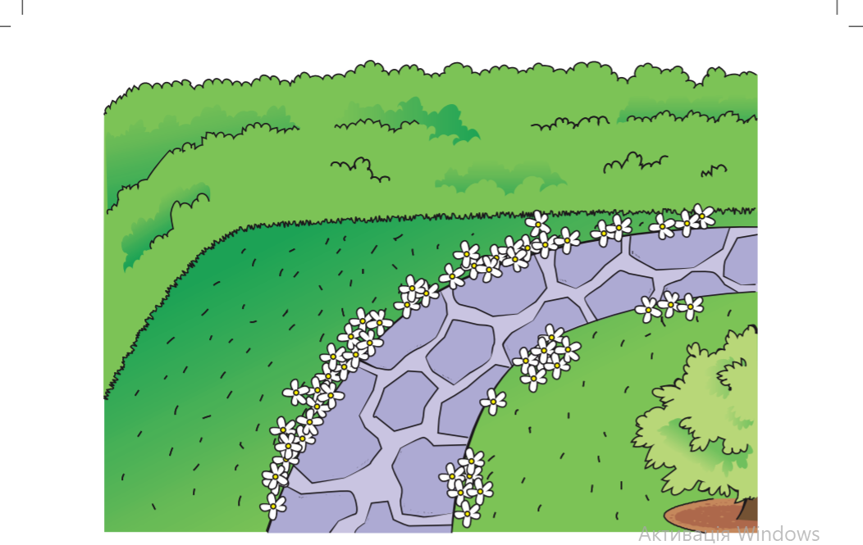
It’s a garden

Slide 9
Ex. 1,2,3,p. 58 (Book)
https://faf2e.ouponlinepractice.com/lms/book?bookid=ff1

Slide 10
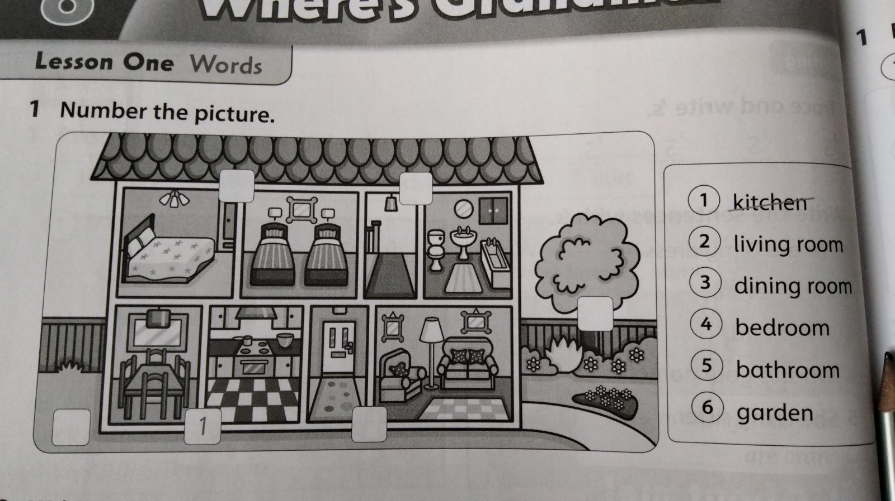
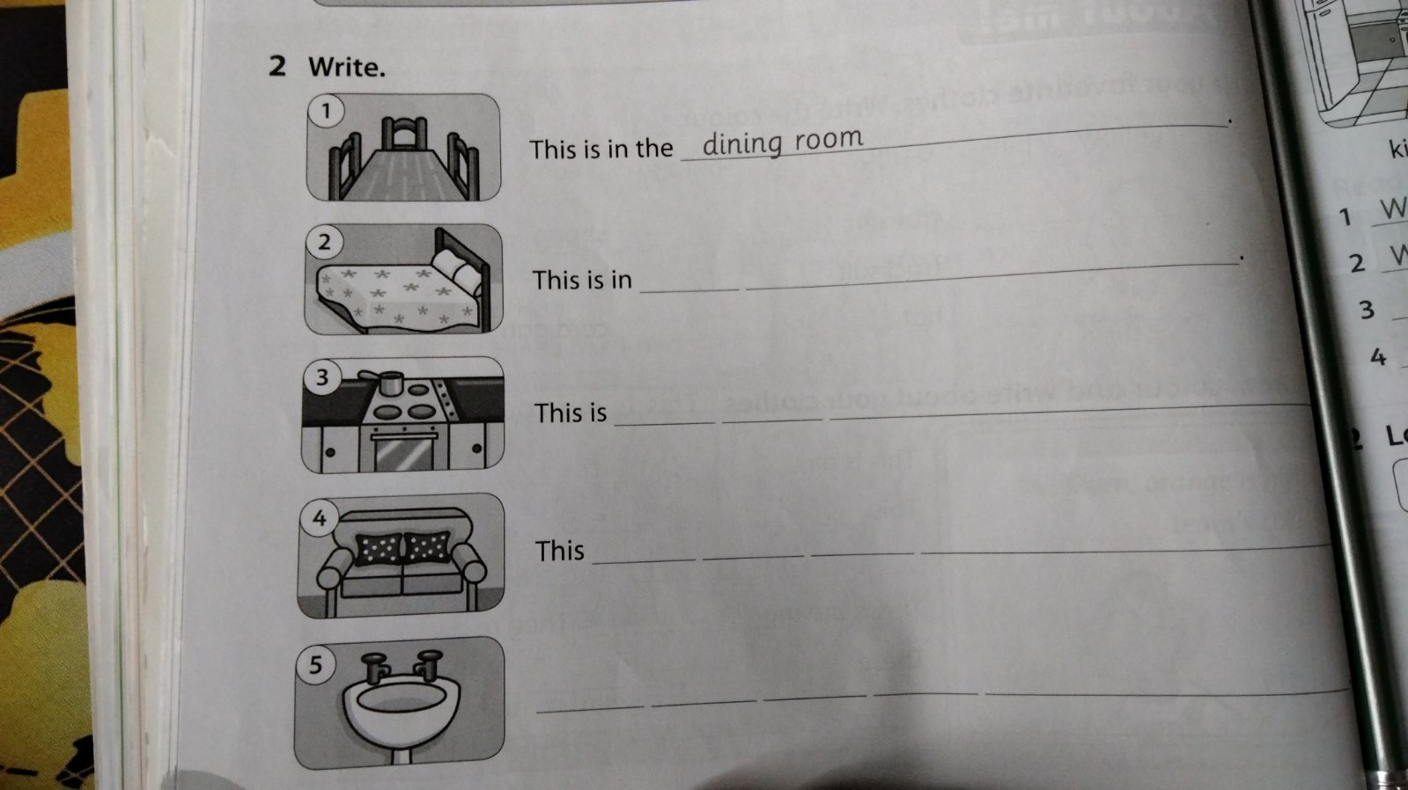
Ex. 1, 2, p. 58 (Workbook)

Slide 11
hometask
Learn the words, p.58
https://www.youtube.com/watch?v=pN8m9YckGSI

Slide 12
Lesson two: Grammar (p.1)
https://www.youtube.com/watch?v=pN8m9YckGSI

Slide 13
What’s this?
A garden
A living room
A kitchen

Slide 14
What’s this?
A garden
A living room
A kitchen

Slide 15
What’s this?
A garden
A bathroom
A bedroom

Slide 16
What’s this?
A garden
A bathroom
A bedroom

Slide 17
What’s this?
A garden
A dining room
A bedroom

Slide 18
What’s this?
A living room
A dining room
A kitchen

Slide 19
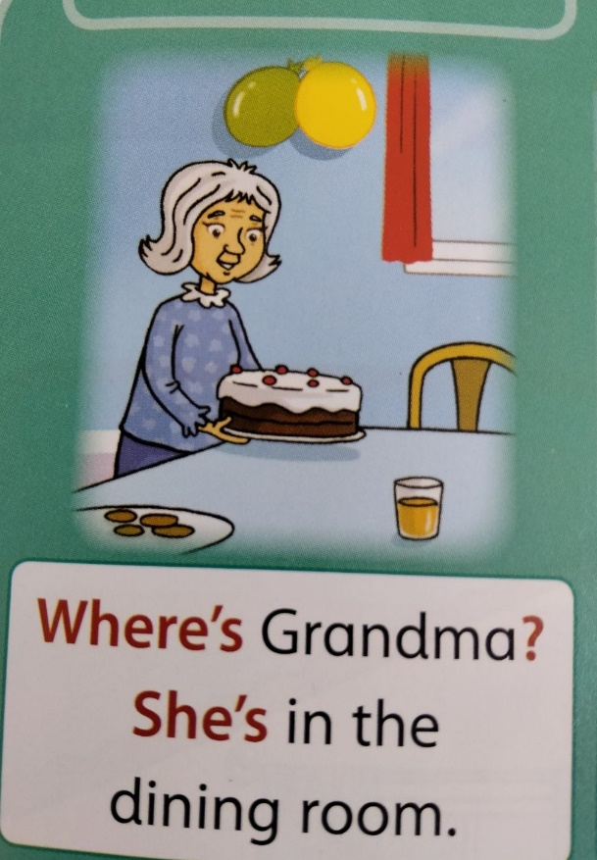
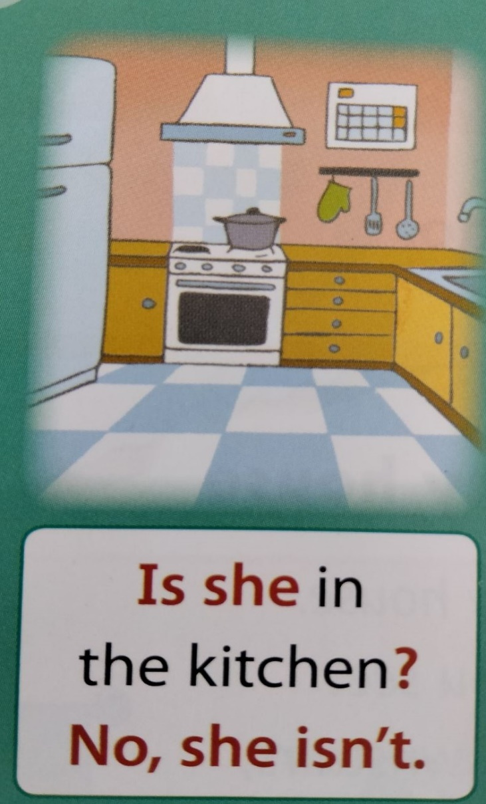
Where is…? Where’s…?

Slide 20
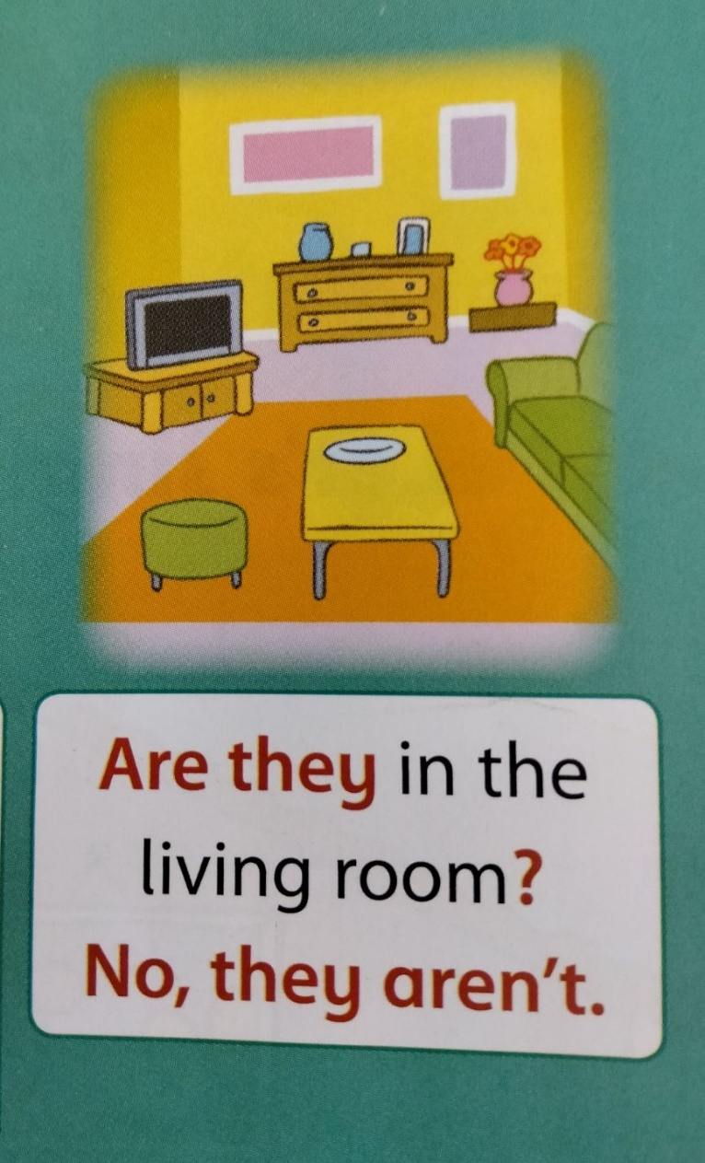
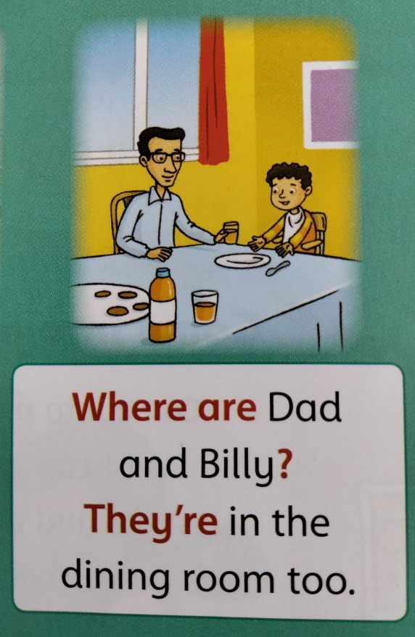
Where are they?

Slide 21

Where are you now?
I’m in the ……. living room
Dialogue

Slide 22
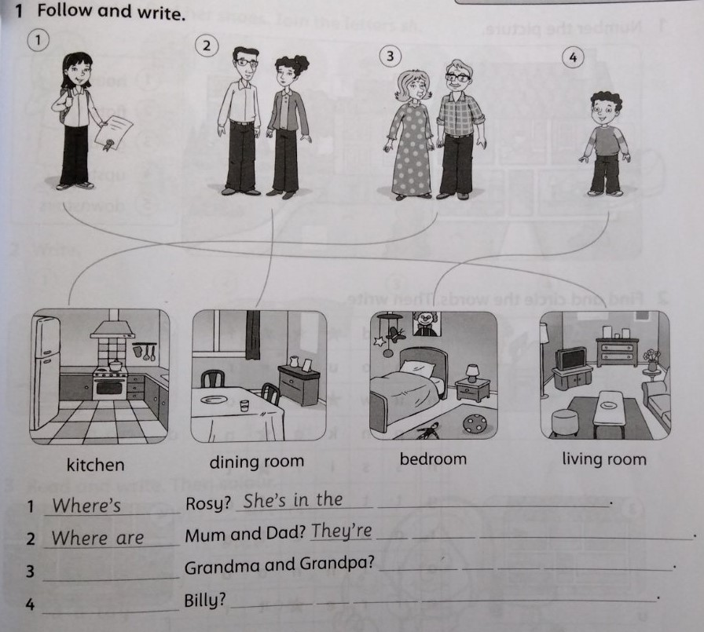
Workbook
Ex. 1, p. 59

Slide 23
Hometask
Revise the words!!!

Slide 24
Lesson two: Grammar (p.2)
https://faf2e.ouponlinepractice.com/lms/book?bookid=ff1
(ex. 3, p. 58- watch the video story and discuss the rooms of the house)

Slide 25
Online practice
https://faf2e.ouponlinepractice.com/lms/workbook?bookid=ff1
(Where’s Grandma, words&grammar)

Slide 26
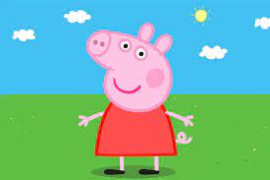
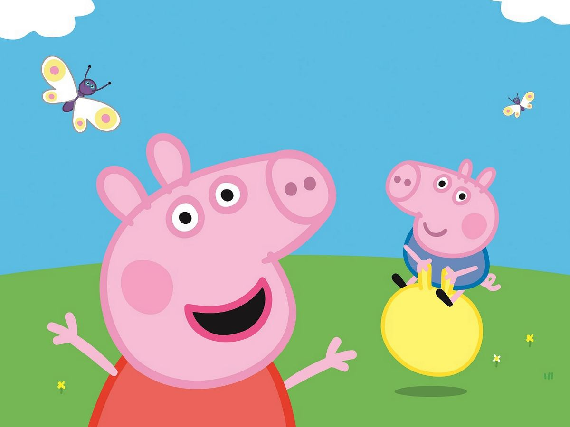
IS
ARE

Slide 27
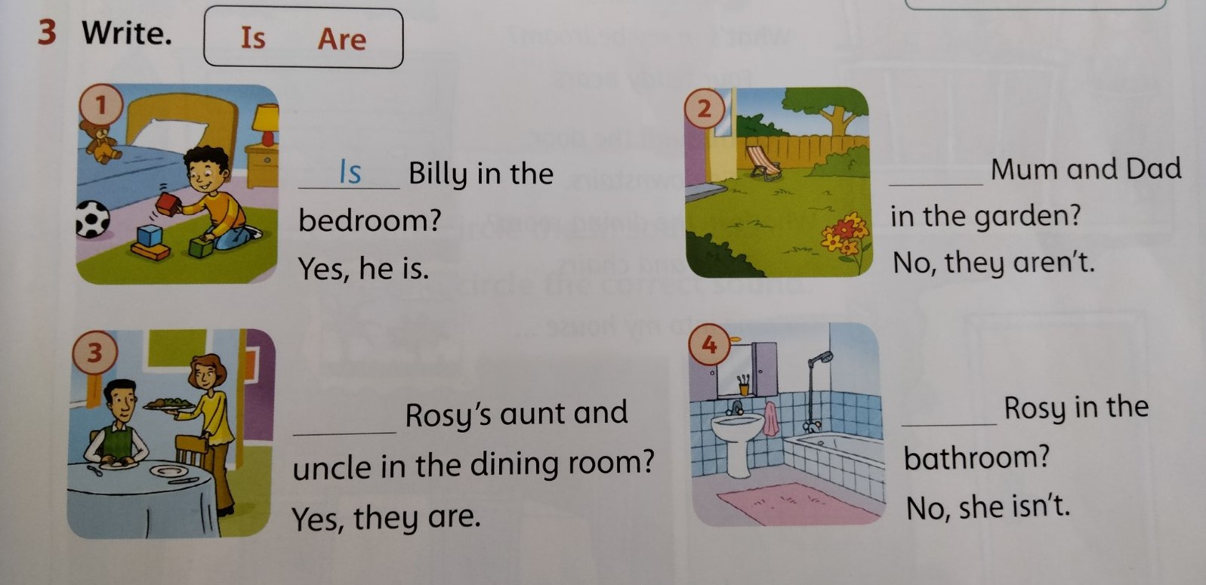

Slide 28
Lesson 3: song
Hometask-check (ex.3, p.59)
Revise “House” vocabulary (orally)
https://wordwall.net/resource/10048852/english/house

Slide 29
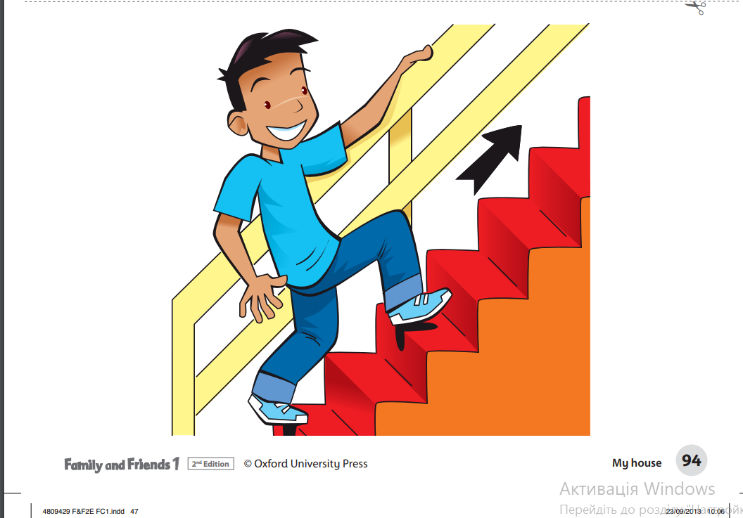
New words
Upstairs

Slide 30
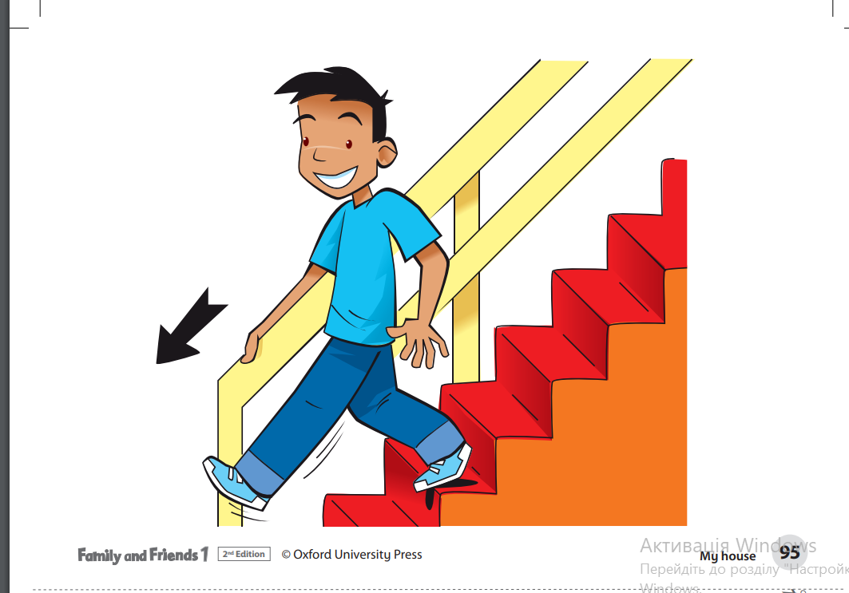
Downstairs

Slide 31
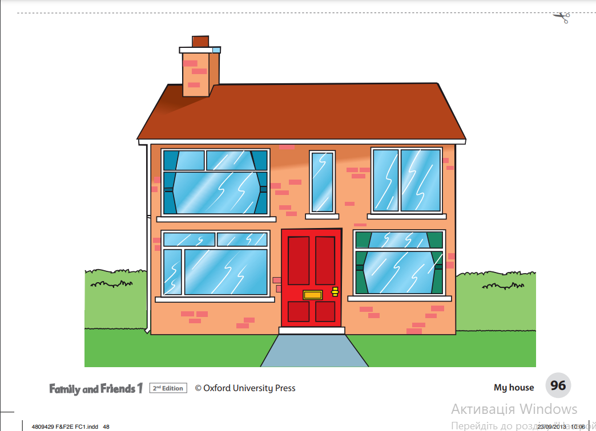
House

Slide 32
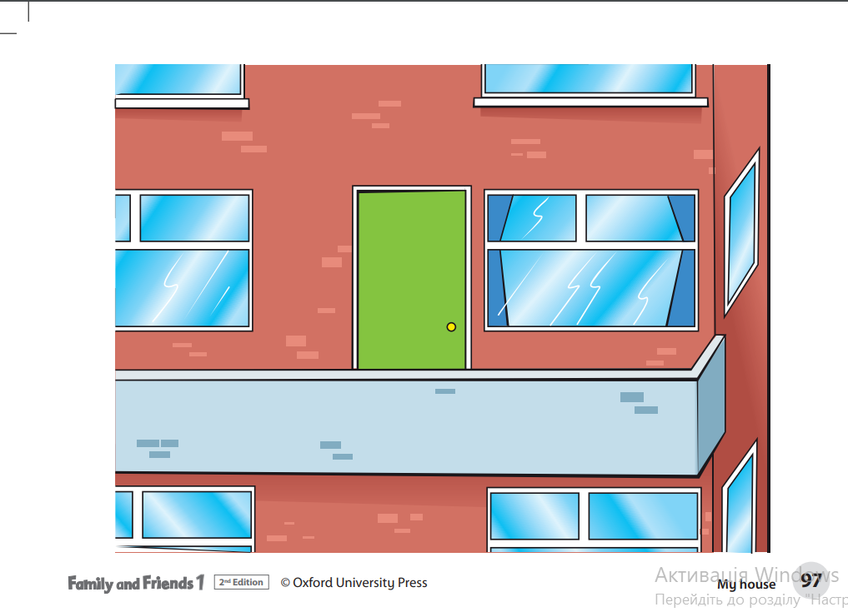
Flat

Slide 33
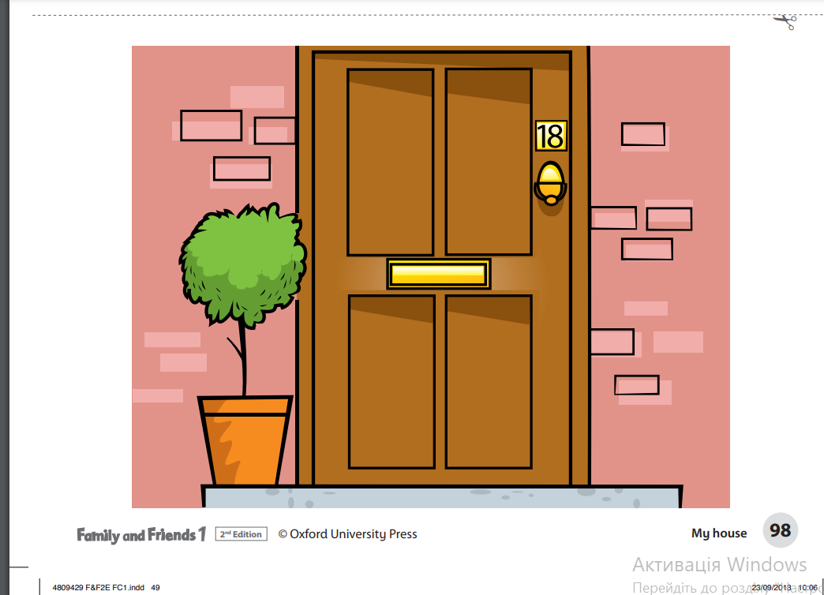
Front door

Slide 34
Listen and sing
Ex.1,2,3, p. 60 (orally)
Ex. 3, p.60 (find and underline new words in the song)

Slide 35
hometask
Ex. 1, 2, p. 60 (WB)
https://www.liveworksheets.com/worksheets/en/English_as_a_Second_Language_(ESL)/Parts_of_the_house/Rooms_in_the_house_yt784581yx
https://wordwall.net/resource/32305313/house-f-f
(the two last on Friday)

Slide 36

Lesson three: workbook
Revise “House” Vocabulary

Slide 37
Online practice
https://faf2e.ouponlinepractice.com/lms/workbook?bookid=ff1
Ask the words orally (one by one)

Slide 38
writing
Insert the missing letters (in the chat and in the copybooks)
Ho…se
u…sta…rs
Fl…t
Gar…en
b…dr…om
D … … r

Slide 39
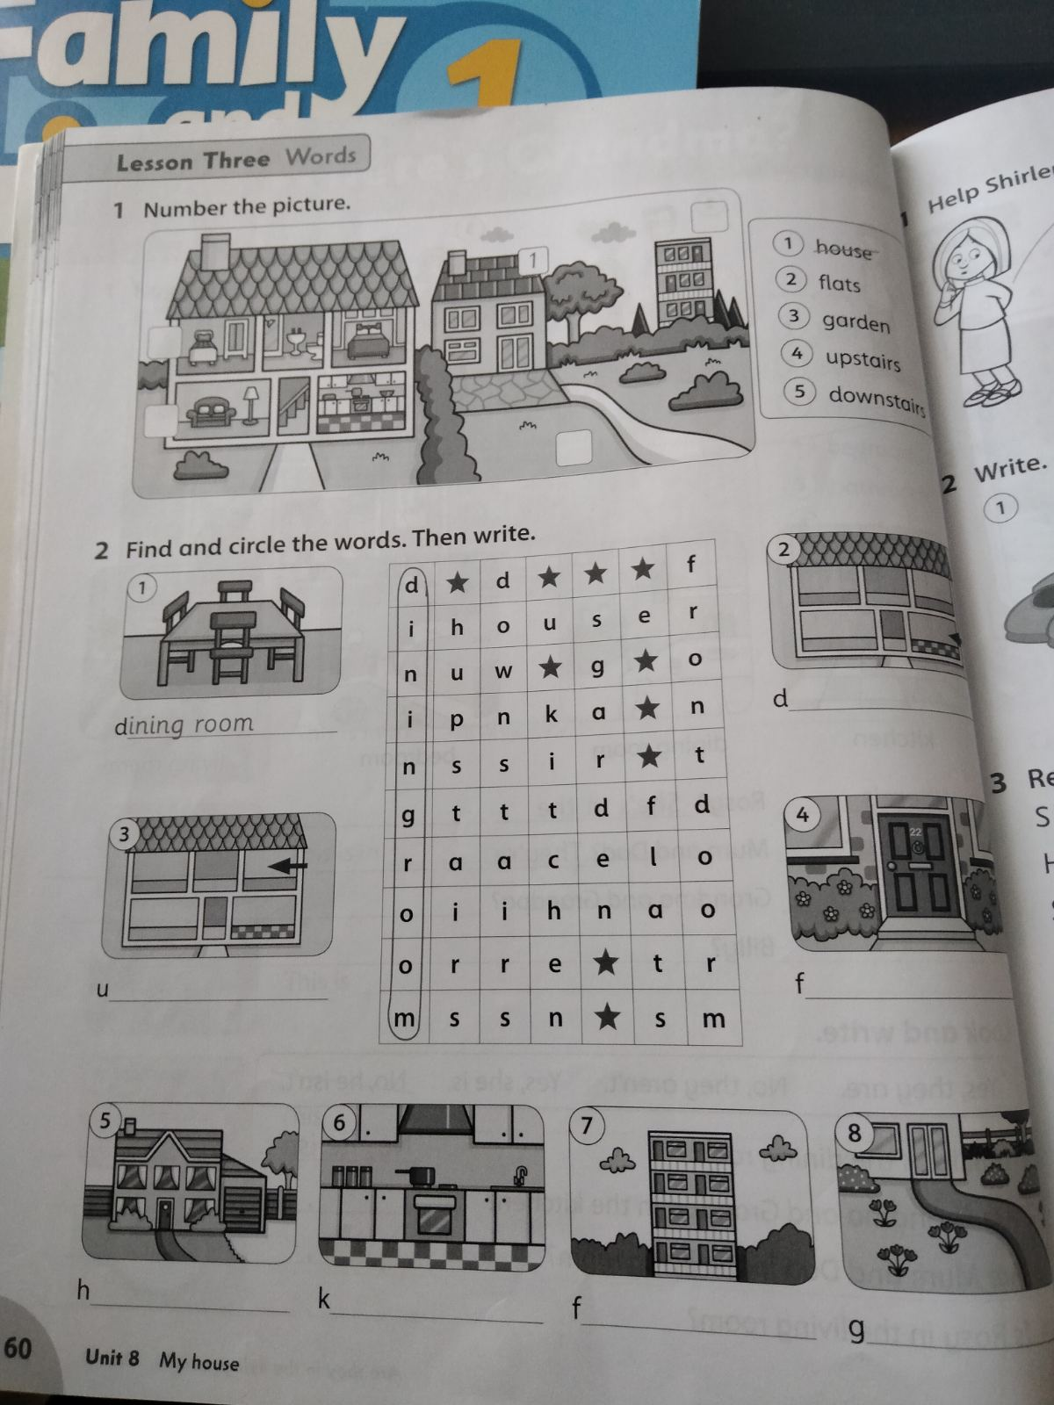
WB, p. 60 (ex.1,2)
hometask: revise the words, p.128 (WB)

Slide 40

Lesson four: phonics
To pronounce the sound “sh”on its own and in words;
To differentiate between the sound “sh”, “s”, “h”

Slide 41

https://www.youtube.com/watch?v=75p-N9YKqNo

Slide 42
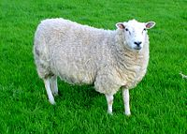
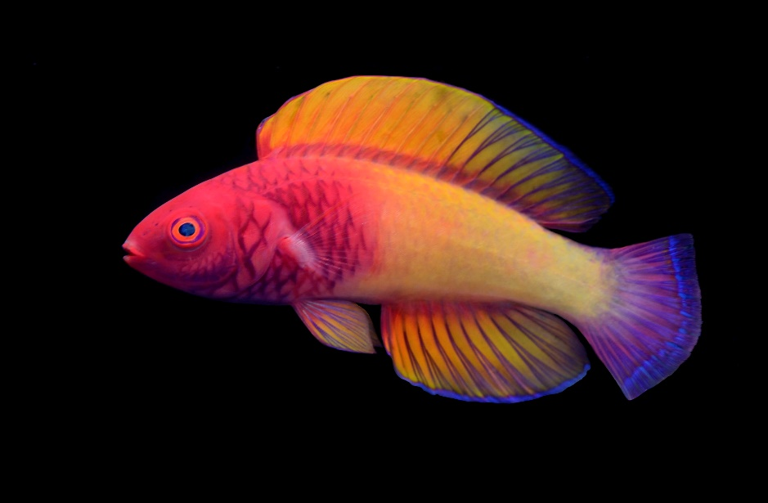
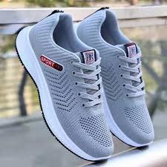
https://www.starfall.com/h/ltr-classic/?mg=g

Slide 43
Shoes
Sheep
Fish
She
T-shirt
Shop
Sharpener
Shark

Slide 44
Listen and Chant, ex. 2, p. 61 (book) https://faf2e.ouponlinepractice.com/lms/book?bookid=ff1
Shirley’s shoes are red,
Her T-shirt is blue.
She’s got a toy sheep,
An a toy fish too.
The sheep is white,
The fish is blue.
Shirley wants to play,
With me and with you.

Slide 45
hometask
P. 61 (WB) (start at the lesson and finish at home)

Slide 46
Lesson five: skills time!
Revise the sound “sh”
Revise “House” Vocabulary

Slide 47

Shoes
Sheep
Fish
She
T-shirt
Shop
https://faf2e.ouponlinepractice.com/lms/workbook?bookid=ff1

Slide 48
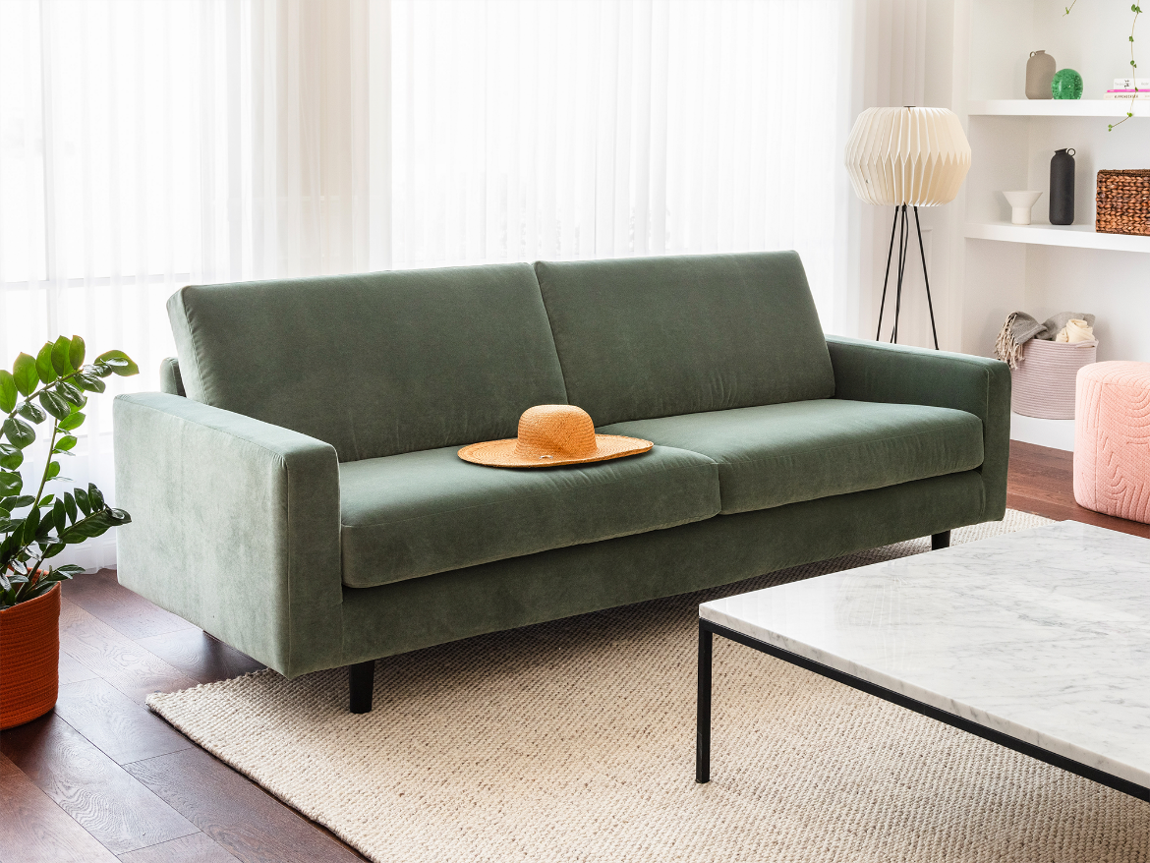
Ex. 4, p. 61
sh
h
s

Slide 49

Ex. 4, p. 61
sh
h
s

Slide 50

Ex. 4, p. 61
sh
h
s

Slide 51

speaking
Talk about homes, ask individual children to name the rooms in their house/the colours
E.g. My bedroom is green.

Slide 52
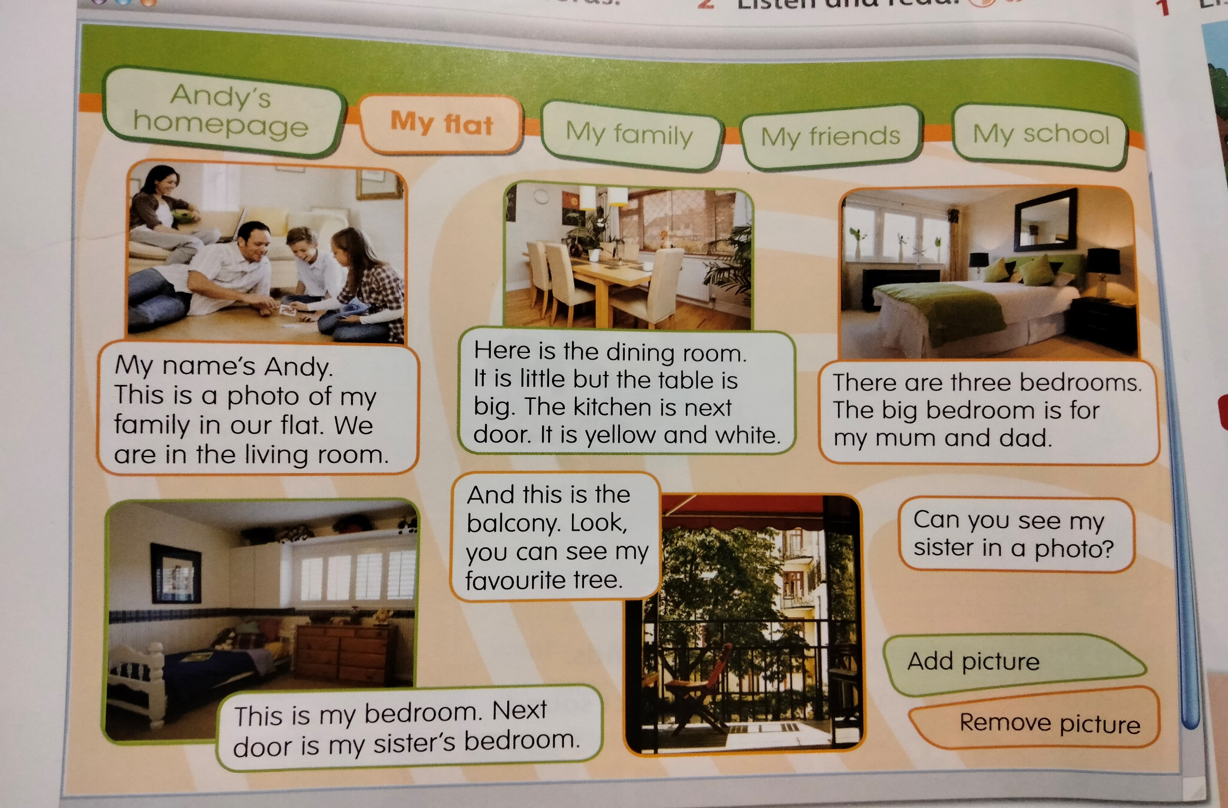
Reading, p. 62

