Slide 1
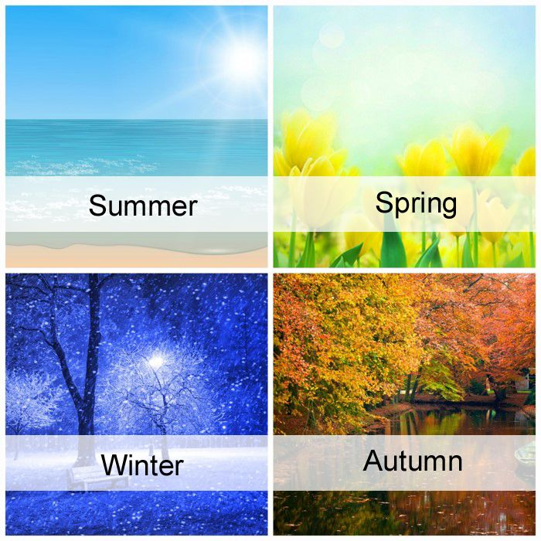
Seasons and Weather
https://www.youtube.com/watch?v=_6cG913j6kc

Slide 2
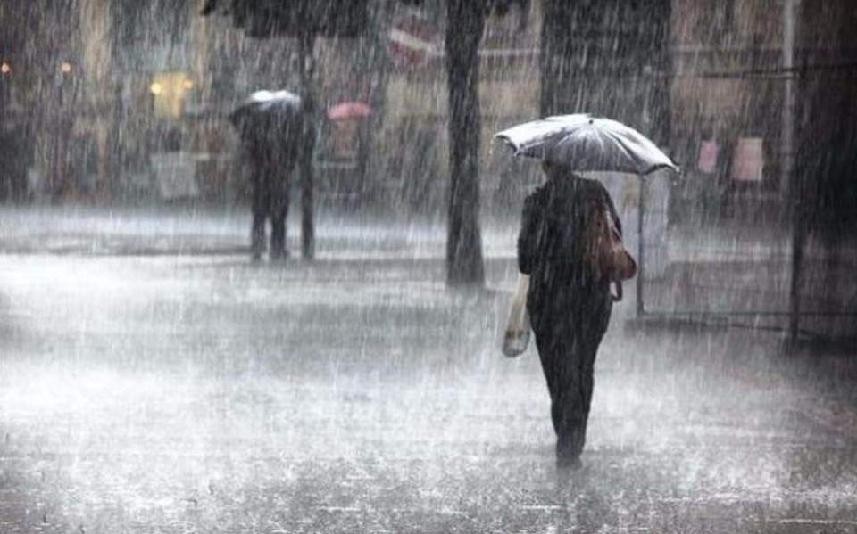
IT IS WET AND RAINY

Slide 3
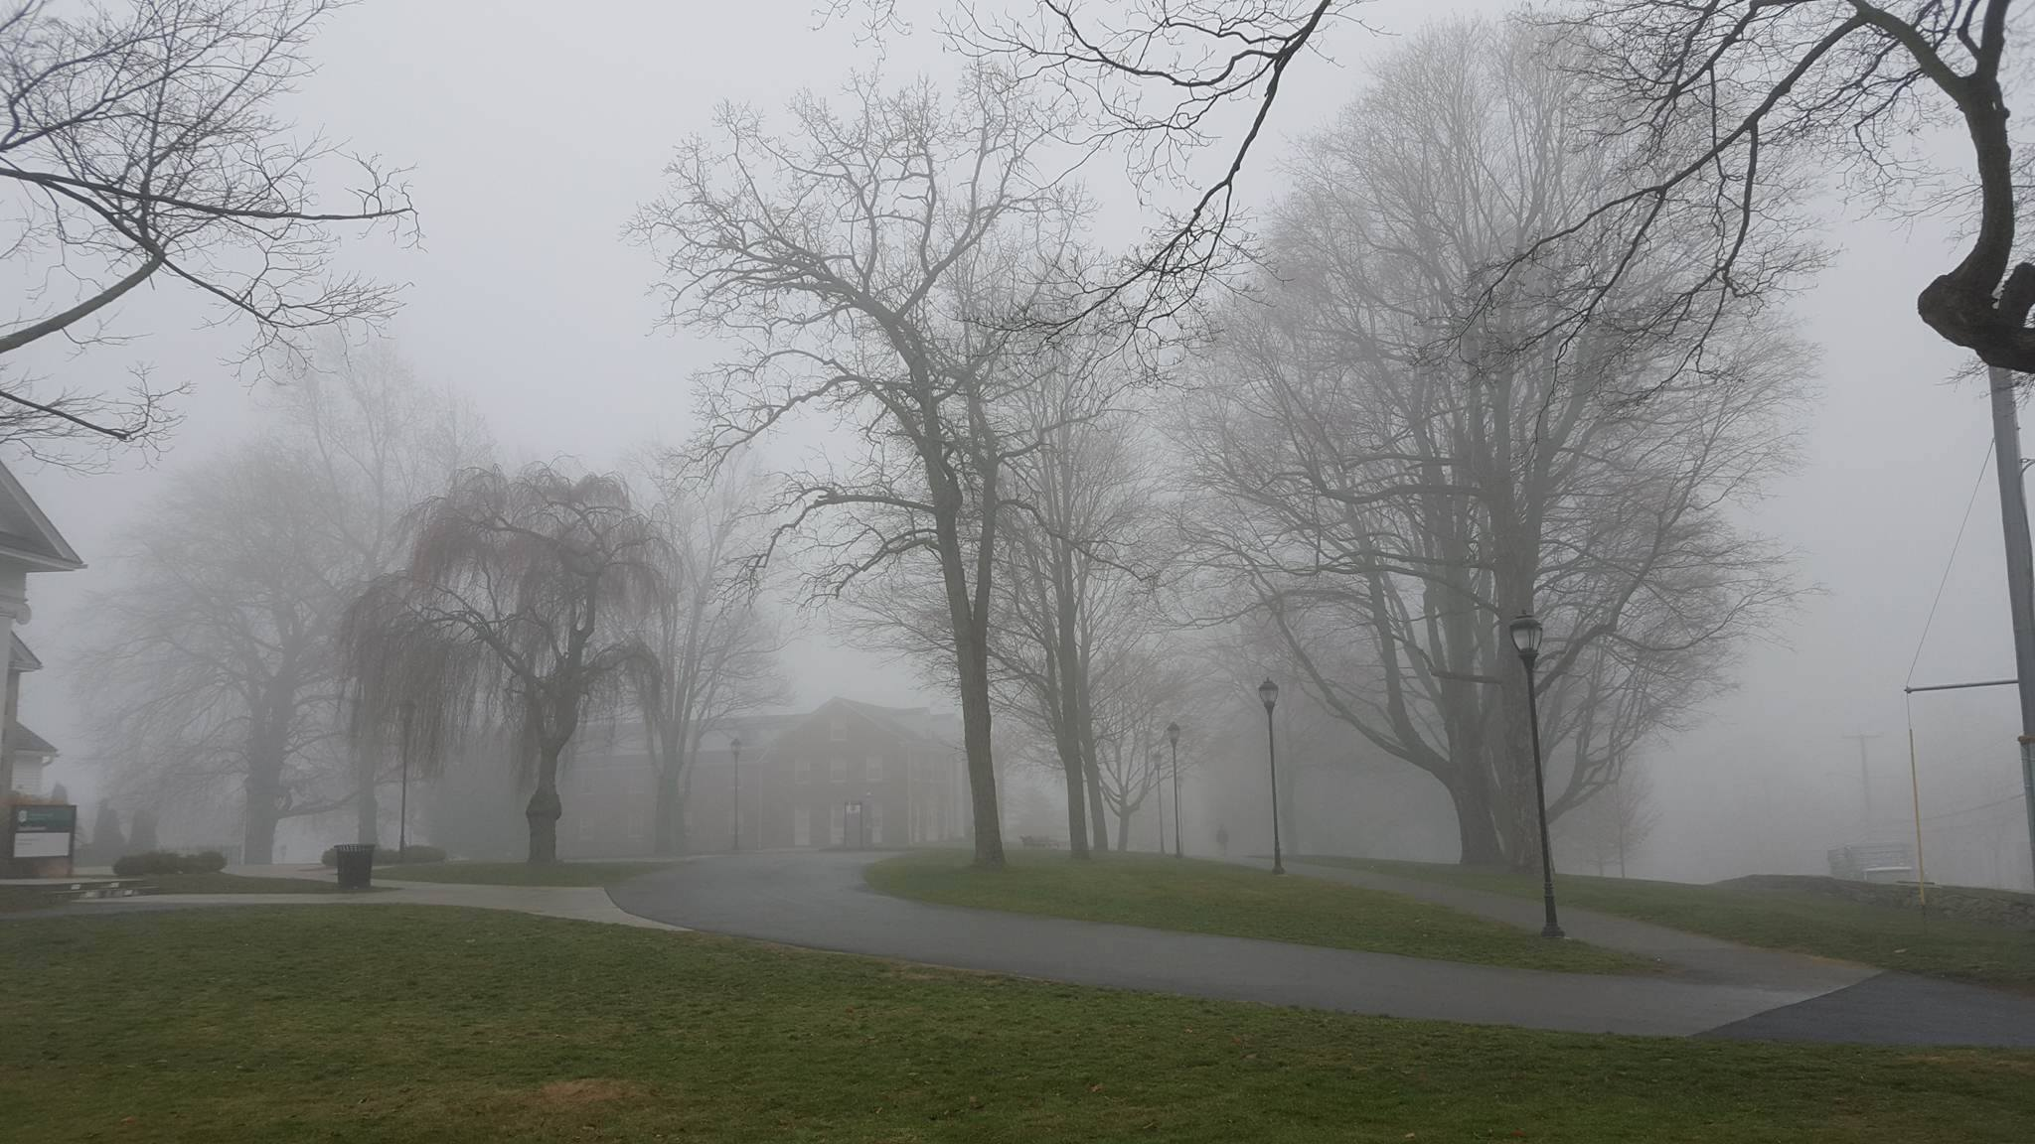
IT IS FOGGY

Slide 4
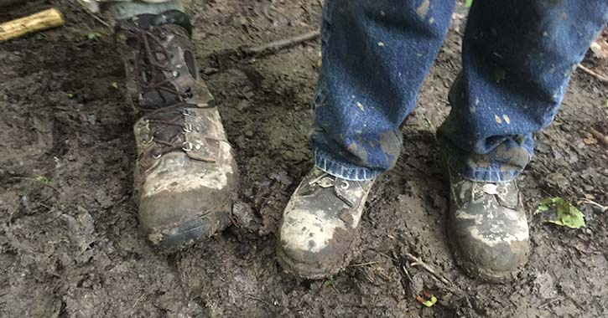
IT IS MUDDY

Slide 5
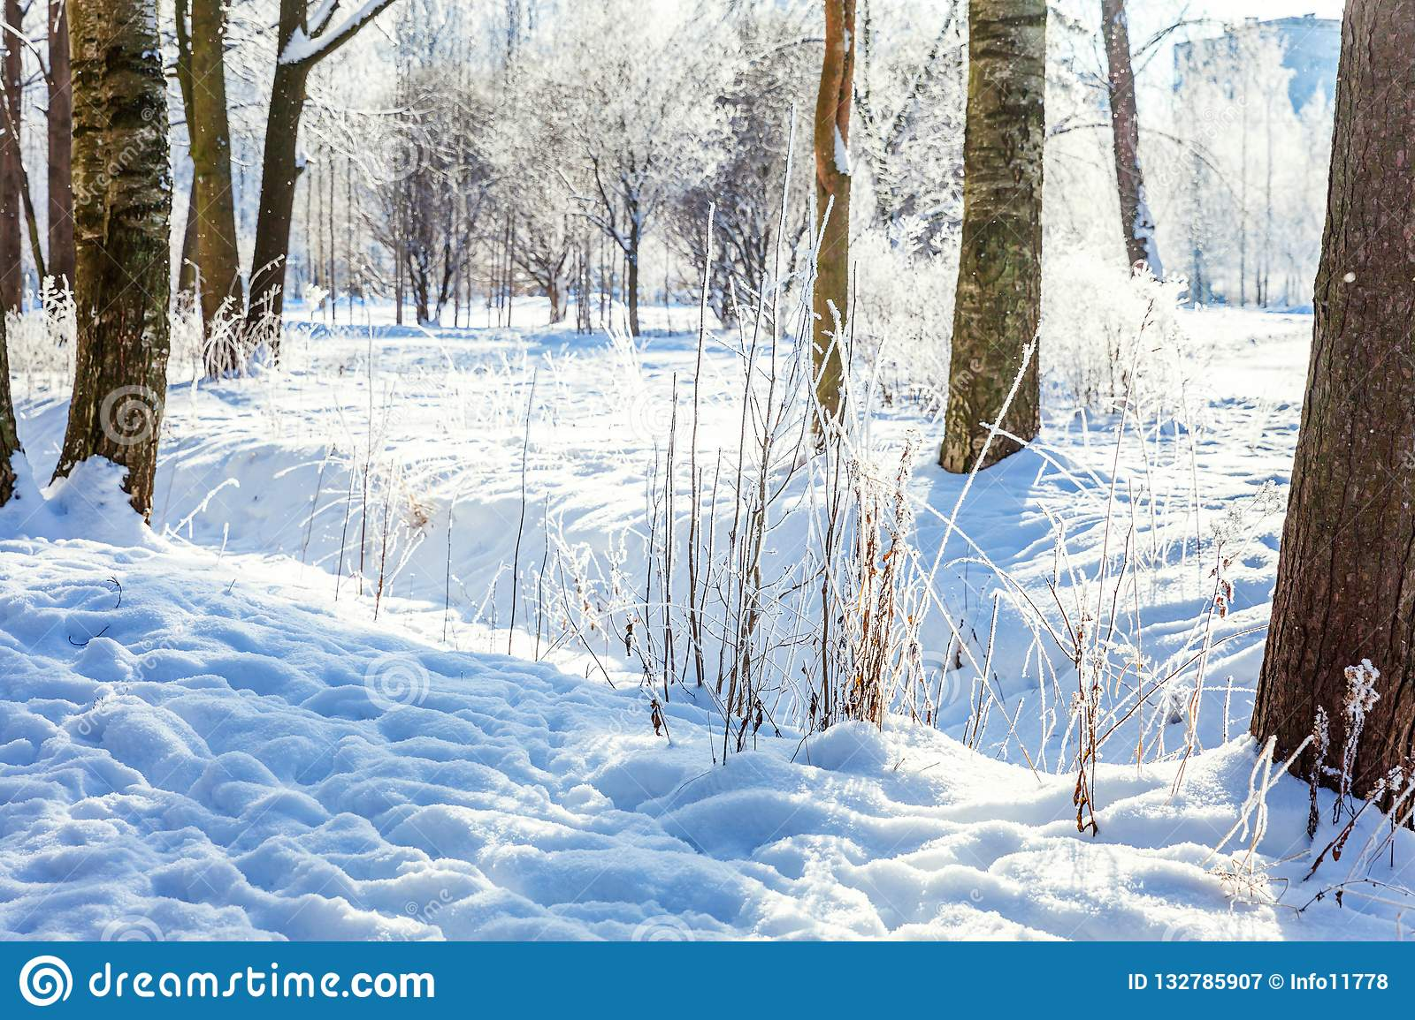
IT IS FROSTY AND SNOWY

Slide 6

IT IS…..
CLOUDY
SUNNY
RAINY
COLD
FROSTY
SNOWY
HOT AND WARM
WINDY

Slide 7
https://www.youtube.com/watch?v=Z2biA1gczXs

