Slide 1
WINTER
By Oksana Solodka

Slide 2
PROCEDURE OF THE LESSON
1) Hometask-check (vocabulary and ex. 1, p. 100)
2) Reading and Speaking (ex. 2, 3, p. 101)
3) Introduction of the New Vocabulary (ex. 1,p. 103)
4) Hometask (ex.1, 2, p. 103-104)

Slide 3
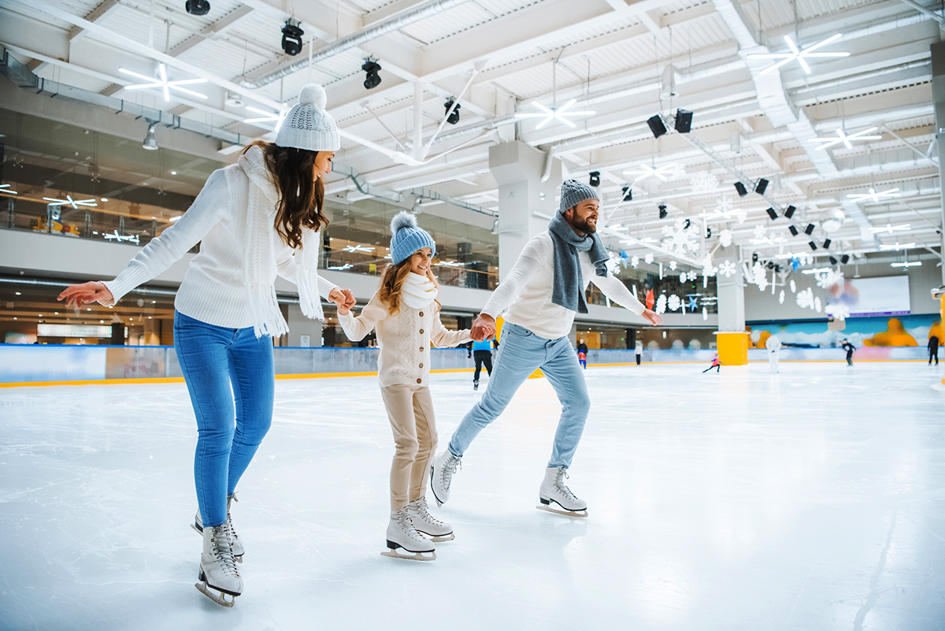
In WINTER we can…SKATE

Slide 4
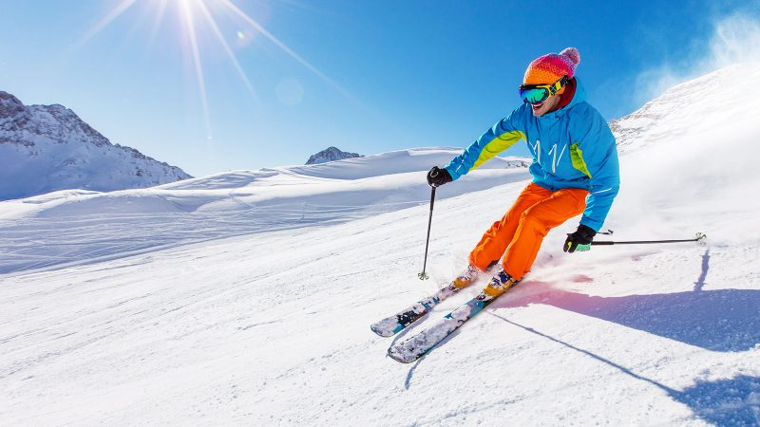
In WINTER we can… SKI

Slide 5
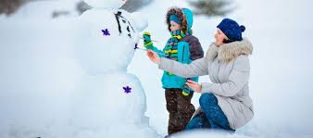
In WINTER we can…MAKE A SNOWMAN

Slide 6
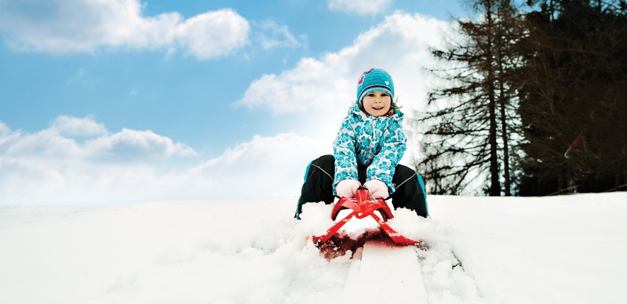
In WINTER we can…SLEDGE

Slide 7
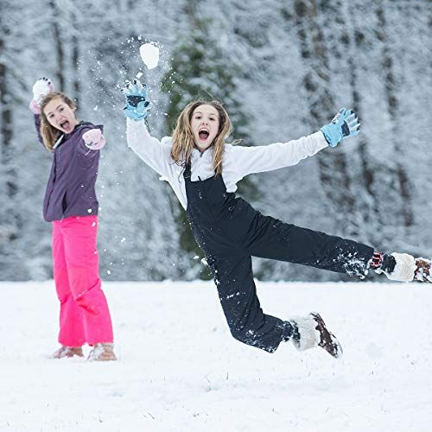
In WINTER we can…PLAY SNOWBALLS

Slide 8
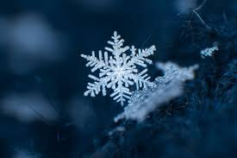
A SNOWFLAKE

