Slide 1
ADVERBS OF FREQUENCY
BY OKSANA SOLODKA

Slide 3
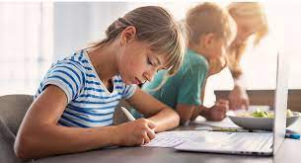
ALWAYS
I always do my homework.
We always play football after school.
My mum always cooks borshch on Sundays.
Peter always arrives at school at 9.00.

Slide 4
USUALLY
We usually go to school 5 days a week.
I usually go to bed at 10.00 pm.
Tom usually has breakfast at 8.00

Slide 5
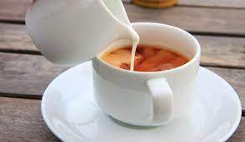
OFTEN
I often leave school at 15.00.
British people often drink tea with milk.

Slide 6
SOMETIMES
We sometimes have dinner at the restaurant.
I sometimes wake up at 6.00 am.

Slide 7
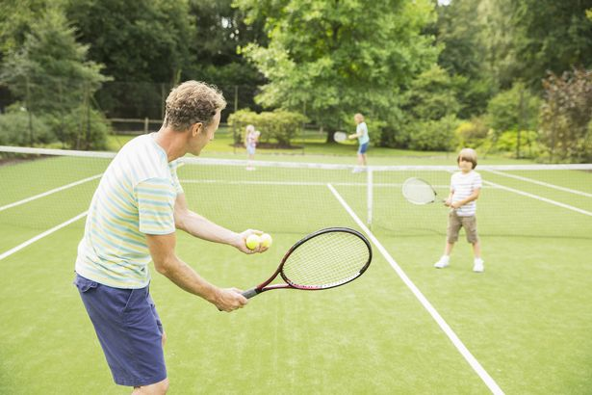
HARDLY EVER
I hardly ever go to bed at midnight.
We hardly ever play tennis after lessons.

Slide 8
Book activities
Ex. 1-4, p. 22 (classwork)
Ex. 4- 6, p. 126 (homework)

