Slide 1
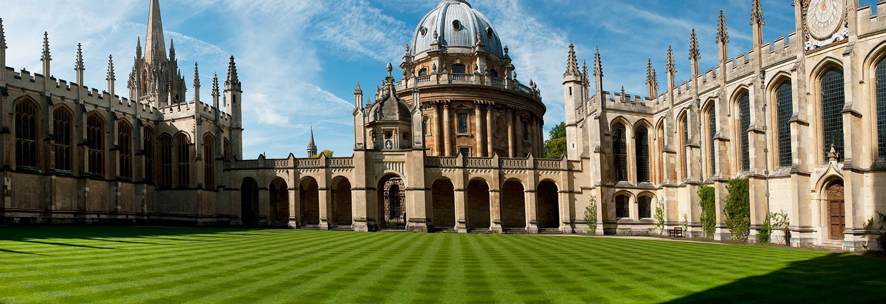
OXFORD UNIVERSITY
BY OKSANA sOLODKA

Slide 2
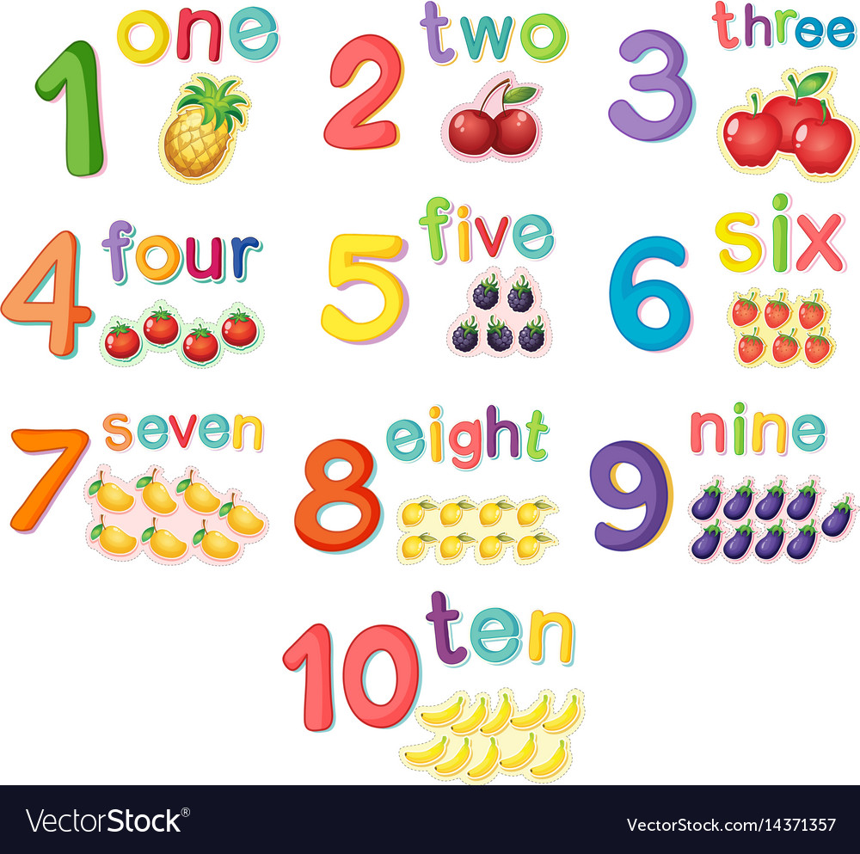
Numbers
10 – ten
100 – a hundred (one hundred)
110 – a hundred and ten (one hundred and ten)
1000 – a thousand (one thousand)
20 January – the twentieth of January
January 20 – January the twentieth
2022 – twenty twenty-two (two thousand and twenty-two)
Ex. 3, p. 21 (book)

Slide 3

Video watch
https://www.youtube.com/watch?v=WzSoPYDiefw
https://www.youtube.com/watch?v=n9EUqIoBJXA (!!!!)

Slide 4
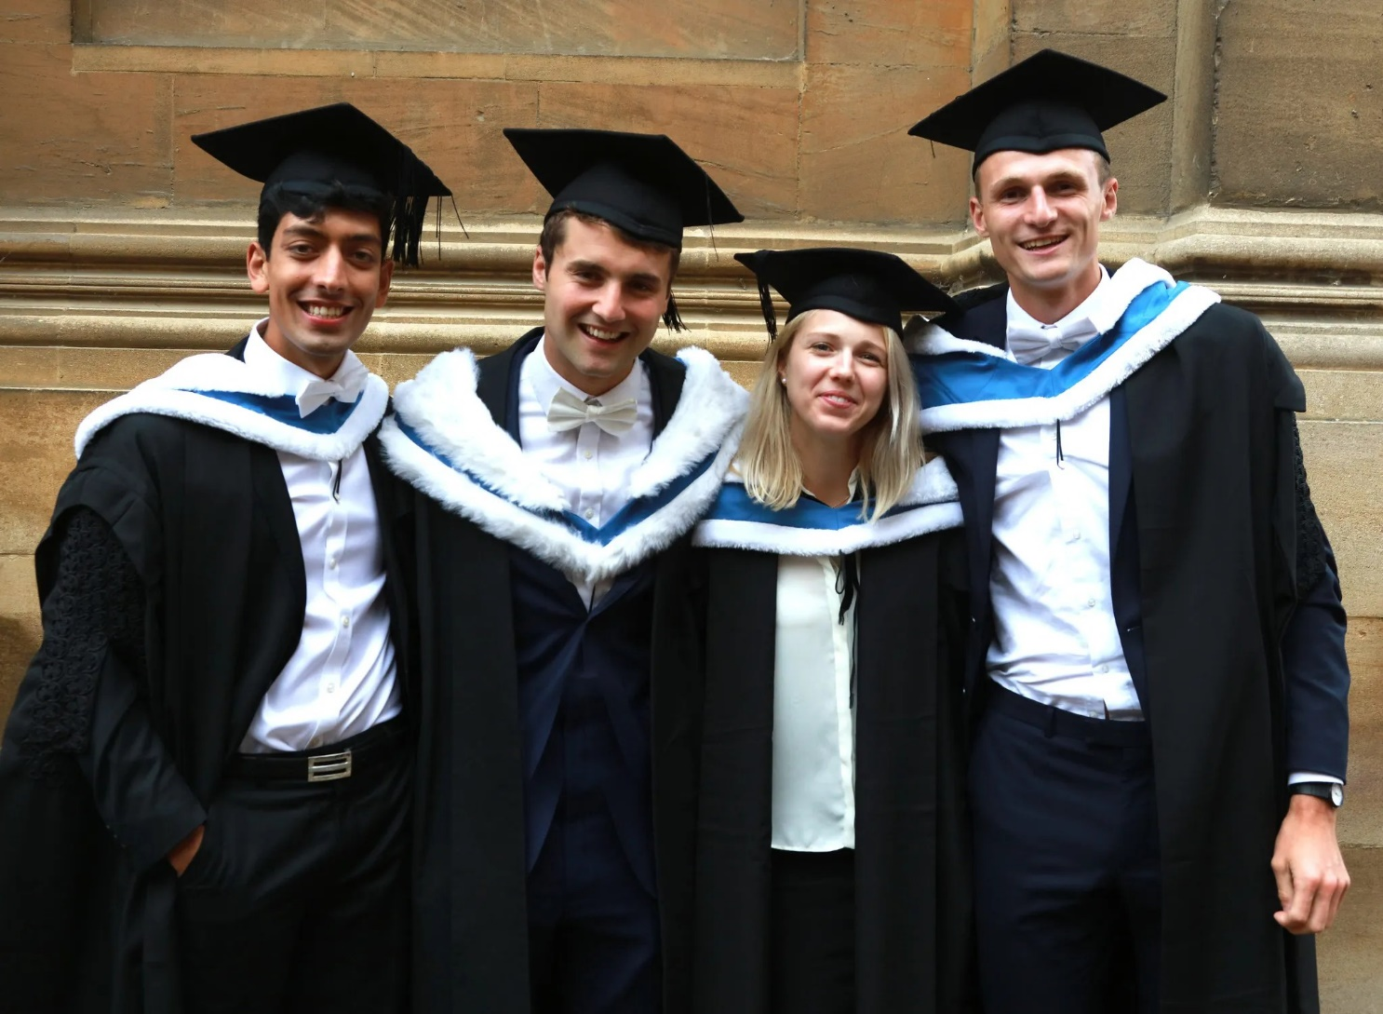
The university of oxford (book)
P. 109 ( ex. 1,2,3)
HT: ex. 7, p. 109 (write)

Slide 5
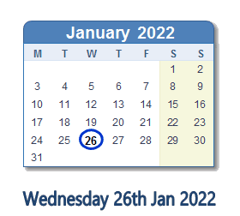
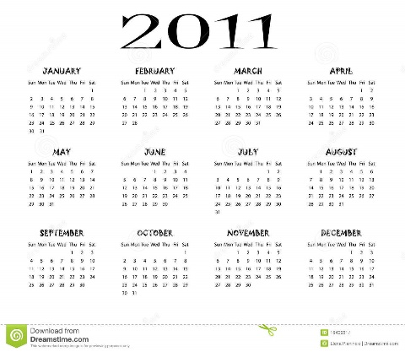




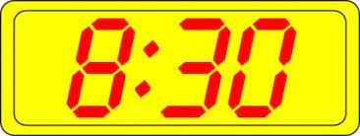
NUMBERS

Slide 6
NUMBERS
https://www.liveworksheets.com/worksheets/en/English_as_a_Second_Language_(ESL)/Big_numbers/How_to_read_large_numbers_gy2525224ax (test)
Before the test – p. 22 (WB) – https://elt.oup.com/student/solutions/elementary3rdedition/audio?cc=ua&selLanguage=uk

