Slide 1
FAMILY.
JOBS

Slide 2

Family vocabulary
https://www.youtube.com/watch?v=3wdM1Rx0HdI
Watch the video and write in Chat all words you remember (in 1 minute)
Check hometask : ex. 2, p. 89 (orally)
Ex. 4, p. 89 (orally)

Slide 3
JOBS
What jobs can you name in English?
https://www.youtube.com/watch?v=cyy6sLTFKHc
(watch and do the task after watching)

Slide 4
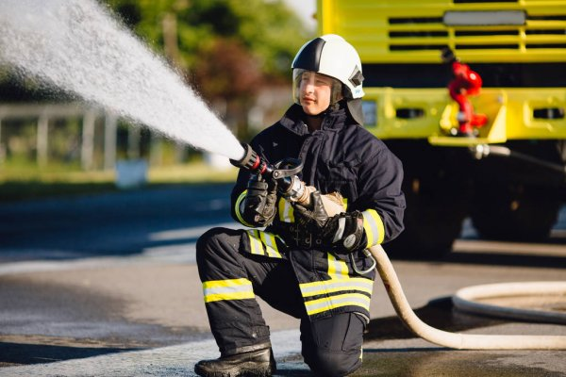

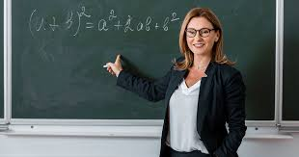
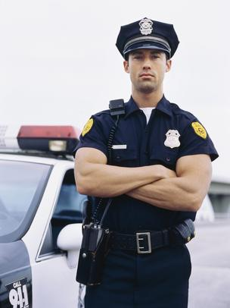



A doctor
A teacher
A fireman
A vet
A nurse
A police officer
A postman

Slide 5

Hometask
Learn the words by heart!

