Slide 1
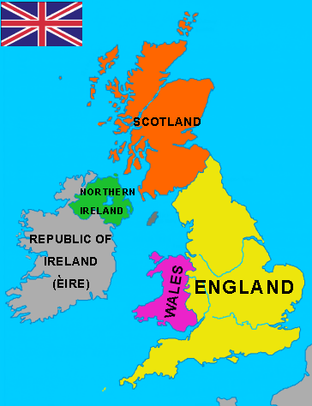
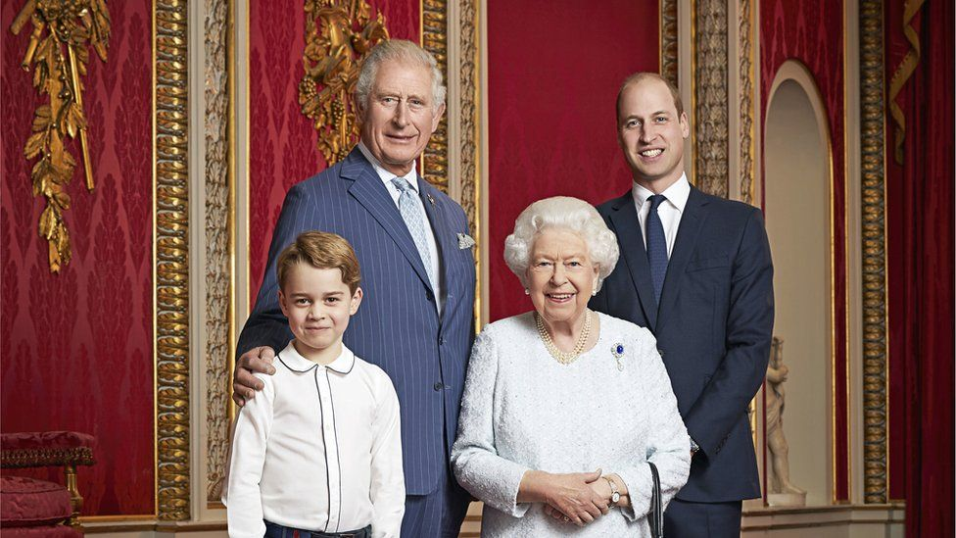
WELCOME TO BRITAIN

Slide 2
https://www.youtube.com/watch?v=ncqDJW4EhmE
The UK- the united kingdom of great Britain and northern ireland

Slide 3
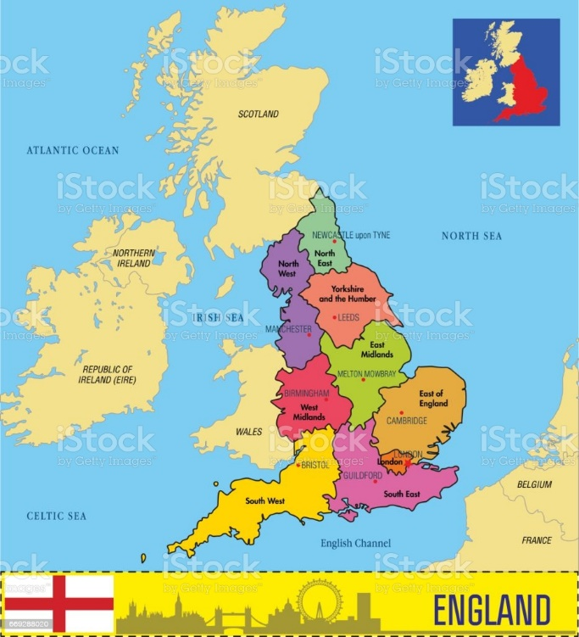
The uk consists of 4 parts!
england

Slide 4
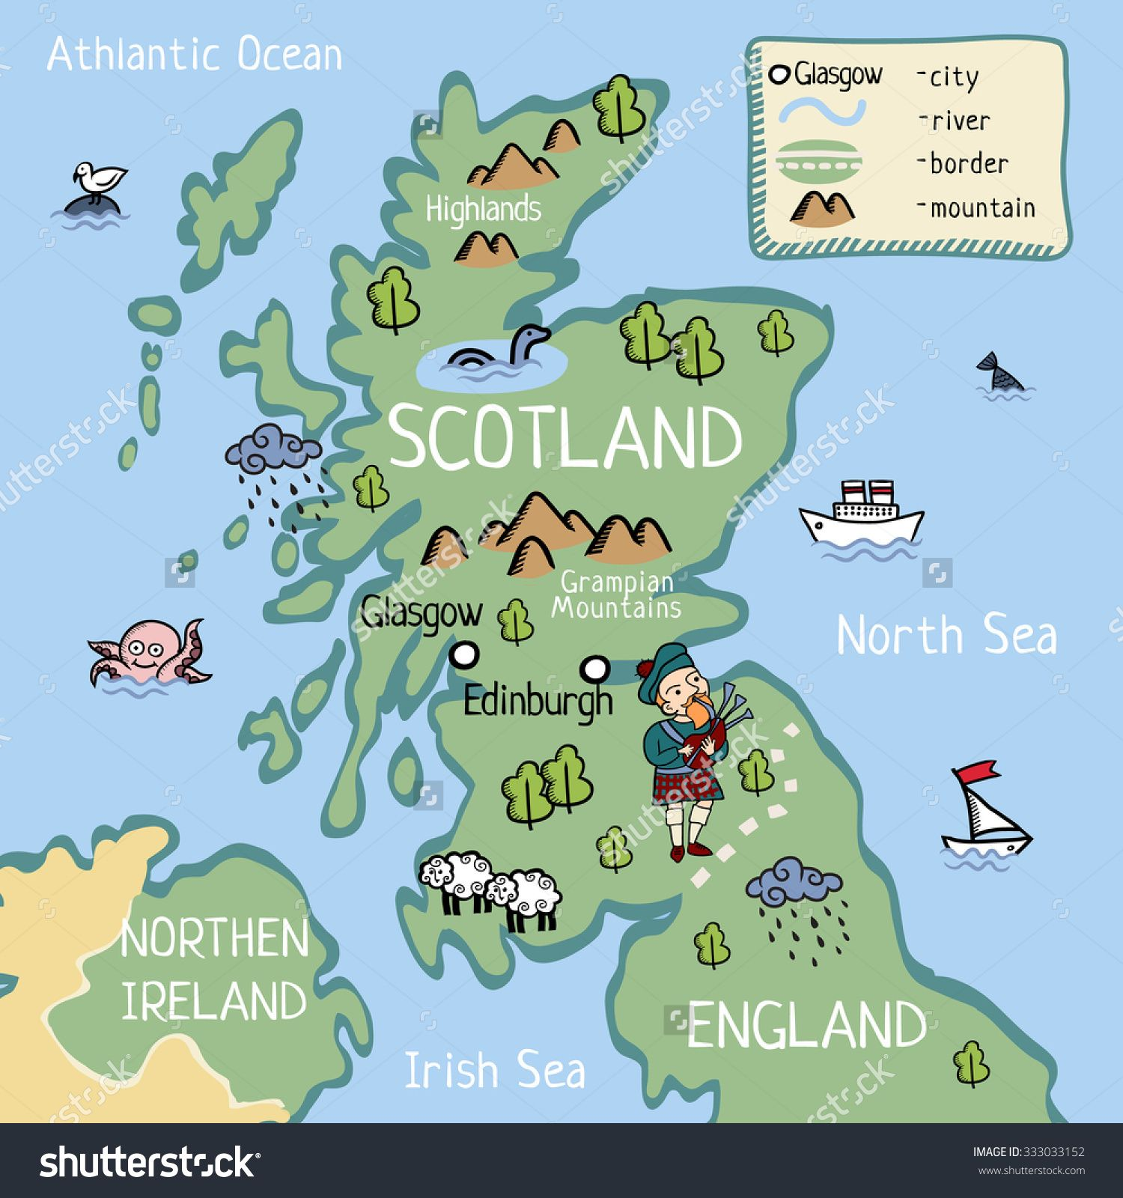
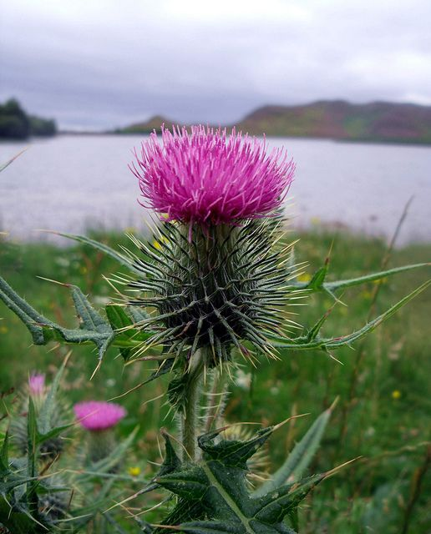
scotland

Slide 5
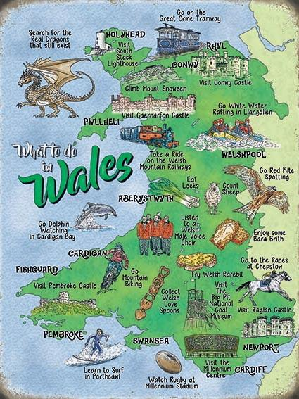
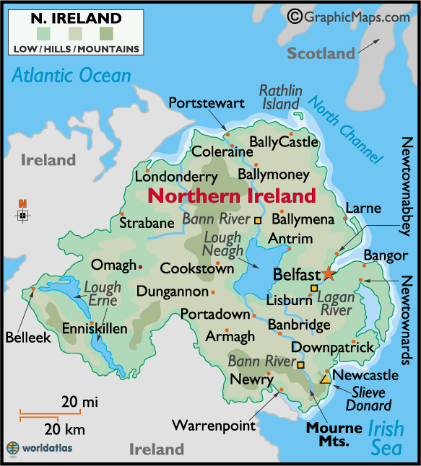
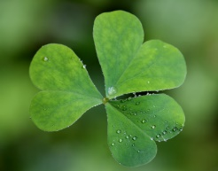
wales
Northern ireland

Slide 6
London is the capital of the uk

Slide 7
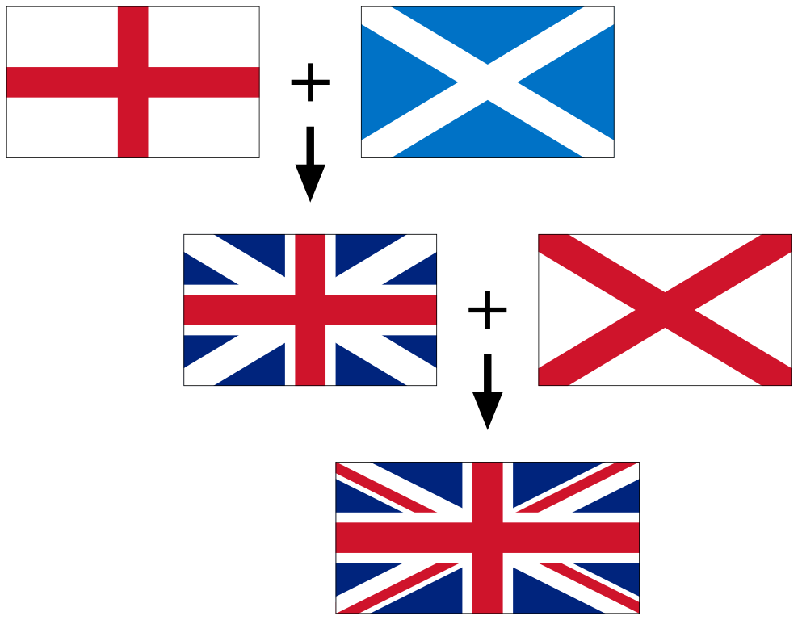
British flag – union jack

Slide 8
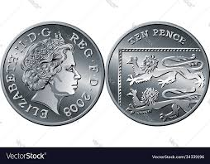
British money – pounds and pence

Slide 9
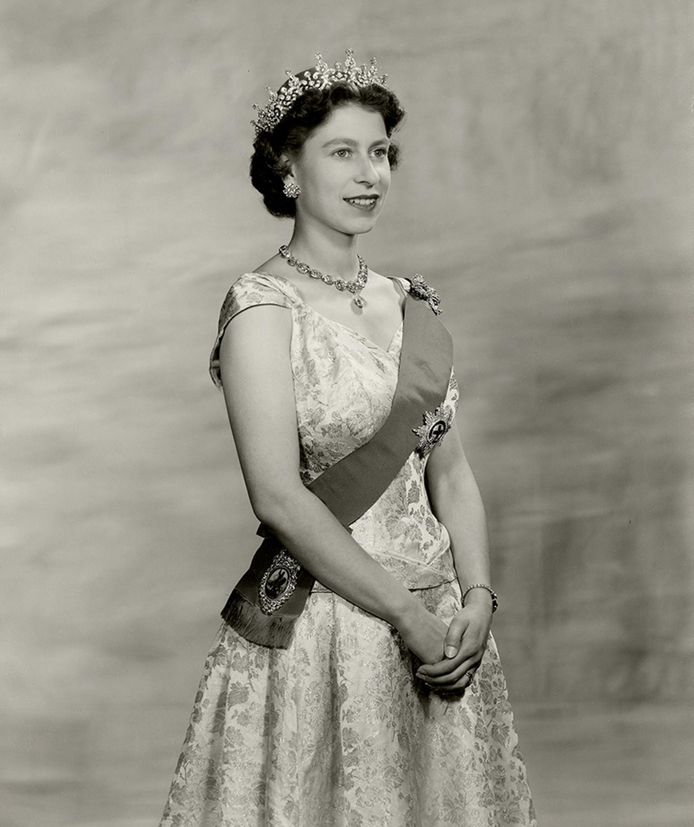
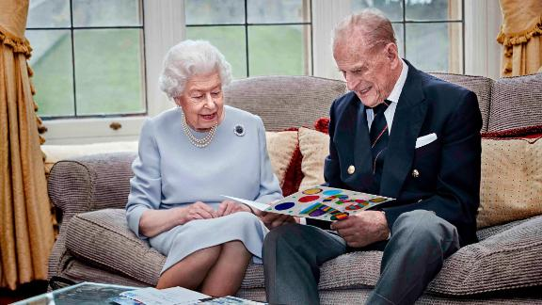
The head of the state is the queen, today it’s queen Elisabeth ii.

Slide 10
https://www.liveworksheets.com/worksheets/en/English_as_a_Second_Language_(ESL)/Reading_comprehension/The_UK_-_reading_hy1208894uc

