Slide 1
HEALTHY FOOD
MUCH/MANY

Slide 2
PROCEDURE OF THE LESSON
Hometask-check (ex. 4, p. 96)
Book: ex. 1(a), p. 98 (orally)
Explain the difference between much and many (ex. 2, p. 99, ex. 2, 102)
Hometask: revise the vocabulary

Slide 3

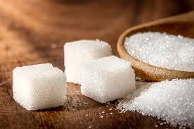

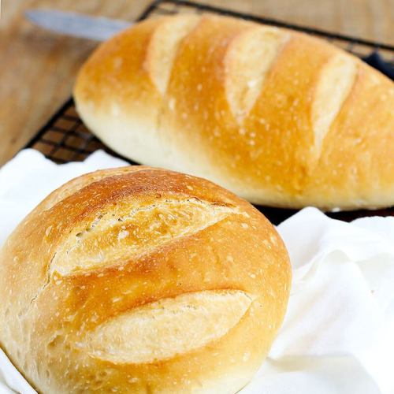
MUCH

Slide 4
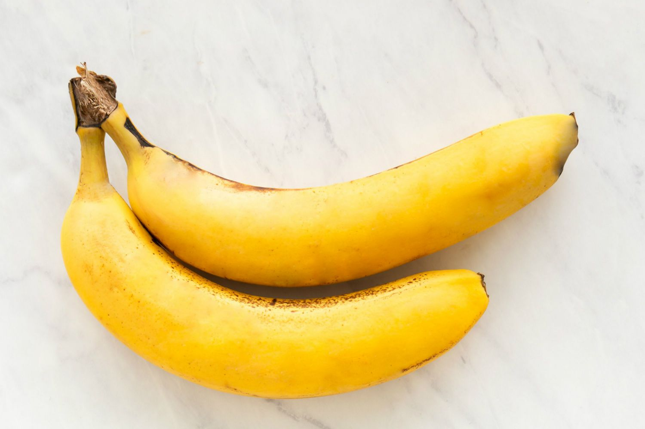
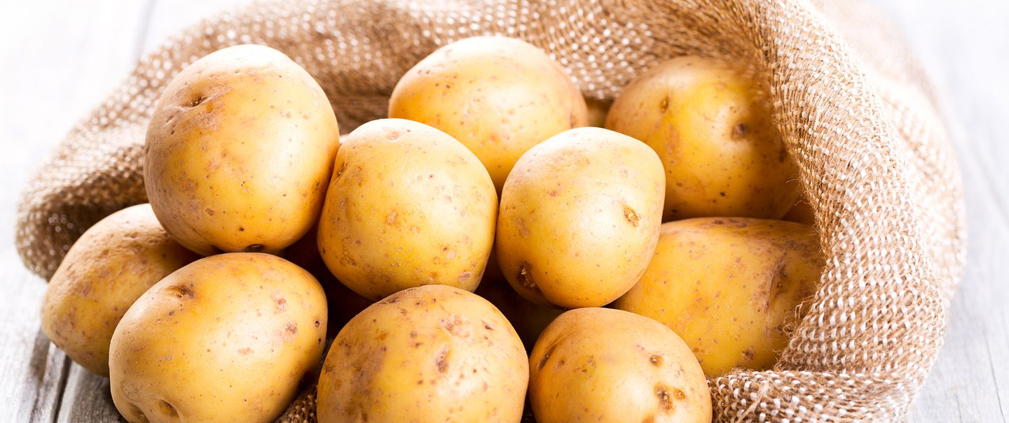
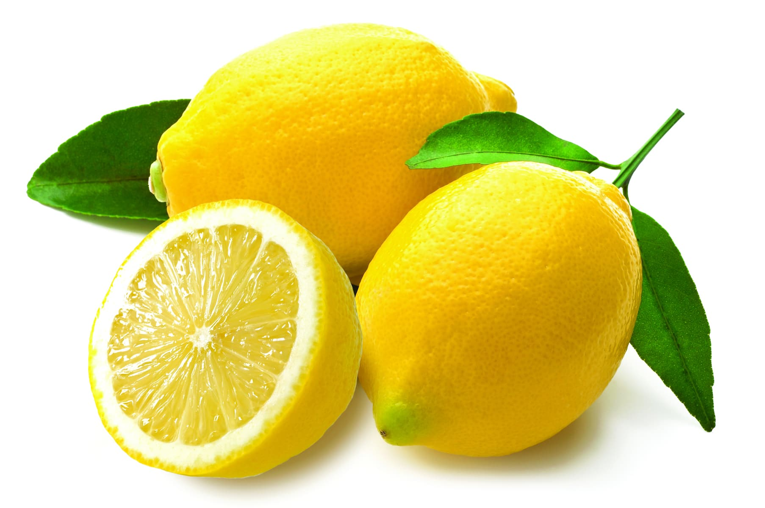
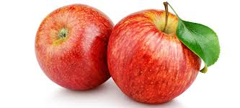
MANY

Slide 5
https://www.liveworksheets.com/worksheets/en/English_as_a_Second_Language_(ESL)/Countable_and_uncountable_nouns/Countable_and_Uncountable_fe60913gn
https://www.liveworksheets.com/worksheets/en/English_as_a_Second_Language_(ESL)/Countable_and_uncountable_nouns/How_much-How_many_mf220685gd
https://www.liveworksheets.com/worksheets/en/English_as_a_Second_Language_(ESL)/Quantifiers/Quantifiers_ep158017st

