Slide 1
HOW MUCH/HOW MANY
By Oksana Solodka

Slide 2
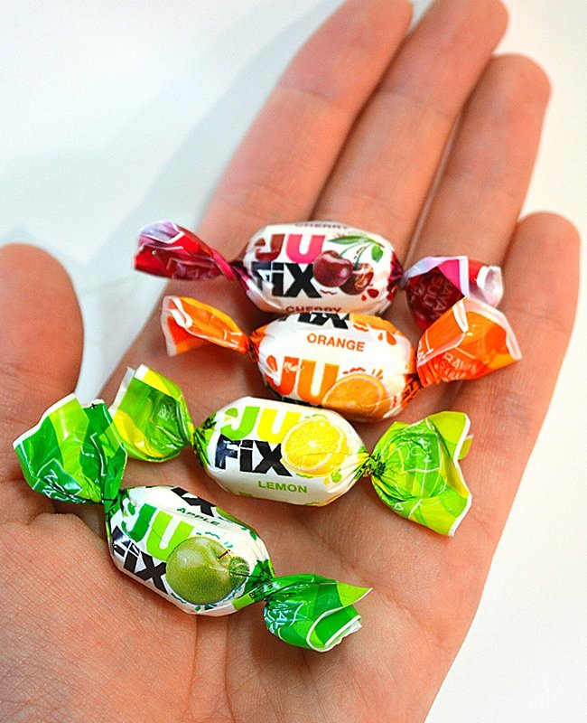
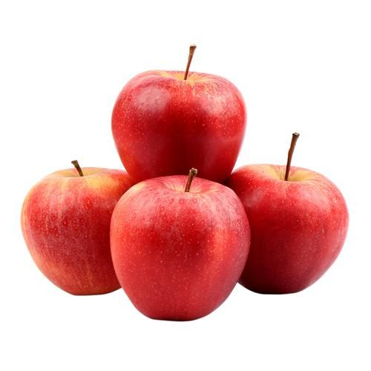
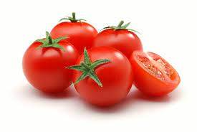
How many ? (countable)

Slide 3
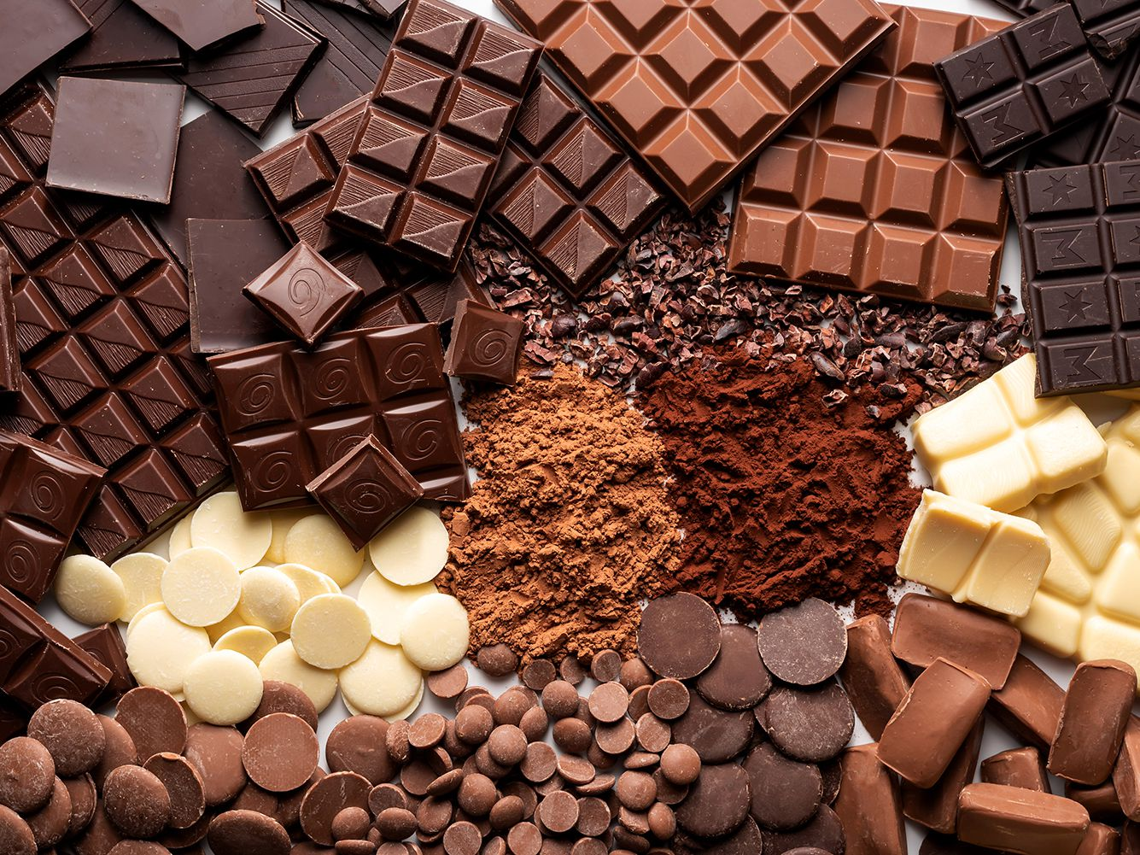
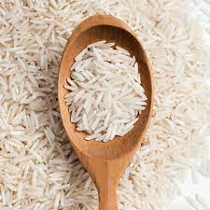
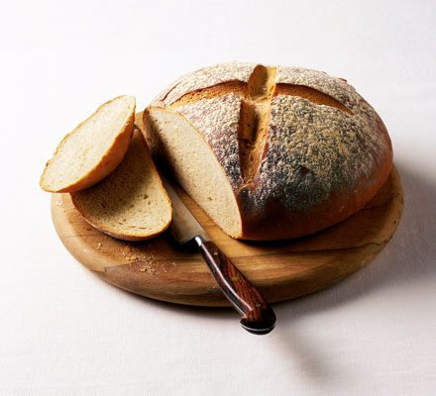
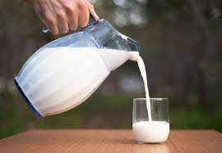
How much? (uncountable)

Slide 4
Grammar tests
https://www.liveworksheets.com/worksheets/en/English_as_a_Second_Language_(ESL)/Countable_and_uncountable_nouns/How_much$_or_How_many$_bf1398939ge
https://wordwall.net/resource/790117/much-many
HT: ex.2, p.102 (orally)

