Slide 1
FOOD
https://www.youtube.com/watch?v=YC1HfRDWwQQ

Slide 2
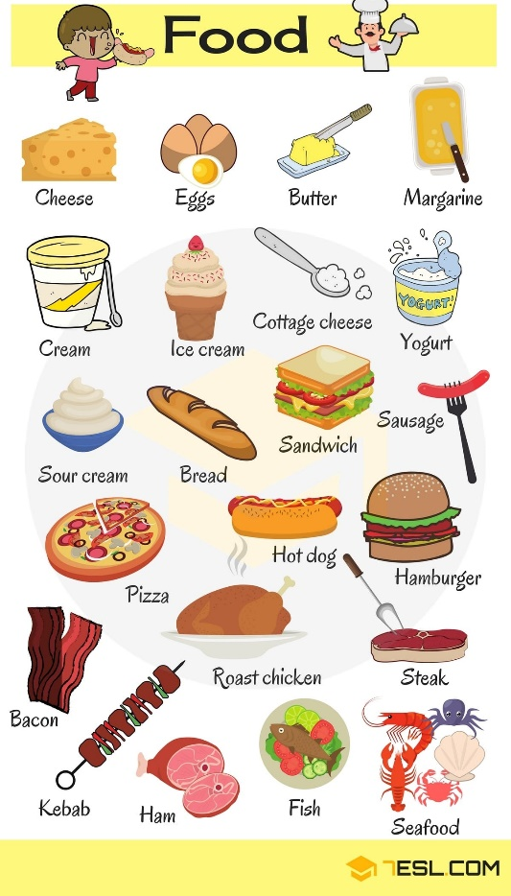
I LIKE….
I DON’T LIKE …

Slide 3
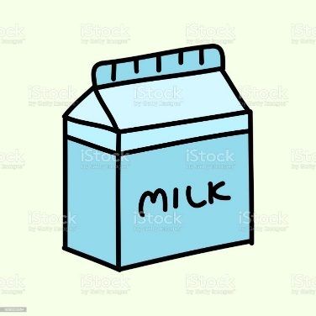
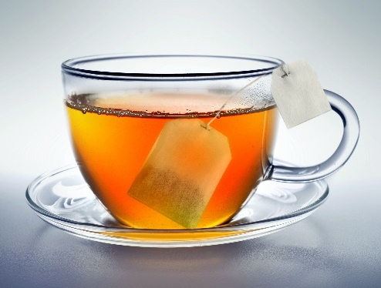
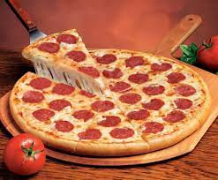
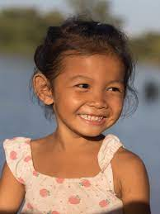
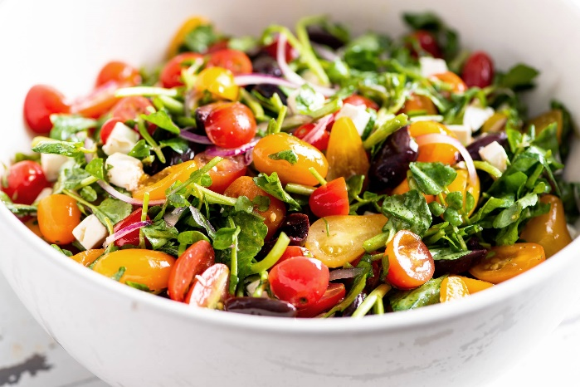
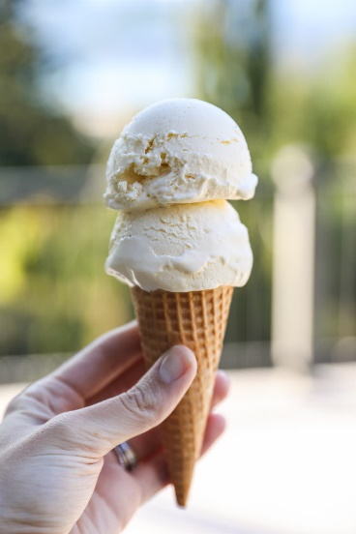
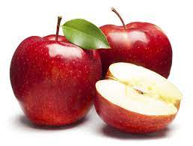
Anna likes…

Slide 4
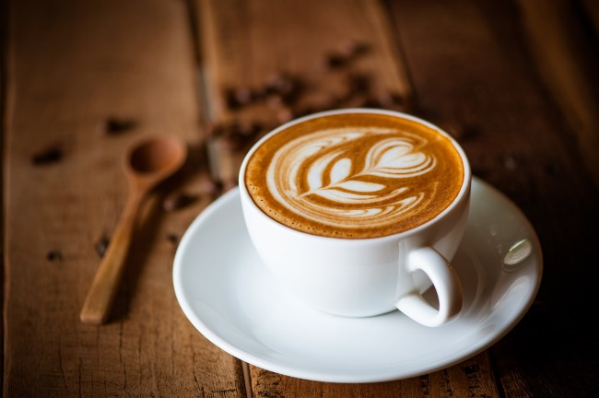
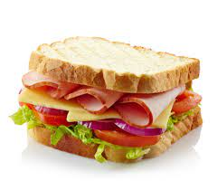
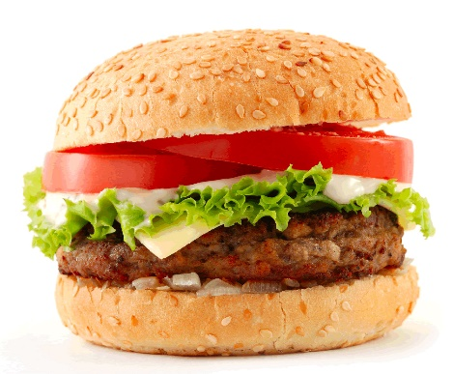
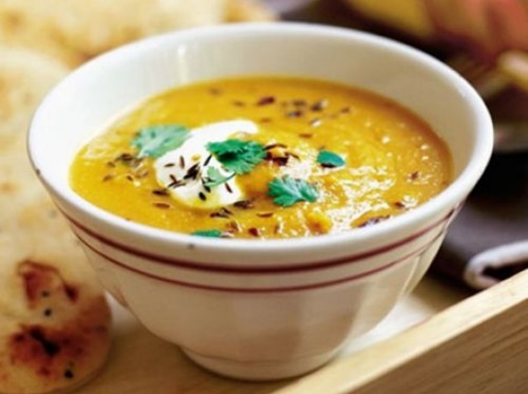
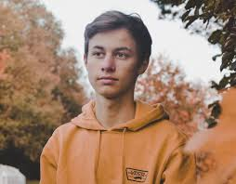
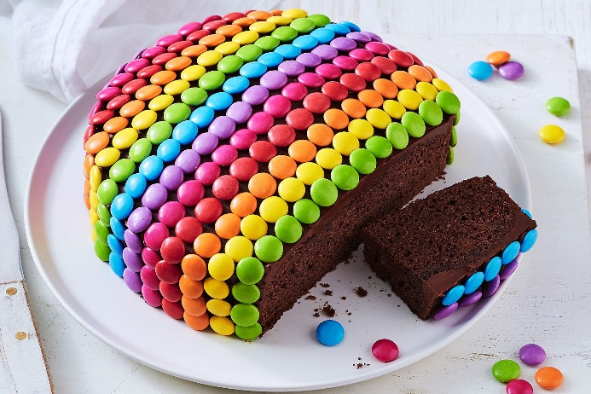
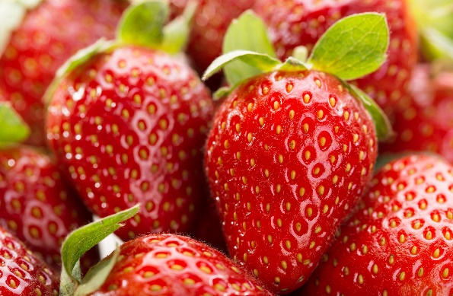
TOM LIKES …

Slide 5
https://www.liveworksheets.com/worksheets/en/English_as_a_Second_Language_(ESL)/Likes_and_dislikes/I_like...-_I_don't_like..._-_Do_you_like...$_rz1402110zt https://www.liveworksheets.com/worksheets/en/English_as_a_Second_Language_(ESL)/Food_and_drinks/What_do_you_like_for_breakfast)_jn493310kb
HT: ex.1, p. 109 (do and send me a photo)

