Slide 1
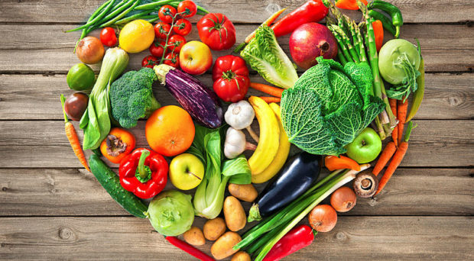
HEALTHY FOOD

Slide 2
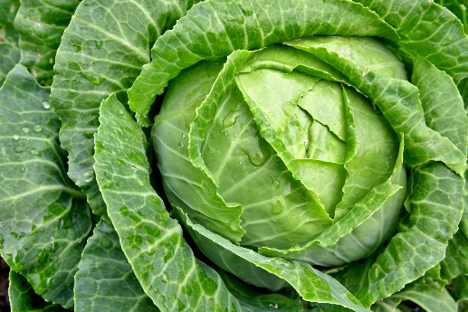
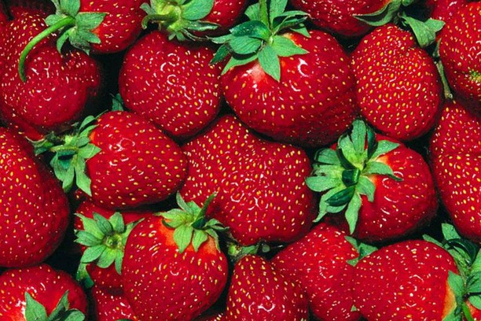
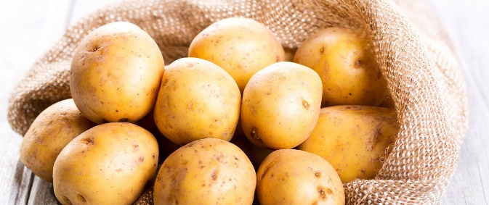
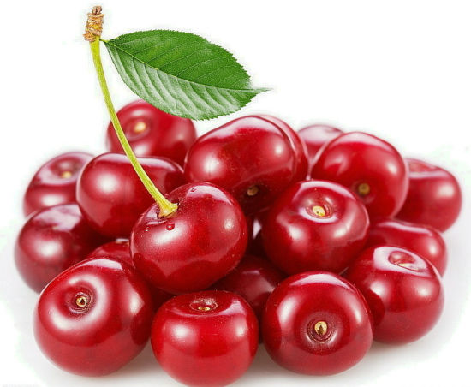
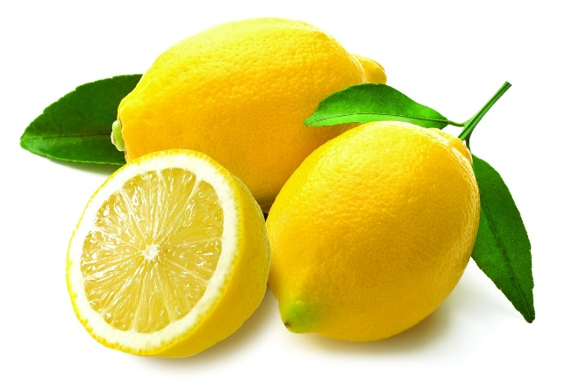
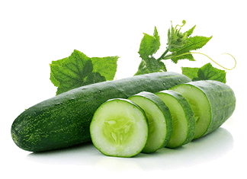
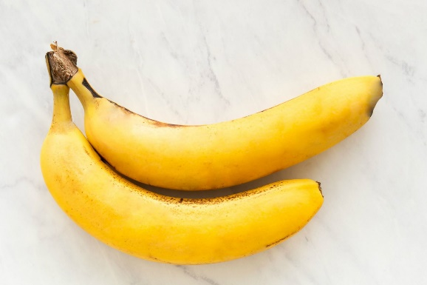
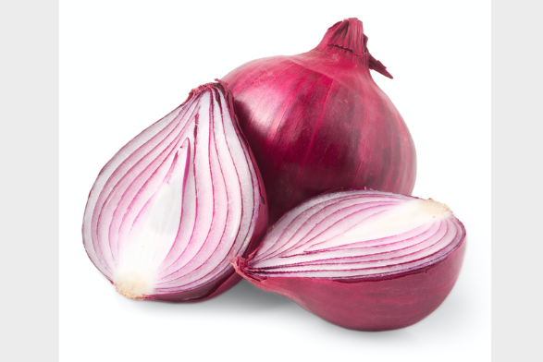
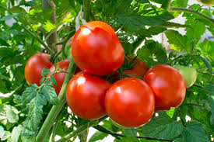
Warm-up

Slide 3
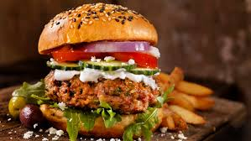
Hometask check
Ex. 4, p. 94 (orally)
Ask some questions about favourite food
Start speaking about healthy
and unhealthy food

Slide 4
Fruit and vegetables are good for your health
You should drink a lot of water every day
Hamburgers are not bad for your health
Chocolate is always bad for your health
You don’t have to eat breakfast in the morning
You can eat while watching TV or reading a book
An apple is a good snack for you

