Slide 1
SCHOOL SUBJECTS
By Oksana Solodka

Slide 2

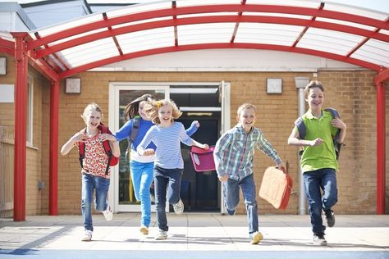
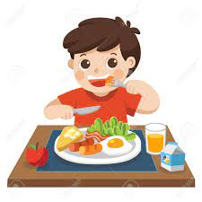


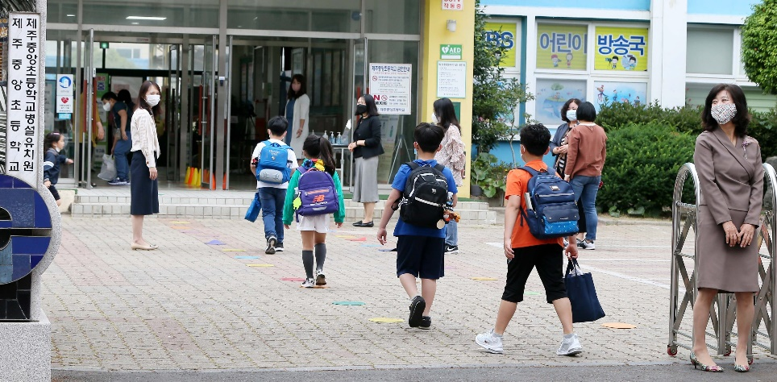
Hometask check:
Ask the words and ex. 1, 2, p. 20 (WB)
Make up sentences with them

Slide 3
Brainstorming
HISTORY
ENGLISH
SCHOOL SUBJECTS
?
?
?

Slide 4
Answer the questions
What lessons have you got today?
What lessons do you have on Monday?
What is your favourite lesson?
What is your least favourite lesson?
Ex. 7, p. 19 (Book)

Slide 5
Workbook tasks
Ex. 5, p. 20 (themselves)
Ex. 6, p. 20 (listen and write the subject https://elt.oup.com/student/solutions/elementary3rdedition/audio?cc=ua&selLanguage=uk
https://www.liveworksheets.com/worksheets/en/English_as_a_Second_Language_(ESL)/School_subjects/School_subjects_yi1219434tc
HT: ex.7, 8, p.20 (WB)

Slide 6

Guess the school subject

Slide 7
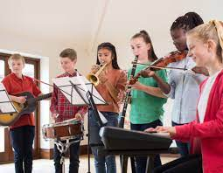

Slide 8
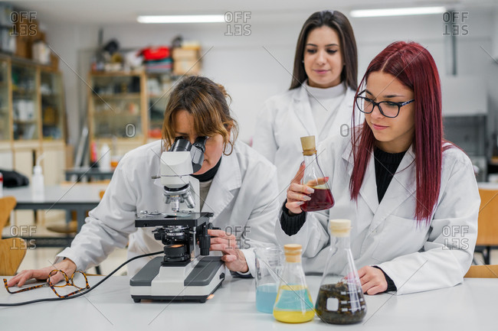

Slide 9
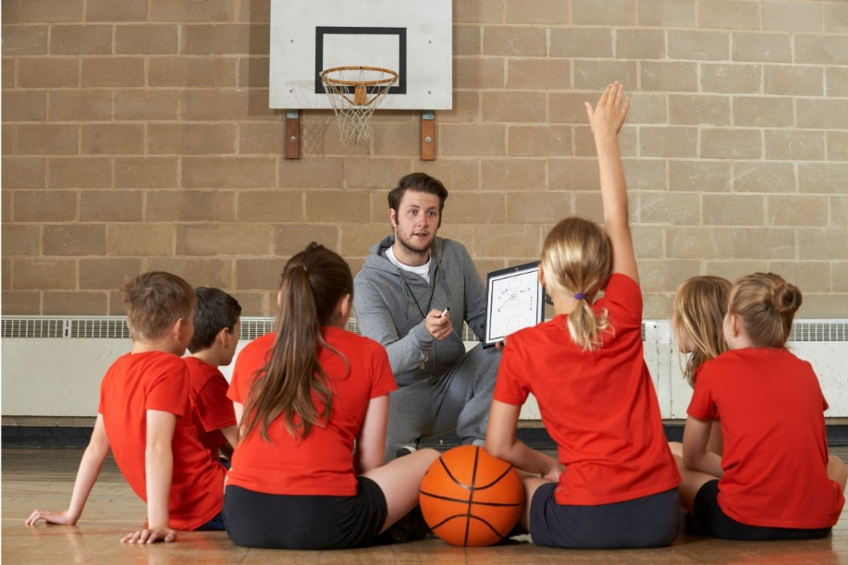

Slide 10
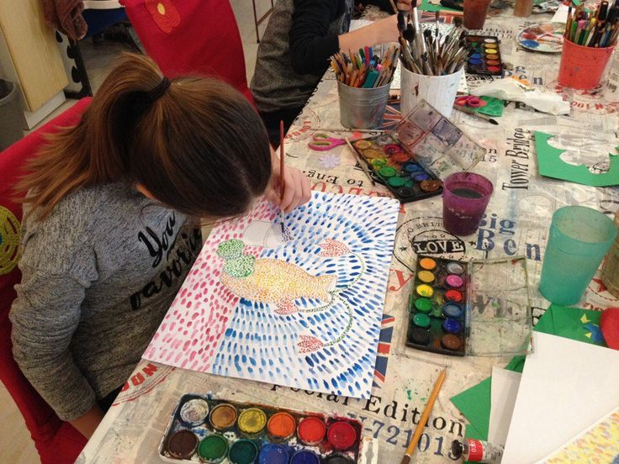

Slide 11
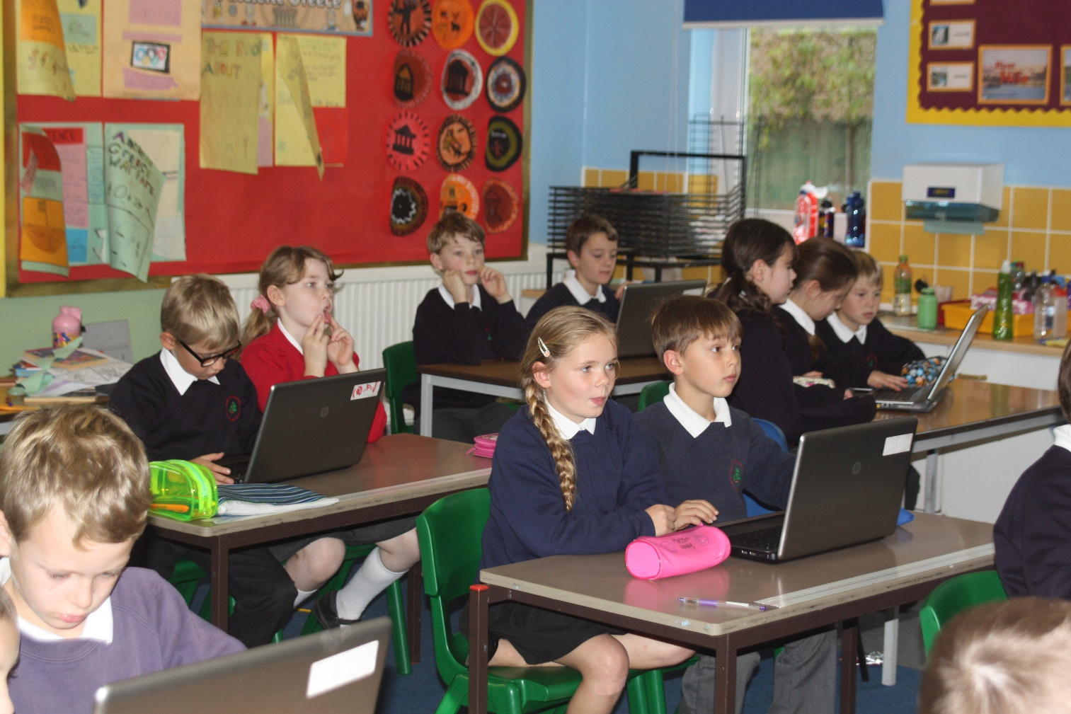

Slide 12
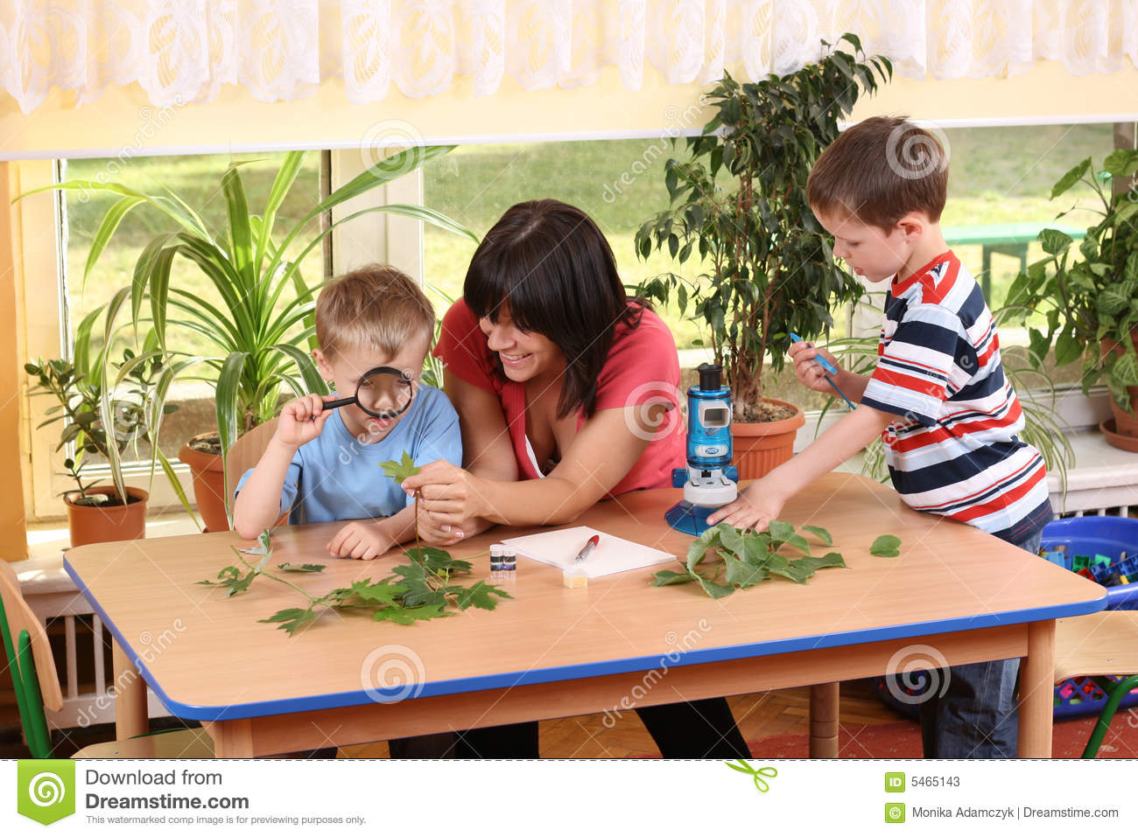

Slide 13


Slide 14
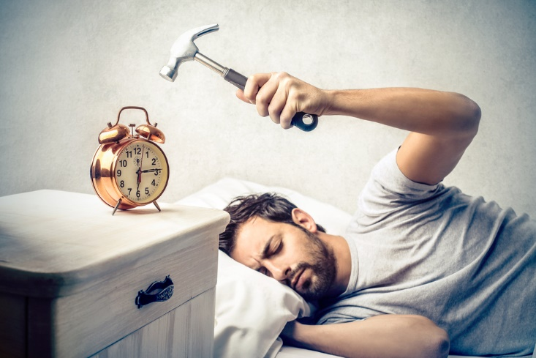
HAVE TO
HAS TO
I have to get up early.
She has to eat breakfast.
They have to go to school.
He has to do his homework every day.

Slide 15

Don’t have to
Doesn’t have to
I don’t have to get up early on Sundays.
She doesn’t have to cook dinner for the family.
We don’t have to wear uniform at school.

Slide 16

Book, p. 20 (ex. 4, 5, 6)
HT: p. 21 (WB)

