Slide 1
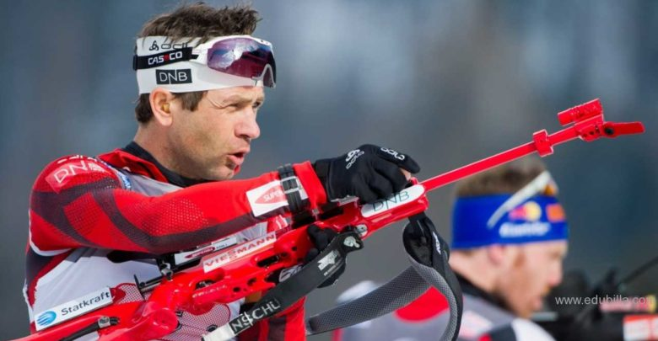
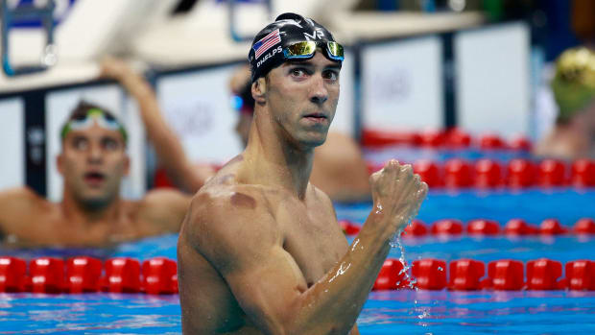
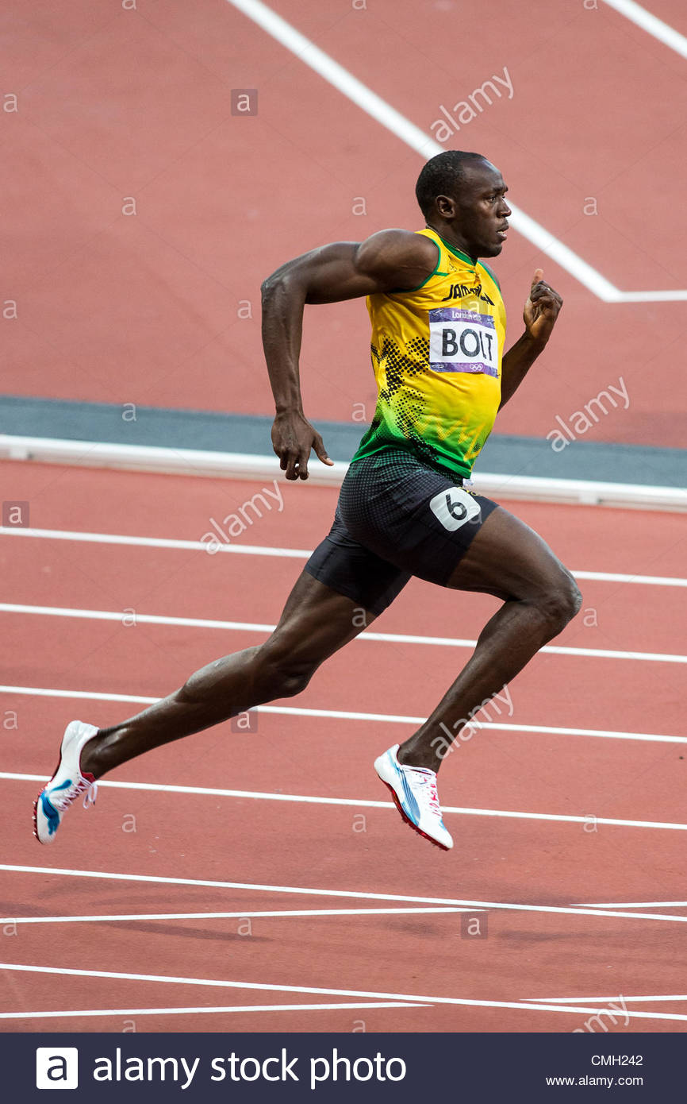
Favourite sportsman
By Oksana Solodka

Slide 2
https://www.youtube.com/watch?v=ENMhrEVa4XQ
Watch the video and note down all kinds of sports that you know
https://www.youtube.com/watch?v=BL2XAB74o-A (for motivation, whether they know any names)

Slide 3
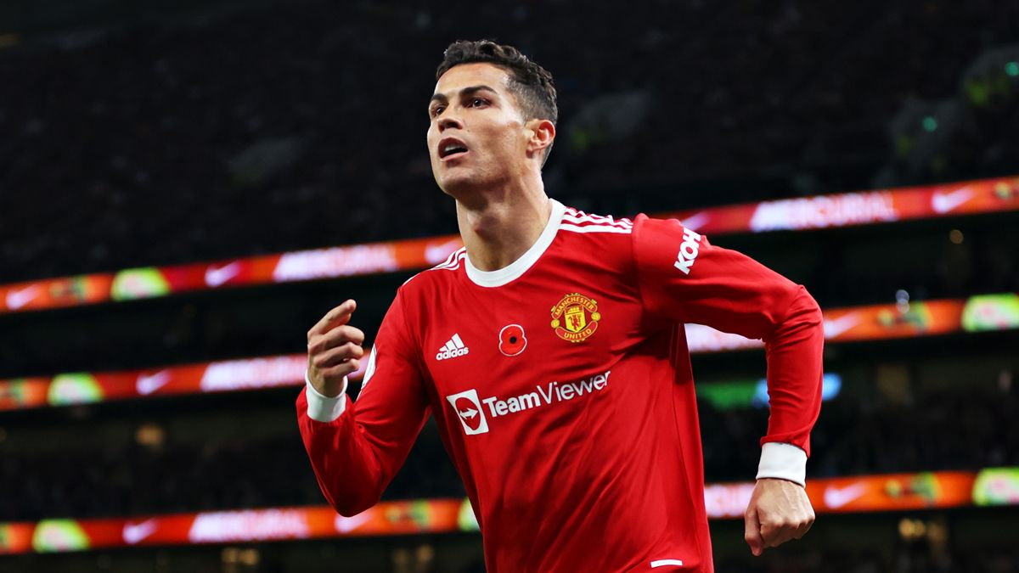
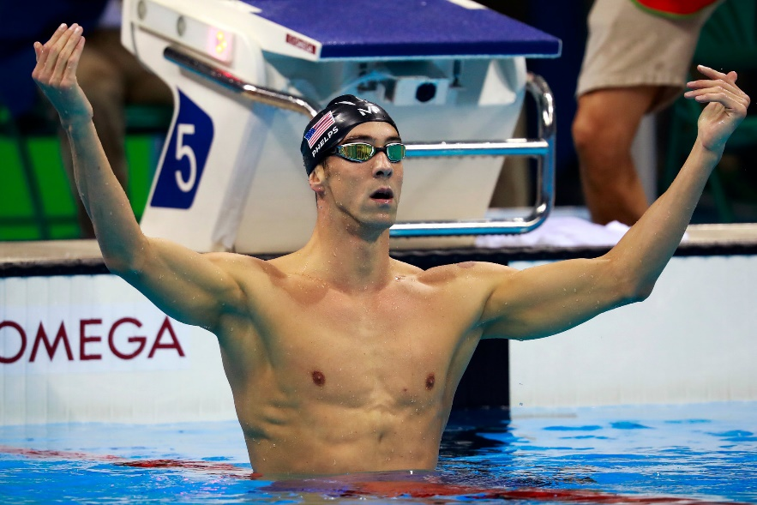
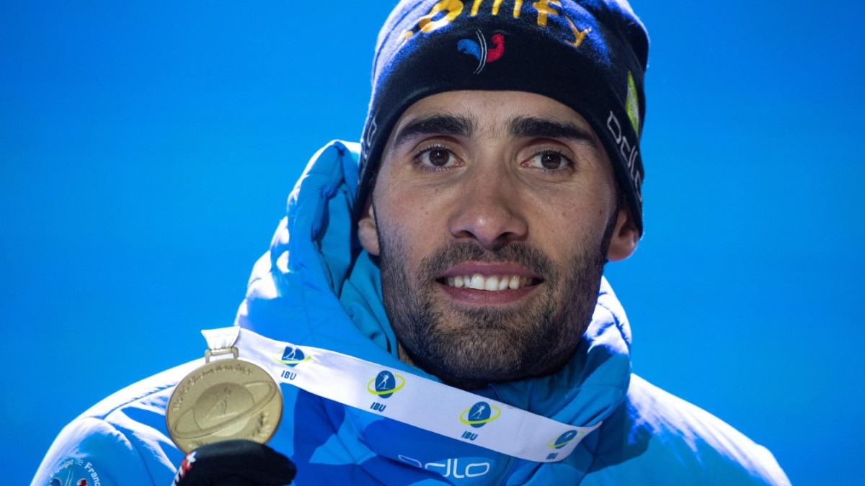
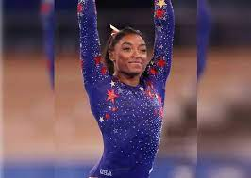
Group Work
1. Christiano Ronaldo
2. Michael Phelps
3. Martin Fourcade
4. Simone Biles

