Slide 1
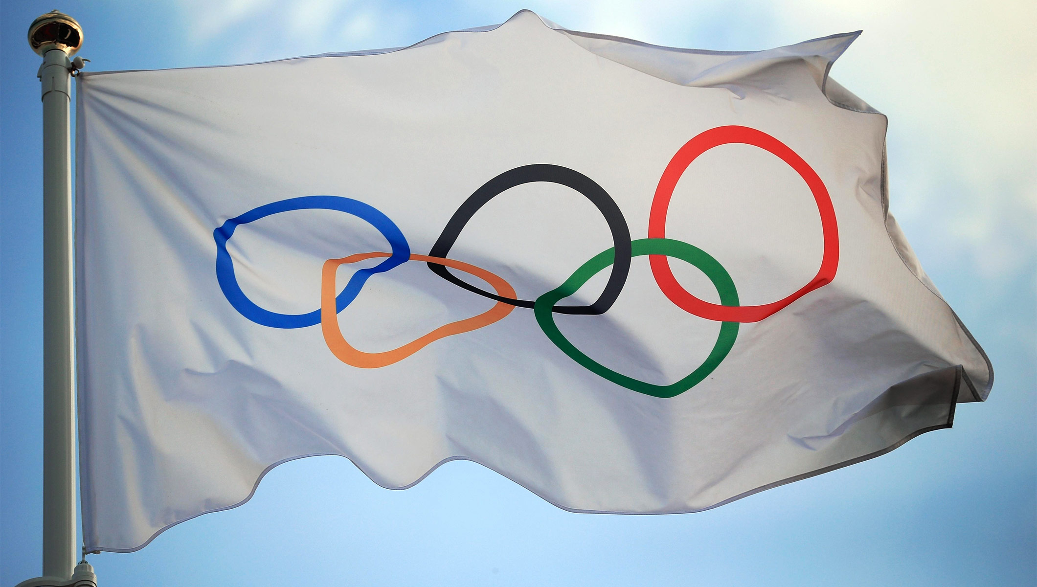
OLYMPIC GAMES

Slide 2
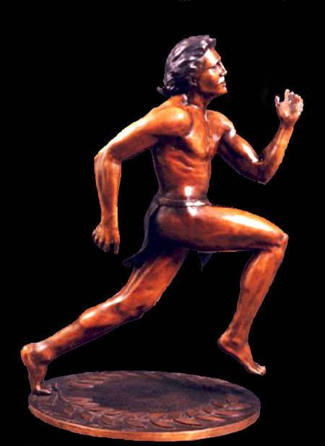
Olympic games started long time ago in ancient Greece about 3,000 years ago.
They were held every 4 years at that time and this goes on till now.
The first modern Olympics took place in 1896 in Greece again.

Slide 3
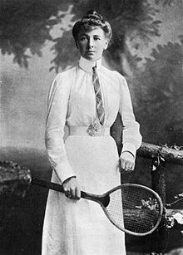
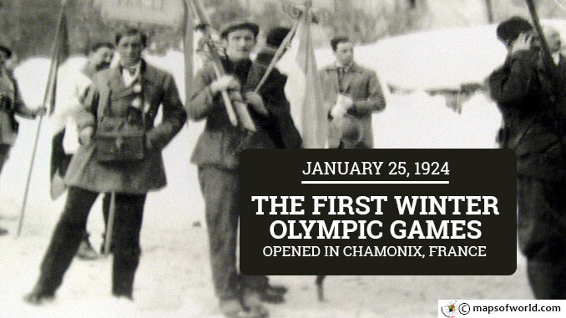
The official symbol of the Games is an Olympic flag with 5 interlocked coloured rings representing the continents on a white background appeared in 1920.
Women started to take part in the Games since 1900 but only in tennis.
The first Winter Olympics were held in 1924.

Slide 4
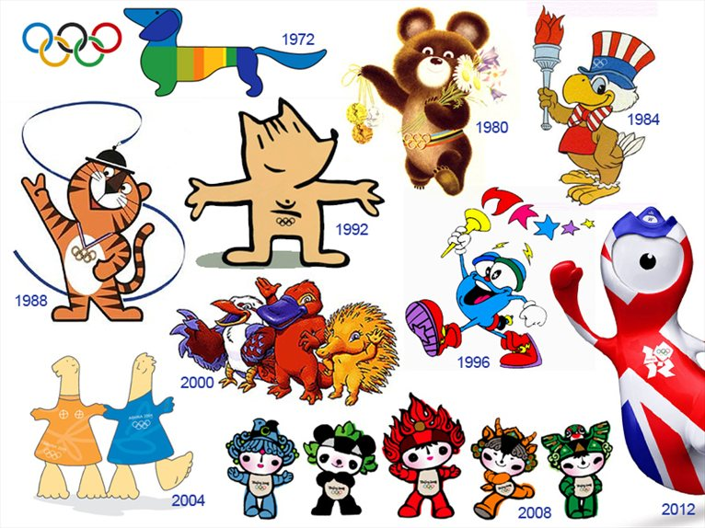
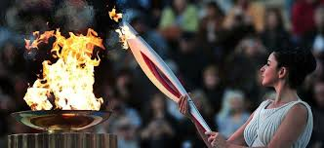
In 1960 there were held the first Paralympic Games for the disabled athletes
The Olympic Motto is “It’s a great honour to win but still a greater honour to compete (take part)”
The Olympic Flame is every time lit in Greece and transferred to the host country
The Olympic Mascot is an animal symbol of every other games

Slide 5
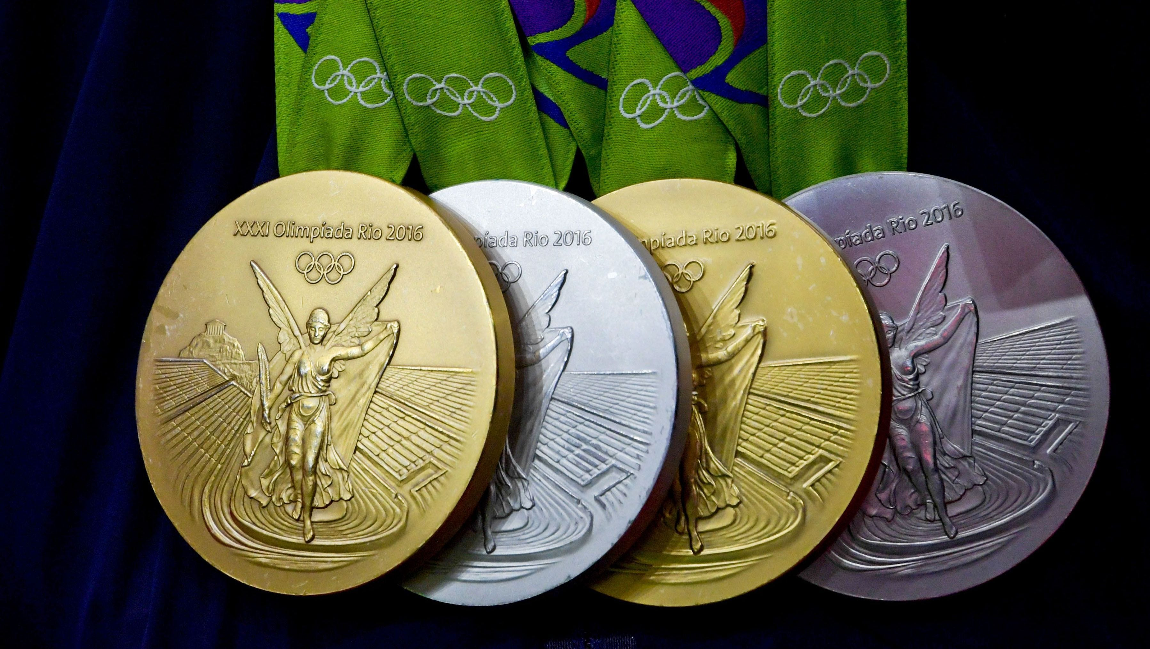
Sportsmen who win at the Games become Olympic Champions
They get medals: gold, silver and bronze
Every Olympic Games last up to 3 weeks and it’s a great holiday for the people in the world

Slide 6
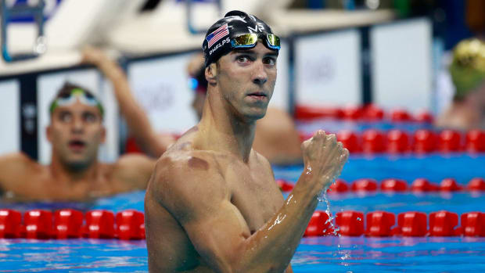
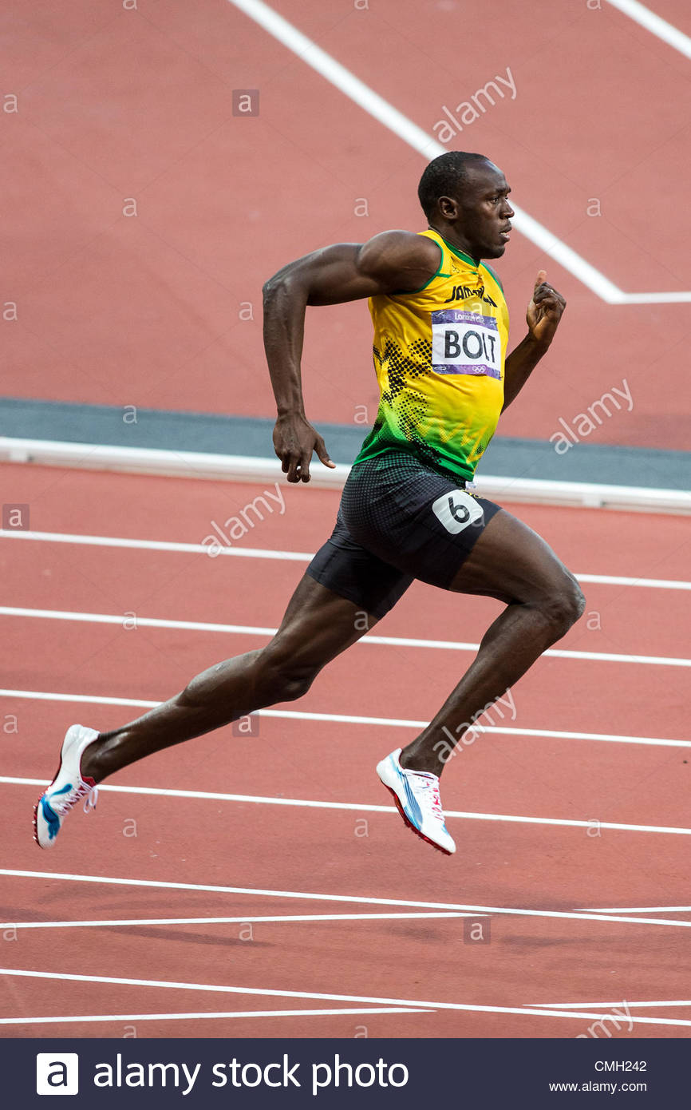
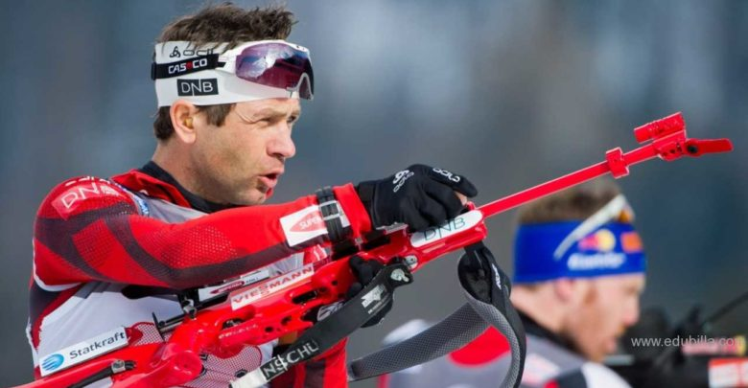
OLYMPIC CHAMPIONS

Slide 7
https://www.youtube.com/watch?v=ENMhrEVa4XQ
https://www.youtube.com/watch?v=BL2XAB74o-A
Google Class

