Slide 1
SPORTS AND GAMES
BY OKSANA SOLODKA

Slide 2
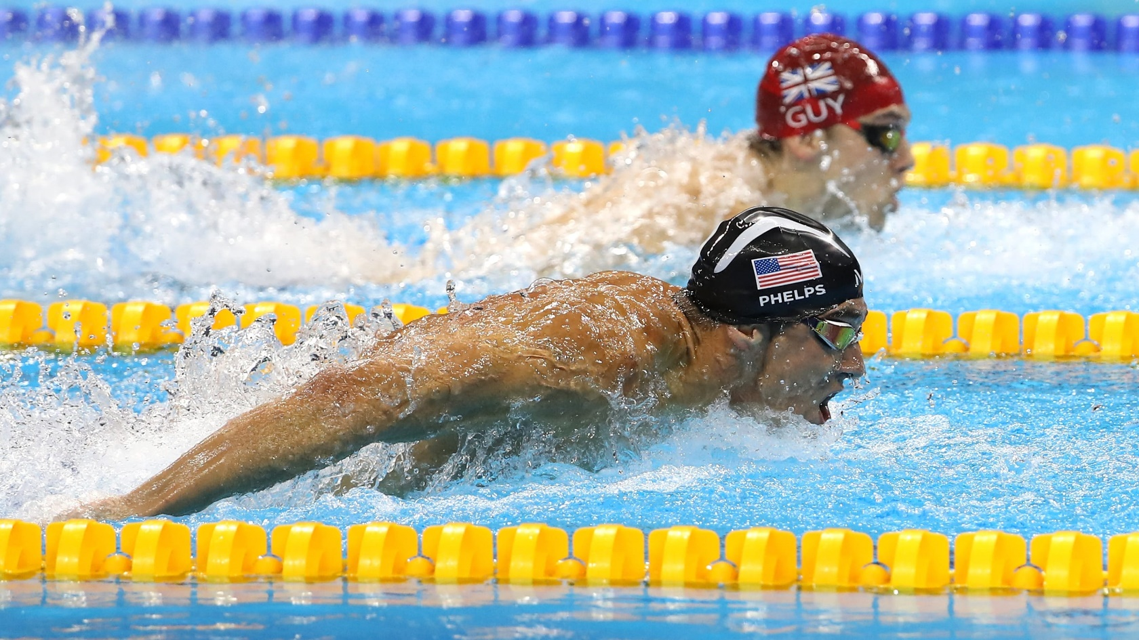
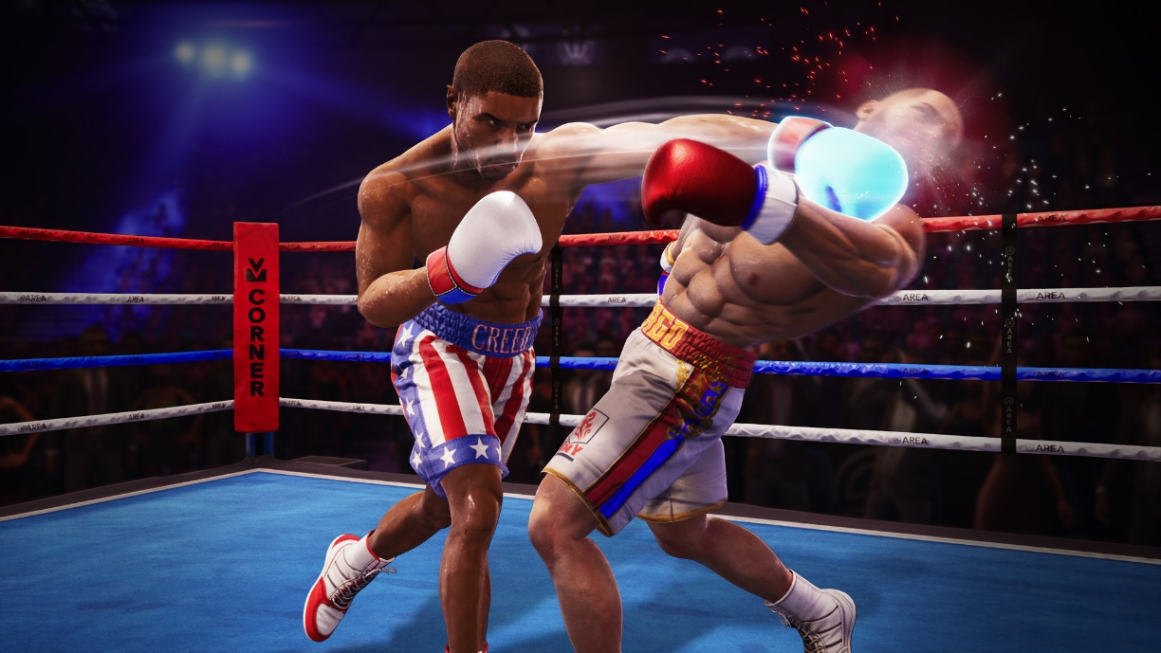
Labelling

Slide 3

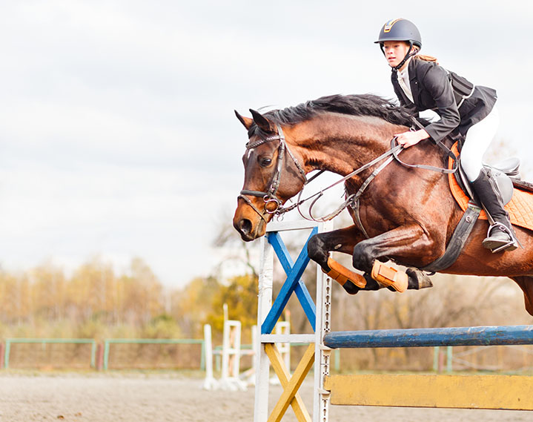

Slide 4
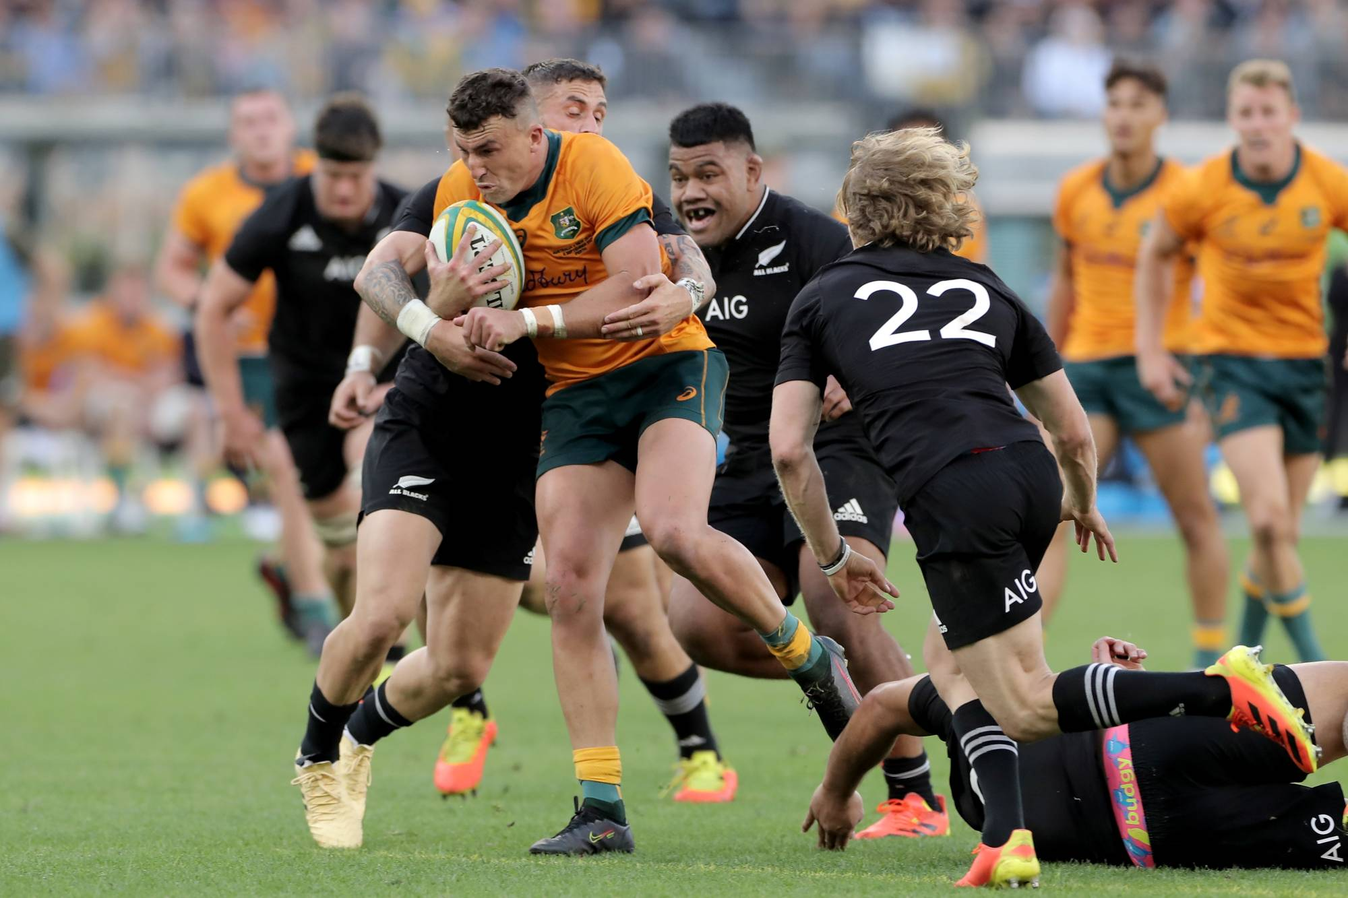

Slide 5
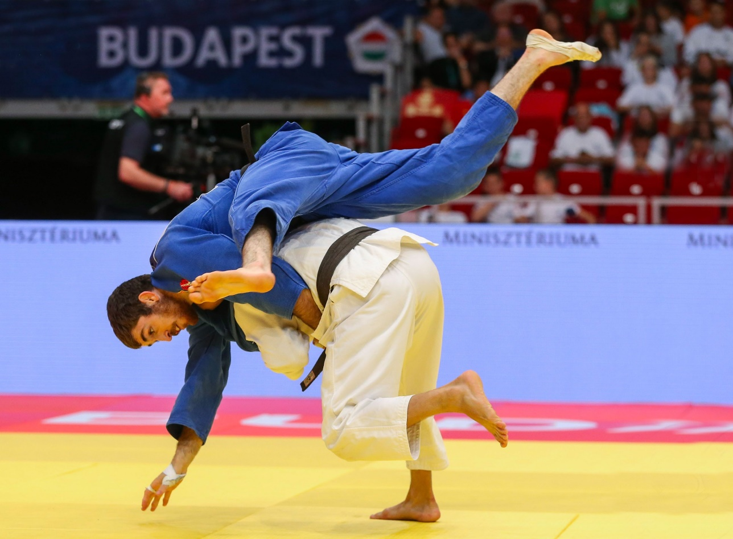
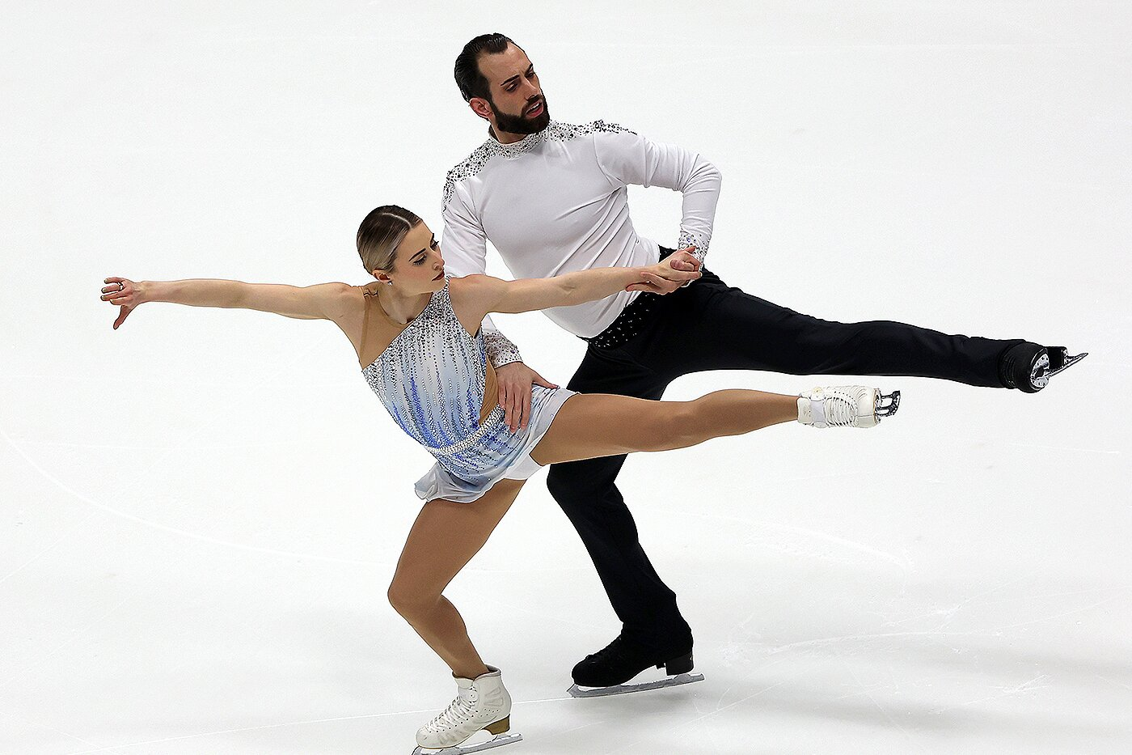

Slide 6
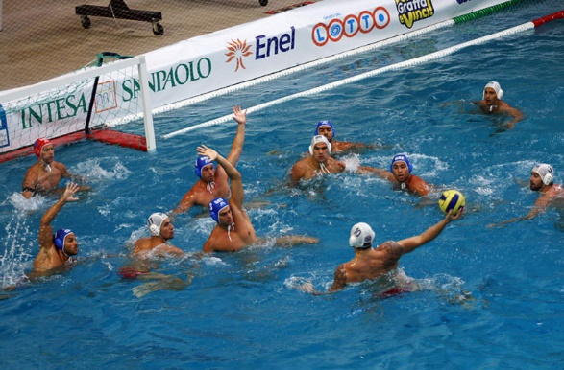
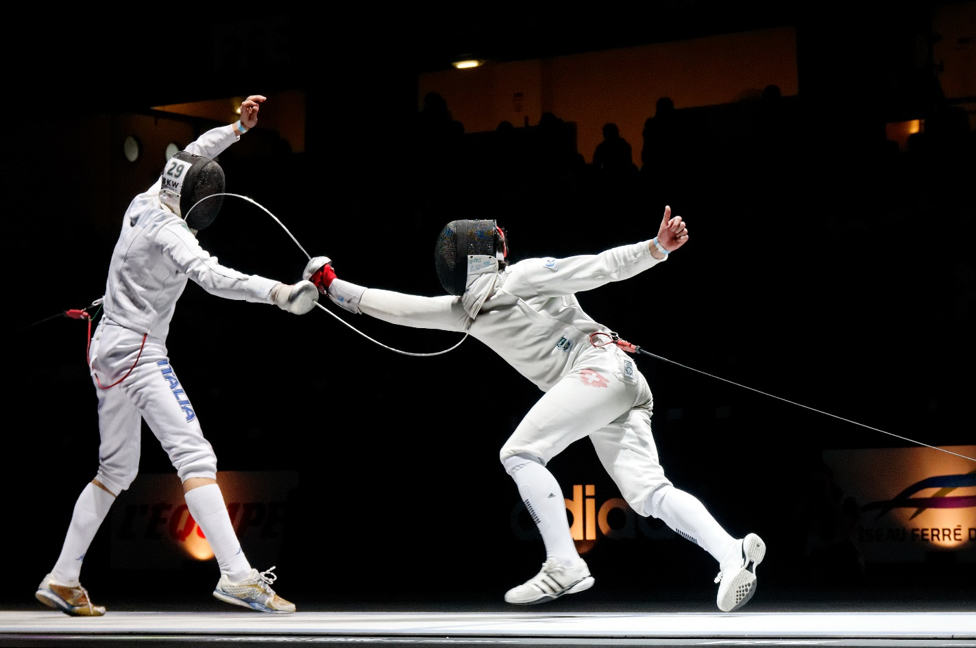

Slide 7

Top-ten sports
https://www.youtube.com/watch?v=Dg29J3JuAqw
Make up your top-five and present it to the class

Slide 8
Vocabulary tests
https://www.liveworksheets.com/gu1816475tl
https://www.liveworksheets.com/zr890853dh
https://wordwall.net/resource/1982514/sports
HT: ex.6, 7, p.103-104

