Slide 1
BOOKS AND WRITERS
By Oksana solodka

Slide 2
Do you like reading? Why? Why not?
What do you like to read about?
What is your favourite book? Who wrote it?
What popular writers do you know?

Slide 3
Video Watching https://www.youtube.com/watch?v=Cfm8rN46T7U
What genres of books do you remember from the video?
Have you got books at home? What genres are they?

Slide 4
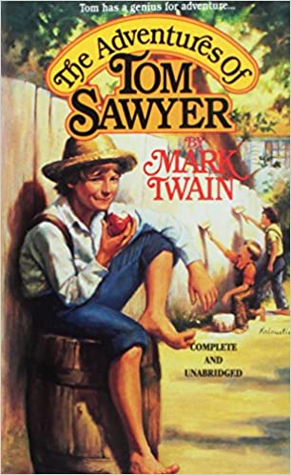
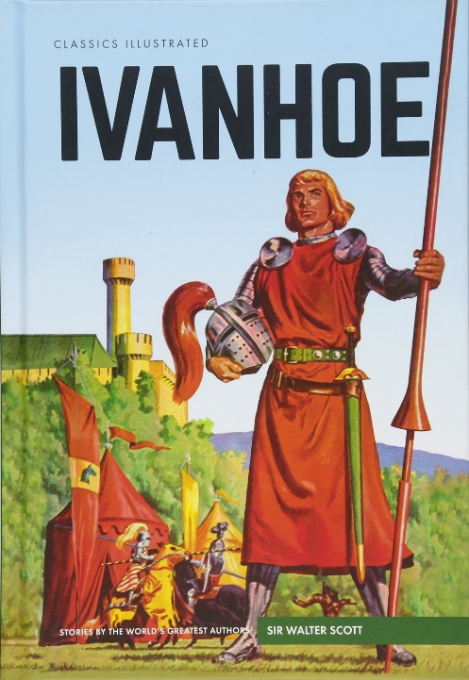
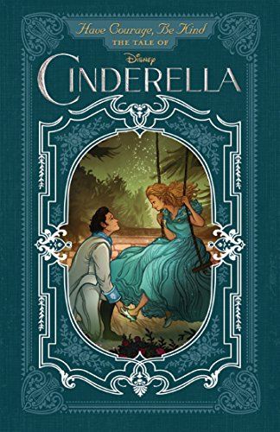
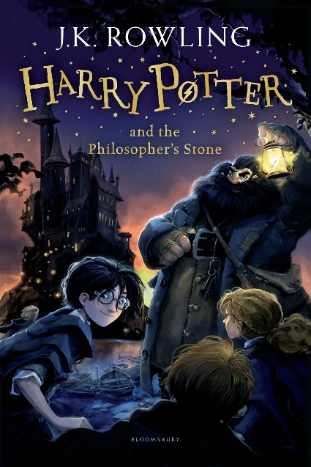
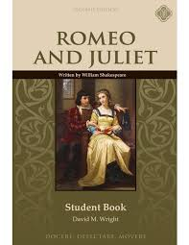
GENRES OF BOOKS
Fantasy
Mystery
Traditional Tales
Realistic fiction
Science Fiction
Historical Fiction
Poetry
Drama

Slide 5
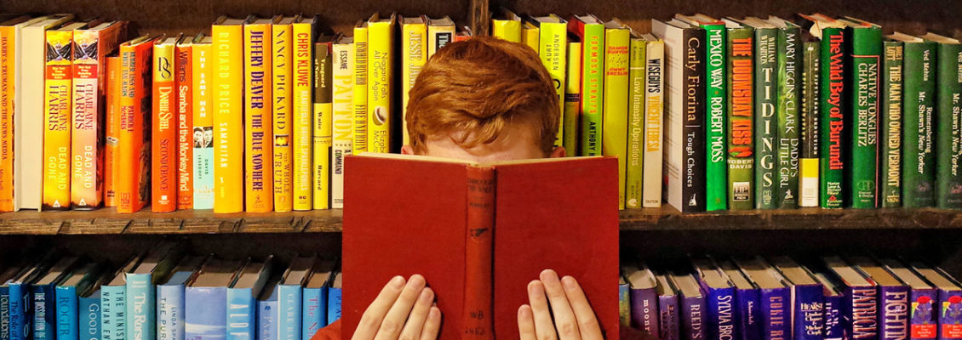
Exercise 2 (a, b), p. 116
Hometask: ex.4(a), p. 117 (explain what to do)

