Slide 1
Unit 3 on screen
By Oksana Solodka

Slide 2
A. Films and tv programmes
Talk about films and TV programmes;
Revise the topic “Articles”

Slide 3
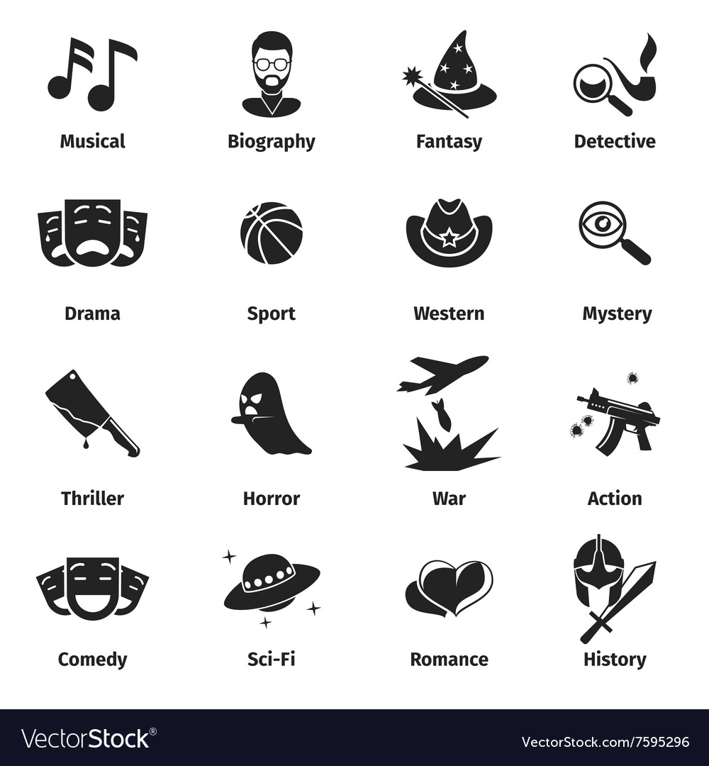
vocabulary: Film genres
Ex. 1,2,3, p. 30 (Book)

Slide 4
Adjectives to describe films
Ex. 4, p.30 (Book)
Write in the chat sentences about films.
I think horror movies are really scary.
I guess adventure films are gripping and exciting.
I suppose soap operas are boring.

Slide 5
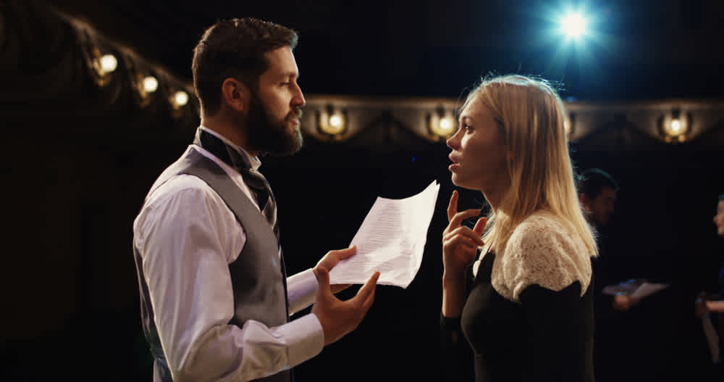
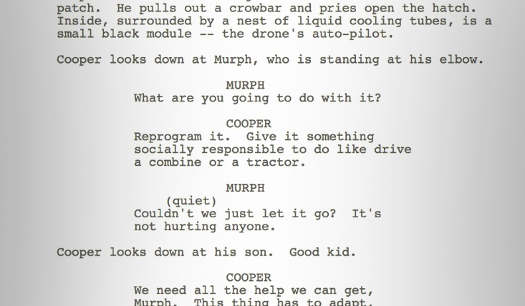
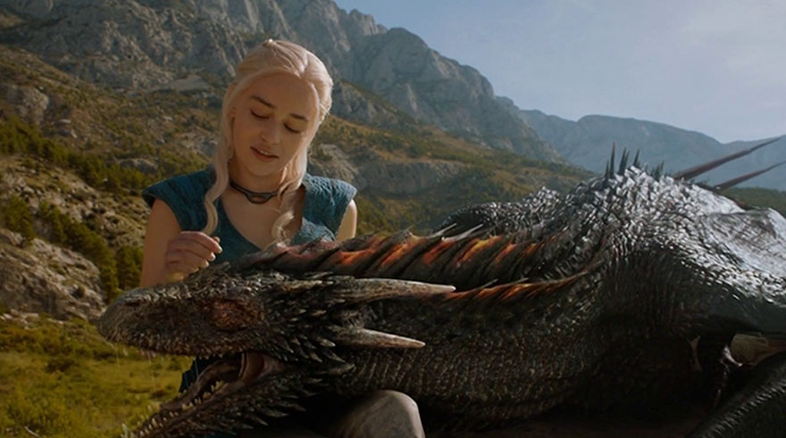
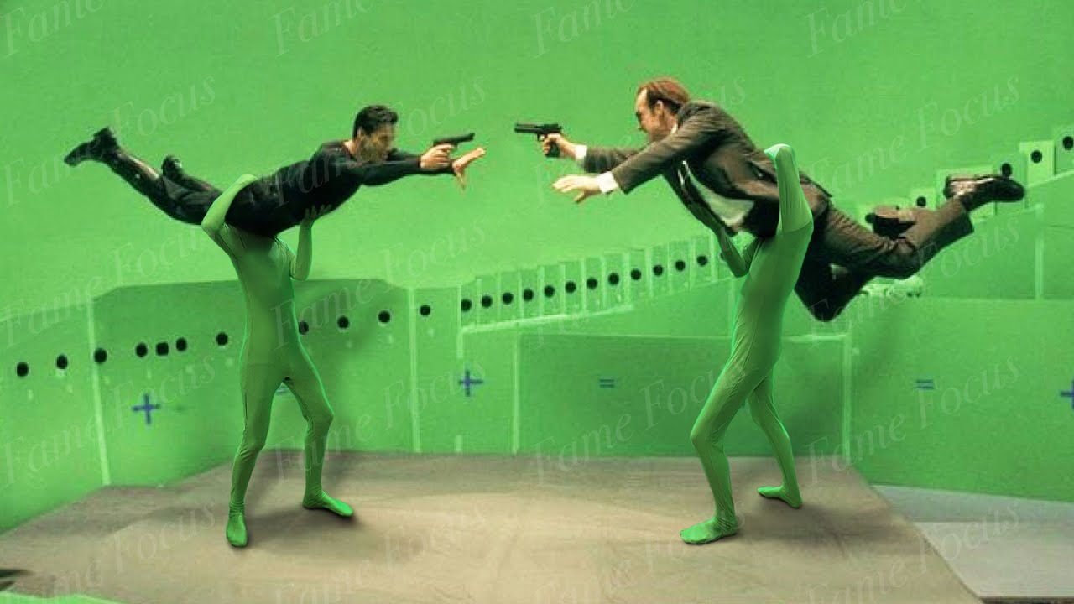
Aspects of films
Acting
Characters
Ending
Plot
Scenes
Script
Soundtrack
Special effects
Ex.6, p. 30 (together)

Slide 6
grammar
Articles
We omit articles when we talk about something in general
I don’t enjoy violence in films.
We use article “the” when we go specific.
I didn’t enjoy the violence in Games of Thrones.

Slide 7
hometask
Ex. 1, 2, 3,4 p. 30 (WB)

Slide 8
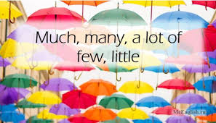
b. Quantity
Revise “Films” Vocabulary;
Talk about quantities

Slide 9
Vocabulary - check
Check ex. 1-4, p. 30 (WB)
Listening, ex. 5, 6, p. 30 (WB)
https://elt.oup.com/student/solutions/preint3rdedition/?cc=ua&selLanguage=uk
Vocabulary Test
https://docs.google.com/forms/d/e/1FAIpQLSf7d4WPd4byVfRHaBnXGnTssyOKIZ7BgSwZbN1QGT2P2gjPkw/viewform

Slide 10
speaking
Ex.1, 2, p.32
Which video games do you prefer?
I prefer city-building games. And you?

Slide 11
Ex.4, p.32
In affirmative sentences
SOME
In negative sentences and questions
ANY

Slide 12
quantity
money
actors
Much
Many
A lot of
A little
A few
Ex.6, p.32 +GB, p.128
films
crime
horror

Slide 13
hometask
P. 31 (WB)

