Slide 1
PAST SIMPLE
By Oksana Solodka

Slide 2
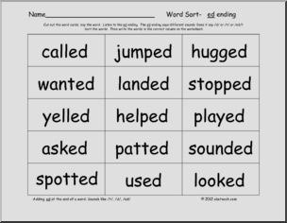
Regular verbs

Slide 3
We watched a movie last night.
They cooked dinner for the family.
I lived in Scotland two years ago.
Charlie moved to Paris last week.
Ex. 1, p.9 (WB)

Slide 4
IRREGULAR VERBS
Be – was/were
Buy- bought
Come – came
Go – went
Have – had
Get – got
Do – did
Make – made
……….
Ex. 2, 3, 4, p. 9 (WB)

Slide 5
https://www.youtube.com/watch?v=egNPTRgURuo
HT: ex.5, 9 (WB)

Slide 6
Hometask- check: ex. 5, p.9 (WB)
Grammar Test ( 5-10 minutes!)
https://www.liveworksheets.com/worksheets/en/English_as_a_Second_Language_(ESL)/Past_simple_Irregular_Verbs/Irregular_Past_Tense_Verbs_Match_fa1876041xa

Slide 7
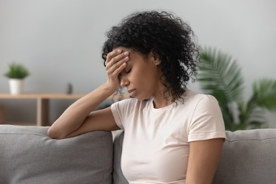
Feelings

Slide 8
p. 5 (transcript, TB) ex. 4, p.11 (B), ex.2, p. 10 (WB)
HT: ex.1, 3, p. 10 (WB)

