Slide 1
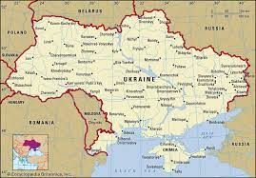
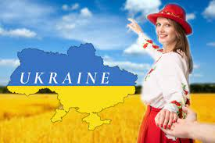
Welcome to ukraine
By Oksana Solodka

Slide 2
https://www.youtube.com/watch?v=Pu8tL3ptXRM
UKRAINE IS …. (FINISH THE SENTENCE)

Slide 3
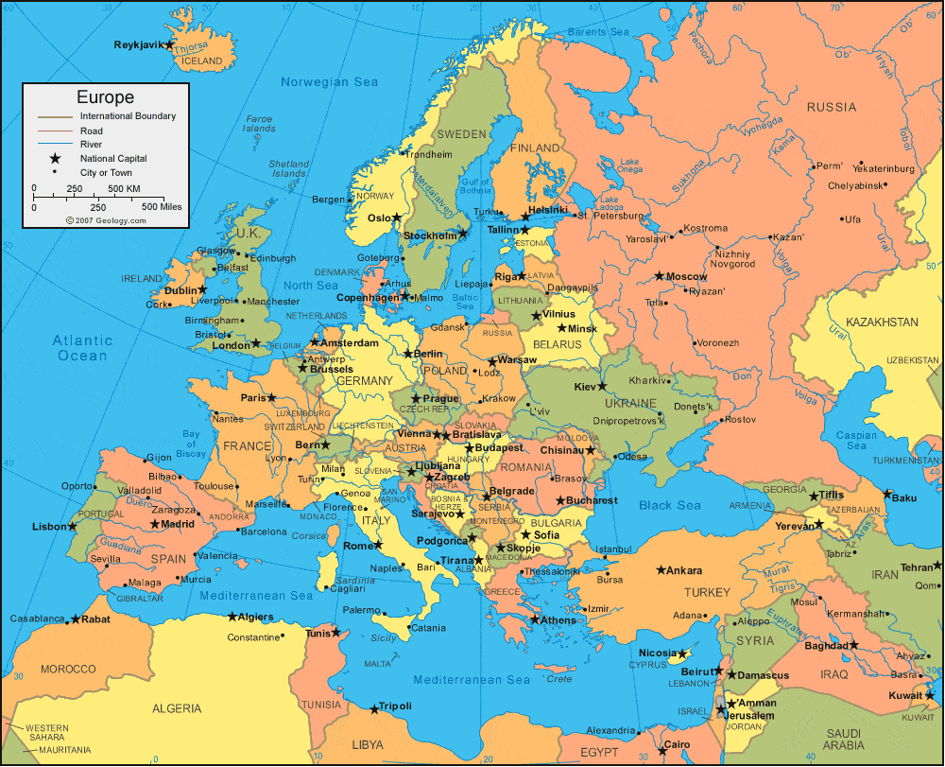
Ukraine is situated in the centre of eastern Europe and is one of its biggest countries

Slide 4
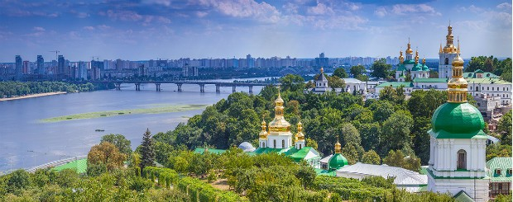
The capital of Ukraine is Kyiv, which is located on the Dnipro river

Slide 5
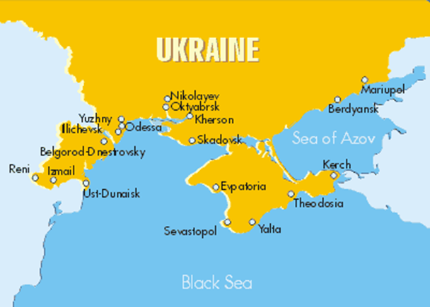
Ukraine is washed by the black sea and the sea of azov

Slide 6
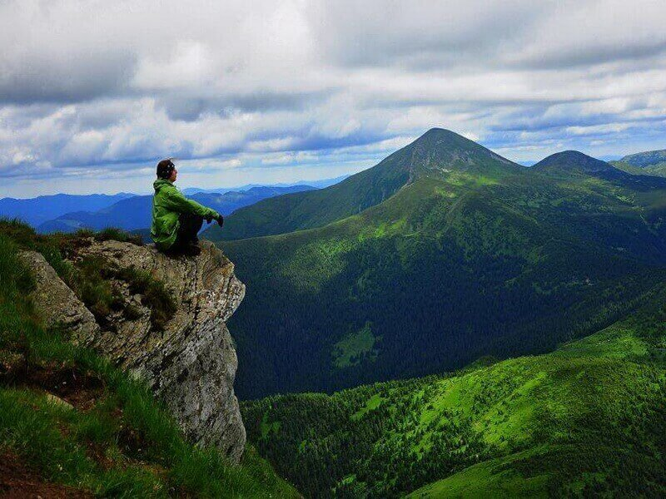
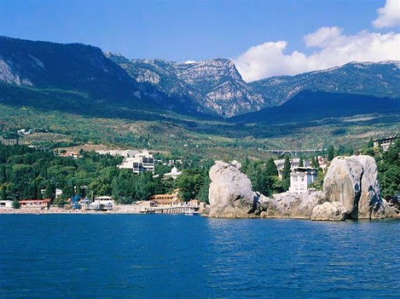
There are two mountain ranges in Ukraine: the carpathians and the Crimean, but they aren’t very high

Slide 7
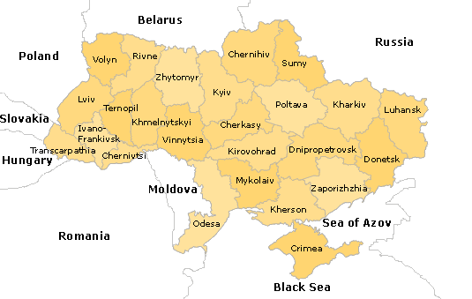
Ukraine borders on seven countries: Poland, Slovakia, moldova, Romania, hungary, Belarus and russia

Slide 8
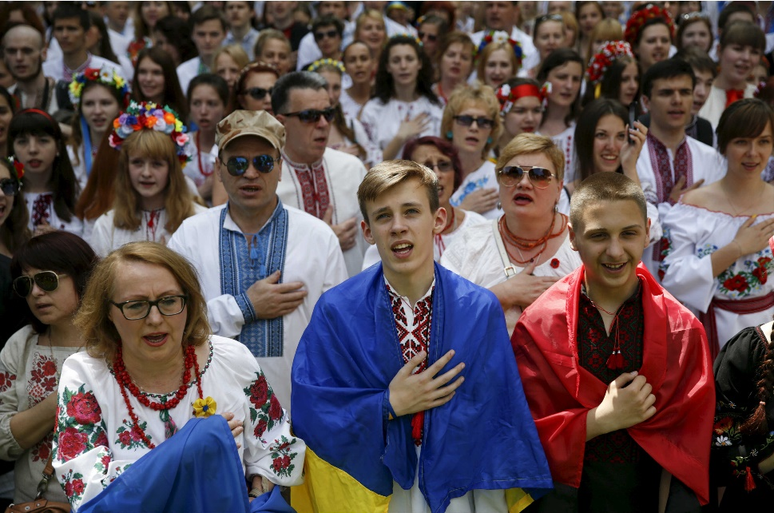
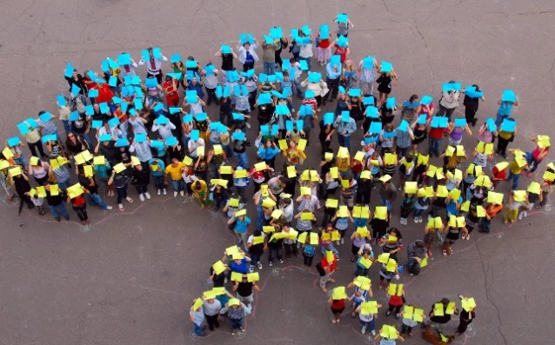
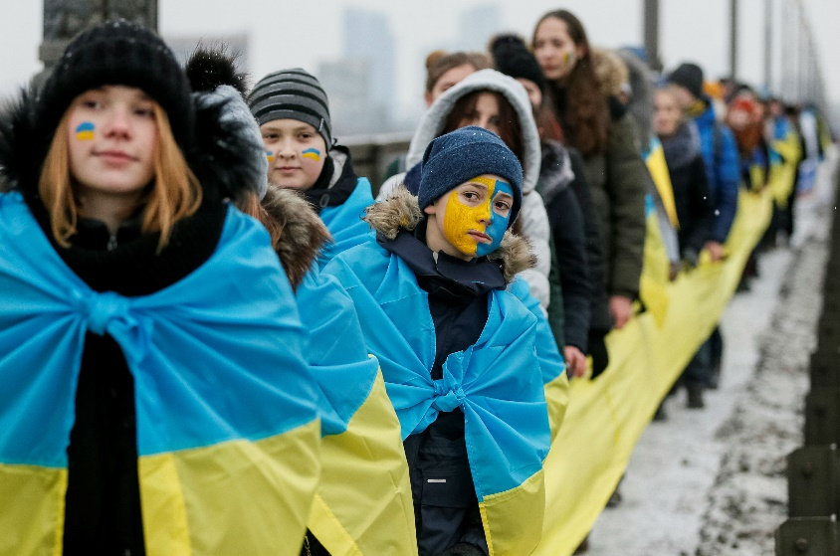
The population of Ukraine is about 47 million people and even less, unfortunately.

Slide 9
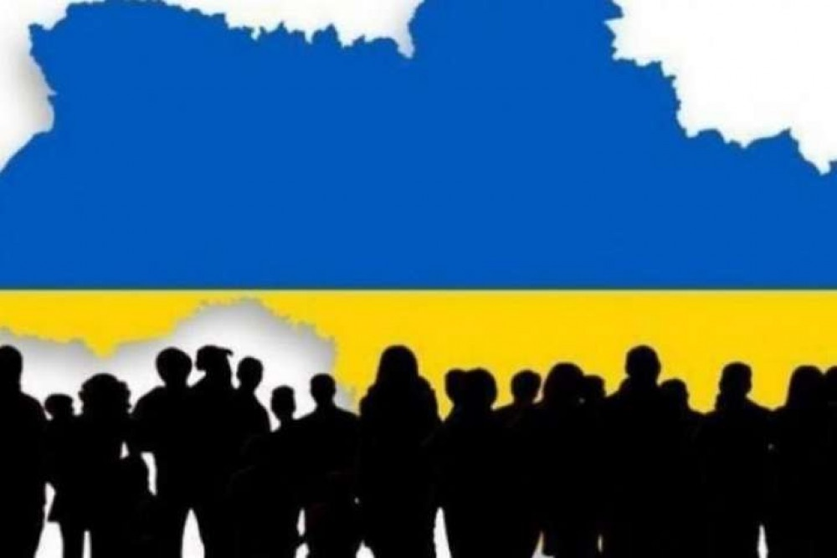
Hometask: https://classroom.google.com/c/NTQyNjM3NTY0MDZa/a/MzE4NDAxMzM2NTc2/details

