Slide 1
Inventors and Discoveries
By Oksana Solodka

Slide 3
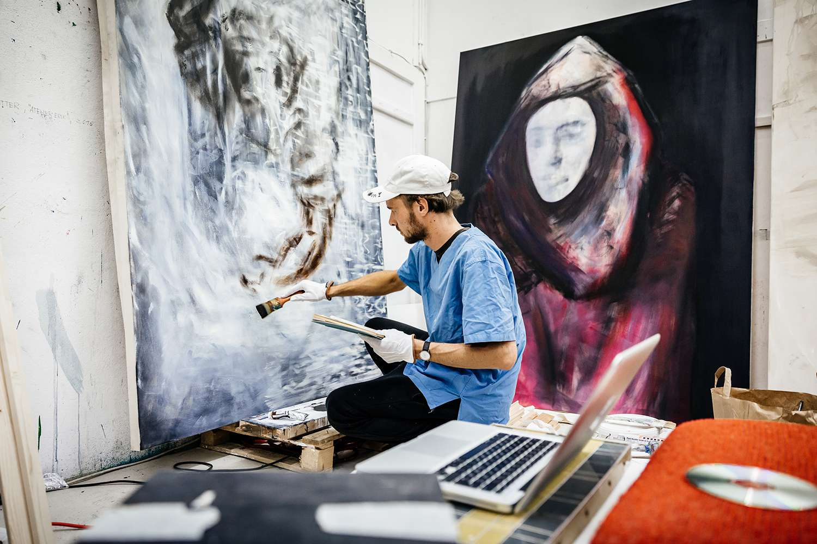
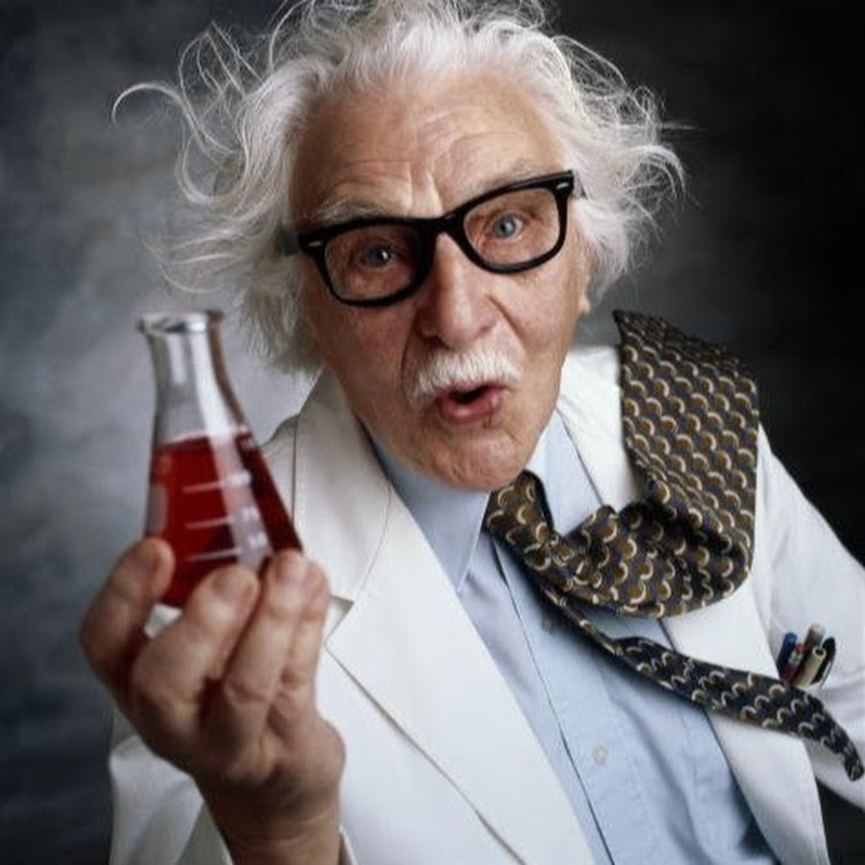
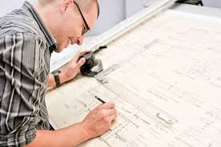
An inventor – винахідник
An architect – архітектор
An artist - митець
An engineer – інженер(ex.2, p.118) p.118)

Slide 4
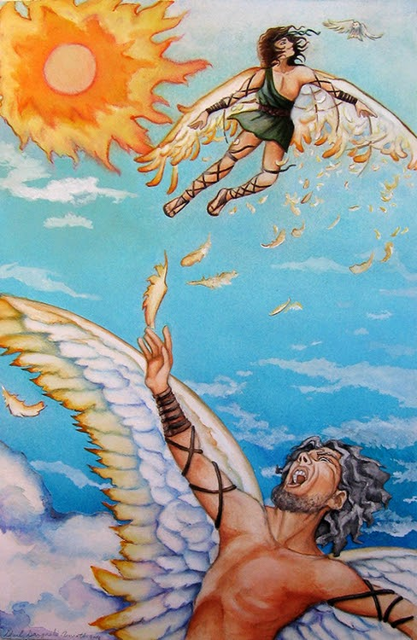
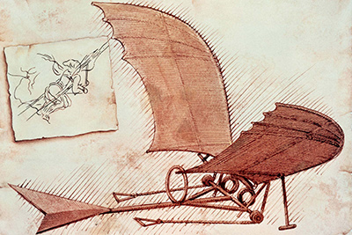
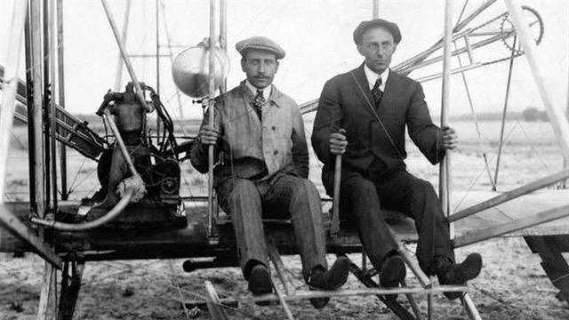
First Flights
https://www.youtube.com/watch?v=-kjRL-Q-KBc
Ex.6, p. 121 (after listening to the story)

Slide 5
FAMOUS INVENTORS AND THEIR INVENTIONS
https://www.liveworksheets.com/worksheets/en/Natural_Science/Machines/Inventions_and_inventors_ls1733085ti
https://www.youtube.com/watch?v=dYDJ3lDrfyY
Watch the video and complete the form – at the lesson!
https://docs.google.com/forms/d/e/1FAIpQLSei7VTkShCXOCec0X1LmG6TDW1YLAnGbef7nluoUgnMUCoWIA/viewform

Slide 6
Plan
1. The name of the inventor.
2. The country/nationality/hometown/interesting facts of the inventor.
3. The device/invention he/she invented.
4. The way this invention is used nowadays.

