Slide 1


ENGLAND
KEY FACTS

Slide 2
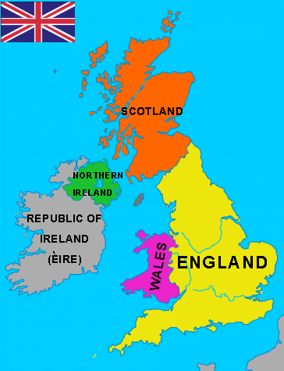
speaking
Ask the hometask
(retelling)

Slide 3

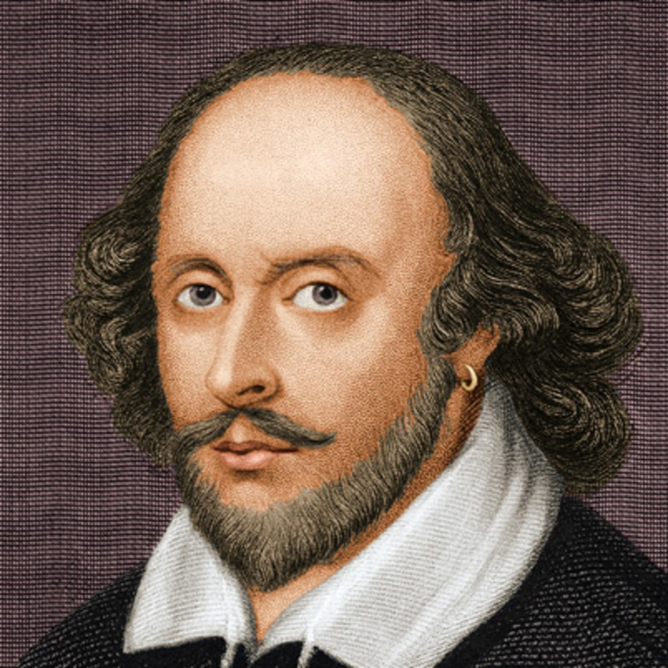

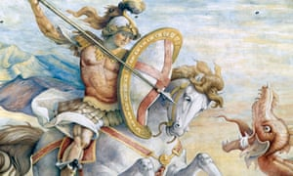

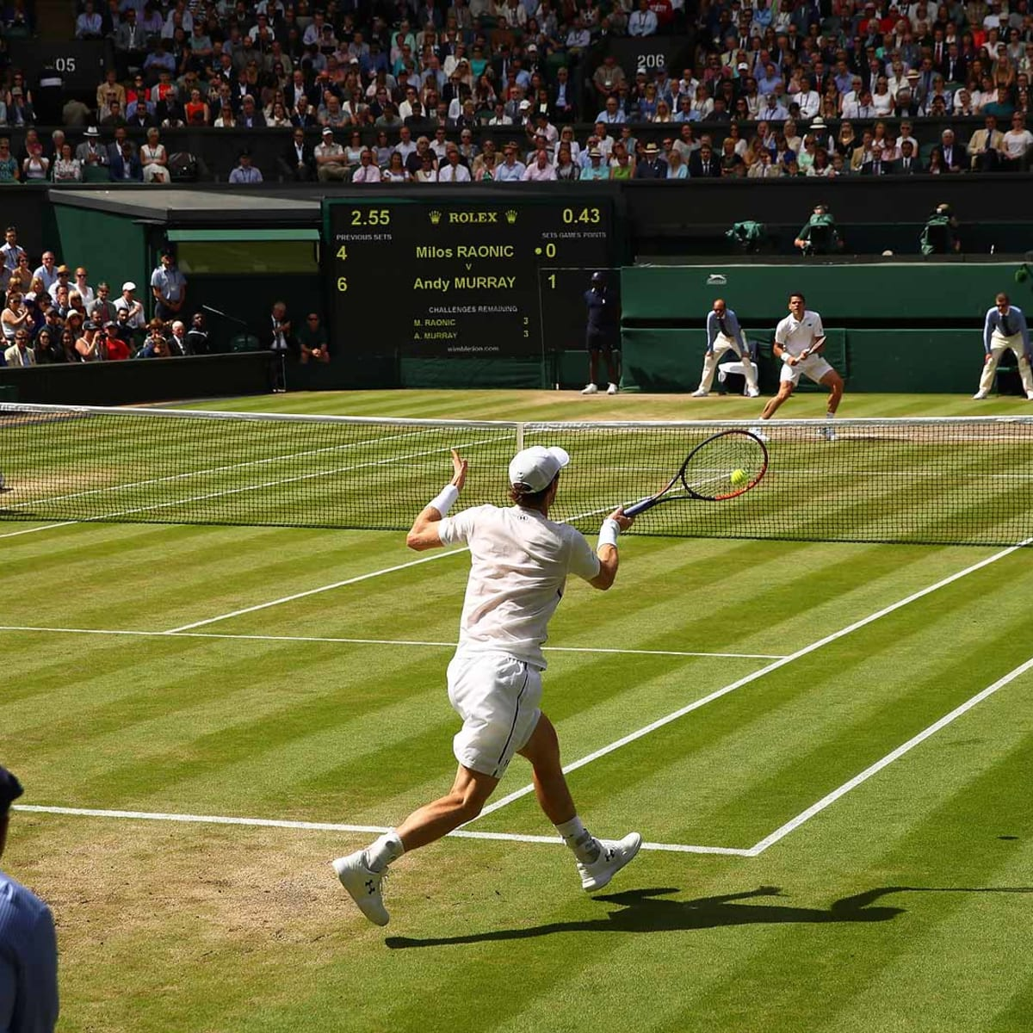



Slide 4
Watching and testing
https://www.youtube.com/watch?v=ul32LQ9Pahk
https://docs.google.com/forms/d/e/1FAIpQLSc8FJ7PIoehqDAzTiZ1hp2t-zrd5CJT2wJGBlhQmCn_d8lwAw/viewform
Hometask: ex. 7, p. 186-187 (read and translate)

