Slide 1
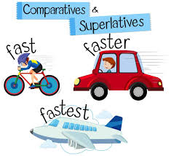
DEGREES OF COMPARISON
By Oksana solodka

Slide 2
Positive Degree
1)London is a big city.
2) I live in a small village.
3) This farmhouse is really remote.
4) My house is as spacious as a palace!

Slide 3
Comparative Degree
1) London is bigger than Kyiv.
2) My village is smaller than a town.
3) My house is more remote than my friend’s one.
4) My new school is more spacious than the old one.

Slide 4
Superlative Degree
1)London is the biggest city in Europe.
2) My village is the smallest in the region.
3) This island is the most remote from the mainland.
4) This is the most spacious mansion I’ve ever seen!

Slide 5
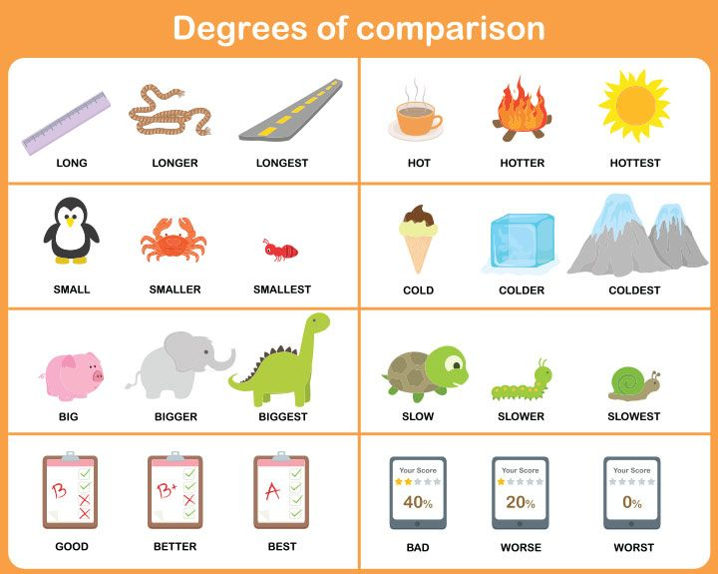

Slide 6
https://wordwall.net/resource/5854968/degrees-comparison-disney
https://www.liveworksheets.com/worksheets/en/English_as_a_Second_Language_(ESL)/Degrees_of_Comparison_of_Adjectives/Comparatives_hy1520771xx
Hometask: ex. 1,2, p. 41

