Slide 1
CULTURE
NAMES: CHARLES DICKENS; HELEN KELLER

Slide 2
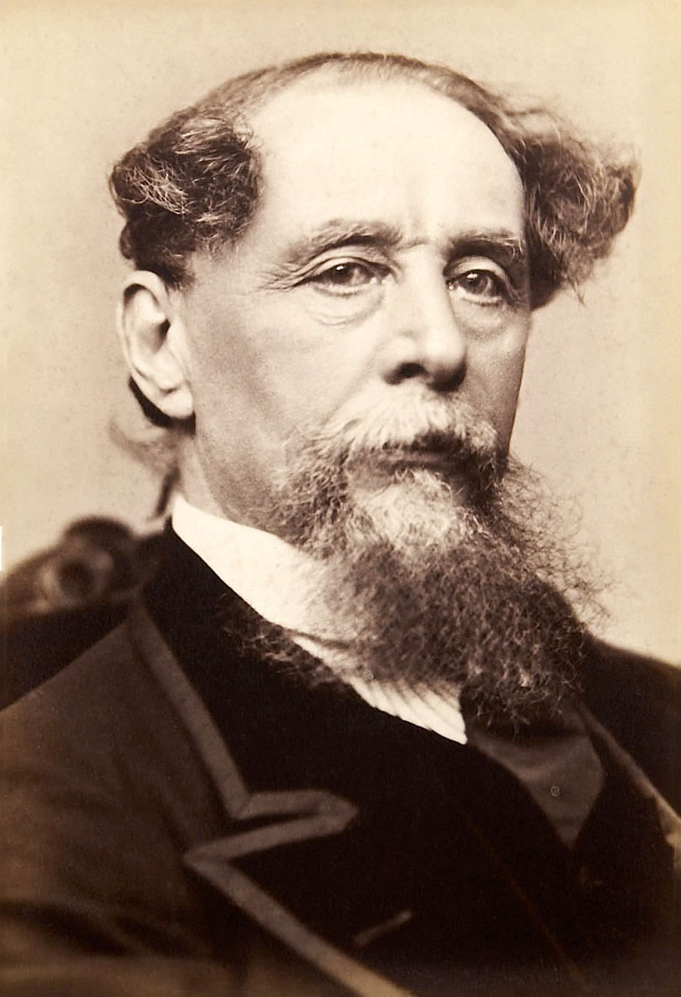
Charles dickens
https://www.youtube.com/watch?v=gsVzpAN2jhY
Charles Dickens was born in the 18th century.
Dickens always slept facing South.
He was almost killed in a train accident.
He included several phrases and words into the British dictionary.
Charles and his wife Caroline had ten children whom he gave funny nicknames.
Dickens experimented on his wife, children and friends with hypnotism.
He liked to rearrange furniture in the house.
His favourite novel was Oliver Twist, which was also biographical.
(then – book, p. 118, ex. 2,3)

Slide 3
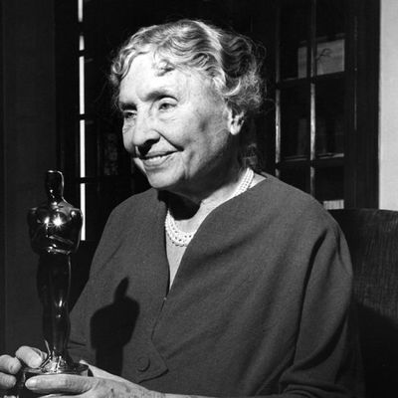
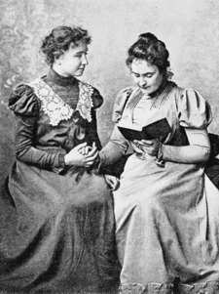
The best and most beautiful things in the world cannot be seen or even touched – they must be felt with the heart

Slide 4
https://www.youtube.com/watch?v=oxiJ02-hpZY
1) died at the age of 87
2)her teacher Anne Sullivan died
3) graduated from Radcliffe College
4) entered Radcliffe College
5) had mastered Braille
6) the film about her won an Oscar award
Ten years
1900
1904
1936
81
1968

