Slide 1
PASSIVE VOICE

Slide 2
BE + PAST PARTICIPLE
Am, is, ARE + p.p. (present Simple)
e.g. Many people are invited to the party
Am, is, are being +P.P. (Present Continuous)
The road is being built at the moment
Was, were + P.P. (Past simple)
Hamlet was written by Shakespeare
Have, has, had been + P.P. (Present and past perfect)
A new art gallery has been opened in our town
Will be + P.P. (Future simple)
A classic ballet performance will be staged in our local theatre
Can be + P.P. (modals)
Anything can be done about this problem

Slide 3
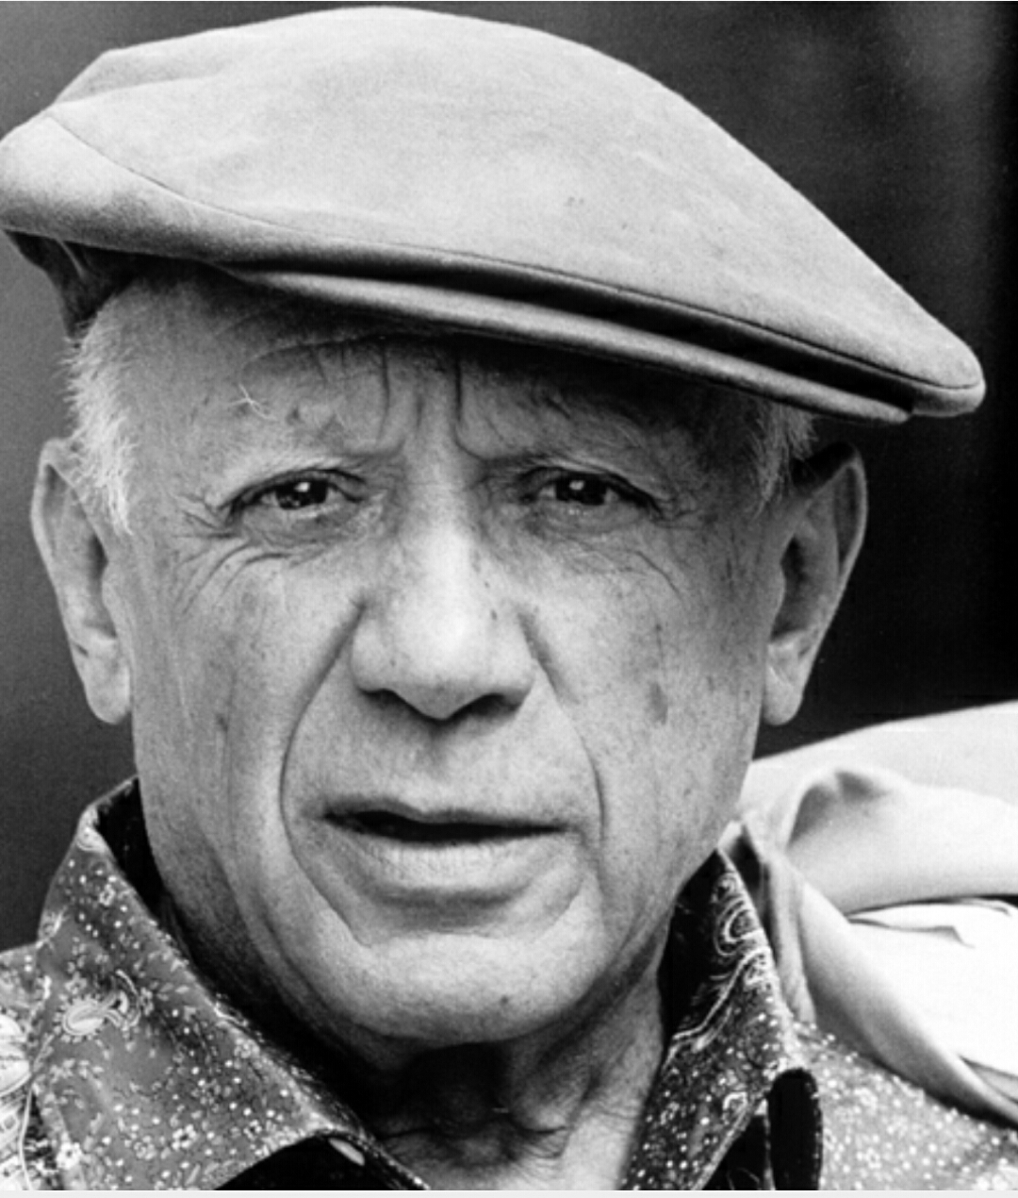
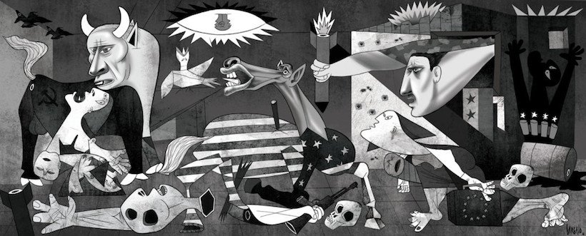
By

Slide 4
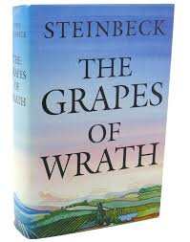
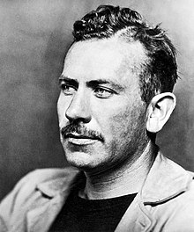

Slide 5
https://www.liveworksheets.com/qr69114va
https://www.liveworksheets.com/worksheets/en/English_as_a_Second_Language_(ESL)/Passive_voice/Lord_of_the_Rings_opening_scene_cf353340dy
Book and workbook!!!!

Slide 6

Grammar test https://www.liveworksheets.com/worksheets/en/English_as_a_Second_Language_(ESL)/Passive_voice/Pasive_voice*_Present_and_Past_po252444ae
15-20 minutes, in pairs!

Slide 7
Workbook tasks
P. 75, ex. 1-5 (whatever we can☺)

