Slide 1

journeys
Third Conditional

Slide 2
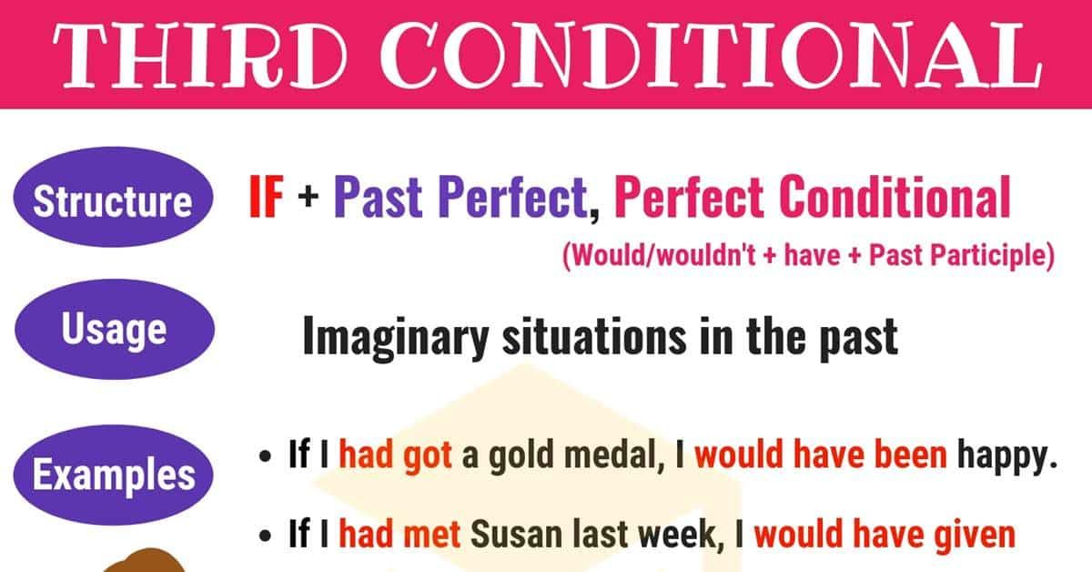
Ex. 1, 3,4, p.97 (wb)

Slide 3
Travel solutions (p.98, wb)
https://elt.oup.com/elt/students/solutions/audio/2-12_solutions_intermediate_3rd_ed.mp3?cc=ua&selLanguage=uk
https://elt.oup.com/elt/students/solutions/audio/2-13_solutions_intermediate_3rd_ed.mp3?cc=ua&selLanguage=uk

Slide 4
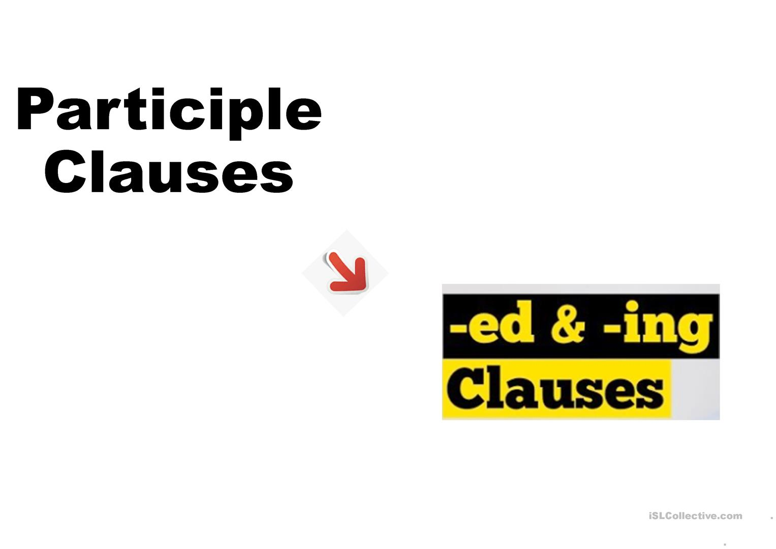
Participle clauses
A student talking to the headmaster is my boyfriend
The paintings stolen at the art gallery were found last week. https://www.liveworksheets.com/uc85107yx hometask: WB, p. 99

