Slide 1
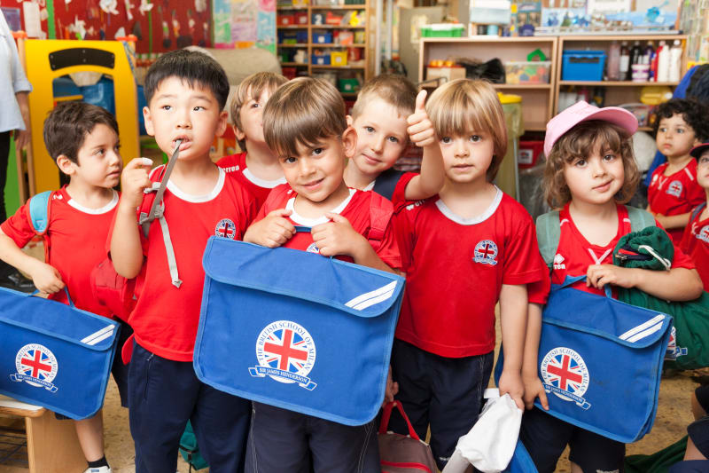
BRITISH SCHOOLING
By Oksana solodka

Slide 2
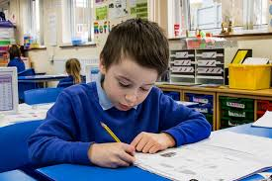
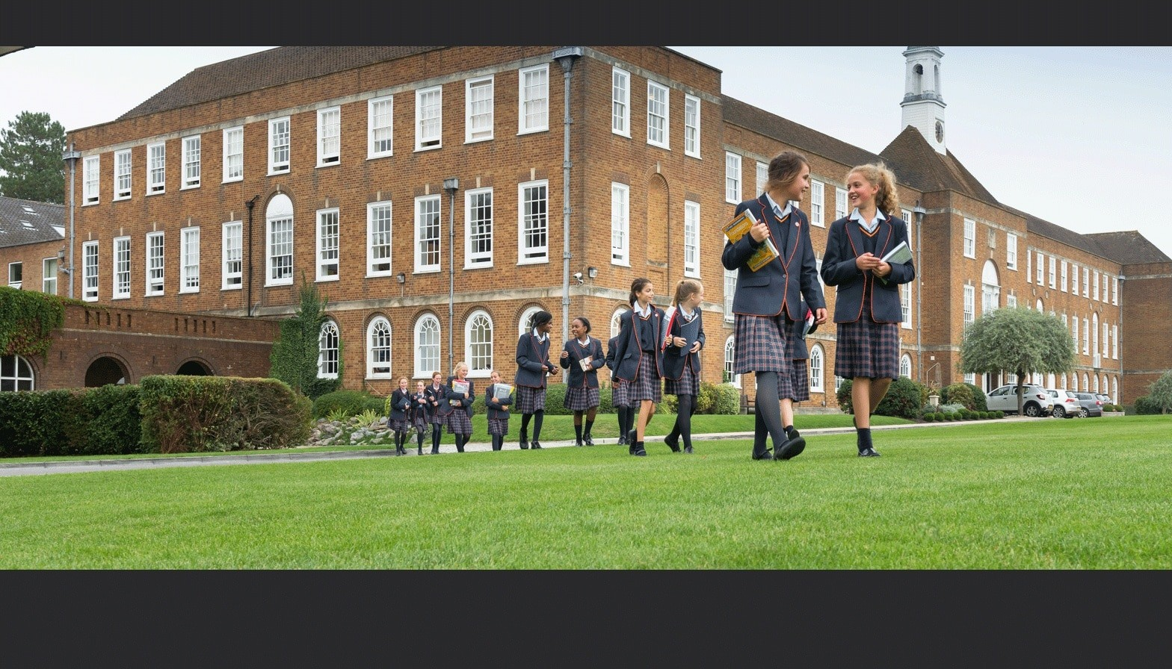
Describe the pictures

Slide 4
p. 117 ( work with the text)
1. state a. year
2. private b. minister
3. prime c. forces
4. academic d. school
5. senior e. officer
6. armed f. school

Slide 5
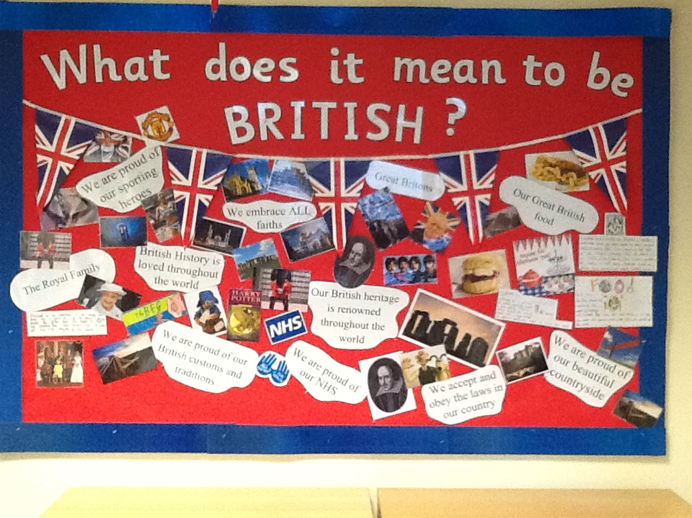
https://slideplayer.com/slide/8527568/
Discuss in groups and present it to the others

