Slide 1
Christmas in canada
done by Oksana Solodka,
a teacher of English
at Ostriv Secondary School

Slide 2
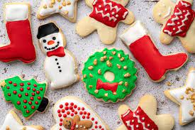
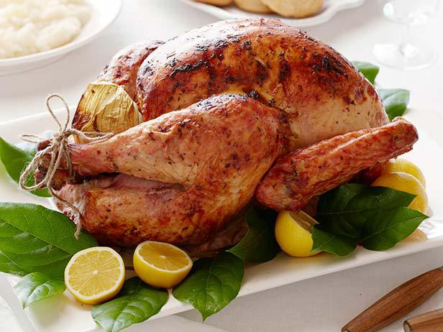
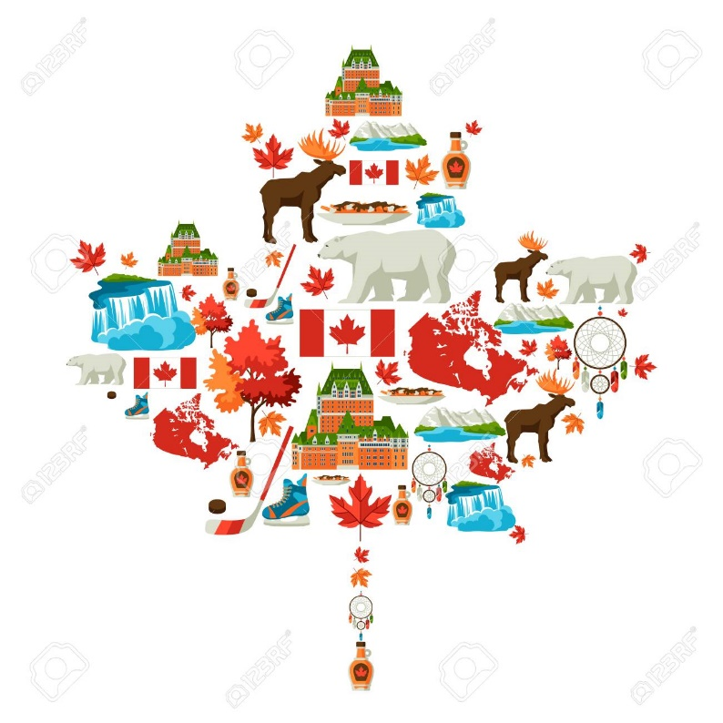
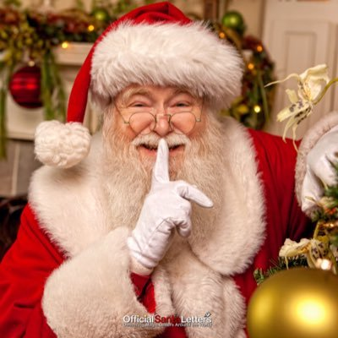
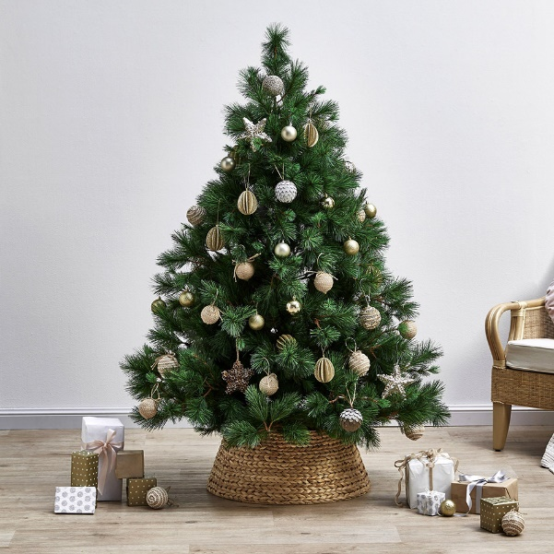
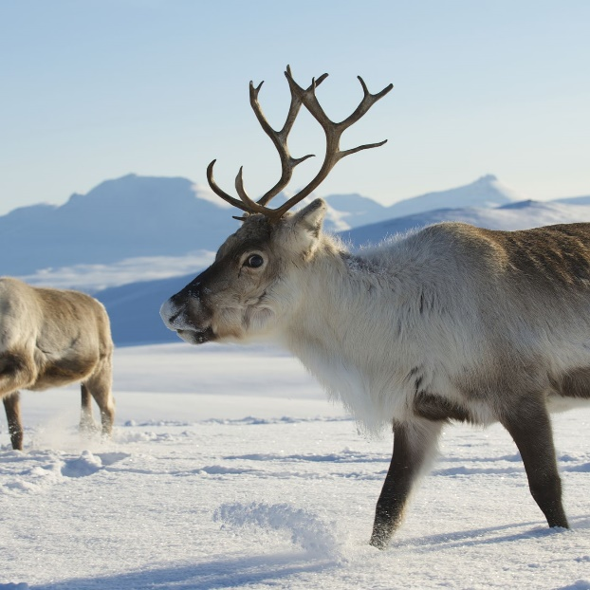

Slide 3
True or false
1. Canada is not a large country.
2. Christmas traditions in Canada come from different countries.
3. Ukrainian Christmas traditions do not exist in Canada.
4. Canadians hang their stockings by their beds for Santa to bring them presents.
5. The main Christmas meal is a pumpkin pie.
6. At Christmas a lot of Canadians play ice hockey because it’s their national game.
7. The Santa Claus Parade is one of the oldest and largest in the world.
8. Canadians send their best Christmas tree to Americans every year.

Slide 4
Sing a song
https://www.youtube.com/watch?v=g-OF7KGyDis

