Slide 1
Coursebook analysis in terms of the external context. Selecting and evaluating resources outside coursebooks
Developing communicative language skills
By Lesia Yamelynets & Oksana Solodka

Slide 2
Objectives:
analyse, evaluateand adapt grades 5 –9 coursebook activities in terms of real-life context
explore activities and resources for integrating communicative language skills in grades 5 –9.

Slide 3
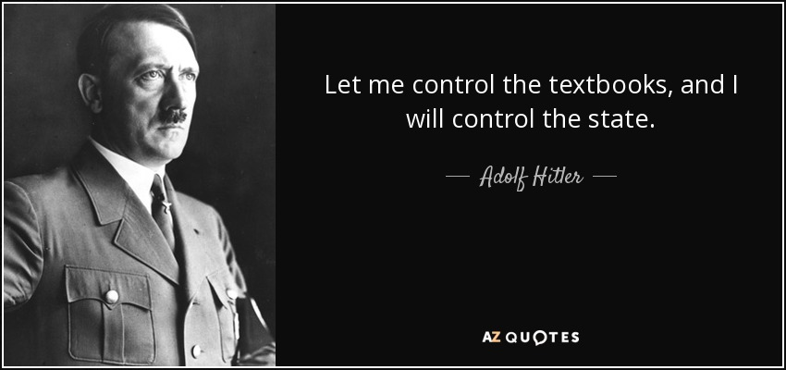

Slide 4
Group Work
What books were you taught at school? Were you satisfied? Why? Why not?
What books do you use with your students? Why?

Slide 5
What makes a good textbook?
Free space.
Visuals.
Age-appropriate material.
Well-balanced textbook design.
Textbook storyline.

Slide 6
True/False
A good textbook should be colourful, as many pictures as possible;
It should have grammar rules written in native language;
It should be coherent to the age of students (appropriate texts, activities, pictures);
It should have a Teacher’s Book to make the educational process easier;
It should be clearly divided into topics according to the National Curriculum;
It should contain some additional material like Reader’s Corner, Culture Corner, Project Corner, etc.
Your ideas???

Slide 7
Coursebooks Analysis

