Slide 1
FORMATIVE AND SUMMATIVE ASSESSMENT. PRINCIPLES AND STRATEGIES
Session 8
by Lesia Yamelynets & Oksana Solodka

Slide 2
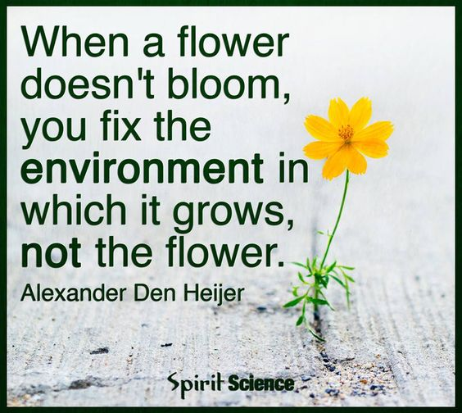
Assessment is today’s means of modifying tomorrow’s instruction
Carol Tomlison

Slide 3

Objectives:
By the end of the session participants will be able to
enhance knowledge and understanding of assessment for learning and assessment of learning;
examineand evaluate the current situation with assessment in schools;
identify areas where assessment can be improved
identify assessment for learning principles and strategies;
analyze and evaluate ways of assessing learning;
consider the value of effective feedback for learning.

Slide 4
1. Why do you assess?
2. What do you assess?
3. When do you assess?
4. How is assessment carried out?

Slide 5
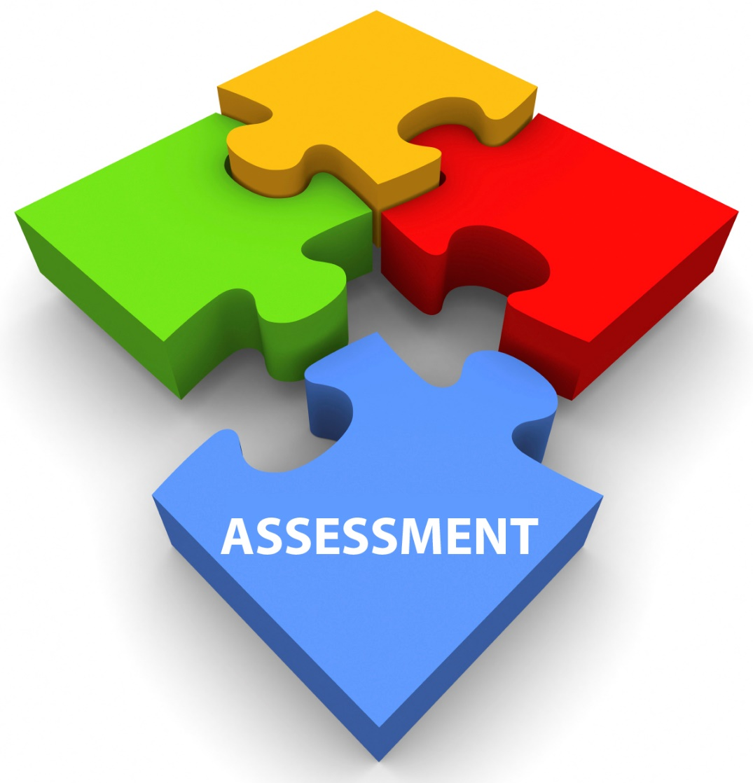
How can we assess?
Observations
Essays
Interviews
Performance tasks
Exhibitions and demonstrations
Portfolios
Learning journals
Teacher-created tests
Self- and peer- evaluation
Questioning
…..

Slide 6
The goal of ??? assessment is to monitor student learning to provide ongoing feedback that can be used by instructors to improve their teaching and by students to improve their learning.
Formative
The goal of ??? assessment is to evaluate student learning at the end of an instructional unit by comparing it against some standard or benchmark.
Summative

Slide 7
Formative or summative ???
Midterm exam;
Final project;
Portfolio;
Tests;
Learning journal;
During the process;
After the course;
Grades;
Monitoring;
Evaluation is a process;
Evaluation is a product.

Slide 8
Beliefs and attitudes
Assessment for learning occurs at all stages of the learning process.
Regular testing is formative.
Learners place more value on feedback from the teacher than on self- and peer-assessment.
Teaching is constrained by pressures on teachers and their institutions to deliver good examination results.
Assessment for learning gives learners greater autonomy and the possibility of becoming self-regulated and lifelong learners.

Slide 9
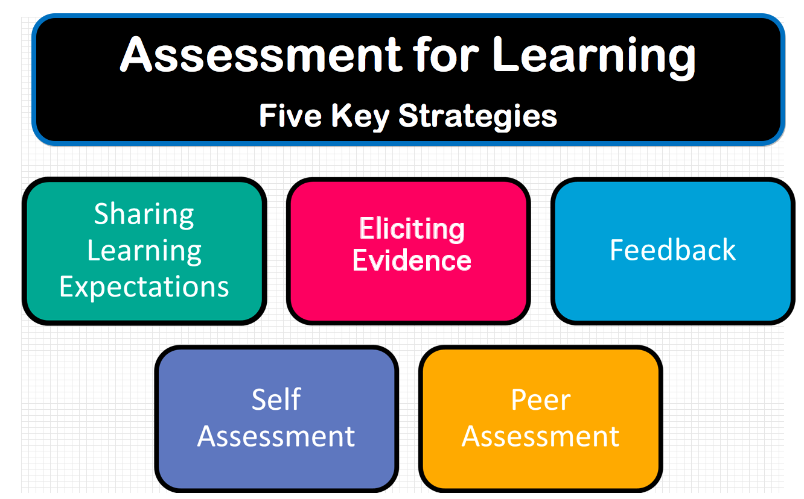

Slide 10
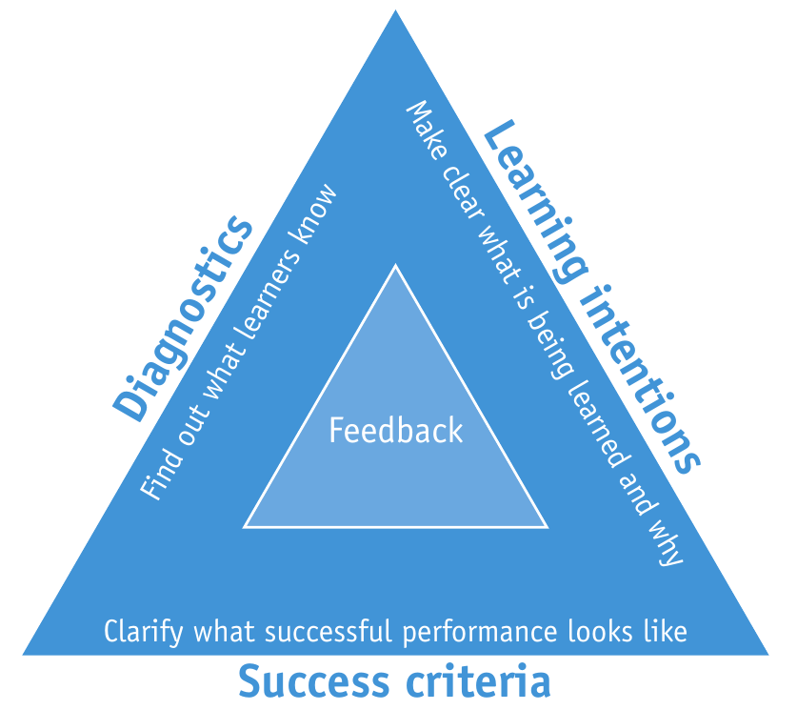
Classroom practices

Slide 11
Group 1. How do you find out what your learners know? Give examples.
Group 2. How do you make clear what is learned and why for your students?
Group 3. How do you understand that the activity is successful? Do you use any criteria?

Slide 12
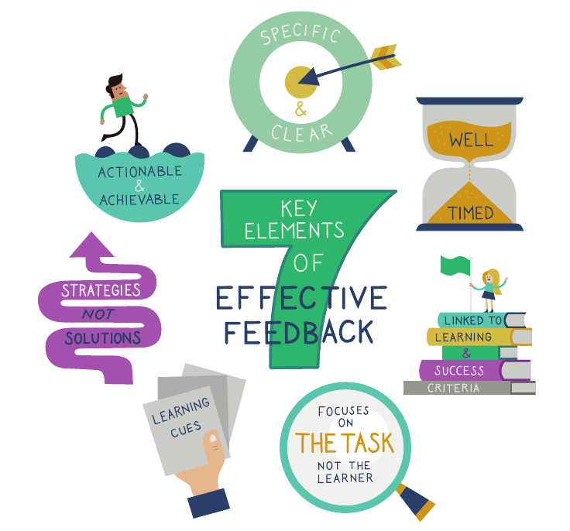
Effective feedback

Slide 13
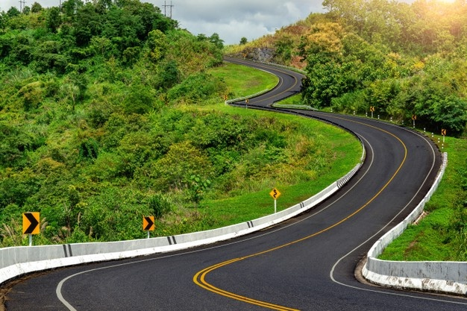
“It’s not about the destination, it’s about the journey.”

