Slide 1
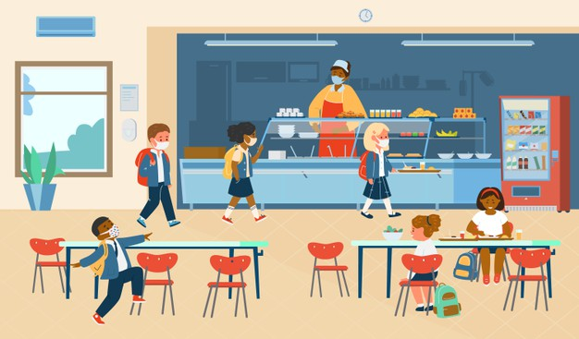
SCHOOL CANTEEN
By Oksana Solodka

Slide 2



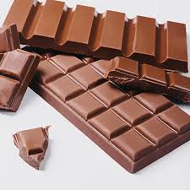


ON THE MENU:

Slide 3
I LIKE …

Slide 4
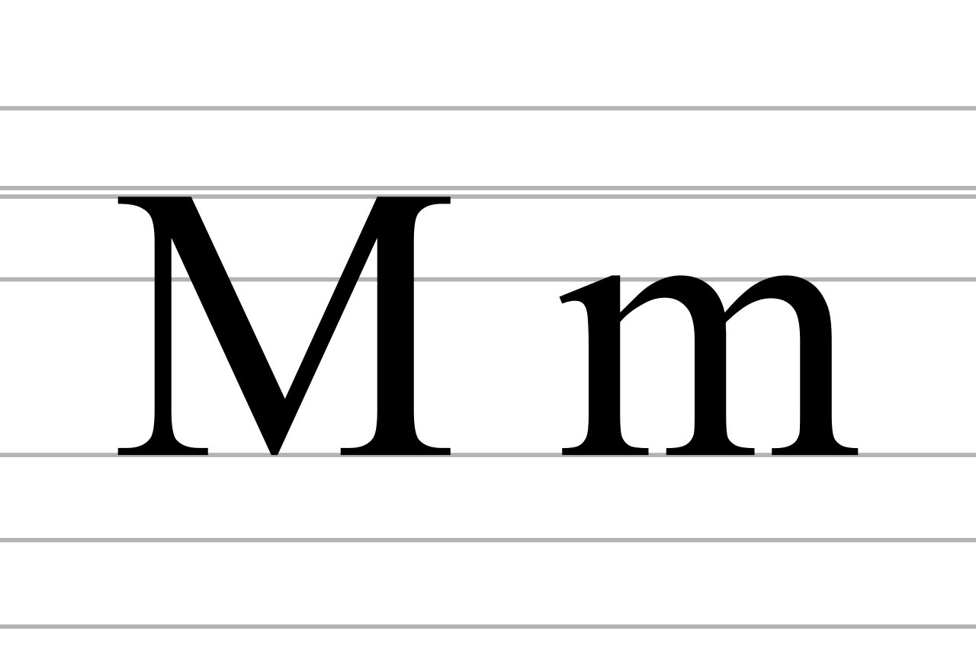


Slide 5

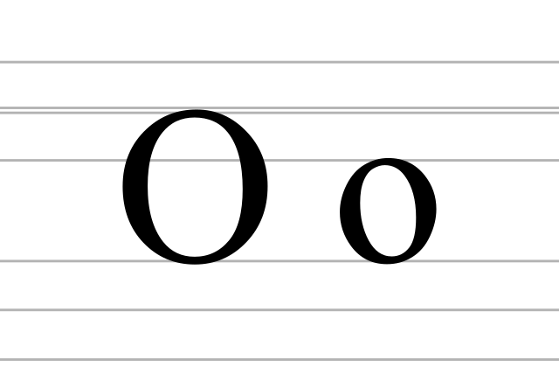
LETTER Oo https://www.youtube.com/watch?v=uAuN63H_mK8

Slide 6
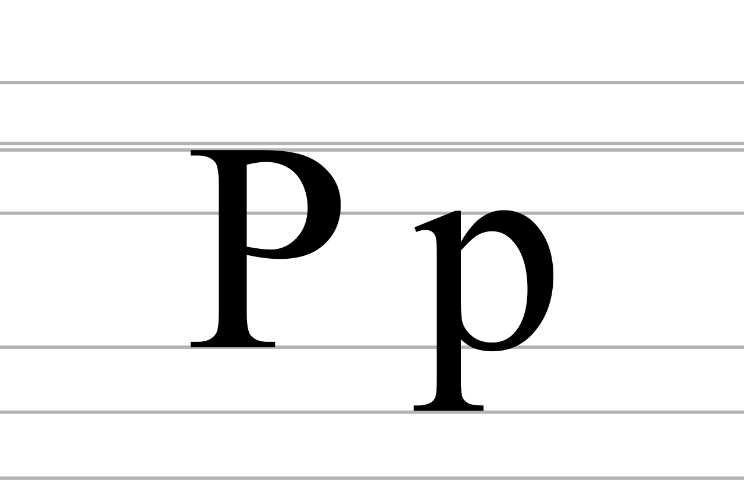
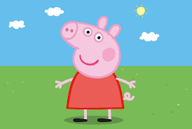
LETTER Pp https://www.youtube.com/watch?v=Ixmthv8nXMo

